Slide 1


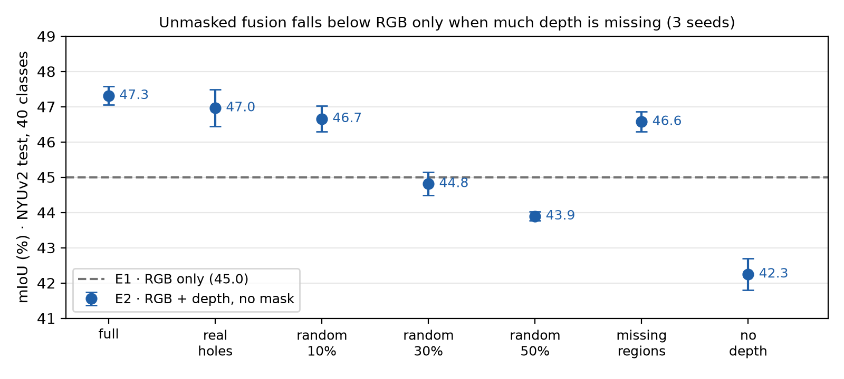
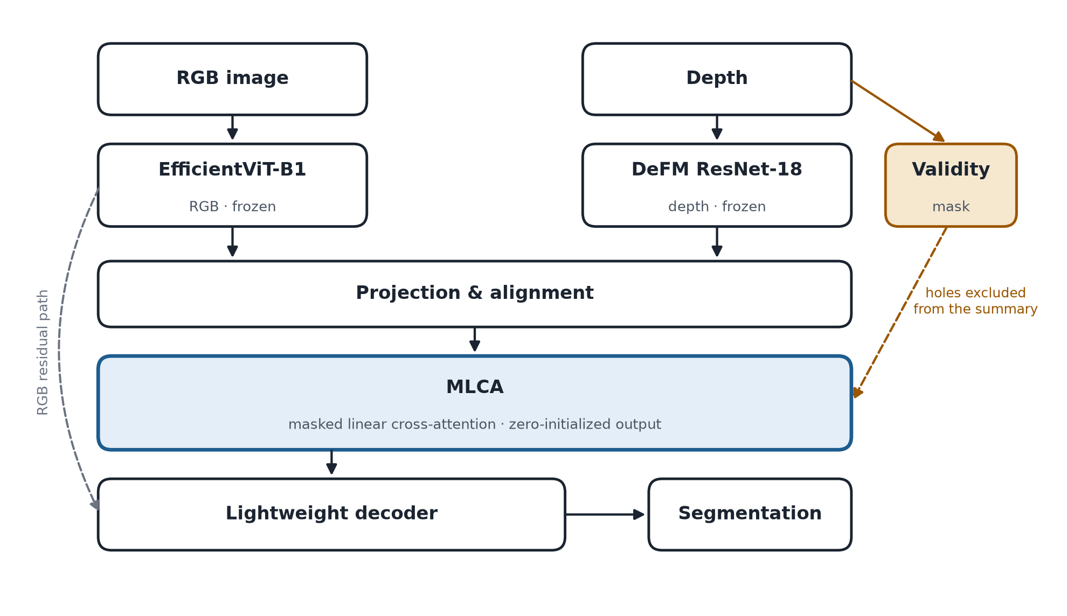
Workshop on Artificial Intelligence and Machine Learning Applications
Masked Linear Cross-Attention for Robust RGB-D Semantic Segmentation
with Efficient Pretrained Extractors
Mónica Abarca¹ • Marshall Fernández¹ • Joaquin Gonzalez Villarreal¹ • Claudia Suárez¹
¹Pontificia Universidad Católica del Perú, Peru | Deep Learning INF659, 2026-2
[AUTHOR / PROJECT / INSTITUTION LOGOS — place official logos here]
MOTIVATION & RESEARCH PROBLEM
OBJECTIVES / CONTRIBUTION
• Depth sensors fail: reflective, dark or sunlit surfaces leave holes, and a sensor can drop out.
• RGB-D fusion networks degrade sharply: with 25% of depth pixels zeroed, the best models on DeLiVER lose 19–23 mIoU [1].
• Robust methods mostly rely on large backbones or on training strategies that add cost.
• Question: can a masked linear cross-attention keep RGB-D segmentation robust to missing depth at low cost?
• MLCA: a linear cross-attention that excludes invalid depth positions exactly, at no extra cost.
• Zero-initialized output without bias: with no valid depth, MLCA contributes exactly zero.
• Systematic test against real holes, random holes, missing regions, noise and no depth.
• Accuracy–robustness–cost trade-off: mIoU, parameters, FLOPs, latency and memory.
METHODOLOGY
RESULTS & DISCUSSION
Frozen EfficientViT-B1 (efficient RGB backbone [2]) + frozen DeFM ResNet-18 (depth foundation model [3]).
MLCA: oᵢ = φ(qᵢ)ᵀS / (φ(qᵢ)ᵀz + ε), S = Σⱼ mⱼφ(kⱼ)vⱼᵀ, z = Σⱼ mⱼφ(kⱼ); mⱼ = 0 at depth holes.
Preliminary results (NYUv2 test, 40 classes, 3 seeds, predictions registered before training):
• Unmasked fusion (E2) helps with full depth (+2.3 mIoU) but falls below RGB only with 50% random holes (−1.1) and with an empty depth map (−2.7): it cannot tell missing depth from a measured value.
• Synthetic checks: with no valid depth the MLCA block returns exactly the RGB features; holes are excluded exactly; cost grows linearly (slope 1.14 vs 2.00 for softmax).
Planned (November 2026):
• E3 linear cross-attention, no mask • E4 MLCA • E5 ± modality dropout • E6 masked softmax (UCTNet-style [4])
CONCLUSIONS
KEY REFERENCES
• Preliminary finding: depth added without a mask helps only while it is available; under heavy loss it is worse than ignoring depth.
• Closest prior work (UCTNet [4]) masks a softmax self-attention; MLCA masks a linear cross-attention and removes the contribution of missing depth by construction.
• Limitations: indoor data; a binary mask detects missing, not noisy, depth.
• Next: E3–E6; latency on an embedded device if available; loss of the RGB stream; field data.
Take-home: depth should help when present and do no harm when it fails.
[1] C. Liao et al., Benchmarking multi-modal semantic segmentation under sensor failures, CVPR Workshops, 2025.
[2] H. Cai et al., EfficientViT: Multi-scale linear attention for high-resolution dense prediction, ICCV, 2023.
[3] M. Patel et al., DeFM: Learning foundation representations from depth for robotics, IEEE T-RO (cond. accepted), 2026.
[4] X. Ying and M. C. Chuah, UCTNet: Uncertainty-aware cross-modal transformer network for indoor RGB-D semantic segmentation, ECCV, 2022.
[5] J. Zhang et al., CMX: Cross-modal fusion for RGB-X semantic segmentation with transformers, IEEE T-ITS, 2023.
ACKNOWLEDGMENTS / FUNDING
CONTINUE THE CONVERSATION
Course Deep Learning INF659 (2026-2), Pontificia Universidad Católica del Perú.
Public datasets: NYU Depth V2 and Cityscapes. Pretrained models: EfficientViT (Apache 2.0) and DeFM (Apache 2.0).
AI assistance (Claude, Anthropic) was used for code and drafting, and is declared in the project's decision log.
[ QR CODE to the project repository ]
Contact: [contact e-mail]
BRING YOUR RESEARCH. SHARE YOUR IDEAS. JOIN THE CONVERSATION.
WAIMLAp 2026 • November 18–20, 2026 • Lima, Peru • waimlap.org

