Slide 1
SyriaTel Customer Churn Classifier

Slide 2
1. PROJECT OVERVIEW
Customer acquisition is very costly to businesses, especially in the telecom industry, therefore customer retention is paramount for a business to be successful. Finding ways to retain existing customers is more cost effective than acquiring new customers.
This project addresses the core business issue of customer retention in a telecom company. Key stakeholders such as telecom companies and consultants are focused on gaining insights into the factors that influence customer churn rate, enabling them to make pro-active, data-driven decisions to improve customer satisfaction.

Slide 3
OBJECTIVES
1. Assess the Factors/Features Impacting Customer Churn:
Analyze the Syriatel churn data and determine the features that impact customer churn rate the most. These will provide measures that Syriatel can implement proactively to improve customer retention.
2. Suggest Proactive Measures to Reduce Customer Churn Rate:
Suggest proactive measures by assessing the features that make customers likely to stop doing business with SyriaTel, the company can then target these customers with these measures and improve retention.
3. Develop a Classification Model to Predict SyriaTel's Customer Churn:
Build and evaluate multiple classification models using the best features to predict when a customer will likely stop doing business with SyriaTel. Provide stakeholders with a predictive tool for estimating customer churn at Syriatel.

Slide 4
2. DATA SOURCE
The dataset is from the SyriaTel Customer Churn csv. The data represents details about SyriaTel's customers and sets the churn feature to true or false. Through analysis of the predictive features, we'll gain insight into what affects customer churn.
Some of the key features are listed below:
area code: the area code of the customer
international plan: true if the customer has the international plan, otherwise false
voice mail plan: true if the customer has the voice mail plan, otherwise false
total day calls: total number of calls the user has done during the day
total day charge: total amount of money the customer was charged by the Telecom company for calls during the day
total eve minutes: total number of minutes the customer has been in calls during the evening
total eve charge: total amount of money the customer was charged by the Telecom company for calls during the evening
total night minutes: total number of minutes the customer has been in calls during the night
total night charge: total amount of money the customer was charged by the Telecom company for calls during the night
total intl minutes: total number of minutes the user has been in international calls
customer service calls: number of calls the customer has made to customer service
churn: true if the customer terminated their contract, otherwise false

Slide 5
3. FEATURE ANALYSIS
Analyze the impact of the predictor variables on the predicted variable, churn.
First step is to categorize the features:
Continuous features are numeric values with an infinite number of possible values.
Categorical features are values that have a finite number of categories/groups.

Slide 6
Analysis 1: Explore the Impact of Categorical Features on Customer Churn:
This section analyzes the impact of the categorical features(state, area code, international plan, voicemail plan) on the target feature (churn).

Slide 7
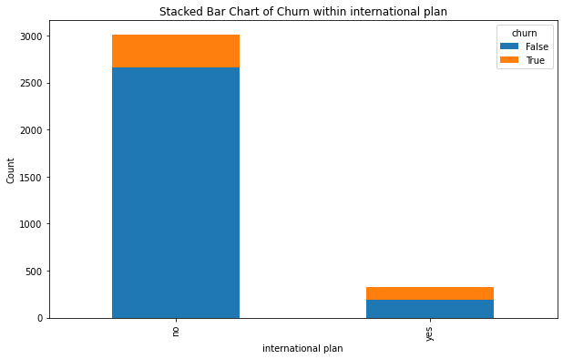
Observation 1:
From the stacked bar chart below, 42% of the customers with an international plan left SyriaTel in comparison to 11% of those that don't have an international plan.

Slide 8
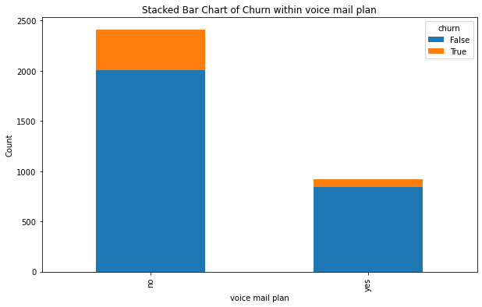
Observation 2:
From the stacked bar chart below, the customer churn for those without a voice mail plan is higher than the customers with a plan, at 16% versus 8%.

Slide 9
Analysis 2: Explore the Impact of Numeric Features on Customer Churn:
Observation:
From the bar chart below, the most significant numeric value on customer churn is customer service calls. Customers with more service call are more likely to discontinue their service with SyriaTel.

Slide 10
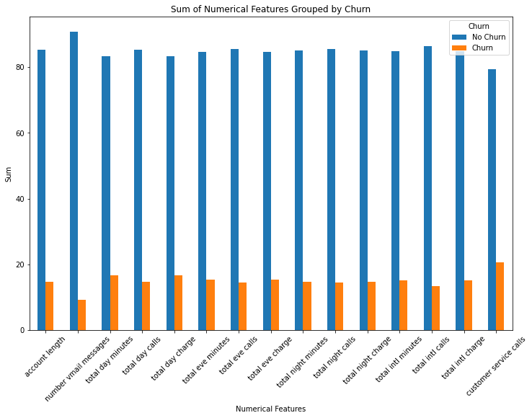

Slide 11
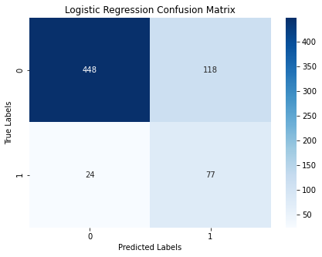
4. Modelling
Model 1 : Logistic Regression Classifier
Logistic Regression is a type of classification algorithm under supervised machine learning that predicts the probability of a classification outcome based on one or more predictor variables. In this project, the target variable(churn) is binary, either true or false.
Model Evaluation

Slide 12
Model 1 : Logistic Regression Classifier
Observations
Accuracy: The model correctly predicted 78.7% of the instances in the testing set. This is a decent overall performance.
F1-score: The F1-score of 0.52 indicates a moderate balance between precision and recall. It's lower than the accuracy, suggesting there might be some trade-off between these two metrics.
Recall: The high recall of 0.762 means the model is good at identifying most of the positive instances, but it might also incorrectly classify some negative instances as positive.
Precision: The low precision of 0.395 suggests that the model incorrectly classifies many negative instances as positive, as shown by the low precision score on the True(1) class.
Conclusion
Recall is the most significant metric, since the goal is to identify customers about to leave and implement proactive measures to prevent that. Precision is also important to ensure that retention efforts are not wasted on customers unlikely to churn.
This model wouldn't be ideal to predict customer churn.

Slide 13
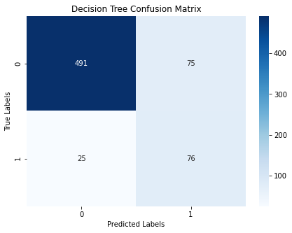
Model 2 : Decision Trees Classifier
Model 2 : Decision Trees Classifier
Decision tree classifier is a supervised machine learning algorithm that works by splitting the data into subsets based on the value of input features.
Each node represents a decision rule, and each branch represents an outcome of that rule.
Model Evaluation

Slide 14
Model 2 : Decision Trees Classifier
Observations
Accuracy: The model correctly predicted 85% of the instances in the testing set. This is a good overall performance, and improved compared to logistic regression model.
F1-score: The F1-score of 0.603 indicates a moderate balance between precision and recall. It's lower than the accuracy, suggesting there might be some trade-off between these two metrics.
Recall: The high recall of 0.752 means the model is good at identifying most of the positive instances, but it might also incorrectly classify some negative instances as positive.
Precision: The improved precision score of 0.503 is moderate, indicating that while the model is good at identifying positive instances, it might also incorrectly classify some negative instances as positive.
Conclusion
Overall performance of the decision tree model has improved compared to logistic regression.
With a precision score of 0.503 and recall of 0.752, the model is still struggling to identify positive instances of the churn feature, customers who have left the business.

Slide 15
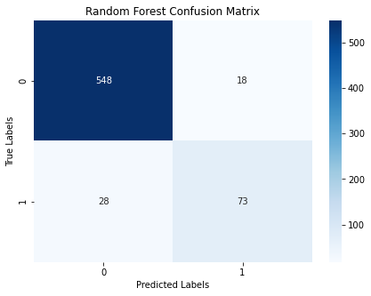
Model 3 : Random Forest Classifier
Model 3 : Random Forest Classifier
Random forest is a supervised machine learning algorithm that creates a set of decision trees from a randomly selected subset of the training data.
Random forest is best suited for handling large, complex datasets and providing insight into feature importance.
Model Evaluation

Slide 16
Model 3 : Random Forest Classifier
Observations
Accuracy: The model correctly predicted 93.1% of the instances in the testing set, which is an excellent overall performance, and an improvement compared to the Decision Tree model.
F1-score: The F1-score of 0.76 indicates a good balance between precision and recall. It's lower than the accuracy, suggesting there might be some trade-off between these two metrics.
Recall: The recall of 0.723 is moderate, meaning the model might miss some positive instances. This is a slight decline compared to Decision tree.
Precision: The precision score of 0.802 is significantly improved, but still indicates that the model might incorrectly classify some negative instances as positive.
Conclusion
Overall performance of the Random forest is better compared to the logistic regression and decision tree classifiers.
Through hyperparameter tuning, the overall performance of the model has improved now with a recall 0.752 and precision of 0.817.

Slide 17
5. Model Comparison
ROC Curve and AUC
ROC curve illustrates the true positive rate (recall) against the false positive rate of a classifier. AUC represents a measure of the overall ability of the classifier to distinguish between positive and negative classes.
The higher the AUC, the better the performance. The best performing model will have an ROC that hugs the upper left corner of the graph, illustrating a high true positive rate and low false positive rate.

Slide 18
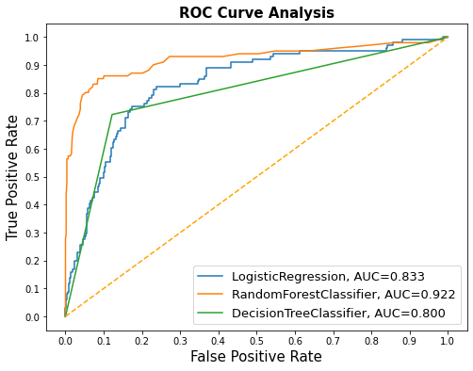
5. Model Comparison : ROC Curve and AUC
From the ROC and AUC value illustrated below, the best performing model is the Random Forest Classifier. This model will best predict the customers about to leave the business.

Slide 19
6. CONCLUSION
Objective 1: Assess the Factors/Features Impacting Customer Churn:
Conclusion:
Findings: Through feature analysis, the most impactful features on customer churn are: total day charge, customer service calls, international plan and total international calls.
Implications: These features suggest that customers who feel overcharged, dissatisfied with international plans and unresolved issues leading to multiple customer service calls are the most likely to churn.

Slide 20
6. CONCLUSION
Objective 2: Suggest Proactive Measures to Reduce Customer Churn Rate:
Conclusion:
Findings: An increase in customer service calls by a customer suggests that the customer is highly dissatisfied and likely to churn. An increase in total day charges, increases customer churn.
Implications: Implement more effective and responsive customer service protocols to resolve customer complaints. Offer personalized subscriptions to customers as the daily charges increase. Improve international calls plan to boost customer satisfaction.

Slide 21
6. CONCLUSION
Objective 1: Develop a Classification Model to Predict SyriaTel's Customer Churn:
Conclusion:
Findings: The tuned random forest classifier is the best model to predict customer churn, with an `AUC` score of `0.922` and an accuracy score of 93.7%.
Implications: This random forest classifier can be used to predict when a customer is likely to churn based on multiple predictor variables. This will enable data-driven decisions to boost customer retention and targeted campaigns to improve customer satisfaction.

Slide 22
6. RECOMENDATIONS
1. Focus on Boosting International Calls:
- Consider offering more tailored or flexible international plans that better match customer needs, possibly with options for additional benefits or reduced rates.
2. Enhance Customer Support:
- Monitor customers who frequently contact support and proactively reach out to them to resolve potential issues before they escalate. Implement more effective and responsive customer service protocols.
3. Use Data-Driven Insights to Target Dissatisfied Customers:
- Incorporate insights from predictive data analysis to come up with targeted campaigns for highly dissatisfied customers about to churn

