Slide 1
Service creation tools for 3G, IP and telehealth
Joakim Pettersson

Slide 2
Overview
Basic functionality in network-oriented APIs
Extendable services in user-oriented APIs
Interactive environment with Python interpreter
Very short design time: hours rather than months!
Higher level and more productive services
Improved feedback and creativity
Basic functionality
Extendable services
Interactive environment
IP
OSS, GIS, Web, GUI
Socket, RMI, VPN
AAA
QoS
IDE
Inspect
Debug
Configure
Deploy
Maintain
Vertical-market applications
IITLIB
SIP
IITAPI
PC
PDA
Phone
Team
Observer
Controller
Logger
Terminal
Python
Java
C++
C#
IMS
Parlay X
Parlay
Connects to WCDMA system
NRGSDK
Parlay/OSA+Ericsson functions
IITSDK
Call
SMS
MMS
Locate
Equivalent design time and code size
Python: Hours, ~1 page
Telephony applications
Java: Days, ~3 pages
Java: Weeks, ~10 pages
CORBA: Months, ~30 pages

Slide 3

The IITAPI library
Goal: Objects within the interface should map to common needs, using familiar words or symbolism with well-established interpretation
State-of-the-art: Heavily technology-dependent, both in their application programming interfaces (APIs) and documentation
IITAPI: Extendable Phone & Team (Parlay), PDA and PC (IP), Observer, Logger & Controller (RMI) services
  Uses plain and simple language which has
  well-established meaning in terms of
  familiarly used real-word objects.
  They are easily interacted with for example using Python, to consolidate or correct the initial interpretation.

Slide 4
Telehealth services
Goal: Make it easy to prototype and test distributed logic
State-of-the-art: Either on-line or local monitoring. No control. Many competing solutions.
Relevant building blocks in IITAPI:
    Observer – input connectivity & latency management
    Controller - output connectivity & latency management
    Logger - information management
    Terminal - connectivity & information maintenance
  Similar architecture as Mobihealth BAN (IMHO state-of-the-art)
  Much more intuitive language (add, remove, start, stop, log, retrieve).
  Currently handles automatic maintenance of connectivity, logic and information locally.
  Experimenting with automatic maintenance also for distributed connectivity, logic and information (Python/Pyro and Java/Cajo).

Slide 5
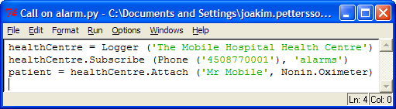






Example service: Alarm → Phone call
Sensor
Patient
Logger
samples, alarm
Actuator
treatment
Nurse
“Care instruction”

Slide 6



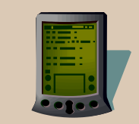


Patient monitoring – goal
Logger
Patient
alarm
treatment
“Care instruction”
care
alarm
Nurse
Doctor

Slide 7
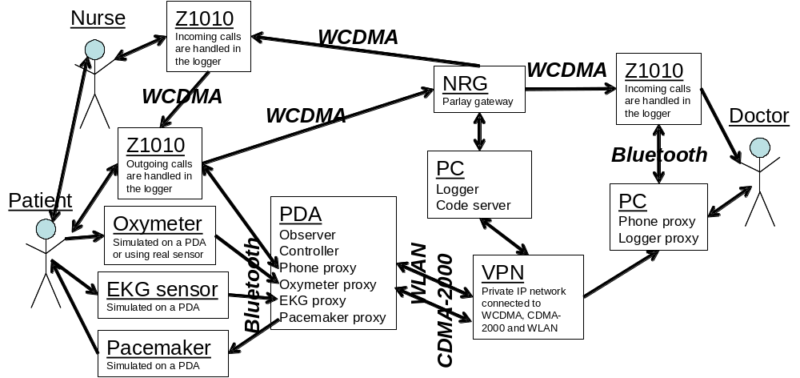
Patient monitoring - technologies

Slide 8
IITAPI – What’s missing
CDMA-2000 telephony (Nortel) – how to integrate?
    SS7 UMAP for telephony
    SMPP for text messaging
    MM7 for multimedia messaging
  Messaging: Use SMPP and MM7 of Ericsson NRG 4.1 via Parlay-X?
  Call control: Use SS7 UMAP of Brooktrout’s NS700 via JAIN?
Distributable services – Python, Java or agent technology?
    Pyro is used in research – powerful but slow, C only (Java under development)
    Cajo has smallest footprint – powerful and efficient but only for Java
    Jini is most established – powerful but complex and only for Java
    Grid agents? – hip but limited in functionality
    Sensor network agents? – fast, small and efficient but not OS-independent
Bluetooth/IR and WLAN connectivity – protocol, port or socket APIs?
Automatic billing – good or bad?
Where and what to publish?
Who owns IITAPI (.py, .jar & .doc) after my assignment?

Slide 9
Other Python-related work:
OSS management
Test and verification
Rapid prototyping
IDE for distributed services
Contact:
joakim.pettersson@iitelecom.com
(514) 395-2079

