Slide 1


2018
JUNE 16
LISBON

Slide 2
GLOBAL DEVOPS
BOOTCAMP
Notes:
@gdevopsbc
#DevOps
#GDBC
#globaldevopsbootcamp

Slide 3




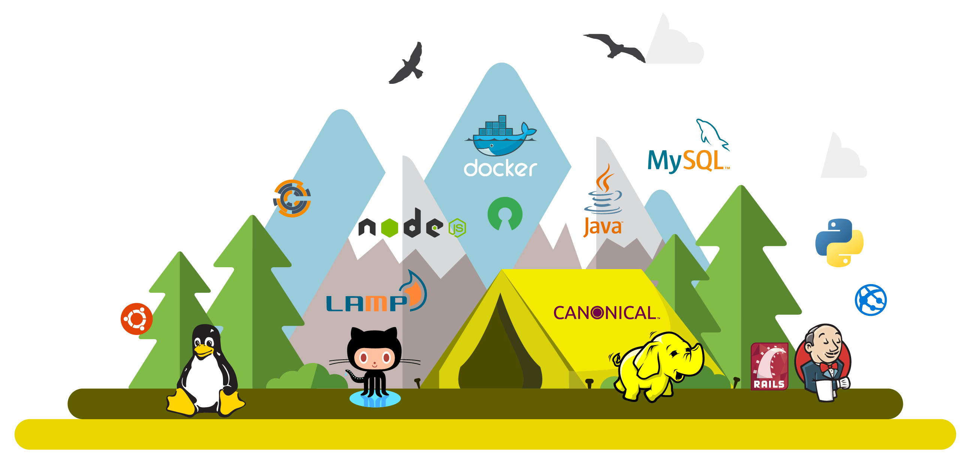



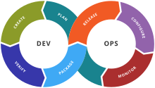
@jalmeida
#GDBC

