Slide 1
How to make a
website with sound?
Joanna Luberadzka
Hot Topics Seminar 22.07.2020

Slide 2
Before I talk about websites with sound…
...how to create any website?
DEMO1 (SMILEY):
1. Simple website – one picture, one button, moving…
2. Developer tools in our browser.
3. HTML code – elements of the website (static).
4. Javascript code – modifying parameters, assigning actions
to buttons and in general to control what’s happening.

Slide 3
Motivation:
- We want to run our auditory experiments online.
- There are many various experiment builder software packages.
- Do we have to use them, or can we create experiments by building our own website from scratch, using what is typically used for building websites – html and javascript code? How easy/hard is it?
- Focus: Audio (for auditory experiments)
- Problem: Processing audio in the web is still not that straightforward...

Slide 4
Audio in the web:
- 1995: Internet Explorer 2 for the first time supported a tag called <bgsound> (no visual element). Netscape browser supported the <embed> tag, which allowed for the mutlimedia to be embedded in the page.
- 1996: Flash software, allowed users to add audio to their websites (for the first time with some time control, which was good for developing games). It was used across many platforms.
- 2011: iPhone release and Steve Jobs writing an open letter criticizing Flash. But at that time already HTML5 was in development.
- 2014: HTML5 release with the <audio> tag (nice, but it does
not have all the functions of Flash).
- Currently: <audio> tag and Web Audio Application
Programming Interface (Web Audio API)
Source:
https://code.tutsplus.com/courses/add-sound-to-your-site-with-web-audio/lessons/a-brief-history-of-audio-on-the-web

Slide 5
How to create a website with sound
using the <audio> tag?
DEMO 2 (EXPERIMENT):
1. Experiment website – 1 image, 3 audio files, button to display answer/play next sound example.
2. HTML code – audio elements, image, button.
3. Javascript code – not really related to audio processing, but all what is ‘around’ that.

Slide 6
How to create a website with sound
using the <audio> tag?
DEMO2 (EXPERIMENT):
1. Experiment website – 1 image, 3 audio files, button to display answer/play next sound example.
2. HTML code – audio elements, image, button.
3. Javascript code – not really related to audio processing, but all what is ‘around’ that.

Slide 7
How to create a website with sound
using the Web Audio API?
- Problem with the <audio> tag: not much control over timing, no sound modifications.
- The Web Audio API is a high-level JavaScript API for processing and synthesizing audio in web applications.
- Handled by Assembly/C/C++ code in the browser, but we control it with JavaScript.

Slide 8
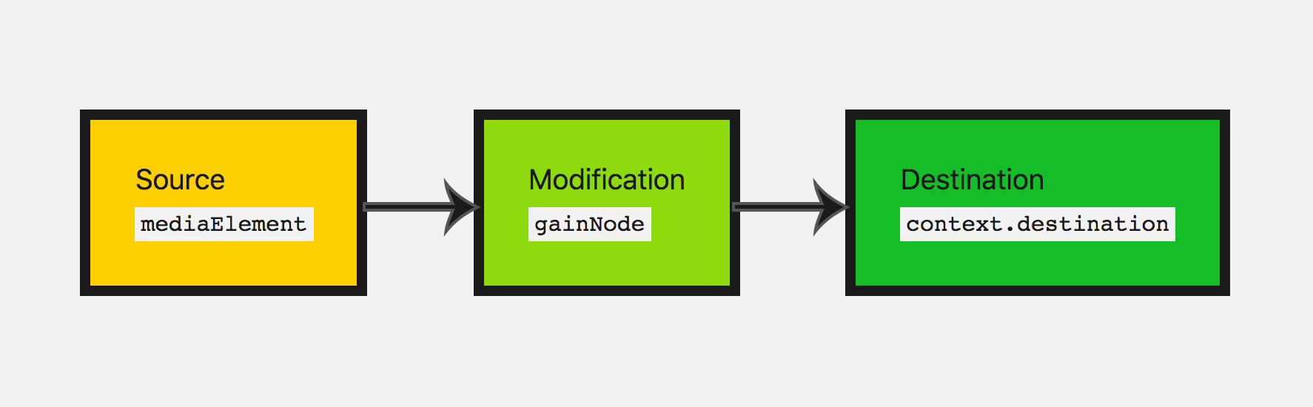
How to create a website with sound
using the Web Audio API?
Basic architecture:
Audio context
Build-in oscilator,
Audio from audio node
Gain, Filter, Distortion, Reverb, Convolver, Panner
Headphones (2 channels) ?

Slide 9
How to create a website with sound
using the Web Audio API?
DEMO3 (EFFECTS):
1. Experiment website – play/stop button and three sliders.
2. HTML code – sliders, button.
3. Javascript code – Web Audio API, assigning parameters to sliders.

Slide 10
Summary:
- Websites can be created by combining HTML and Javascript coding.
- We can put audio on our Website either via <audio> node (HTML) or via Web Audio API (Javascript).
- Audio element is quite limited and Web Audio API is quite complicated to use.

Slide 11
(My) Conclusions
It’s not worth programming experiments on your own because:
- Web Audio API is not as straightforward for sound editing as matlab or python.
- For online experiments, apart from audio we need all additional things like data collection, instructions, etc.
It’s worth learning basics of HTML and Javascript because:
- Building websites with audio is great for all kinds of demos,
where we want to present our work in a compact way, for example as additional material to papers.
- Making small changes in Javascript code generated by experiment builder software might be needed.

Slide 12
Useful links:
Documentation:
https://developer.mozilla.org/en-US/docs/Web/API/Web_Audio_API
Tutorials:
https://www.html5rocks.com/en/tutorials/webaudio/intro/
https://middleearmedia.com/web-audio-api-basics/
Demos:
https://webaudio.github.io/demo-list/
https://webaudiodemos.appspot.com/

