Slide 1
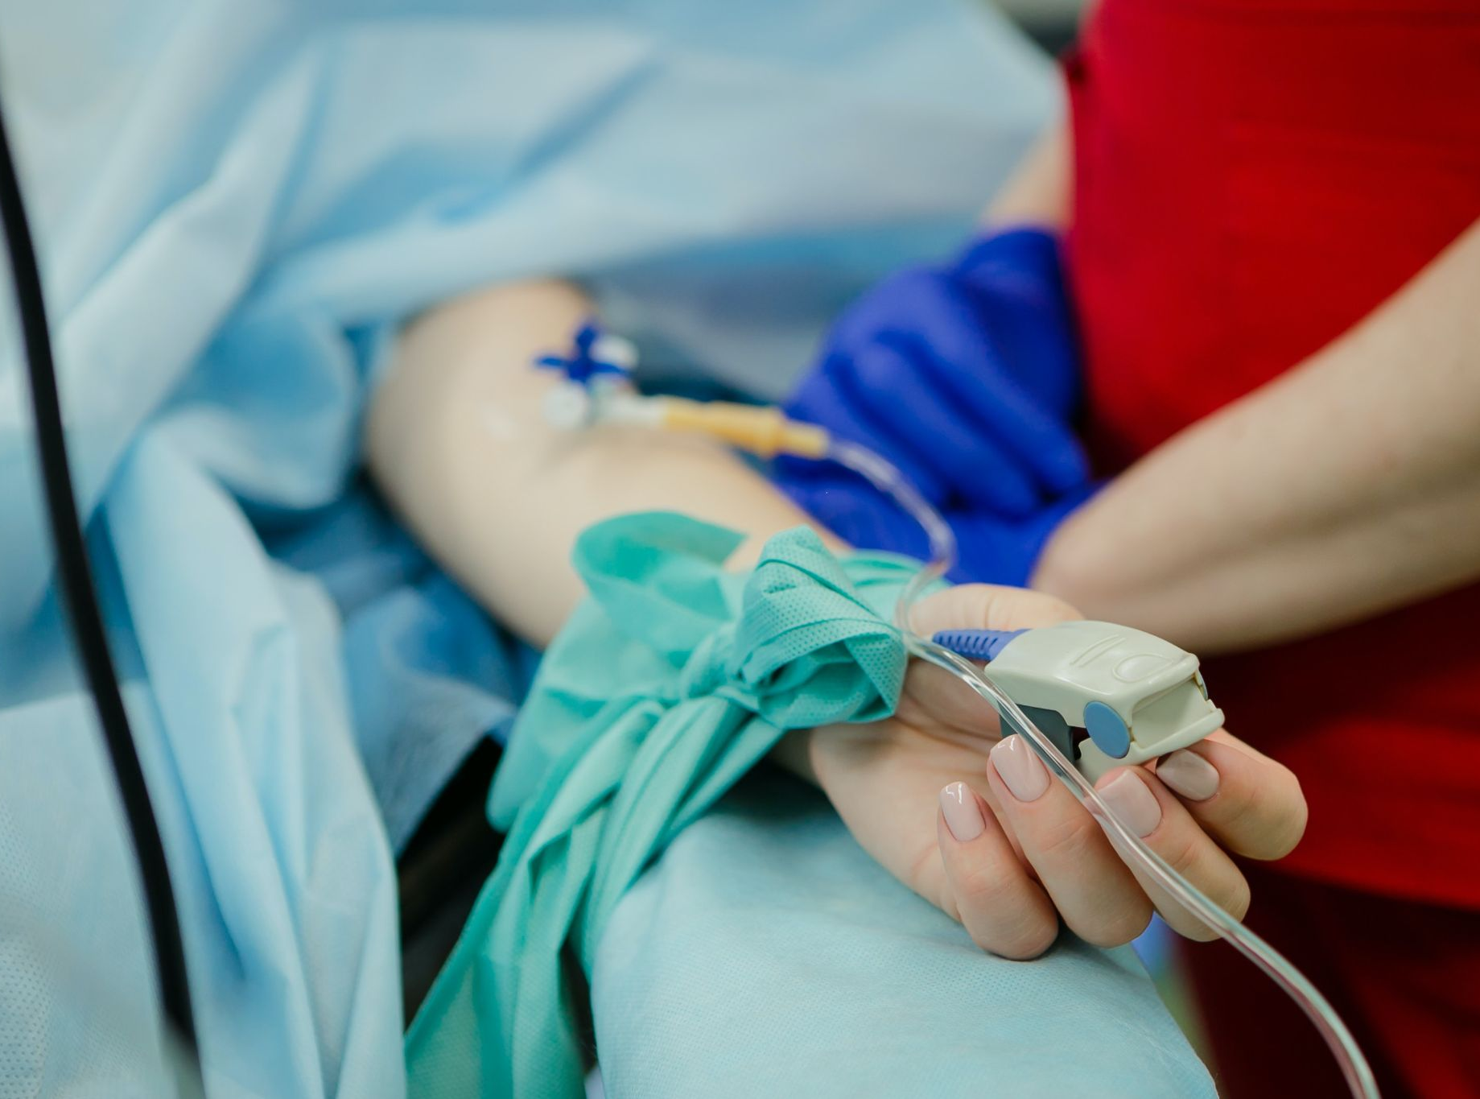
SpO2-SaO2 AS A RACE PROXY
Jethro Kwong, João Matos, Nividha Jadeja, Tanya Hawrylyshyn, Suyeon Park, Zach Zaiman

Slide 2
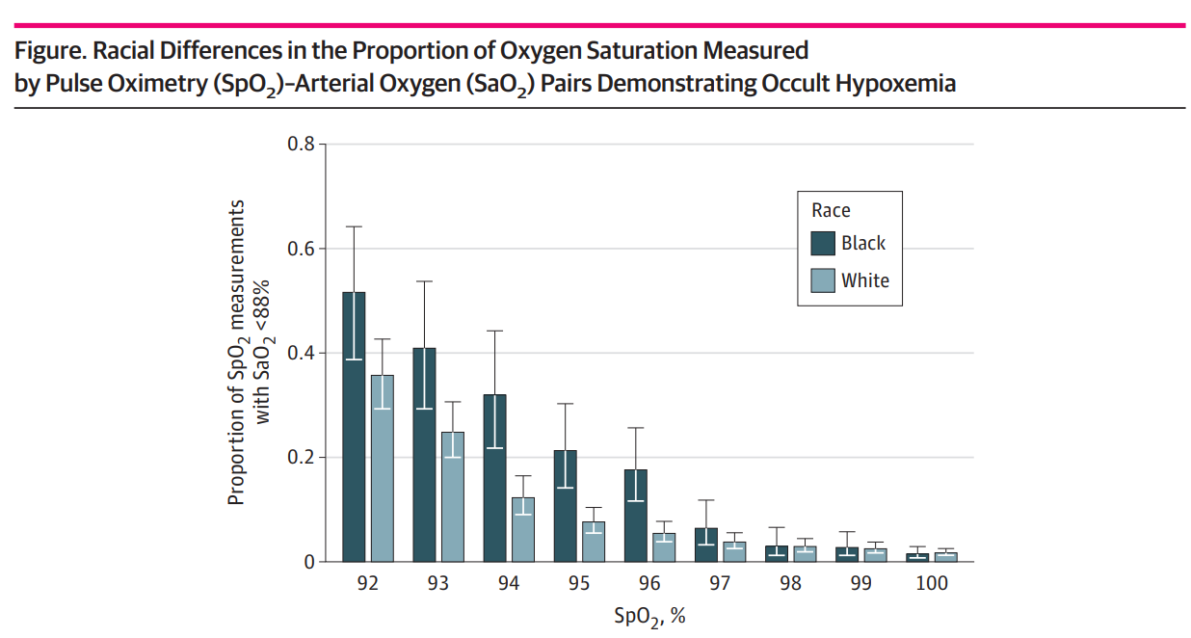
Background
Race/ethnicity is not included in clinical datasets (Canada, Europe, …)
Racial bias is a major concern in clinical AI research
Difference between SpO2 (pulse oximetry) and SaO2 (arterial oxygen saturation) has been shown to correlate with race

Slide 3
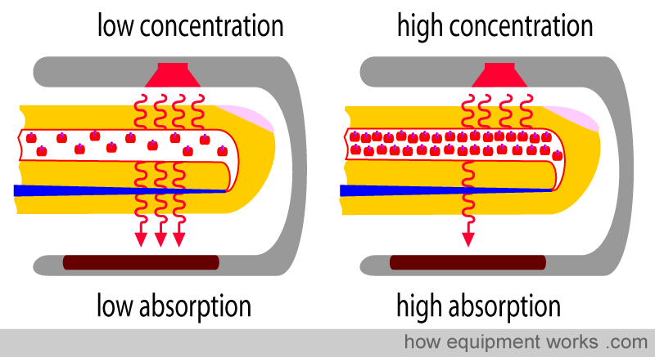
Study Question
Hypothesis
White vs non-White
SpO2-SaO2 gap
“Can we use the difference between SpO2 and SaO2 as a proxy for race?”
The difference between SpO2 and SaO2 can serve as a consistent proxy for race.
Figure 1. Darker skin = a high absorption of light
Lighter Skin = a low absorption of light

Slide 4
Can we learn the relation between the SpO2-SaO2 gap with race from other data sets and apply it to GIM?
MIMIC-IV
40,400 Pairs
White Mean (SD): 0.95 (3.05)
Non-White Mean (SD): 1.56 (3.19)
within 30 min
Merged Datasets
Undersampling
~ 25k points
10% test
eICU-CRD
105,214 Pairs
White Mean (SD): 1.09 (3.85)
Non-White Mean (SD): 1.73 (4.20)
within 30 min
White vs. Non-White, Logistic Regression, 1 Feature only
Balanced Accuracy: 54.4% | AUC: 56.0%

Slide 5

Better than flipping a coin!
Let’s use it in GIM Dataset

Slide 6
GIM Dataset
Study Population
Over 22,000 patient encounters for 14,000 unique patients who were admitted under the GIM service at St. Michael’s Hospital between 2011 and 2019.
531 Encounters with SpO2 - SaO2 Pairs captured within 1.5 hours window

Slide 7
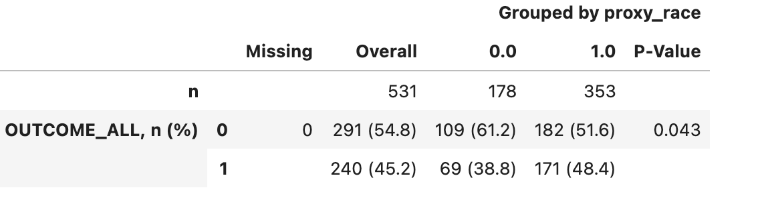
Study Outcomes
GAS PIPELINES
TUNNEL WORKS
WATER TREATMENT PLANTS
14 / 244 patients had multiple measurements (≥1 SpO2-SaO2 pairs)
The model consistently identified the proxy race in 13/14 samples
Non-White
White
OUTCOME_ALL = ICU Transfer OR Death OR Palliative Entry OR Palliative Discharge
delay = Time from occult hypoxemia (SaO2 < 88%) to any respiratory intervention

Slide 8
Lessons Learned
GAS PIPELINES
TUNNEL WORKS
WATER TREATMENT PLANTS
SpO2 - SaO2 holds some predictive power for race-ethnicity
We can validate the proxy model with other Data sets
e.g, Emory ICU Database (blacks are well represented)
Adjust for confounding in the SpO2-SaO2 difference
Age
Gender
Ventilation
Hemoglobin
Bilirubin
Include other proxies for race
Drill race down, make it multiclass
A robust race proxy would enable clinical research in databases without that information!

Slide 9
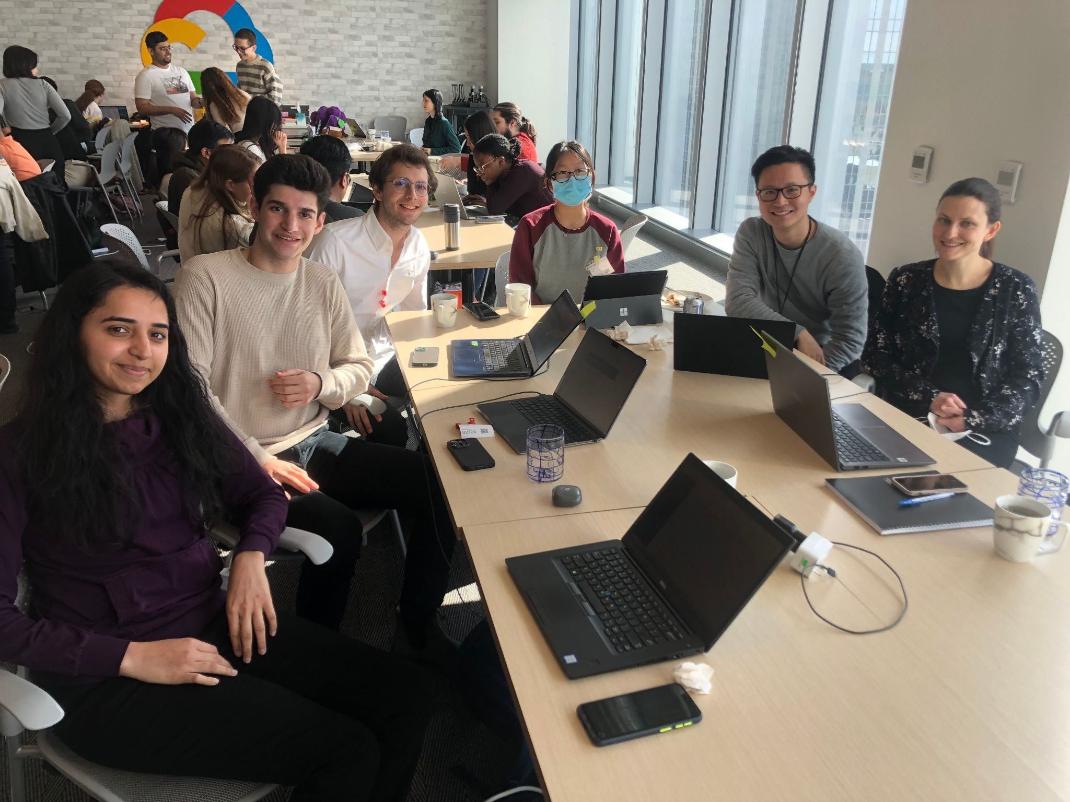
Thank you!
Jethro Kwong, João Matos, Nividha Jadeja, Tanya Hawrylyshyn, Suyeon Park, Zach Zaiman

Slide 10
References
E. Andrist, M. Nuppnau, R. P. Barbaro, T. S. Valley, and M. W. Sjoding, “Association of Race With Pulse Oximetry Accuracy in Hospitalized Children,” JAMA Netw Open, 1 Mar 2022. Accessed: Feb 24, 2023. [Online]. Available: https://jamanetwork.com/journals/jamainternalmedicine/fullarticle/2792653
Wikimedia Commons, “Lighting Diagram of Pulse Oximeter 2,” Accessed: Feb 24, 2023. [Online]. Available: https://commons.wikimedia.org/wiki/File:Lighting_Diagram_of_Pulse_Oximeter_2.jpg
A. Fawzy, T. D. Wu, K. Wang, et al., “Racial and Ethnic Discrepancy in Pulse Oximetry and Delayed Identification of Treatment Eligibility Among Patients With COVID-19,” JAMA Intern Med, May 31, 2022. Accessed: Feb 24, 2023. [Online]. Available: https://jamanetwork.com/journals/jamainternalmedicine/fullarticle/2792653
Racial Bias in Pulse Oximetry Measurement | NEJM

