Slide 1
Chapter 1 Methods And Results
Main
Current ASIC analysis: stand-alone methods/results presentation for the true cluster-result bundle
Goal
Talk boundaries
Review the frozen Chapter 1 design choices and exact operational implementation.
Show how hospitals, stays, rows, and labels are retained or dropped.
Summarize the current ASIC baseline, hard-case, and horizon results from cluster-results.
Keep all interpretation measurement-bound to the recorded feature set, charting process, and temporal aggregation.
No PhD framing, proposal alignment, or thesis storyline.
No biological subtype claims, causal claims, or irreducible-randomness claims.
Empirical source priority: cluster-results over older local artifacts.
Retained stays
24h test rows
6,446
33,676
Current ASIC retained cohort
Binary-evaluable test split
Interpretation: This is a bounded review of near-term in-ICU mortality risk structure under the current ASIC representation, not a generic mortality-prediction talk.
Source: ch1_methods_results_deck_overview.md; chapter1_analysis_spec_frozen_v1.md
1

Slide 2
Frozen Study Setup
Methods
Frozen v1 analysis contract before ASIC result interpretation
Data
Endpoint
Horizons
Development dataset: ASIC
External-validation target: MIMIC-IV
This deck shows ASIC only
Primary outcome: in-ICU mortality
Hard-case analysis is defined on fatal stays
No event-timed death label is available
Primary: 24h
Main contrast: 48h
Sensitivities: 8h, 16h, 72h
Unit
Baseline models
Explicit non-claims
Patient-time prediction instances
Completed 8h blocks
Operational first-stay ICU analysis
Logistic regression
XGBoost
Calibration-aware evaluation
No biological death classes
No irreducible stochasticity claim
No causal attribution
Interpretation: The core scientific choices were frozen early enough that later ASIC findings can be read against a stable design contract rather than a post hoc analysis setup.
Source: chapter1_analysis_spec_frozen_v1.md; phase1_working_reference.md; ch1_run_config.json
2

Slide 3
Cohort Construction And Exclusions
Methods
From standardized ASIC input to the retained Chapter 1 cohort
Exact cohort definition
Site logic
Adult ICU stays with mechanical ventilation >=24h.
First ICU stay via readmission = 0 proxy.
Valid in-ICU mortality label and >=1 valid prediction instance required.
Include hospital only if ICU mortality is usable.
Require at least 3 of 4 core physiologic groups with dynamic coverage.
Excluded hospitals: asic_UK00, UK01, UK03, UK06.
Input
8 hospitals
15,969 stays
Site-eligible
4 hospitals
8,769 stays
After mech_vent_ge_24h_qc
6,558 stays
Final retained
6,446 stays
Hospital | Retained stays
asic_UK02 | 745
asic_UK04 | 470
asic_UK07 | 2,197
asic_UK08 | 3,034
Major stay-level gates after site restriction
What to say aloud
Upstream mech_vent_ge_24h_qc is the main within-site drop mechanism.
Readmission = 0 is the operational first-stay proxy.
No retained stay fails the saved cohort verification checks.
Most contraction happens before modeling, at explicit site and stay eligibility steps.
This is a site-restricted ASIC cohort, not every standardized ASIC hospital.
Interpretation: The retained cohort is shaped primarily by explicit site eligibility and stay-level gating, so any result should be read relative to this restricted analytic population.
Source: chapter1_site_eligibility.csv; chapter1_counts_by_hospital.csv; chapter1_cohort_summary.csv
3

Slide 4
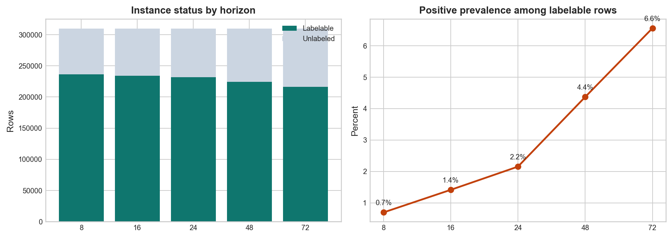
Time Representation, Valid-Instance Rule, And Proxy Labels
Methods
Row construction and labelability are part of the analysis design, not just preprocessing detail
Valid prediction-instance rule
Completed 8h blocks are the time grid.
Patient must still be alive and in ICU at prediction time.
At least 3 of 4 core physiologic groups must be observed in-block.
Rows remain only when horizon-specific labelability is unambiguous.
Observed-data gate
248,772 unique usable 8h blocks before horizon duplication.
69.4% with all 4 core groups observed.
30.6% with exactly 3 of 4.
Figure: labelable/unlabeled burden by horizon plus positive prevalence among labelable rows
Positive: icu_mortality = 1 and icu_end_time_proxy_hours in (t, t+H].
Negative: icu_mortality = 0 and icu_end_time_proxy_hours >= t+H.
Otherwise unlabeled; 24h counts are 231,596 labelable, 4,986 positive, 226,610 negative, 78,048 unlabeled.
ASIC does not provide true death/discharge timestamps, so these are proxy within-horizon labels.
Caveat: Both row retention and labelability are shaped by current-block measurement coverage plus the proxy ICU-end-time rule, so the analyzed row set is intentionally restrictive.
Source: label_logic_audit.md; chapter1_cohort_summary.csv; chapter1_observation_process_qc_summary.csv
4

Slide 5
Frozen Modeling Design Choices
Methods
Feature boundary, preprocessing policy, split strategy, baselines, and metrics
Feature boundary
Preprocessing policy
Split strategy
Baselines and metrics
Primary feature set: 31 routine variables.
Extended set adds 15 sparse-lab variables.
Model-ready export selects 186 blocked dynamic columns.
98 LOCF/missingness indicator columns are appended.
Bounded LOCF only for pre-specified families.
Ventilator LOCF only within ventilation-supported windows.
No final imputation in preprocessing export.
Downstream imputation is deferred to model training.
Target 70 / 15 / 15.
Operational split unit: stay_id_global.
Splitting within retained hospitals.
Frozen seed: 20260327.
Baselines: logistic regression and XGBoost.
Metrics: AUROC, AUPRC, intercept, slope, Brier.
Calibration is a gating issue before hard-case interpretation.
Model-ready rows
Base features
Selected columns
Indicators
Export imputation
1,142,533
31
186
98
None
Across 5 horizons and 3 splits
Frozen primary set
Blocked dynamic feature columns
LOCF and missingness indicators
Deferred to training stage
Operational caveat
The frozen intent is first-stay analysis, but ASIC lacks patient identifiers, so splitting remains stay-level after first-stay proxy filtering.
Interpretation: The design intentionally exposes missingness and emphasizes calibration-aware baselines rather than relying on aggressive feature engineering or a large model zoo.
Source: ch1_feature_sets.json; chapter1_primary_readiness_summary.csv; preprocessing_interface.md
5

Slide 6
Retained Cohort And Realized Split Summary
Results
Current ASIC run scale and the realized internal split balance
Retained stays
Valid instances
Per horizon
24h test rows
Test stays
6,446
1,548,220
309,644
33,676
967
Final Chapter 1 cohort
Across all five horizons
Before labelability filtering
With 752 positives
26.78% stay mortality
Realized stay split
24h row-level split summary
Split | Stays | Mortality+ | Stay mortality
Train | 4,511 | 1,207 | 26.76%
Validation | 968 | 259 | 26.76%
Test | 967 | 259 | 26.78%
Split | 24h rows | 24h positives | 24h event rate
Test | 33,676 | 752 | 2.23%
Train | 162,269 | 3,489 | 2.15%
Validation | 35,651 | 745 | 2.09%
What this changes relative to the synthetic local bundle
The current ASIC package is a full-scale internal run with a binary-evaluable test split.
Main-deck performance numbers can therefore be reported on test rather than falling back to validation.
Interpretation: The current ASIC bundle is a real internal evaluation package, not a local smoke-test artifact, which materially changes how performance slides should be read.
Source: chapter1_cohort_summary.csv; chapter1_stay_split_summary.csv; chapter1_primary_split_summary.csv
6

Slide 7
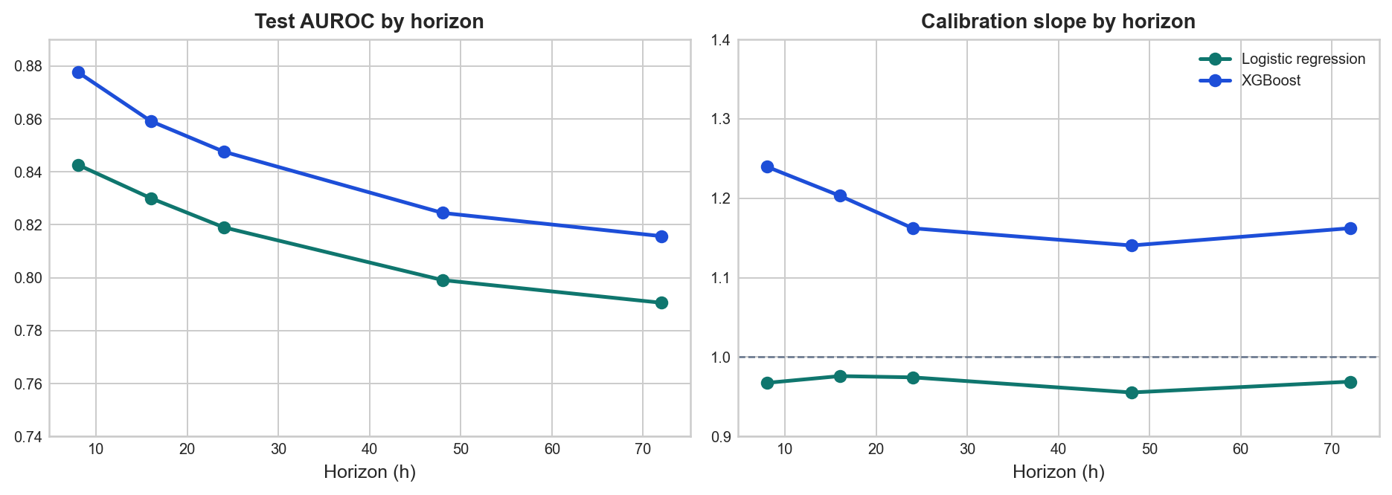
Baseline Model Performance And Calibration
Results
Headline quantitative baseline results on the true test split
24h test metrics
Model | Rows | Events | AUROC | AUPRC | Slope | Brier
Logistic regression | 33,676 | 752 | 0.819 | 0.268 | 0.974 | 0.0186
XGBoost | 33,676 | 752 | 0.848 | 0.318 | 1.162 | 0.1351
Readout
Logistic regression: AUROC 0.819, AUPRC 0.268, slope 0.974, Brier 0.0186.
XGBoost: AUROC 0.848, AUPRC 0.318, slope 1.162, Brier 0.1351.
XGBoost ranks better; logistic regression remains the cleaner probability model.
Figure: test AUROC and calibration slope across horizons for logistic regression and XGBoost
Interpretation: The ranking-versus-calibration tradeoff is real in this ASIC run: XGBoost discriminates better, while logistic regression is the more stable anchor for calibration-first hard-case interpretation.
Source: combined_metrics.csv; reporting_split_summary.csv
7

Slide 8
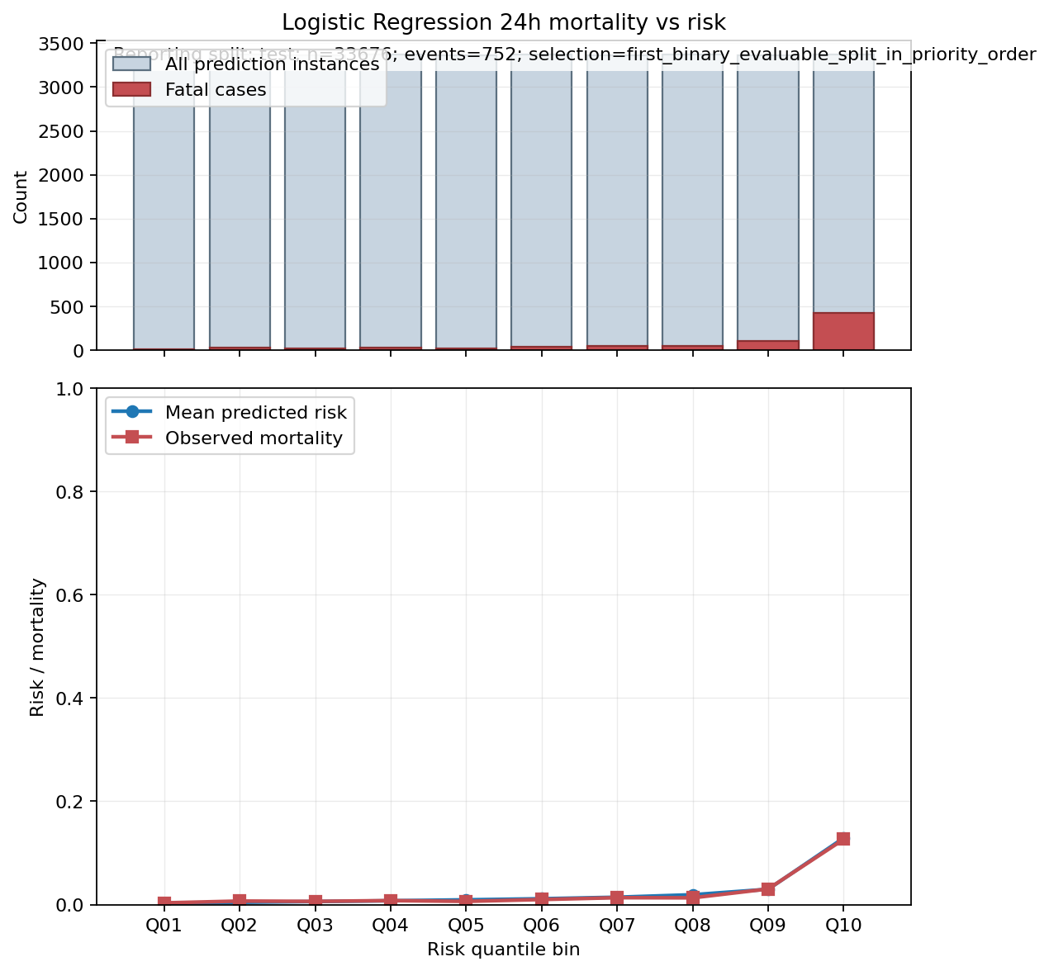
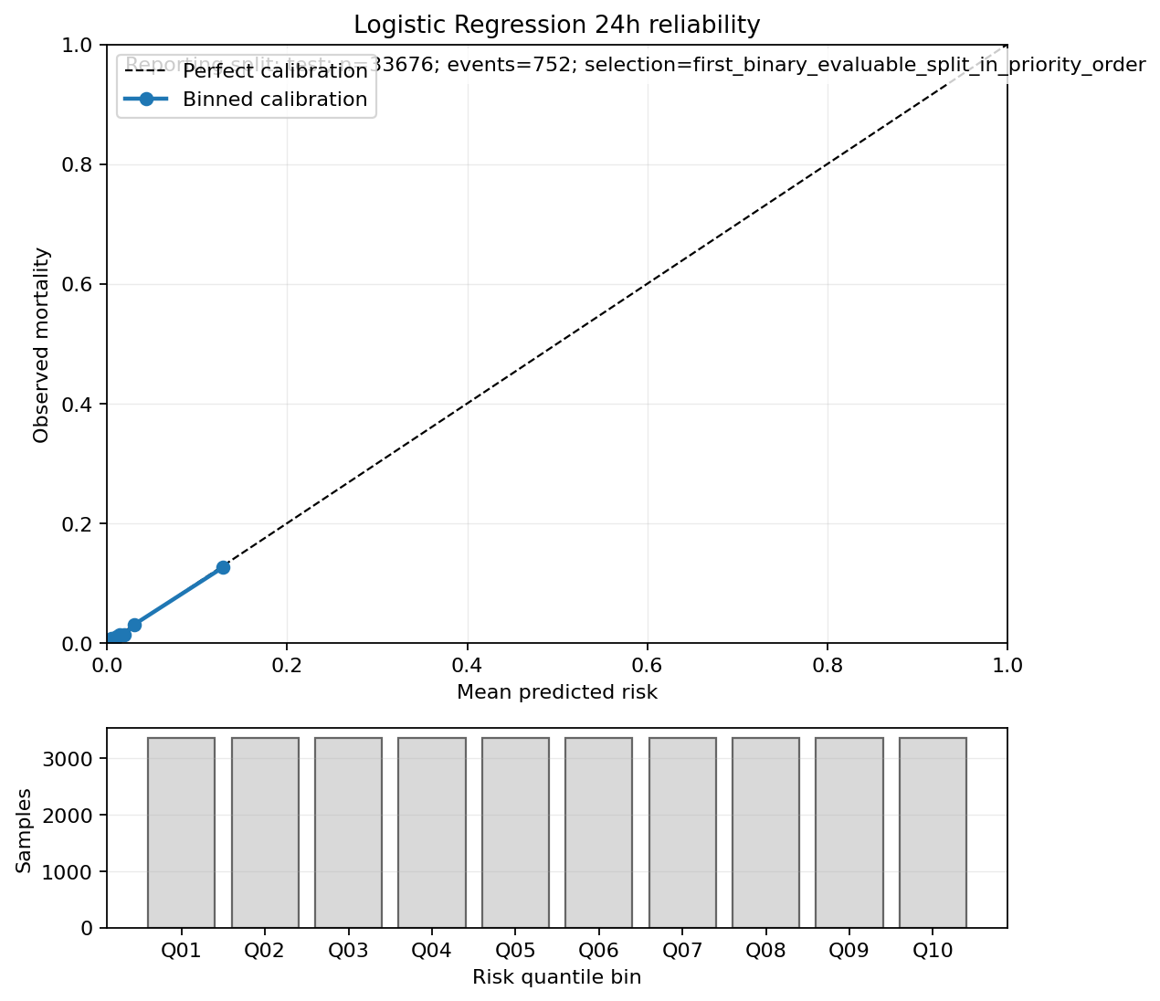
Primary 24h Mortality-Vs-Risk Structure
Results
Logistic regression at the frozen primary horizon
Figure: 24h observed mortality across risk bins for logistic regression on the test split
Figure: 24h reliability plot
Interpretation: At 24h the logistic model preserves coherent risk ordering with acceptable calibration, which makes the hard-case analysis interpretable as a bounded descriptive exercise.
Source: horizon_24h/mortality_vs_risk_plot.png; horizon_24h/reliability_plot.png
8

Slide 9
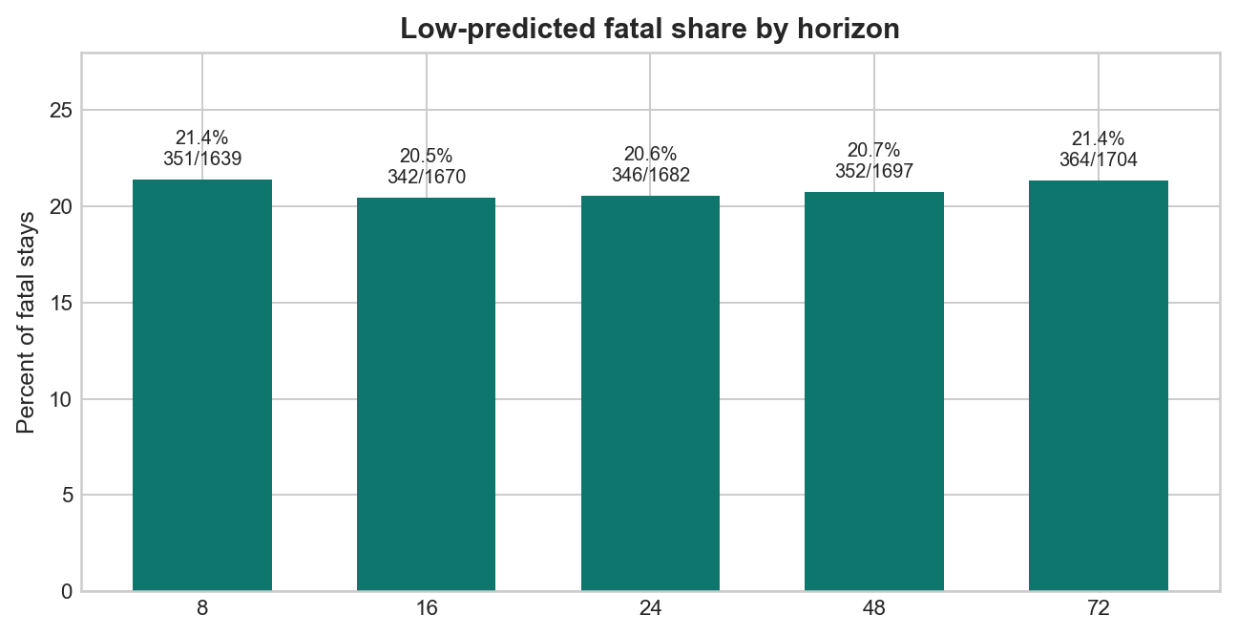
Hard-Case Definition And Burden
Results
Operational rule and resulting low-predicted fatal burden by horizon
Frozen hard-case rule
Rule: asic_logistic_last_eligible_nonfatal_q75_v1.
Collapse to one last eligible stay-level point per stay and horizon.
Mark fatal stays as hard cases if predicted risk is below the nonfatal q75 threshold.
24h fatal stays
24h hard cases
1,682
346
Last eligible stay-level slice
Low-predicted fatal stays
Horizon | Q75 threshold
8h | 0.0044
16h | 0.0093
24h | 0.0146
48h | 0.0324
72h | 0.0527
Figure: hard-case share among fatal stays across the frozen horizon grid
Interpretation: Under the frozen logistic rule, low-predicted fatal stays are a substantial minority of fatal stays at every horizon rather than a rare edge case.
Source: horizon_hard_case_summary.csv
9

Slide 10
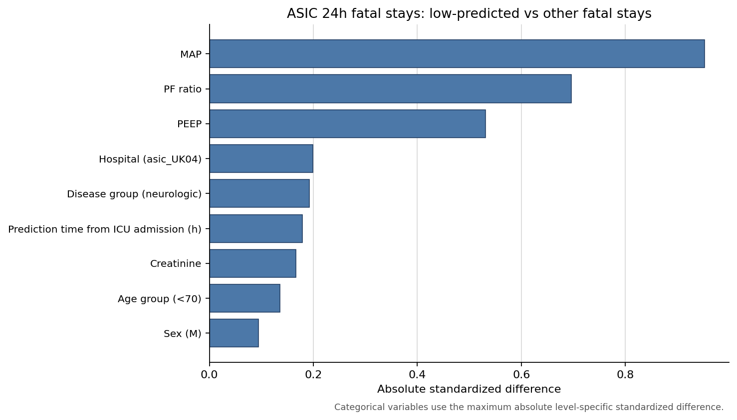
24h Hard-Case Comparison
Results
Low-predicted fatal stays versus other fatal stays at the primary horizon
24h stay-level slice
Fatal stays: 1,682.
Low-predicted fatal: 346.
Other fatal: 1,336.
Strongest differences
Prediction time: 176 [96, 310] (n=346) vs 232 [96, 456] (n=1336).
MAP: 81.0 [68.3, 92.2] (n=336) vs 58.1 [38.4, 71.0] (n=1306).
PF ratio: 277.7 [204.7, 344.4] (n=224) vs 172.3 [111.3, 257.5] (n=1009).
PEEP: 9.3 [6.5, 10.2] (n=263) vs 10.1 [8.0, 12.2] (n=1186).
Bounded subgroup signals
Hospital: asic_UK02: 27 (8%); asic_UK04: 37 (11%); asic_UK07: 161 (47%); asic_UK08: 121 (35%).
Disease group: surgical / postoperative / trauma-related: 191 (55%); respiratory / pulmonary: 127 (37%); infection / sepsis non-pulmonary: 2 (1%); cardiovascular: 17 (5%); neurologic: 7 (2%); other / mixed / uncategorized: 2 (1%).
Exact age is unavailable; age_group only.
Interpretation: Low-predicted fatal stays look less aligned with captured short-term physiologic severity, but this remains a descriptive operational comparison rather than a typology of death.
Source: effect_size_figure.png; comparison_table.csv; asic_hard_case_comparison_variable_audit_memo.md
10

Slide 11
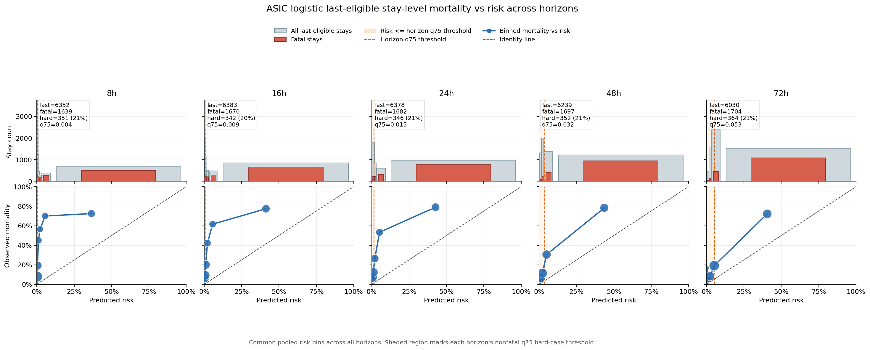
Horizon Dependence
Results
Does the hard-case burden survive across the frozen horizon grid?
Figure: mortality-versus-risk structure across 8h, 16h, 24h, 48h, and 72h horizons
Mean pairwise Jaccard
24h vs 48h
24h vs 72h
Manifest label
Note
0.828
0.885
0.824
persist
The figure is descriptive.
It does not redefine the hard-case rule.
Across all horizon pairs
Hard-case overlap
Hard-case overlap
Current saved read
Interpretation: The current ASIC outputs support a descriptive persistence read: the hard-case burden changes little across horizons and cross-horizon membership overlap remains high.
Source: mortality_risk_horizon_comparison.png; pairwise_overlap.csv; final/run_manifest.json
11

Slide 12
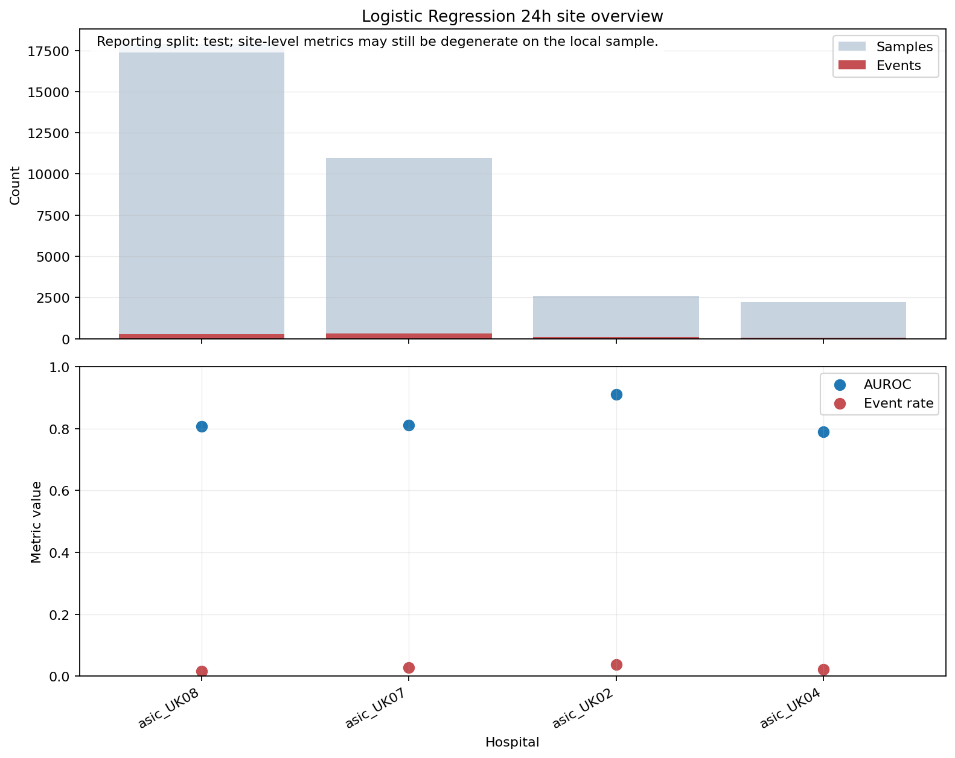
Secondary Robustness Summary
Results
Cross-model agreement is mature; temporal aggregation remains provisional
Cross-model agreement at 24h
Logistic hard: 346.
XGBoost-Platt hard: 227.
Overlap: 188.
Jaccard: 0.488.
54% of logistic hard cases are confirmed by XGBoost-Platt.
Temporal preview: 8h vs 16h aggregation
Logistic 24h AUROC 0.819 -> 0.816; AUPRC 0.268 -> 0.235.
XGBoost 24h AUROC 0.848 -> 0.846; AUPRC 0.318 -> 0.291.
Encouraging, but still only a preview rather than a formal sensitivity run.
Site sanity check
Pooled 24h result is not obviously driven by one hospital.
Site-level calibration is still much sparser and more variable than pooled results.
Figure: 24h site-stratified logistic overview for the test split
Interpretation: Robustness is mixed rather than all-or-none: horizon persistence is strong, cross-model agreement is only moderate, and temporal aggregation has an encouraging but incomplete preview.
Source: horizon_hard_case_agreement_summary.csv; primary_24h_site_overview.png; aggregation_comparison_metrics.csv
12

Slide 13
Current Bounded Interpretation
Results
Most defensible technical readout of the current ASIC package
Supported now
Explicit non-claims
ASIC supports heterogeneous predictability under the observed feature set.
Logistic 24h risk is a usable calibration-aware anchor for hard-case definition.
About one-fifth of fatal stays are low-predicted under the frozen logistic rule.
The low-predicted fatal burden persists descriptively across the frozen horizons.
Hard cases are operational and measurement-bound, not ontological classes.
No biological death subtype claim.
No claim that these deaths are inherently or irreducibly unpredictable.
No causal explanation for why cases are low-predicted.
No claim that hard-case membership is model-invariant at patient level.
No external-transport claim, because MIMIC results are not available yet.
Interpretation: The defensible claim is about heterogeneous predictability under this recorded representation; the deck should not slide into subtype language or deeper causal interpretation.
Source: context_sprint4.md; chapter1_analysis_spec_frozen_v1.md; hard-case comparison summary.md
13

Slide 14
Open Limitations And Pending Analyses
Results
What still blocks a more closed ASIC interpretation
Current limitations
Pending sensitivity work
ASIC lacks true death and ICU-discharge timestamps for within-horizon labels.
Rows are shaped by valid-instance and labelability gates, not just model fitting.
Splitting remains stay-level because ASIC lacks patient identifiers.
The 24h hard-case package lacks exact age; age_group only is available.
Several comparison proxies depend on partial coverage or bounded LOCF.
Some older markdown interpretation memos still contain stale preliminary wording.
Observation-process hard-case comparison.
Treatment-limitation sensitivity or a formal explicit absence note.
Formal temporal-aggregation sensitivity beyond the current preview.
Disease-stratified predictability analyses.
MIMIC external validation and transportability check.
Caveat: The current ASIC package is strong enough for a bounded methods/results presentation, but it is not yet closed on the key interpretation-critical sensitivities.
Source: label_logic_audit.md; asic_hard_case_comparison_variable_audit_memo.md; preview_note.md
14

Slide 15
Appendix A1 — Full Metrics By Model And Horizon
Appendix
Test-split metrics only
Logistic regression
XGBoost
Model | Horizon | Rows | Events | AUROC | AUPRC | Slope | Brier
Logistic | 8h | 34,356 | 248 | 0.843 | 0.209 | 0.968 | 0.0063
Logistic | 16h | 34,029 | 500 | 0.830 | 0.251 | 0.976 | 0.0124
Logistic | 24h | 33,676 | 752 | 0.819 | 0.268 | 0.974 | 0.0186
Logistic | 48h | 32,559 | 1,474 | 0.799 | 0.296 | 0.955 | 0.0371
Logistic | 72h | 31,448 | 2,144 | 0.791 | 0.326 | 0.969 | 0.0544
Model | Horizon | Rows | Events | AUROC | AUPRC | Slope | Brier
XGBoost | 8h | 34,356 | 248 | 0.878 | 0.282 | 1.240 | 0.1072
XGBoost | 16h | 34,029 | 500 | 0.859 | 0.319 | 1.203 | 0.1236
XGBoost | 24h | 33,676 | 752 | 0.848 | 0.318 | 1.162 | 0.1351
XGBoost | 48h | 32,559 | 1,474 | 0.824 | 0.338 | 1.141 | 0.1554
XGBoost | 72h | 31,448 | 2,144 | 0.816 | 0.371 | 1.162 | 0.1662
Interpretation: The ranking-versus-calibration tradeoff is consistent across horizons rather than being unique to 24h.
Source: combined_metrics.csv
A1

Slide 16
Appendix A2 — Site-Stratified 24h Sanity Check
Appendix
Backup view for pooled 24h interpretation
Hospital | Events | AUROC | AUPRC | Slope
asic_UK02 | 96 | 0.911 | 0.564 | 1.528
asic_UK04 | 50 | 0.790 | 0.195 | 1.233
asic_UK07 | 308 | 0.811 | 0.278 | 0.939
asic_UK08 | 298 | 0.808 | 0.234 | 0.928
Backup read
All four retained hospitals have evaluable 24h test metrics.
Site-level calibration varies more than pooled calibration and should stay secondary.
Figure: 24h site overview for logistic regression on the test split
Interpretation: The pooled 24h signal is not obviously driven by a single hospital, but site-level inference should remain cautious because counts are much smaller than in the pooled analysis.
Source: primary_24h_site_overview.png; combined_primary_site_summary.csv
A2

Slide 17
Appendix A3 — Cross-Model Hard-Case Agreement By Horizon
Appendix
Logistic regression versus XGBoost-Platt
Horizon | Logistic hard | XGB-Platt hard | Overlap | Jaccard
8h | 351 | 179 | 145 | 0.377
16h | 342 | 202 | 163 | 0.428
24h | 346 | 227 | 188 | 0.488
48h | 352 | 248 | 202 | 0.508
72h | 364 | 258 | 213 | 0.521
24h anchor
Jaccard 0.488 at 24h.
188 stays are hard in both models.
Broader burden is more stable than exact patient-level membership.
Pattern across horizons
Agreement improves somewhat at longer horizons.
It remains well short of model invariance.
This weakens decomposition-style claims more than the descriptive hard-case burden itself.
Interpretation: Cross-model overlap is meaningful but incomplete, so patient-level hard-case membership should be treated as model-sensitive.
Source: horizon_hard_case_agreement_summary.csv
A3

Slide 18
Appendix A4 — Variable Audit For The 24h Hard-Case Comparison
Appendix
Availability and proxy-readiness check
Family | Status | Completeness | Note
Age | Not ready | 0/1,682 exact age | Only age_group exists
Sex | Ready | 1,682/1,682 | Static join complete
Disease group | Ready | 1,682/1,682 | Hierarchy-sensitive ICD bag
Prediction time | Ready | 1,682/1,682 | Hours from ICU admission proxy
Respiratory | Ready | 1,233/1,682 PF | Current-block PF when present
Hemodynamic | Ready with fallback | 1,642/1,682 MAP | MAP cleaner than vasopressor mapping
Renal | Ready | 1,650/1,682 creatinine | Major LOCF dependence
Ventilation | Ready | 1,449/1,682 PEEP | Mostly current-block
Bottom line
The comparison variable package is usable, but it is not a complete clinical adjustment set and exact age remains unavailable in the current ASIC layer.
Source: asic_hard_case_comparison_variable_audit_memo.md
A4

Slide 19
Appendix A5 — Why SOFA Was Not Used
Appendix
SOFA feasibility audit for the 24h fatal-stay slice
Missing standard components
Available but incomplete
Complete-case problem
No GCS / CNS field.
No vasopressor variables in the model-ready layer.
No urine-output field for renal SOFA.
Standard SOFA scoring therefore cannot be completed.
Respiratory scorable in 73%.
Platelets 92%, but heavily LOCF-based.
Bilirubin 71%, with major 48h LOCF dependence.
Creatinine 98%, but 65% depends on 48h LOCF.
Only 244/1,682 (15%) complete cases with current-block values.
825/1,682 (49%) even after LOCF.
Coverage is structured, not plausibly MCAR.
Respiratory scorable in 73%; coagulation 92% but largely LOCF-based.
Liver is 71% available, with 51% depending on 48h LOCF.
MAP is 98% available, but standard vasopressor inputs are absent.
No GCS field and no urine output field were found.
Complete-case coverage across partially represented organs is 49% even after LOCF.
Interpretation: A direct proxy table is cleaner and more reproducible than an incomplete pseudo-SOFA built from missing standard domains.
Source: sofa_feasibility_memo.md
A5

Slide 20
Appendix A6 — Observation-Process Readiness
Appendix
Instrumentation exists; the explanatory sensitivity analysis does not yet
Derived variables
Metric | Value | Comment
Usable 8h blocks | 248,772
Core groups observed = 4 | 69.4%
Core groups observed = 3 | 30.6%
Median TSL HR | 0.25 h | near-real-time
Median TSL BP | 0.25 h | near-real-time
Median TSL Resp | 0.50 h | less dense than HR/BP/Oxy
Median TSL Oxy | 0.25 h | near-real-time
obs_hr_grp_block, obs_bp_grp_block, obs_resp_grp_block, obs_oxy_grp_block.
n_core_grps_obs_block.
tsl_hr_grp_h, tsl_bp_grp_h, tsl_resp_grp_h, tsl_oxy_grp_h.
Block-level export is unique before horizon duplication.
Current status
Observation-process variables are derived and QC'd, but no saved hard-case comparison using them is present in the current result bundle.
That means the instrumentation is ready while the interpretation-critical sensitivity result remains pending.
Interpretation: Observation-process confounding remains an open interpretive risk because readiness is documented but the actual sensitivity result is still missing.
Source: chapter1_observation_process_qc_summary.csv; chapter1_observation_process_implementation_note.md
A6

Slide 21
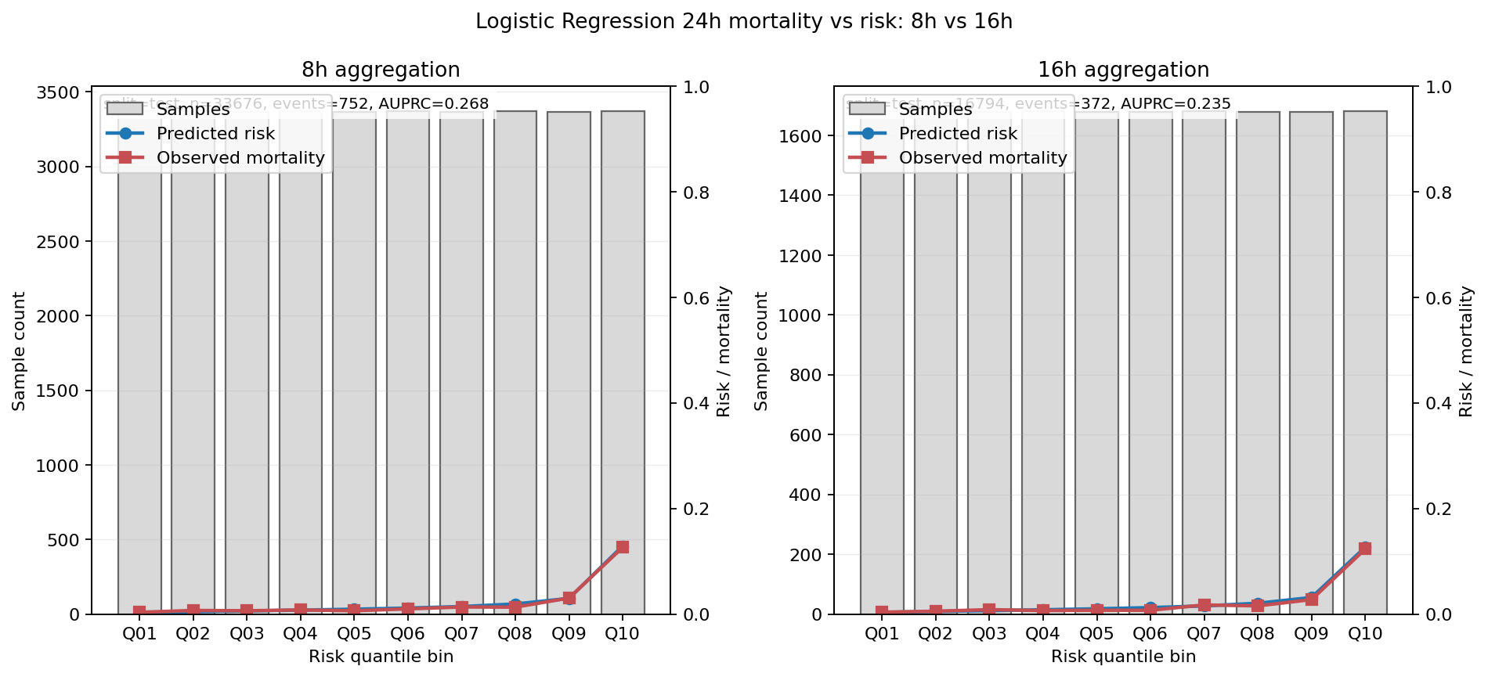
Appendix A7 — Temporal Aggregation Preview: 8h Vs 16h
Appendix
Provisional backup slide, not a formal sensitivity conclusion
Model | AUROC | AUPRC | Slope | Brier
Logistic | 0.819 -> 0.816 | 0.268 -> 0.235 | 0.974 -> 0.974 | 0.019 -> 0.019
XGBoost | 0.848 -> 0.846 | 0.318 -> 0.291 | 1.162 -> 1.175 | 0.135 -> 0.136
Preview note
Maximum absolute AUROC delta across comparable holdout pairs: 0.018.
Maximum absolute AUPRC delta: 0.066.
The preview does not choose an optimal aggregation and should not refreeze the design alone.
Figure: logistic 24h mortality-vs-risk structure under 8h versus 16h aggregation
Interpretation: The early temporal preview shows movement without obvious collapse, which is encouraging but still too narrow to close the temporal-sensitivity question.
Source: logistic_regression_24h_mortality_vs_risk_8h_vs_16h.png; aggregation_comparison_metrics.csv; preview_note.md
A7

