Slide 1
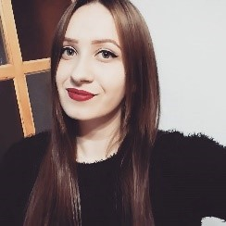

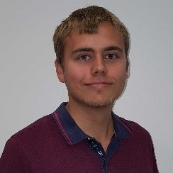
Project FynBus
Team Fire-nado
 | Roxana Ion |  | Hedviga Arta Geriņa
 | Jonas Laursen |  | Matthew Peterson

