Slide 1
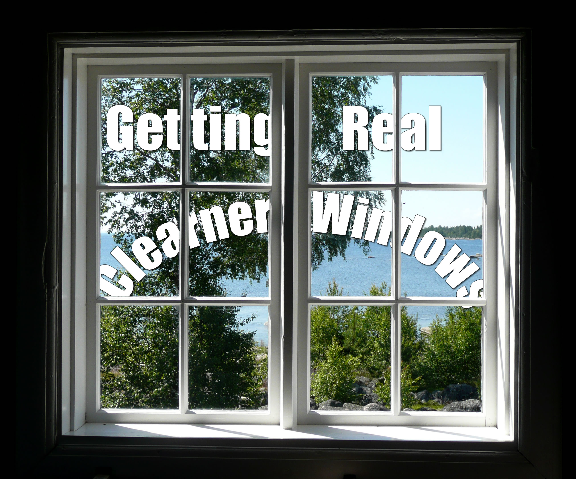
Getting Real
Mission: Cleaner Windows

Slide 2

Our Company
CR Vinduespolering & Rengøring
Founded 1998 – took off in '09
28 Employees (inc. Office Staff)
24h service across Syddanmark
Notes:
CR Vinduespolering & Rengørning
CR Window- & Cleaning
Founded in 1998 – one guy cleaning windows across Fyn, really took of in 2009 when Ole (our contact) came onboard and they bought an existing customer clientel
Employ 28 people, including the 3 office staff, and run a 24h service(prefer day work)

Slide 3
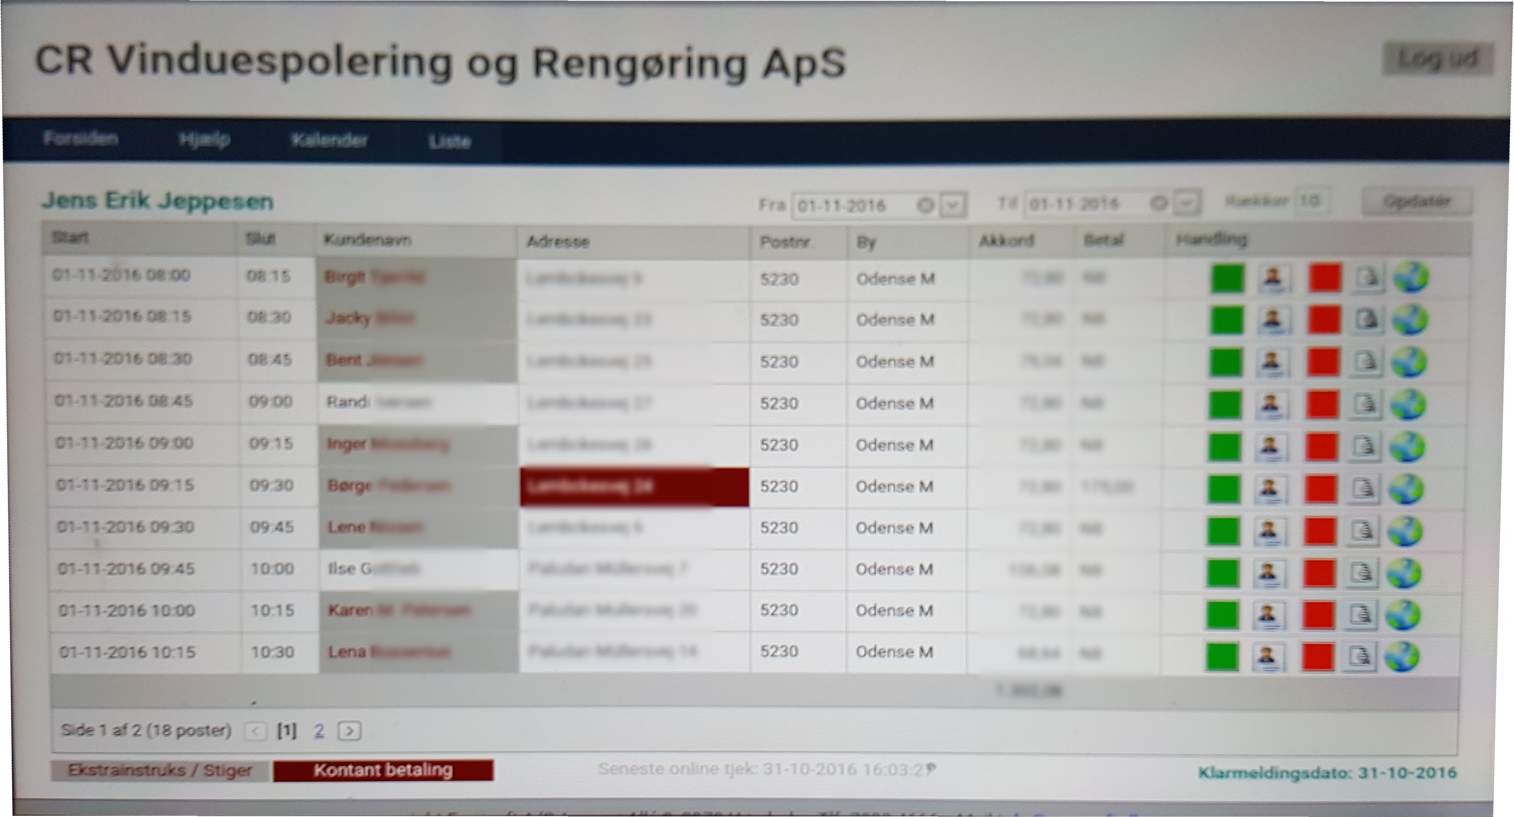
What we are doing for them
Reworking Existing System
Customer and Schedule Management
Notes:
Existing system
Server runs off computer in office
Web interface – badly scaled to tablets

Slide 4
Class Diagram, SSD, SD
Agile
Meeting with business owner
Business Model and business analysis
Domain Model, Object Model
User Stories, Roles and Scenario
Feedback
Implement the code

Slide 5
Prioritized requirements
F U R P S +
Usability Human factor
Leveling requirements
Notes:
- Model for classifying software quality attributes
- Human factor; the system should be built to work perfectly for low knowledge users and be easily understandable for anyone.
We tried to leveling the requirements in order to develop the system in a equally way in all requirements needed.
Legal: Hosted under MIT license

Slide 6
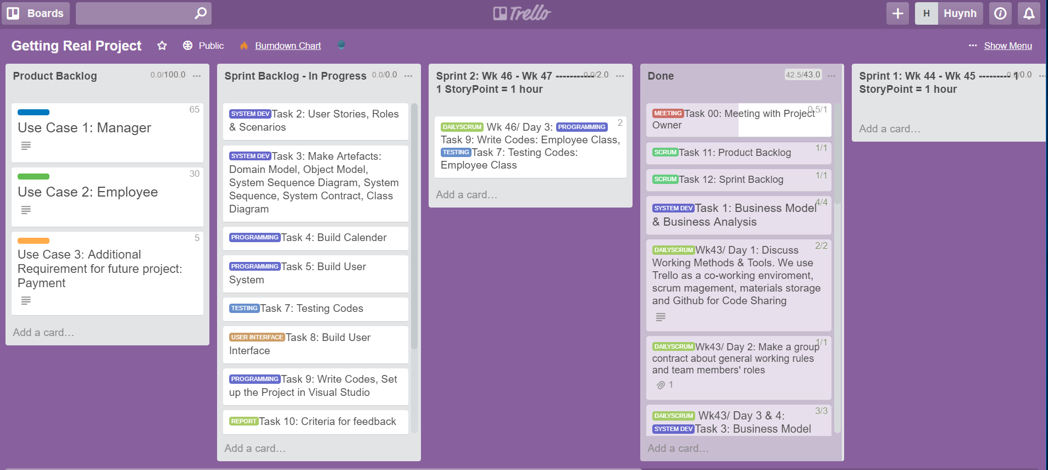

Slide 7
Thank You!

