Slide 1
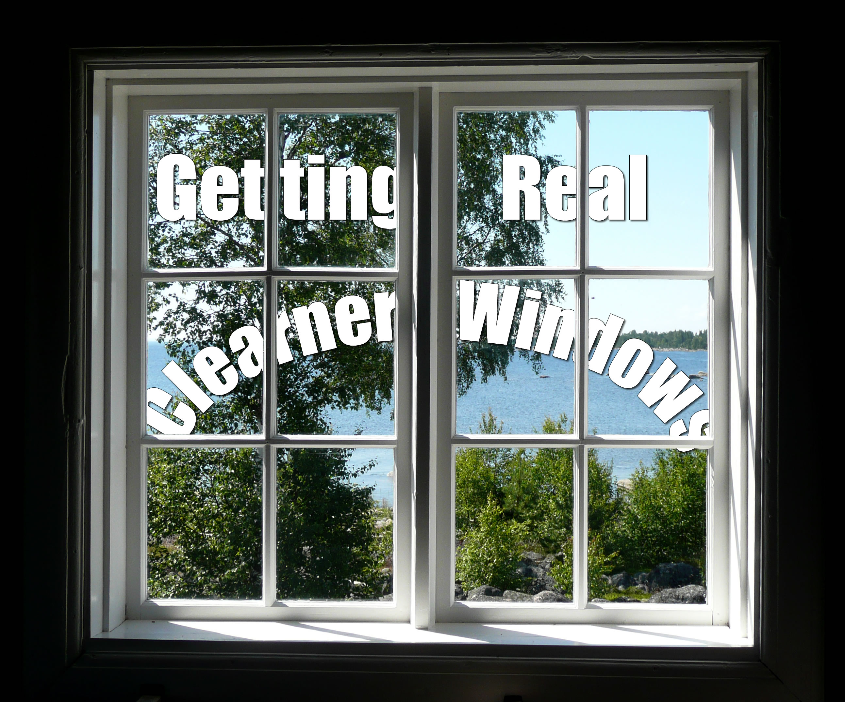
Getting Real
Mission: Cleaner Windows

Slide 2

Our Company
CR Vinduespolering & Rengøring
Founded 1998 – took off in '09
28 Employees (inc. Office Staff)
24h service across Syddanmark
Notes:
CR Vinduespolering & Rengørning
CR Window- & Cleaning
Founded in 1998 – one guy cleaning windows across Fyn, really took of in 2009 when Ole (our contact) came onboard and they bought an existing customer clientel
Employ 28 people, including the 3 office staff, and run a 24h service(prefer day work)

Slide 3
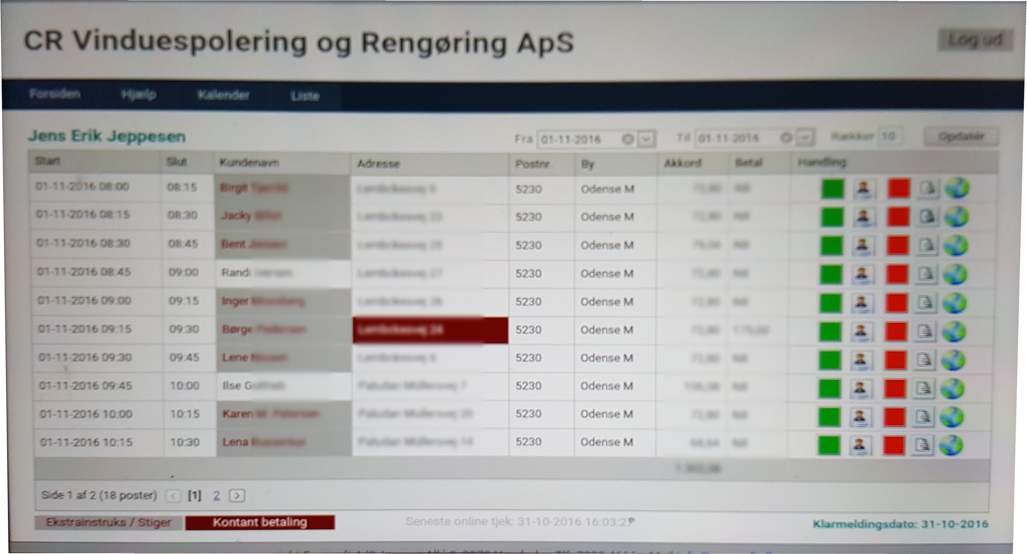
What we are doing for them
Reworking Existing System
Customer and Schedule Management
Notes:
Existing system
Server runs off computer in office
Web interface – badly scaled to tablets

Slide 4
Class Diagram, SSD, SD
Agile
Meeting with business owner
Business Model and business analysis
Domain Model, Object Model
User Stories, Roles and Scenario
Feedback
Implement the code

Slide 5
Prioritized requirements
F U R P S +
Usability Human factor
Leveling requirements
Notes:
- Model for classifying software quality attributes
- Human factor; the system should be built to work perfectly for low knowledge users and be easily understandable for anyone.
- We tried to leveling the requirements in order to develop the system in a equally way in all requirements needed.

Slide 6
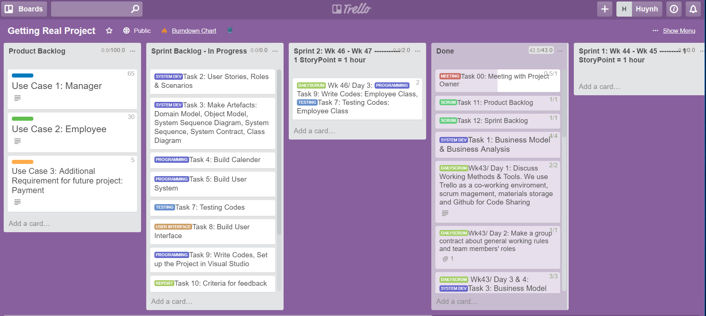

Slide 7
Thank You!
Notes:
Existing system
Web interface – badly scaled to tablets

