Slide 1
Use 1DCNN in Keras to Predict Sentiment from Movie Reviews
Date : Mar 25, 2021, Joan Zhang

Slide 2
Agenda
Objective
Data source
Methodology
Implementation with Keras
Conclusion

Slide 3
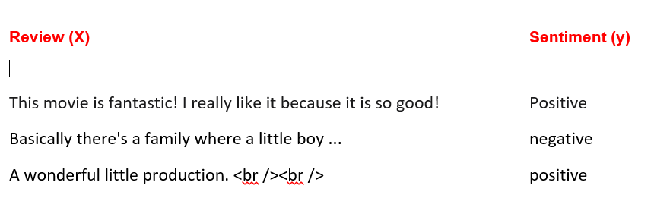
Objective
Sentiment Classification
Notes:
Our objective is to look at a piece of text and tell if someone likes or dislikes the thing they’re talking about. This is called sentiment classification. For example,
The input X is a piece of text and the output Y is the sentiment which we want to predict, such as positive or negative a movie review.

Slide 4
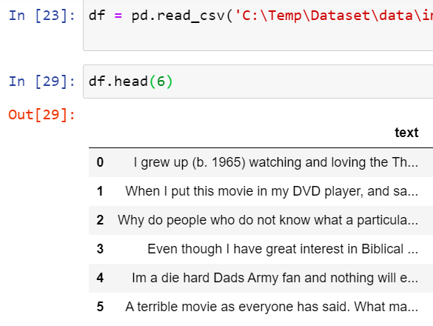
Dataset
Website : https://ai.stanford.edu/~amaas/data/sentiment/)

Slide 5
Methodology
Word Embedding
CNN(Convolutional Neural Network)

Slide 6
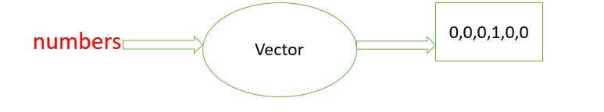
Word Embedding
A technique where words are encoded as real-valued vectors in a high-dimensional space
Words that have the same meaning are placed close together
eg: sentence -> ” Word embedding is word converted into numbers ”

Slide 7
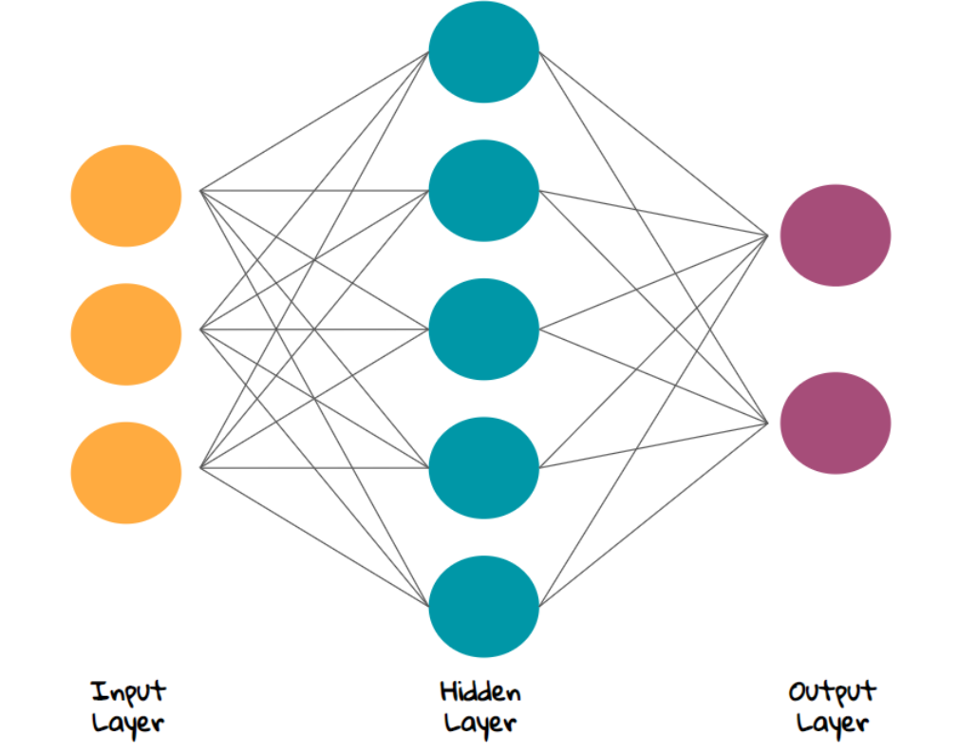
CNN(Convolutional Neural Network)
Neural Network Architecture

Slide 8
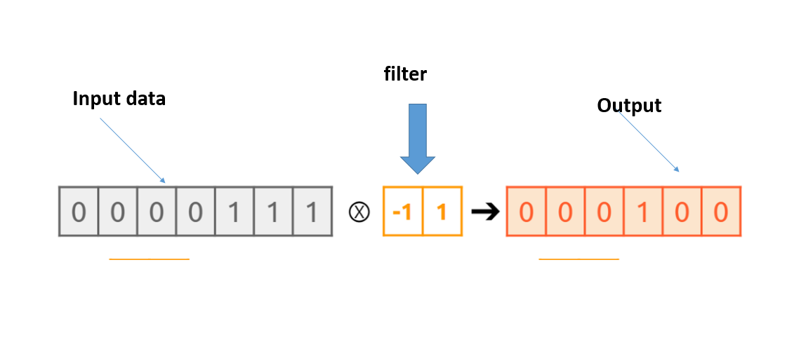
CNN(Convolutional Neural Network)
Patten – kernel, filter or feature detector
Detect the wanted features from the data and extract the significant features for prediction
Padding, stride, pooling and flattening

Slide 9
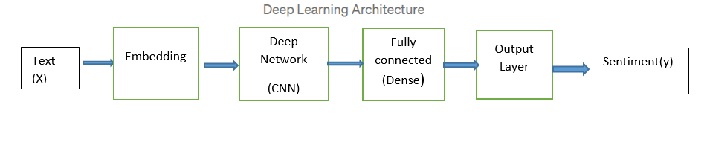
CNN(Convolutional Neural Network)
Model Architecture

Slide 10
Implementation with Keras
A deep learning API
Uses Theano or Tensorflow for its backend
Runs on both CPU and GPU
Supports almost all the models of a neural network – fully connected, convolutional, pooling, recurrent, embedding, etc
Model in Keras is sequential

Slide 11
Conclusion
We see the model achieves the accuracy of above 88%
We can compare this model with other classification models like logistic regression, Naive Bayes and SVM to show contrast
Try CNN to get sentiment of customers on new products/services

