Slide 1


This time will never be different- Justify
This Time is Different: Eight Centuries
of Financial Folly’s Conclusion
Joan Zhang
MScA Capstone Presentation
The Graham School University of Chicago
August 20, 2016

Slide 2
Acknowledgements
University of Chicago
Dr. Yuri Balasanov
Dr. Sema Barlas
Dr. Anil Chaturvedi
Dr. Danny Lian Huan Ng
Graham School Administrative Office Staff
Harvard University
Dr. Carmen Reinhart
Dr. Kenneth Rogoff
International Monetary Fund (IMF)
Dr. Syed Mohammad Ali Abbas

Slide 3
Agenda
Introduction
Methodology
Findings
Conclusion

Slide 4

Introduction
Introduction
Methodology
Findings
Conclusion
Reoccurrence of financial crises
Less cautionary steps towards financial crises
The “this time is different” syndrome

Slide 5
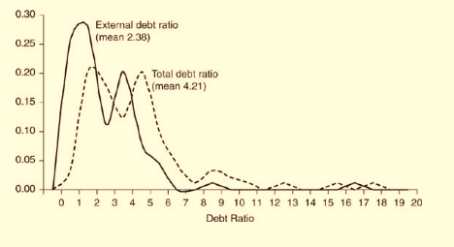
Problem Statement
Introduction
Methodology
Findings
Conclusion
Serial default occurs from time to time around the globe
Domestic debt plays a significant role in default even though external debt is at a very low level
More room to explore?
Notes:
Figure 8.2. Ratios of public debt to revenue during external default: Frequency of occurrence, 1827– 2003 used by authors
RR argue that total debt ratio is greater than external debt ratio by comparing their means
RR use Kolmogorov-Smirnov (KS) test to determine that distributions of external debt ratio and total debt ratio differ significantly

Slide 6
Research Purpose
Introduction
Methodology
Findings
Conclusion
To examine the consistency of serial defaults throughout history
To examine authors’ assertion that domestic debt plays a significant role in default even though external debt is at a very low level
To argue that domestic debt is overlooked

Slide 7
Variables Identified
Introduction
Methodology
Findings
Conclusion
Domestic Debt
External Debt
External Debt Ratio
Total Debt Ratio
Gross National Product (GNP)
Inflation

Slide 8
Research Questions
Introduction
Methodology
Findings
Conclusion
Is serial default a historical pattern?
Does domestic debt play a significant role in default?
What are the correlations among external debt, domestic debt and total debt ?

Slide 9
Methodology
Introduction
Methodology
Findings
Conclusion
Analysis of Debt Structure at Default
Analysis of government strategy after default

Slide 10
Analysis of Debt Structure at Default
Introduction
Methodology
Findings
Conclusion
Data source and Data analysis
Modeling framework
Debt Structure at
default

Slide 11
Data Source and Data Analysis
Introduction
Methodology
Findings
Conclusion

Slide 12
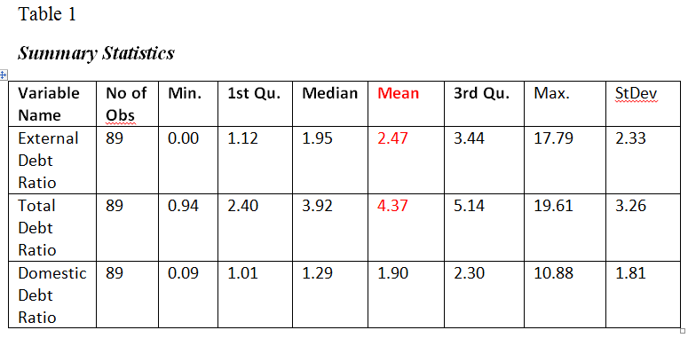
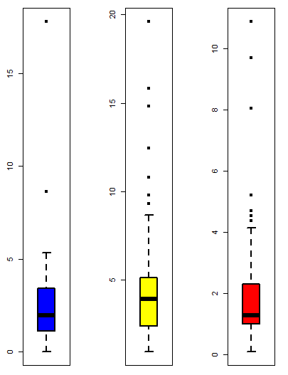
Summary Statistics and Box Plots
Introduction
Methodology
Findings
Conclusion
Figure 1. Box plot for external, total, and domestic debt ratio from left to right
Notes:
Box plot from left to right : external debt ratio, total debt ratio and domestic debt ratio

Slide 13
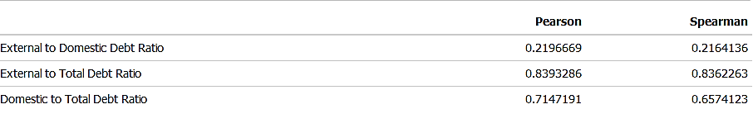
Pearson Correlation and Spearman Correlation
Introduction
Methodology
Findings
Conclusion
Table 2
Notes:
Pearson's correlation assesses linear relationships, Spearman's correlation assesses monotonic relationships (whether linear or not).

Slide 14
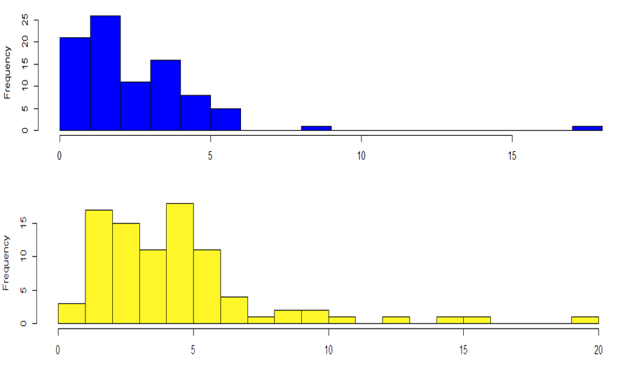
Histograms
Introduction
Methodology
Findings
Conclusion
Figure 2. External debt ratio distribution and total debt ratios distribution
Figure 2. External debt ratio distribution and total debt ratios distribution

Slide 15
Analysis of Debt Structure at Default
Introduction
Methodology
Findings
Conclusion
Data source and Data analysis
Modeling Framework
Debt Structure at
default

Slide 16
Modeling Framework
Introduction
Methodology
Findings
Conclusion
Notes:
Unsupervised learning was used to cluster on 89 observations of defaulting countries.

Slide 17
Data Preparation
Introduction
Methodology
Findings
Conclusion
Outliers in dataset
Log transformation

Slide 18
Assess the Clustering Tendency
Introduction
Methodology
Findings
Conclusion
Hopkins Statistic
Null hypothesis: the dataset is uniformly distributed (i.e., no meaningful clusters, H is about 0.5)
Alternative hypothesis: the dataset is not uniformly distributed (i.e., contains meaningful clusters)
Notes:
Hopkins statistic Hopkins statistic is used to assess the clustering tendency of a dataset by measuring the probability that a given dataset is generated by a uniform data distribution.

Slide 19
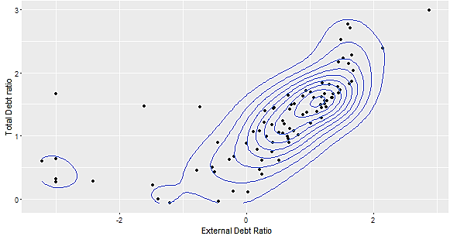
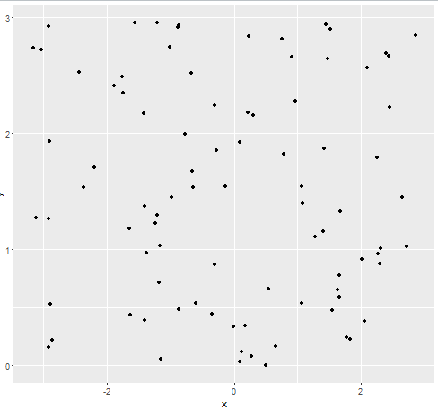
Data Visualization
Introduction
Methodology
Findings
Conclusion
Hopkins test return H value = 0.23
Random uniformly distributed data
Figure 9. Visualization of external debt ratio and total debt ratio on two dimensions
Figure 10. Random Uniformly Distributed Non-Clustering Dataset
Notes:
Hopkins statistic was used to identify possible patterns in the illustration of two-dimensional plots

Slide 20
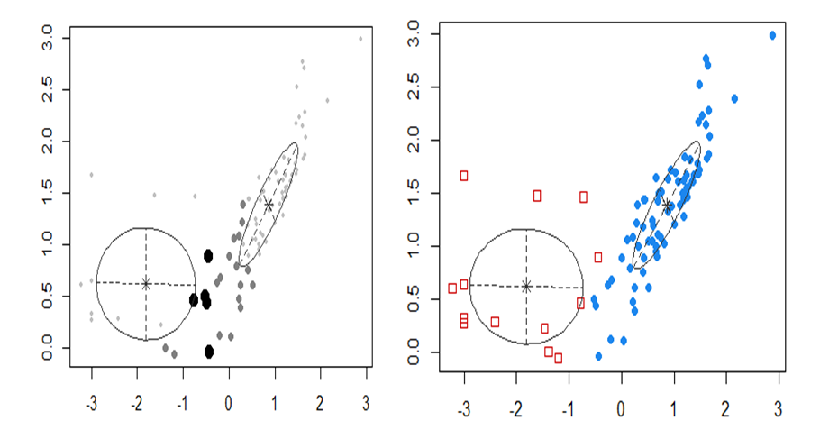
Mclust
Introduction
Methodology
Findings
Conclusion
Large filled dots are in 95% Quan of that distribution. smaller are in the 75–95% by (Fraley & Raftery)
Correspond to the co-variance of the components
Figure 11. Plots of uncertainty and classification

Slide 21
Introduction
Methodology
Findings
Conclusion
Analysis of Clustering Output
Distribution from cluster 1 group
Distribution from cluster 2 group

Slide 22
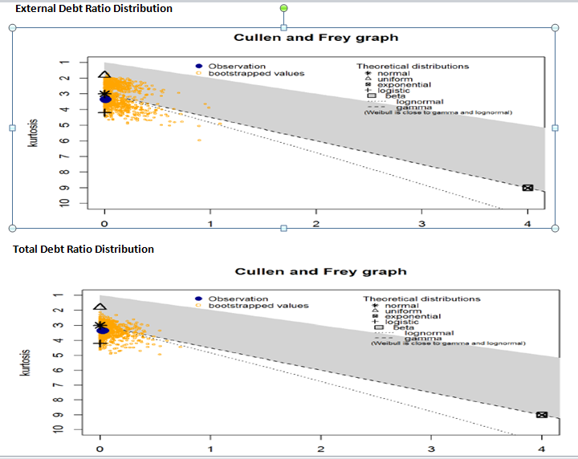
Empirical Distribution of Cluster 1
Introduction
Methodology
Findings
Conclusion

Slide 23
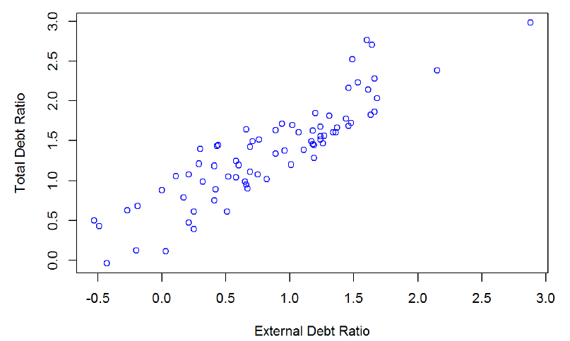
Scatter Plot of Cluster 1
Introduction
Methodology
Findings
Conclusion
Figure 15. Scatter plot of external debt ratio and total debt ratio from cluster 1

Slide 24
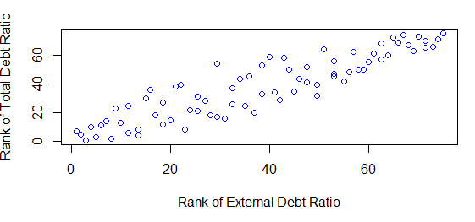
Empirical Copula of Cluster 1
Introduction
Methodology
Findings
Conclusion
Gumbel Copula (upper tail dependency )
Figure 16. Plot of empirical copula from cluster 1

Slide 25
Introduction
Methodology
Findings
Conclusion
Analysis of Clustering Output
Distribution from cluster 1 group
Distribution from cluster 2 group

Slide 26
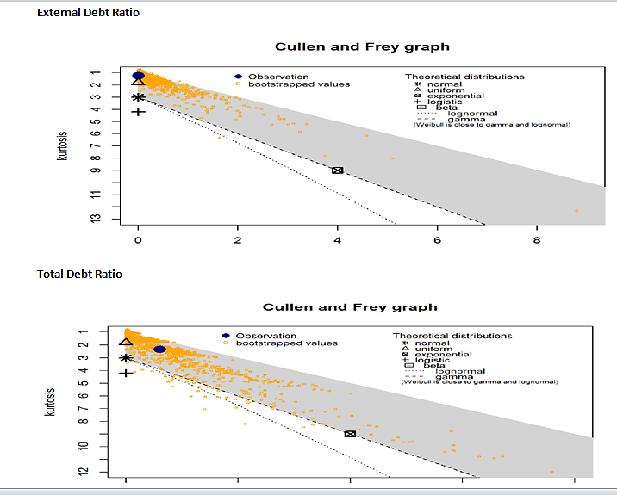
Empirical Distribution of Cluster 2
Introduction
Methodology
Findings
Conclusion
Figure 18. Empirical distribution check from cluster 2 group

Slide 27
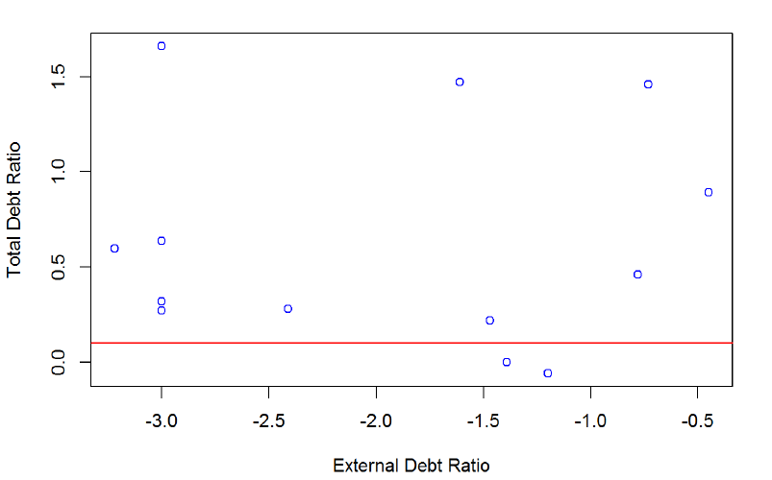
Scatter Plot of Cluster 2
Introduction
Methodology
Findings
Conclusion
T. debt ratio is high E. debt ratio is small /Figure 4
Figure 19. Scatter plot of external debt ratio and total debt ratio from cluster 2
Notes:
x-axis is logged data on external debt ratio. y is logged data on total debt ratio. negative value is due to log transformation on very small of external debt ratio

Slide 28
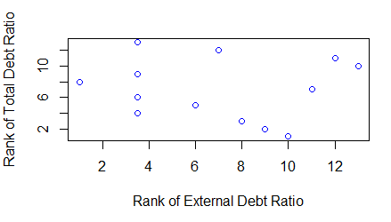
Empirical Copula of Cluster 2 (A)
Introduction
Methodology
Findings
Conclusion
Figure 20. Plot of empirical copula from cluster 2

Slide 29
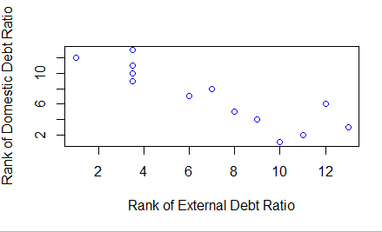
Empirical Copula of Cluster 2 (B)
Introduction
Methodology
Findings
Conclusion
Countermonotonic
Figure 21.Plot of empirical copula between external debt ratio and domestic debt ratio from cluster 2
Notes:
The countermonotonic dependency bettern external debt ratio and domestic debt ratio supports both total debt ratio and domestic debt ratio are high

Slide 30
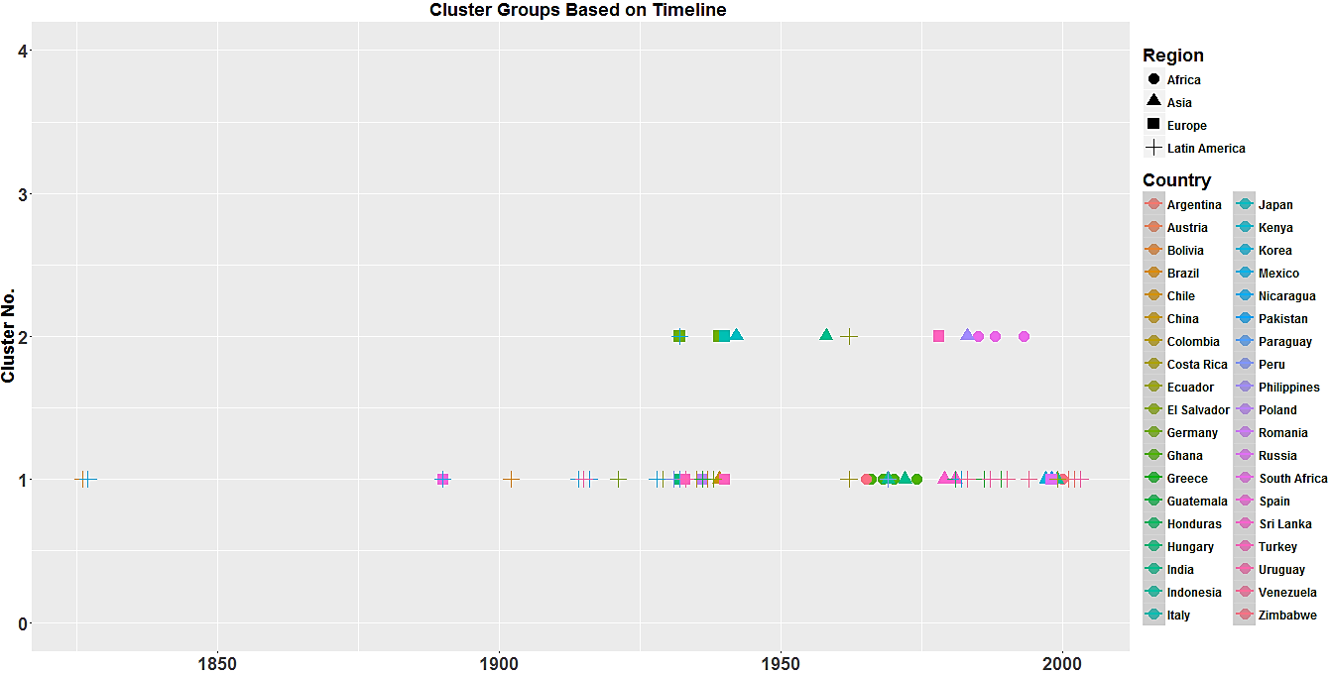
Clustering Output Based upon Timeline
Introduction
Methodology
Findings
Conclusion
Figure 22. Plot of default countries based on timeline

Slide 31
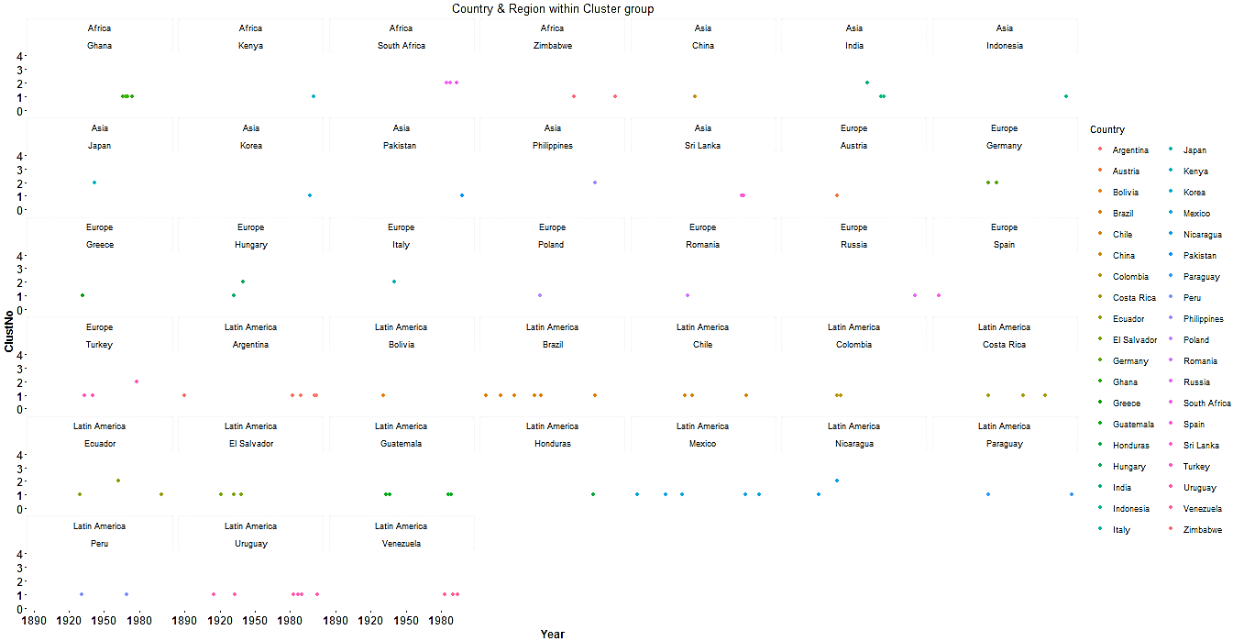
Frequency of Default Countries
Introduction
Methodology
Findings
Conclusion
Costa Rica : 3times
Figure 23. Plot of the number of default countries within each region

Slide 32
Methodology
Introduction
Methodology
Findings
Conclusion
Analysis of Debt Structure at Default
Analysis of government strategy after default

Slide 33
Analysis of Government Strategy After Default
Introduction
Methodology
Findings
Conclusion
Data source and Data analysis
Modeling frame work
Debt Structure after
default

Slide 34
Data Source and Data Analysis
Introduction
Methodology
Findings
Conclusion
Ten-year domestic debt data after government external default was selected
Default year is at time t. where f is the rate of inflation during year t

Slide 35
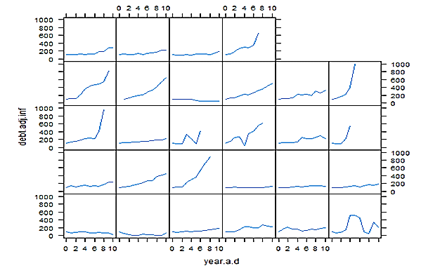
Modeling Framework
Introduction
Methodology
Findings
Conclusion
Function xyplot() of R software
Figure 24. Adjustment of domestic debt over 10 year’s period

Slide 36
Findings
Introduction
Methodology
Findings
Conclusion
Results of Descriptive Analyses
Modeling Results

Slide 37
Results of Descriptive Analyses
Introduction
Methodology
Findings
Conclusion
Domestic debt constitutes a large portion of total debt
Total Debt Ratio
Domestic Debt Ratio
External Debt Ratio
Rho =0.9
Cluster 1
Rho =0.03
Cluster 2
Comonotonic dependency
Rho=0.47 between T.debt ratio and D. debt ratio

Slide 38
Modeling Results
Introduction
Methodology
Findings
Conclusion
Examine authors’ point of view that domestic debt plays a significant role
Examine the consistency of the serial defaults throughout history
Domestic debt is overlooked

Slide 39
Examine Authors’ Point of View: Domestic Debt Plays a Significant Role
Introduction
Methodology
Findings
Conclusion
Region | Country | Default Year | External.Debt. Ratio | Total. Debt. Ratio | Cluster.Num
Africa | South Africa | 1985 | 0.09 | 1.32 | 2
 | South Africa | 1988 | 0.05 | 1.38 | 2
 | South Africa | 1993 | 0.05 | 1.9 | 2
Asia | India | 1958 | 0.2 | 4.35 | 2
 | Japan | 1942 | 0.04 | 1.83 | 2
 | Philippines | 1983 | 0.23 | 1.25 | 2
Europe | Germany | 1939 | 0.05 | 1.31 | 2
 | Hungary | 1940 | 0.3 | 0.94 | 2
 | Italy | 1940 | 0.05 | 5.25 | 2
 | Turkey | 1978 | 0.25 | 1 | 2
Notes:
(1) Default countries have very low level of external debt ratio whereas total debt ratio is high at 100 % or above 100%
(2) domestic debt plays a significant role in countries’ default, but only for the countries in cluster 2.
(2) developing countries in recent time periods from the later 1980s to the early 1990s,

Slide 40
Examine the Consistency of the Serial Defaults throughout History
Introduction
Methodology
Findings
Conclusion
Region | Country | Year | External.Debt.Ratio | Total.Debt.Ratio | Cluster.Num
Africa | Ghana | 1966 | 2.13 | 4.51 | 1
 | Ghana | 1968 | 1.99 | 4.13 | 1
 | Ghana | 1970 | 1.5 | 3.25 | 1
 | Ghana | 1974 | 1.12 | 2.9 | 1
 | Kenya | 2000 | 1.99 | 3.03 | 1
 | Zimbabwe | 1965 | 1 | 2.4 | 1
 | Zimbabwe | 2000 | 1.35 | 4.03 | 1
Latin America | Argentina | 1890 | 4.42 | 12.46 | 1
 | Argentina | 1982 | 1.79 | 3.44 | 1
 | Argentina | 1989 | 17.79 | 19.61 | 1
 | Argentina | 2001 | 1.68 | 2.86 | 1
 | Argentina | 2002 | 5.34 | 7.64 | 1
 | Bolivia | 1931 | 8.62 | 10.79 | 1
 | Brazil | 1826 | 4.4 | 5.56 | 1
 | Brazil | 1898 | 3.7 | 6.1 | 1
 | Brazil | 1902 | 3.45 | 5.3 | 1
 | Brazil | 1914 | 4.3 | 8.68 | 1
 | Brazil | 1931 | 4.99 | 8.51 | 1
 | Brazil | 1937 | 2.56 | 5.51 | 1
 | Brazil | 1983 | 0.83 | 1.98 | 1
 | Chile | 1931 | 3.51 | 4.29 | 1
Notes:
Conversional wisdom
Argentina defaulted five times (1982-2001). Brazil defaulted seven times (1826-1983)

Slide 41
Three Spike Episodes of Default in Countries Across Each Region
Introduction
Methodology
Findings
Conclusion
Later portion of 1920 – 1940: The majority of default countries are from Europe and Latin America. The Great Depression (early 1930s) plays a dominant role in defaulting countries during this period.
Middle portion of 1960 – 1970: The majority of default countries are from Africa and Asia.
1980 to 2000: The majority of defaulting countries are from Latin America and Asia in emerging markets.
Timeline (1827-2003)
Cluster 2
Notes:
Three spike episodes of default in countries across each region over long time period.

Slide 42
Domestic Debt is Overlooked
Introduction
Methodology
Findings
Conclusion
Domestic Debt
External debt
Inflation
Notes:
Overlooked domestic debt explains the link between external debt and inflation.

Slide 43

Conclusions
Introduction
Methodology
Findings
Conclusion
Is “this time really different”?
“The current boom, unlike the many booms that preceded catastrophic collapses in the past (even in our country) is built on sound fundamentals…. ”
Reinhart & Rogoff

Slide 44
Reference
Reinhart, C., and K. Rogoff. 2009a. This Time is Different: Eight Centuries of Financial
Folly. Princeton, NJ: Princeton University Press.
Reinhart, C., and K. Rogoff. 2009b. This Time is Different: Eight Centuries of Financial
Folly. Princeton, NJ: Princeton University Press
Reinhart, Carmen M.; Rogoff, Kenneth (2009-09-11). This Time Is Different: Eight Centuries of Financial Folly (Kindle Location 370). Princeton University Press. Kindle Edition.
Reinhart, Carmen M.; Rogoff, Kenneth (2009-09-11). This Time Is Different: Eight Centuries of Financial Folly (Kindle Locations 903-904). Princeton University Press. Kindle Edition.
Reinhart, Carmen M.; Rogoff, Kenneth. 2009c. This Time Is Different: Eight Centuries of Financial Folly (Kindle Locations 2218-2219). Princeton University Press. Kindle Edition.
Fraley, Chris, and Adrian E. Raftery. 2002 "Model-Based Clustering, Discriminant Analysis, and Density Estimation." Journal of the American Statistical Association 97.458 (2002): 611-31. Model-based Clustering, Discriminant Analysis, and Density Estimation. ABI/INFORM Global.
Reinhart, Carmen M.; Rogoff, Kenneth S.2009d. This Time Is Different: Eight Centuries of Financial Folly (Kindle Locations 2235-2237). Princeton University Press. Kindle Edition.
Wikipedia. Wikimedia Foundation, n.d. Web. 07 Feb. 2016. <https://en.wikipedia.org/wiki/Internal_debt>.
"Trade Definition | Investopedia." Investopedia. N.p., 24 Nov. 2003. Web. 07 Feb. 2016. <http://www.investopedia.com/terms/t/trade.asp>.
"Gross National Product (GNP) Definition | Investopedia." Investopedia. N.p., 20 Nov. 2003. Web. 07 Feb. 2016. <http://www.investopedia.com/terms/g/gnp.asp>.
"Exchange Rate Definition | Investopedia." Investopedia. N.p., 19 Nov. 2003. Web. 07 Feb. 2016. <http://www.investopedia.com/terms/e/exchangerate.asp>.
Wikipedia. Wikimedia Foundation, n.d. Web. 07 Feb. 2016. <https://en.wikipedia.org/wiki/Interest_rate>.
"Commodity Prices." What Is Commodity Prices? Definition and Meaning. N.p., n.d. Web. 07 Feb. 2016. <http://www.investorwords.com/8552/commodity_prices.html>.
James, G., Witten, D., Hastie, T., & Tibshirani, R. (n.d.). An introduction to statistical learning: With applications in R.
Liang Wang, Xin Geng, James Bezdek, Christopher Leckie, Kotagiri Ramamohanarao, "Enhanced Visual Analysis for Cluster Tendency Assessment and Data Partitioning", IEEE Transactions on Knowledge & Data Engineering, vol.22, no. 10, pp. 1401-1414, October 2010, doi:10.1109/TKDE.2009.192
"the Deficit of the Government." The Deficit of the Government. N.p., n.d. Web. 11 June 2016.
Reinhart, Carmen, "Debt Intolerance." Debt Intolerance (2004): n. pag. Web

Slide 45
Appendix
Appendix B
Appendix A
Copula Section
fitCopula(n.obj, pobs(z))
fitCopula() estimation based on 'maximum pseudo-likelihood'
and a sample of size 20.
Estimate Std. Error z value Pr(>|z|)
rho.1 -0.2866 0.3057 -0.938 0.348
The maximized loglikelihood is 0.4761
Optimization converged
Number of loglikelihood evaluations:
function gradient
29 6
Gumbel copula
library(copula)
obj = gumbelCopula(param=5,dim=2)
g.copula = fitCopula(obj, pobs(w))
summary(g.copula)
summary(g.copula)
$method
[1] "maximum pseudo-likelihood"
$loglik
[1] 48.62274
$convergence
[1] 0
$coefficients
Estimate Std. Error z value Pr(>|z|)
param 3.016087 0.5430329 5.554151 2.78964e-08

Slide 46
Appendix (Cont.)
Appendix C
Appendix D
Hopkins test
set.seed(123)
hopkins(f.t.df, n = nrow(f.t.df)-1)
$H
[1] 0.2270414
#Check on external Debt ratio of cluster 1
descdist(F.Debt.Ratio[1:75], discrete

Slide 47
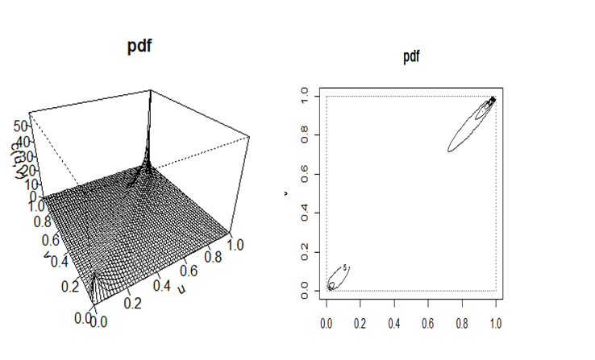
Appendix E (Cont.)
Gumbel Copula (upper tail dependency )

Slide 48
Appendix (Cont.)
Appendix F
Appendix G
KS test on cluster 2 group
Uniform test
D = 0.78808, p‐value = 1.942e‐07
D = 0.47, p‐value = 0.003727
Normality test
## D P.Value
## 0.2434586 0.4240991
## D P.Value
## 0.1861779 0.6923478
Correlation coefficient for cluster1
cor(x1,y1, method="spearman")
[1] 0.9040228
Correlation coefficient for cluster 2
External debt ratio and total debt ratio
cor(x2,y2)
[1] 0.0330602
cor(x2,y2, method="spearman")
[1] -0.06685885
Domestic debt ratio and total
cor(z2, y2)
[1] 0.4664926

Slide 49
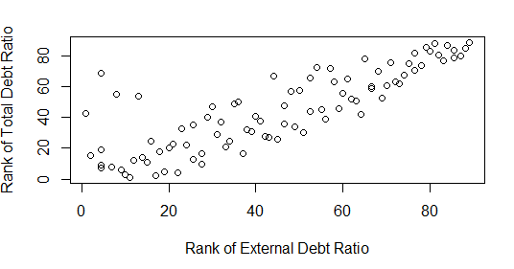
Empirical Copula Analysis
Introduction
Methodology
Findings
Conclusion
Two patterns emerge from the graph: Upward positive relation and outliers
Figure 3. Empirical Copula between external debt ratio and total debt ratio
Notes:
Copulas are used to describe the dependence between random variables.

Slide 50
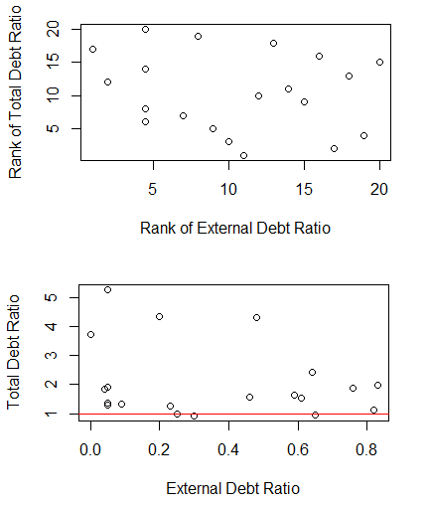
External Debt Ratio is Less Than 1
Introduction
Methodology
Findings
Conclusion
Normal copula fit Rho= -0.29
T.debt. ratio is 100 % +
E.debt ratio is close to 0 or below 100%.
Figure 4. Scatter plot of external debt ratio ( < 1 ) and total debt ratio

Slide 51
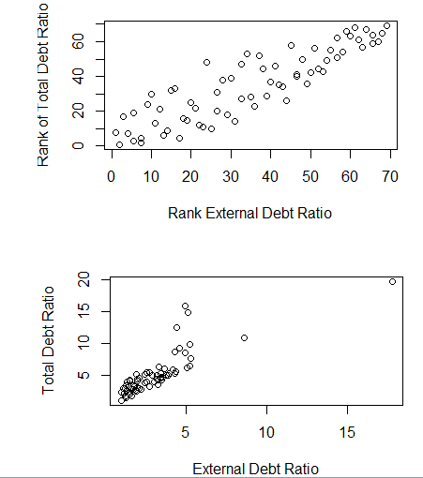
External Debt Ratio is Greater Than or Equal to 1
Introduction
Methodology
Findings
Conclusion
Gumbel Copula
(upper tail dependency)
Rho = 3.02
Figure 5. Scatter plot of external debt ratio (>=1) and total debt ratio
Notes:
What is the estimate parameter from output of Gumbel Coupla fit?

Slide 52
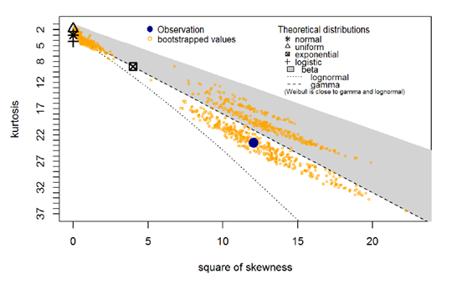
Empirical External Debt Ratio Distribution
Introduction
Methodology
Findings
Conclusion
Figure 6. Cullen and Frey Graph of external debt ratio
Notes:
Using a Cullen & Frey graph compare distributions with bootstrapping 1,000 times

Slide 53
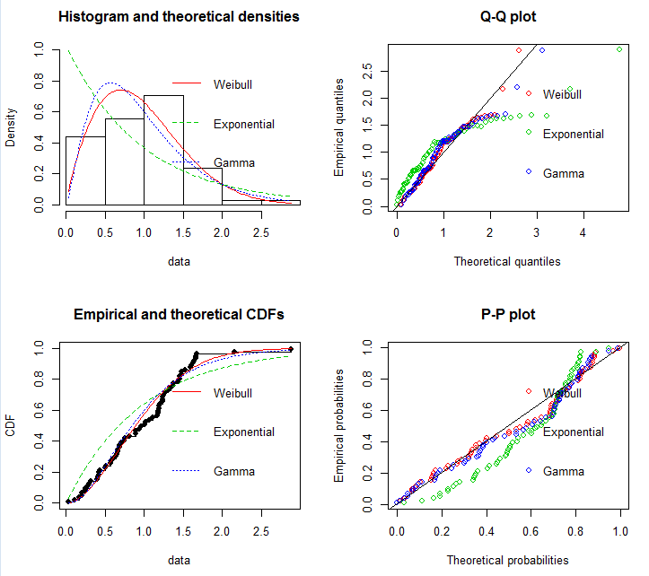
Goodness-of-Fit Plots
Introduction
Methodology
Findings
Conclusion
Figure 7. Goodness-of-fit plots to external debt ratio via functions denscomp, qqcomp, cdfcomp and ppcomp
Notes:
A graphical comparison of multiple fitted distributions . None fits well. Only Weibull and Gamma seem to be better fit.

Slide 54
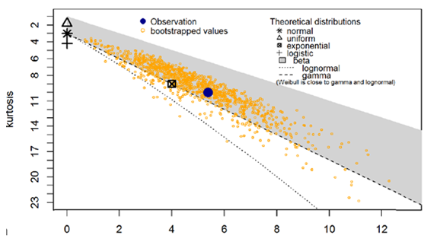
Empirical Total Debt Ratio Distribution
Introduction
Methodology
Findings
Conclusion
Figure 8. Cullen and Frey graph of total debt ratio
Notes:
Total debt ratio follows a gamma distribution

Slide 55
Mclust
Introduction
Methodology
Findings
Conclusion
Mclust package from R software was specifically used
A Gaussian model represents each cluster
Clusters are ellipsoidal, centered at the means µk
The co-variances Σk determine their other geometric features
Each co-variance matrix is parameterized by eigenvalue decomposition in this form
∑_{k}= λ_{k}D_{k}A_{k}D^{T}_{k ,}

Slide 56
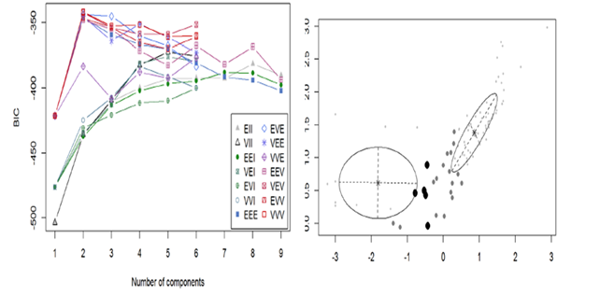
Model and Clustering (A)
Introduction
Methodology
Findings
Conclusion
E for “equal, (volume)
V for “variable" (shape)
I for “coordinate axes”(orientation)
Large filled dots are in 95% Quan of that distribution. smaller are in the 75–95% by (Fraley & Raftery)
Figure 11. Plots of BIC and classification uncertainty
Notes:
left plot shows BIC . Mclust uses an identifier for each possible parametrization of the co-variance matrix that has three letters.
The first identifier refers to volume, the second to shape, and the third to orientation.
EEE means that the clusters have the same volume, shape, and orientation in p-dimensional space.
Right plot depicts the uncertainty of the classification produced by the best model

Slide 57
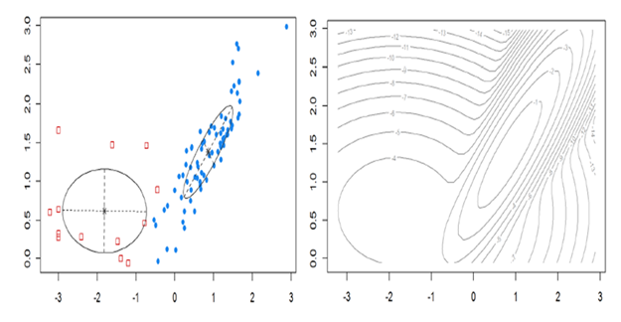
Model and Clustering (B)
Introduction
Methodology
Findings
Conclusion
Correspond to the co-variance of the components
Figure 12. Plots of classification and log density
Notes:
Correlation is low, pic looks more round. If is high, looks more . Right plot is a logarithmic transformation used for the density plot as a contour surface .

Slide 58
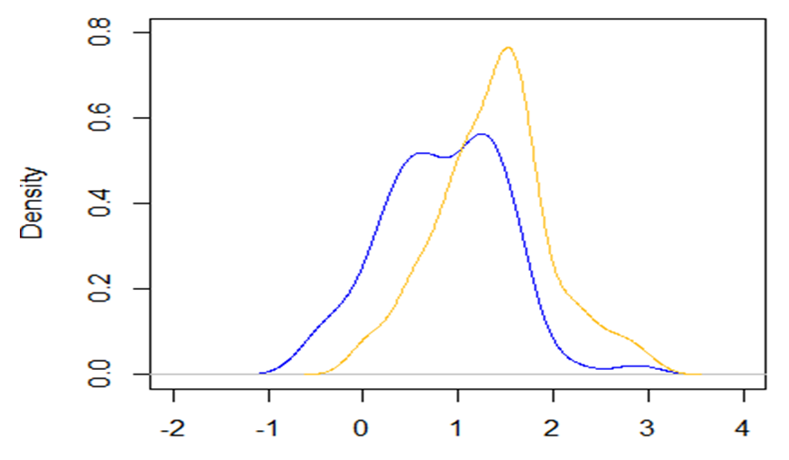
Density Plot of Cluster 1
Introduction
Methodology
Findings
Conclusion
Figure 13. Density plot of external debt ratio and total debt ratio from cluster 1

Slide 59
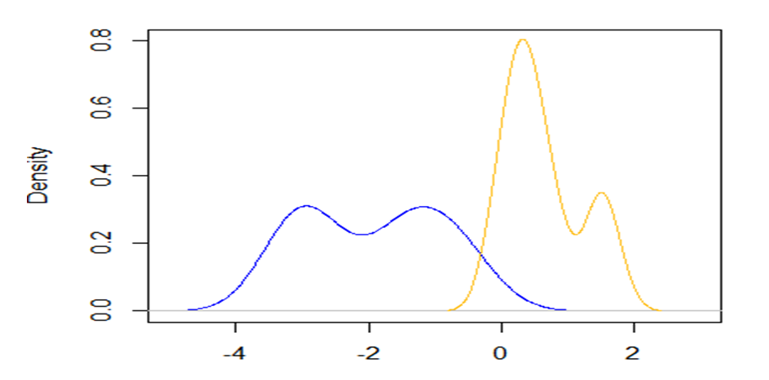
Density Plot of Cluster 2
Introduction
Methodology
Findings
Conclusion
Figure 17. Density plot of external debt ratio and total debt ratio from cluster 2 group

Slide 60


