Slide 1


Application of Machine Learning
Joan Zhang
MScA Capstone Presentation
The Graham School University of Chicago
August 20, 2016, Revised @ Oct, 2017

Slide 2
Agenda
Introduction
Methodology
Findings
Conclusion

Slide 3
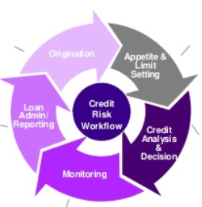


Opportunities of Machine Leaning
Customer Segmentation

Slide 4
What is Machine Learning (ML)?
ML is a semi-automated extraction of knowledge from data
You apply some processes or algorithms to the data using a computer
ML requires you to make any smart decisions

Slide 5

Introduction
Introduction
Methodology
Findings
Conclusion
Reoccurrence of financial crises
Less cautionary steps of towards financial crises
The “this time is different” syndrome
More similarities of financial crises

Slide 6
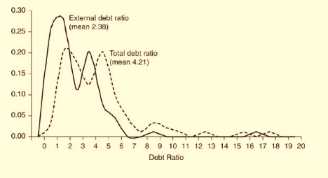
Problem Statement
Introduction
Methodology
Findings
Conclusion
Serial default occurs from time to time around the globe
Domestic debt plays a significant role in default even though external debt is at a very low level
Notes:
Figure 8.2. Ratios of public debt to revenue during external default: Frequency of occurrence, 1827– 2003 used by authors
RR argue that total debt ratio is greater than external debt ratio by comparing their means
RR use Kolmogorov-Smirnov (KS) test to determine that distributions of external debt ratio and total debt ratio differ significantly

Slide 7
Research Purpose
Introduction
Methodology
Findings
Conclusion
To examine the consistency of serial defaults throughout history
To examine authors’ assertion that domestic debt plays a significant role in default even though external debt is at a very low level
To argue that domestic debt is overlooked

Slide 8
Research Questions
Introduction
Methodology
Findings
Conclusion
Is serial default a historical pattern?
Does domestic debt play a significant role in default?
What are the correlations among external debt, domestic debt and total debt ?

Slide 9
Variables Identified
Introduction
Methodology
Findings
Conclusion
Domestic Debt
External Debt
Domestic Debt Ratio
External Debt Ratio
Total Debt Ratio
Inflation
Revenue
Gross National Product (GNP)

Slide 10
Methodology
Introduction
Methodology
Findings
Conclusion

Slide 11

Methodology
Introduction
Methodology
Findings
Conclusion
Known as predict modeling. For example, predict email as spam or non-spam
Extracting structure from data. For example, segment customers to prompt productions
Notes:
If your dataset was the characteristics and purchasing behavior of shoppers at a grocery store, the task might be to segment the shoppers into groups or "clusters" that exhibits similar behaviors so the marketing department of store can target them with different products.

Slide 12
Methodology
Introduction
Methodology
Findings
Conclusion
Analysis of Debt Structure at Default
Analysis of government strategy after default

Slide 13
Analysis of Debt Structure at Default
Introduction
Methodology
Findings
Conclusion
Data source and Data analysis
Modeling framework
Debt Structure at
default

Slide 14
Data Source and Data Analysis
Introduction
Methodology
Findings
Conclusion

Slide 15
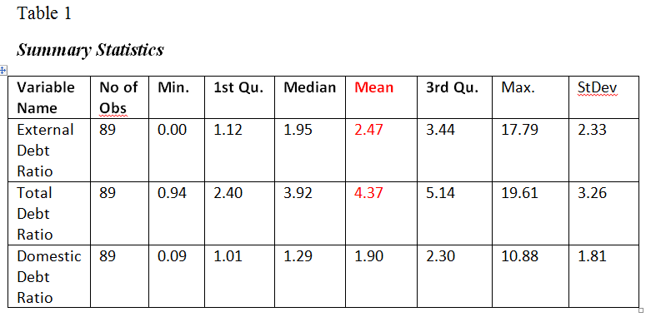
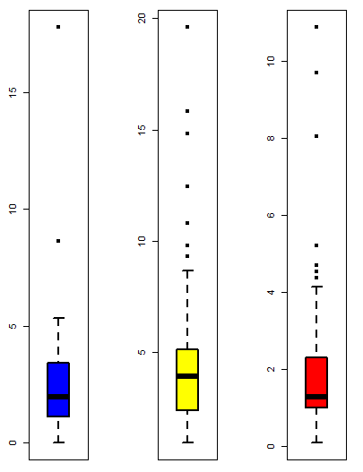
Summary Statistics and Box Plots
Introduction
Methodology
Findings
Conclusion
Figure 1. Box plot for external, total, and domestic debt ratio from left to right
Notes:
Box plot from left to right : external debt ratio, total debt ratio and domestic debt ratio

Slide 16
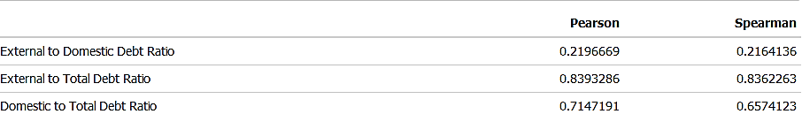
Pearson Correlation and Spearman Correlation
Introduction
Methodology
Findings
Conclusion
Table 2
Notes:
Pearson's correlation assesses linear relationships, Spearman's correlation assesses monotonic relationships (whether linear or not).

Slide 17
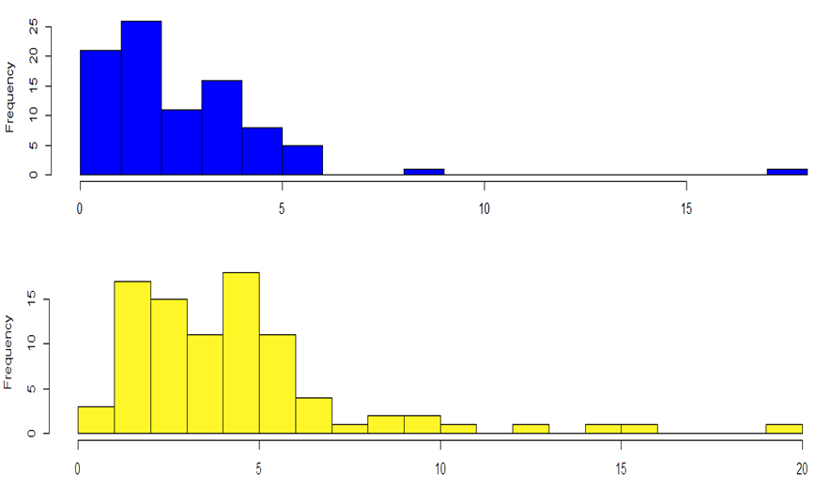
Histograms
Introduction
Methodology
Findings
Conclusion
Figure 2. External debt ratio distribution and total debt ratios distribution
Figure 2. External debt ratio distribution and total debt ratios distribution

Slide 18
Analysis of Debt Structure at Default
Introduction
Methodology
Findings
Conclusion
Data source and Data analysis
Modeling Framework
Debt Structure at
default

Slide 19
Modeling Framework
Introduction
Methodology
Findings
Conclusion
Notes:
Unsupervised learning was used to cluster on 89 observations of defaulting countries.

Slide 20
Data Preparation
Introduction
Methodology
Findings
Conclusion
Outliers in dataset
Log transformation

Slide 21
Assess the Clustering Tendency
Introduction
Methodology
Findings
Conclusion
Hopkins Statistic
Null hypothesis: the dataset is uniformly distributed (i.e., no meaningful clusters, H is about 0.5)
Alternative hypothesis: the dataset is not uniformly distributed (i.e., contains meaningful clusters)
Notes:
Hopkins statistic Hopkins statistic is used to assess the clustering tendency of a dataset by measuring the probability that a given dataset is generated by a uniform data distribution.

Slide 22
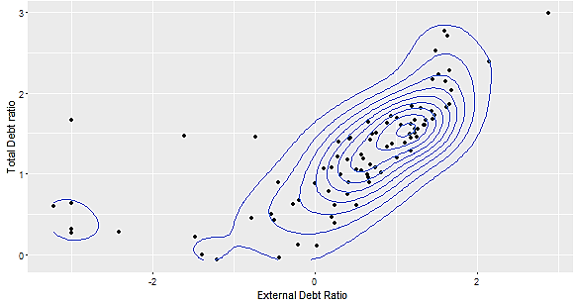
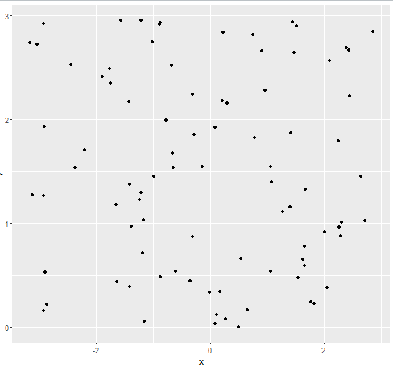
Data Visualization
Introduction
Methodology
Findings
Conclusion
Hopkins test return H value = 0.23
Random uniformly distributed data
Figure 9. Visualization of external debt ratio and total debt ratio on two dimensions
Figure 10. Random Uniformly Distributed Non-Clustering Dataset
Notes:
Hopkins statistic was used to identify possible patterns in the illustration of two-dimensional plots

Slide 23
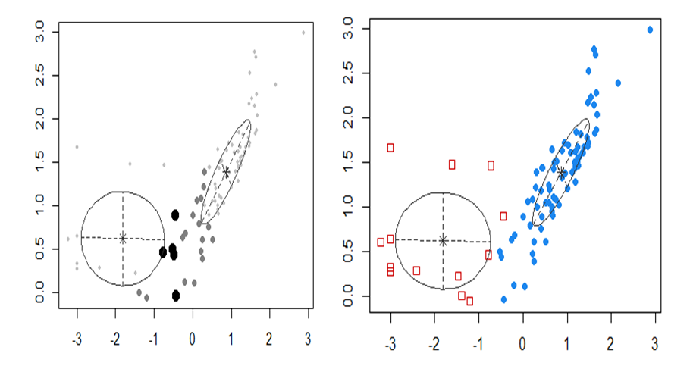
Mclust
Introduction
Methodology
Findings
Conclusion
Large filled dots are in 95% Quan of that distribution. smaller are in the 75–95
Correspond to the co-variance of the components
Figure 11. Plots of uncertainty and classification
Notes:
When fitting models, it is possible to increase the likelihood by adding parameters, but doing so may result in overfitting. Both BIC and AIC attempt to resolve this problem by introducing a penalty term for the number of parameters in the model; the penalty term is larger in BIC than in AIC.

Slide 24
Introduction
Methodology
Findings
Conclusion
Analysis of Clustering Output
Distribution from cluster 1 group
Distribution from cluster 2 group

Slide 25
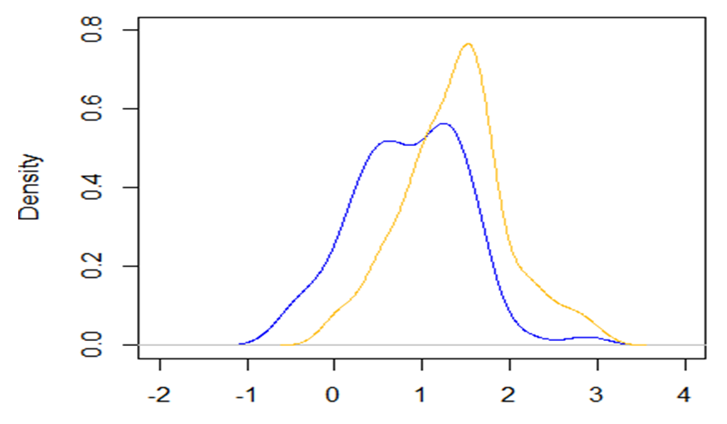
Density Plot of Cluster 1
Introduction
Methodology
Findings
Conclusion
Figure 13. Density plot of external debt ratio and total debt ratio from cluster 1

Slide 26
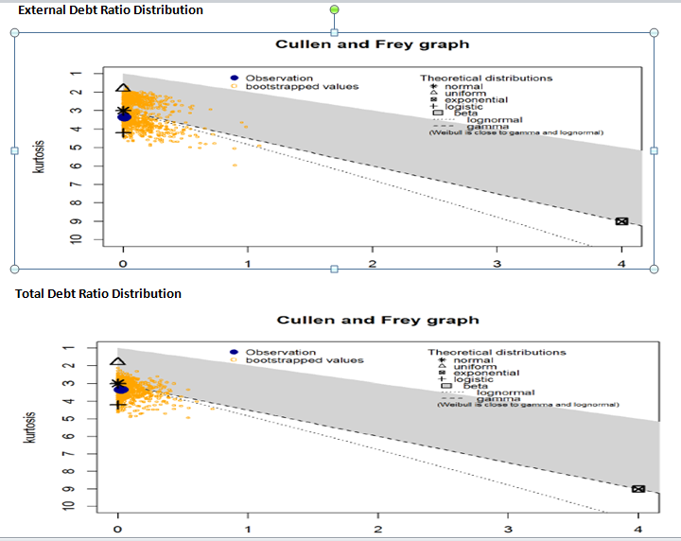
Empirical Distribution of Cluster 1
Introduction
Methodology
Findings
Conclusion
Notes:
To identify distribution, a descdist function was called from fitdistrplus packge. This is outpu called Cullen and Frey graph.

Slide 27
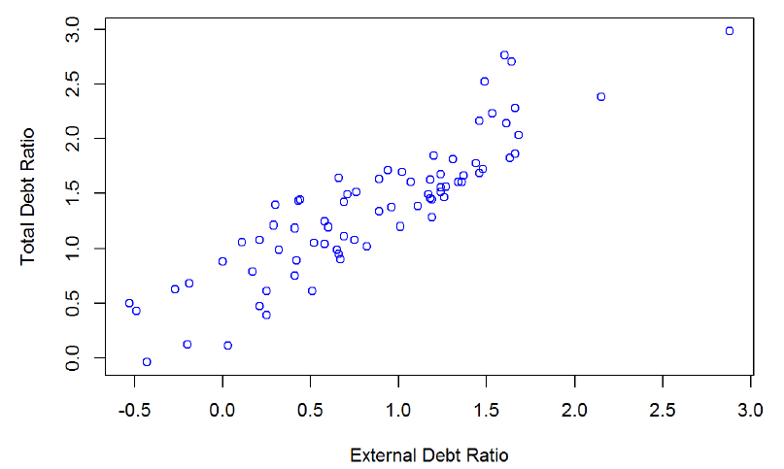
Scatter Plot of Cluster 1
Introduction
Methodology
Findings
Conclusion
Figure 15. Scatter plot of external debt ratio and total debt ratio from cluster 1

Slide 28
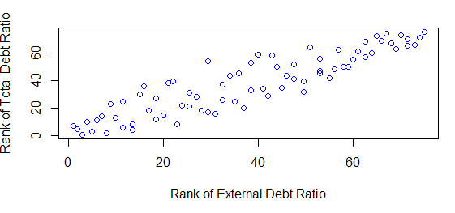
Empirical Copula of Cluster 1
Introduction
Methodology
Findings
Conclusion
Gumbel Copula (upper tail dependency )
Figure 16. Plot of empirical copula from cluster 1

Slide 29
Introduction
Methodology
Findings
Conclusion
Analysis of Clustering Output
Distribution from cluster 1 group
Distribution from cluster 2 group

Slide 30
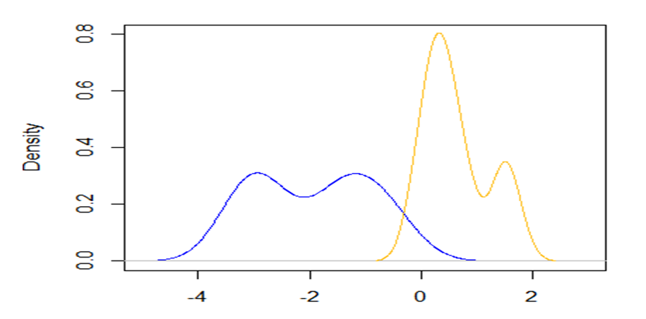
Density Plot of Cluster 2
Introduction
Methodology
Findings
Conclusion
Figure 17. Density plot of external debt ratio and total debt ratio from cluster 2 group

Slide 31
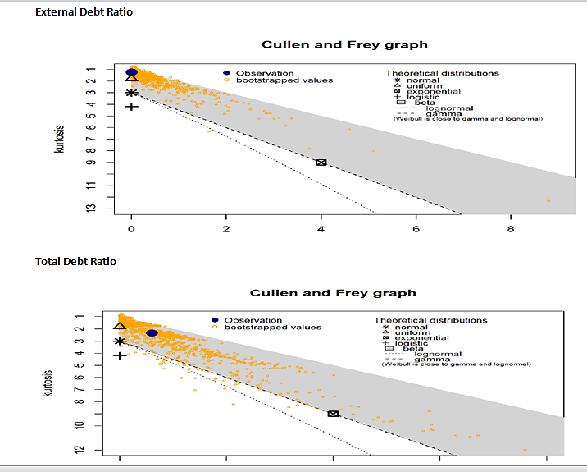
Empirical Distribution of Cluster 2
Introduction
Methodology
Findings
Conclusion
Figure 18. Empirical distribution check from cluster 2 group
Notes:
The Kolmogorov-Smirnov test is used to decide if a sample comes from a population with a specific distribution.

Slide 32
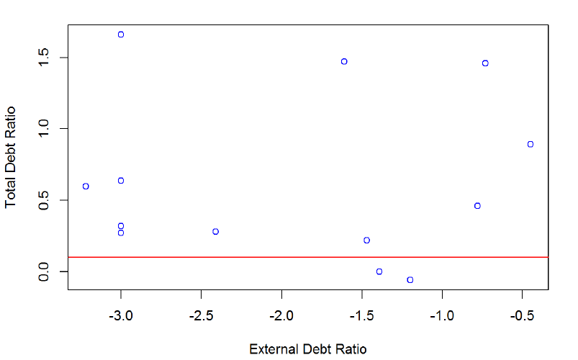
Scatter Plot of Cluster 2
Introduction
Methodology
Findings
Conclusion
T. debt ratio is high E. debt ratio is small /Figure 4
Figure 19. Scatter plot of external debt ratio and total debt ratio from cluster 2
Notes:
x-axis is logged data on external debt ratio. y is logged data on total debt ratio. negative value is due to log transformation on very small of external debt ratio

Slide 33
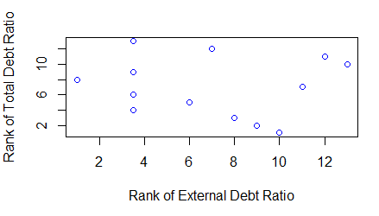
Empirical Copula of Cluster 2 (A)
Introduction
Methodology
Findings
Conclusion
Figure 20. Plot of empirical copula from cluster 2

Slide 34
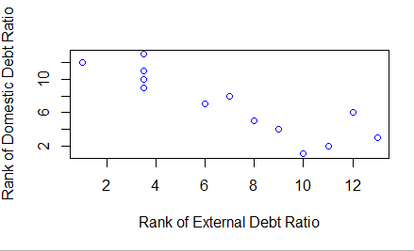
Empirical Copula of Cluster 2 (B)
Introduction
Methodology
Findings
Conclusion
Countermonotonic
Figure 21.Plot of empirical copula between external debt ratio and domestic debt ratio from cluster 2
Notes:
The countermonotonic dependency bettern external debt ratio and domestic debt ratio supports both total debt ratio and domestic debt ratio are high

Slide 35
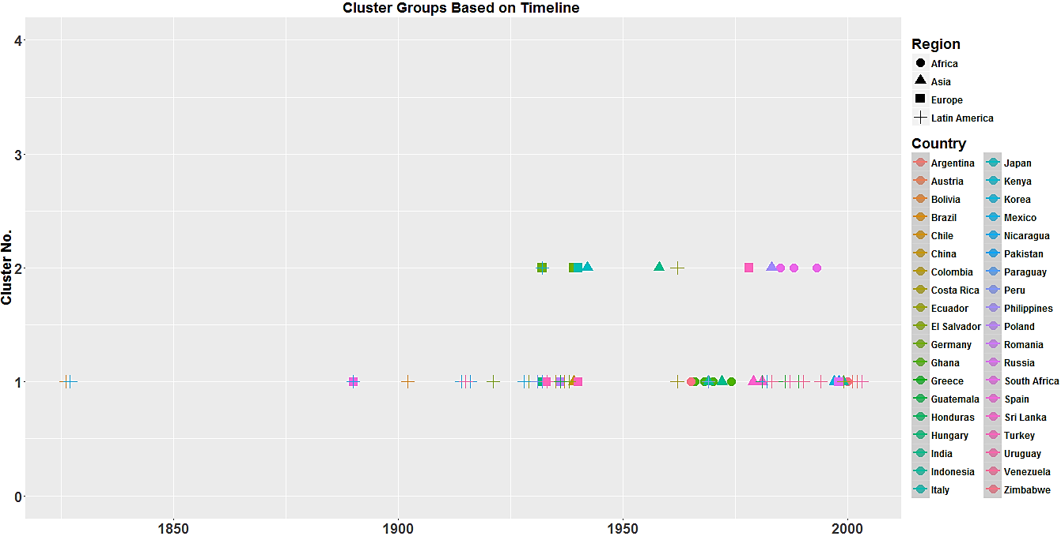
Clustering Output Based upon Timeline
Introduction
Methodology
Findings
Conclusion
Figure 22. Plot of default countries based on timeline

Slide 36
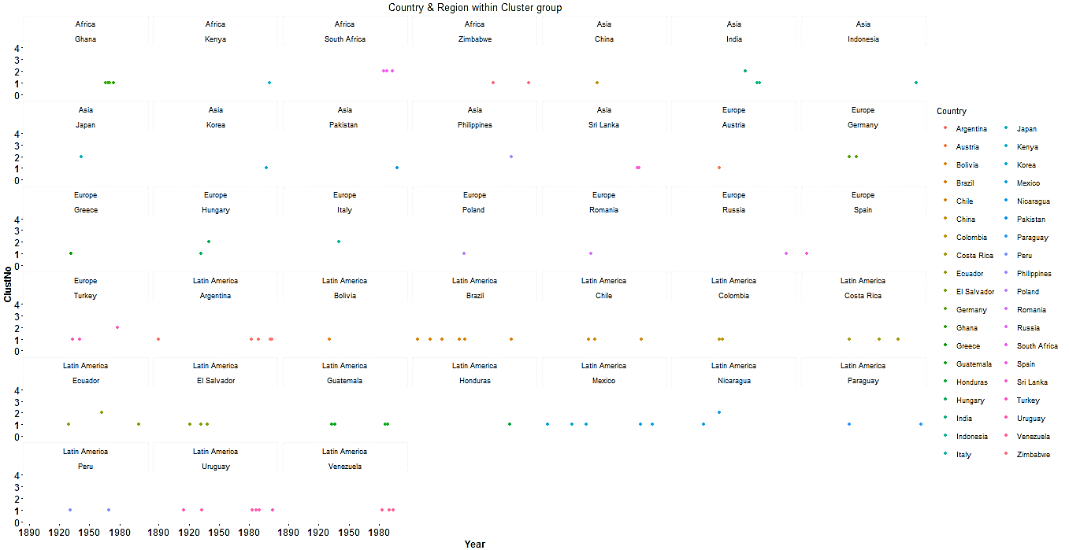
Frequency of Default Countries
Introduction
Methodology
Findings
Conclusion
Costa Rica : 3times
Figure 23. Plot of the number of default countries within each region

Slide 37
Methodology
Introduction
Methodology
Findings
Conclusion
Analysis of Debt Structure at Default
Analysis of government strategy after default

Slide 38
Analysis of Government Strategy After Default
Introduction
Methodology
Findings
Conclusion
Data source and Data analysis
Modeling frame work
Debt Structure after
default

Slide 39
Data Source and Data Analysis
Introduction
Methodology
Findings
Conclusion
Ten-year domestic debt data after government external default was selected
Default year is at time t. where f is the rate of inflation during year t

Slide 40
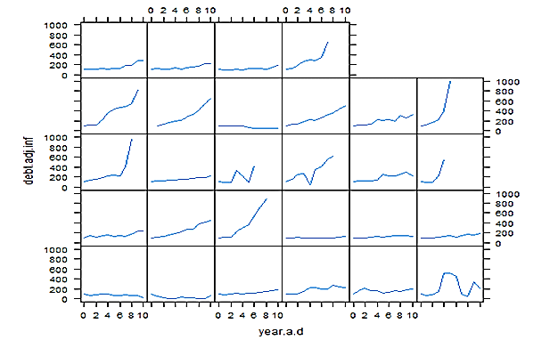
Modeling Framework
Introduction
Methodology
Findings
Conclusion
Function xyplot() of R software
Figure 24. Adjustment of domestic debt over 10 year’s period
Notes:
Government keeps borrowing, clearly, domestic is ignored/overlooked.

Slide 41
Findings
Introduction
Methodology
Findings
Conclusion
Results of Descriptive Analyses
Modeling Results

Slide 42
Results of Descriptive Analyses
Introduction
Methodology
Findings
Conclusion
Domestic debt constitutes a large portion of total debt
Total Debt Ratio
Domestic Debt Ratio
External Debt Ratio
Rho =0.9
Cluster 1
Rho =0.03
Cluster 2
Comonotonic dependency
Rho=0.47 between T.debt ratio and D. debt ratio

Slide 43
Modeling Results
Introduction
Methodology
Findings
Conclusion
Examine the consistency of the serial defaults throughout history
Examine authors’ point of view that domestic debt plays a significant role
Domestic debt is overlooked

Slide 44
Examine the Consistency of the Serial Defaults throughout History
Introduction
Methodology
Findings
Conclusion
Region | Country | Year | External.Debt.Ratio | Total.Debt.Ratio | Cluster.Num
Africa | Ghana | 1966 | 2.13 | 4.51 | 1
 | Ghana | 1968 | 1.99 | 4.13 | 1
 | Ghana | 1970 | 1.5 | 3.25 | 1
 | Ghana | 1974 | 1.12 | 2.9 | 1
 | Kenya | 2000 | 1.99 | 3.03 | 1
 | Zimbabwe | 1965 | 1 | 2.4 | 1
 | Zimbabwe | 2000 | 1.35 | 4.03 | 1
Latin America | Argentina | 1890 | 4.42 | 12.46 | 1
 | Argentina | 1982 | 1.79 | 3.44 | 1
 | Argentina | 1989 | 17.79 | 19.61 | 1
 | Argentina | 2001 | 1.68 | 2.86 | 1
 | Argentina | 2002 | 5.34 | 7.64 | 1
 | Bolivia | 1931 | 8.62 | 10.79 | 1
 | Brazil | 1826 | 4.4 | 5.56 | 1
 | Brazil | 1898 | 3.7 | 6.1 | 1
 | Brazil | 1902 | 3.45 | 5.3 | 1
 | Brazil | 1914 | 4.3 | 8.68 | 1
 | Brazil | 1931 | 4.99 | 8.51 | 1
 | Brazil | 1937 | 2.56 | 5.51 | 1
 | Brazil | 1983 | 0.83 | 1.98 | 1
 | Chile | 1931 | 3.51 | 4.29 | 1
Notes:
Conversional wisdom-countries default when both external debt ratio and total debt ratio are high
Argentina defaulted five times (1980-2002). Brazil defaulted seven times (1826-1983). Emerging markets countries and a number of wealthy countries. Such as Spain, default at 495% in 1877. Austria, Greece and Hungary's defaults in 1932 respectively. Timeline is different for default countries. Same countries defaulted multiple times.

Slide 45
Three Spike Episodes of Default in Countries Across Each Region
Introduction
Methodology
Findings
Conclusion
Later portion of 1920 – 1940: The majority of default countries are from Europe and Latin America. The Great Depression (early 1930s) plays a dominant role in defaulting countries during this period.
Middle portion of 1960 – 1970: The majority of default countries are from Africa and Asia.
1980 to 2000: The majority of defaulting countries are from Latin America and Asia in emerging markets.
Timeline (1827-2003)
Cluster 1
Notes:
Three spike episodes of default in countries across each region over long time period.

Slide 46
Examine Authors’ Point of View: Domestic Debt Plays a Significant Role
Introduction
Methodology
Findings
Conclusion
Region | Country | Default Year | External.Debt. Ratio | Total. Debt. Ratio | Cluster.Num
Africa | South Africa | 1985 | 0.09 | 1.32 | 2
 | South Africa | 1988 | 0.05 | 1.38 | 2
 | South Africa | 1993 | 0.05 | 1.9 | 2
Asia | India | 1958 | 0.2 | 4.35 | 2
 | Japan | 1942 | 0.04 | 1.83 | 2
 | Philippines | 1983 | 0.23 | 1.25 | 2
Europe | Germany | 1939 | 0.05 | 1.31 | 2
 | Hungary | 1940 | 0.3 | 0.94 | 2
 | Italy | 1940 | 0.05 | 5.25 | 2
 | Turkey | 1978 | 0.25 | 1 | 2
Notes:
(1) Default countries have very low level of external debt ratio whereas total debt ratio is high at 100 % or above 100%
(2) domestic debt plays a significant role in countries’ default, but only for the countries in cluster 2.
(2) developing countries in recent time periods from the later 1980s to the early 1990s,

Slide 47
Domestic Debt is Overlooked
Introduction
Methodology
Findings
Conclusion
Domestic Debt
External debt
Inflation
Notes:
Overlooked domestic debt explains the link between external debt and inflation.

Slide 48

Conclusions
Introduction
Methodology
Findings
Conclusion
Is “this time really different”?
“The current boom, unlike the many booms that preceded catastrophic collapses in the past (even in our country) is built on sound fundamentals…. ”
Reinhart & Rogoff
Notes:
Brazil default 7 times (1826-1983) in cluster 1, south Africa defaulted 3 times (1985-1993) in cluster 2 are common phenomenon throughout history and around global

Slide 49


Slide 50
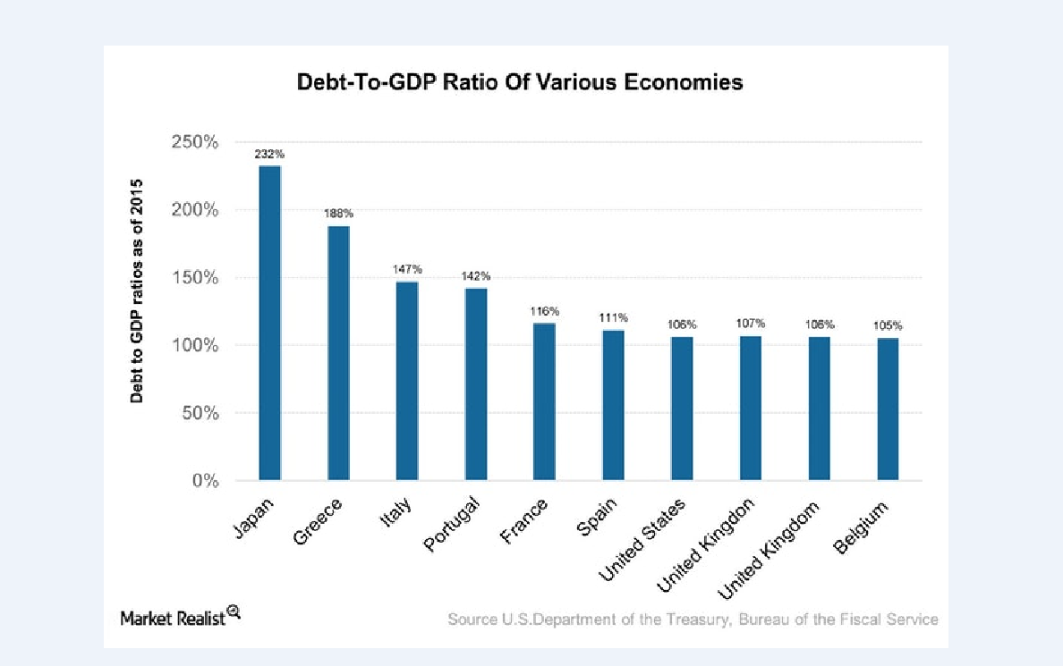
Notes:
US leads to 7th place with 106 % . US is in debt for about $18 trillion 2014. About $5 trillion of that is technically owed to itself - intragovernmental debt . The other $13 trillion is in the form of treasury bonds, treasury notes, savings bonds, and other forms of government issued debt.

Slide 51
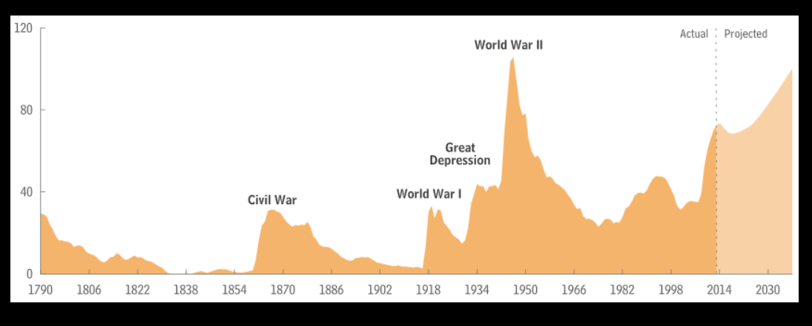
Federal debt held by the public as a percentage of gross domestic product, from 1790 to 2013, projected to 2038

