Slide 1
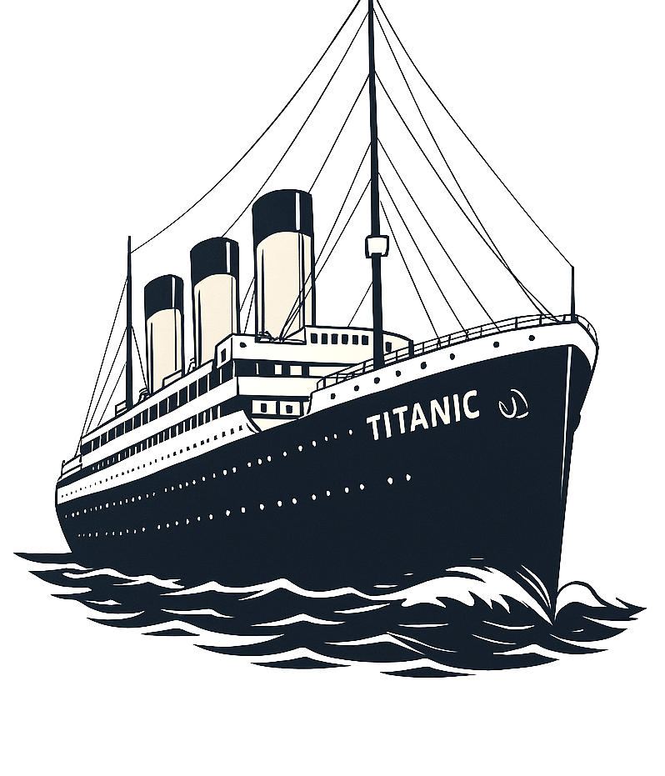

PYTHON –
FINAL PROJECT
TITANIC
DATA ANALYST - TECHOF
Filipa Tiago, Hugo Varela e Joana Correia

Slide 2


INTRODUCTION
Titanic Passengers Data:
Name, Age, Gender
Family on board
Class, Ticket fare and number
Local embarked
Binary survival variable
  (0 – if not survived; 1 – if survived)
DataFrame:
  891 records
  12 columns

Slide 3
DATA TREATMENT
Check for null values
Index: PassengerID
Delete columns: Cabin
  687 null values
Null values in column Age:
  Replaced with median values for men (29) and women (27)
Add new columns:
  Sex boolean
    0 – Female, 1 – Male
  Family size
    Sum of siblings, parents, children and spouses aboard
  Group by family size
    Alone, Small family and Large family
  Group by age
    Passengers grouped by ages
  Survived non boolean
    For chart analysis
Null values in Embarked column
  Changed to the most common value 'S'
Notes:
(we verified that there were 177 nulls in the 'Age' column, 687 in the 'Cabin' column, and 2 in 'Embark');
We deleted the 'Cabin' column;
We grouped by age and family, therefore creating new columns called 'AgeGroup' and 'FamilyCatSize';
We created the 'FamilySize' and 'Sex_bool' columns;
We calculated the median age for women and men and changed values that had no information to the median value found;

Slide 4
OVERALL STATISTICS

Slide 5
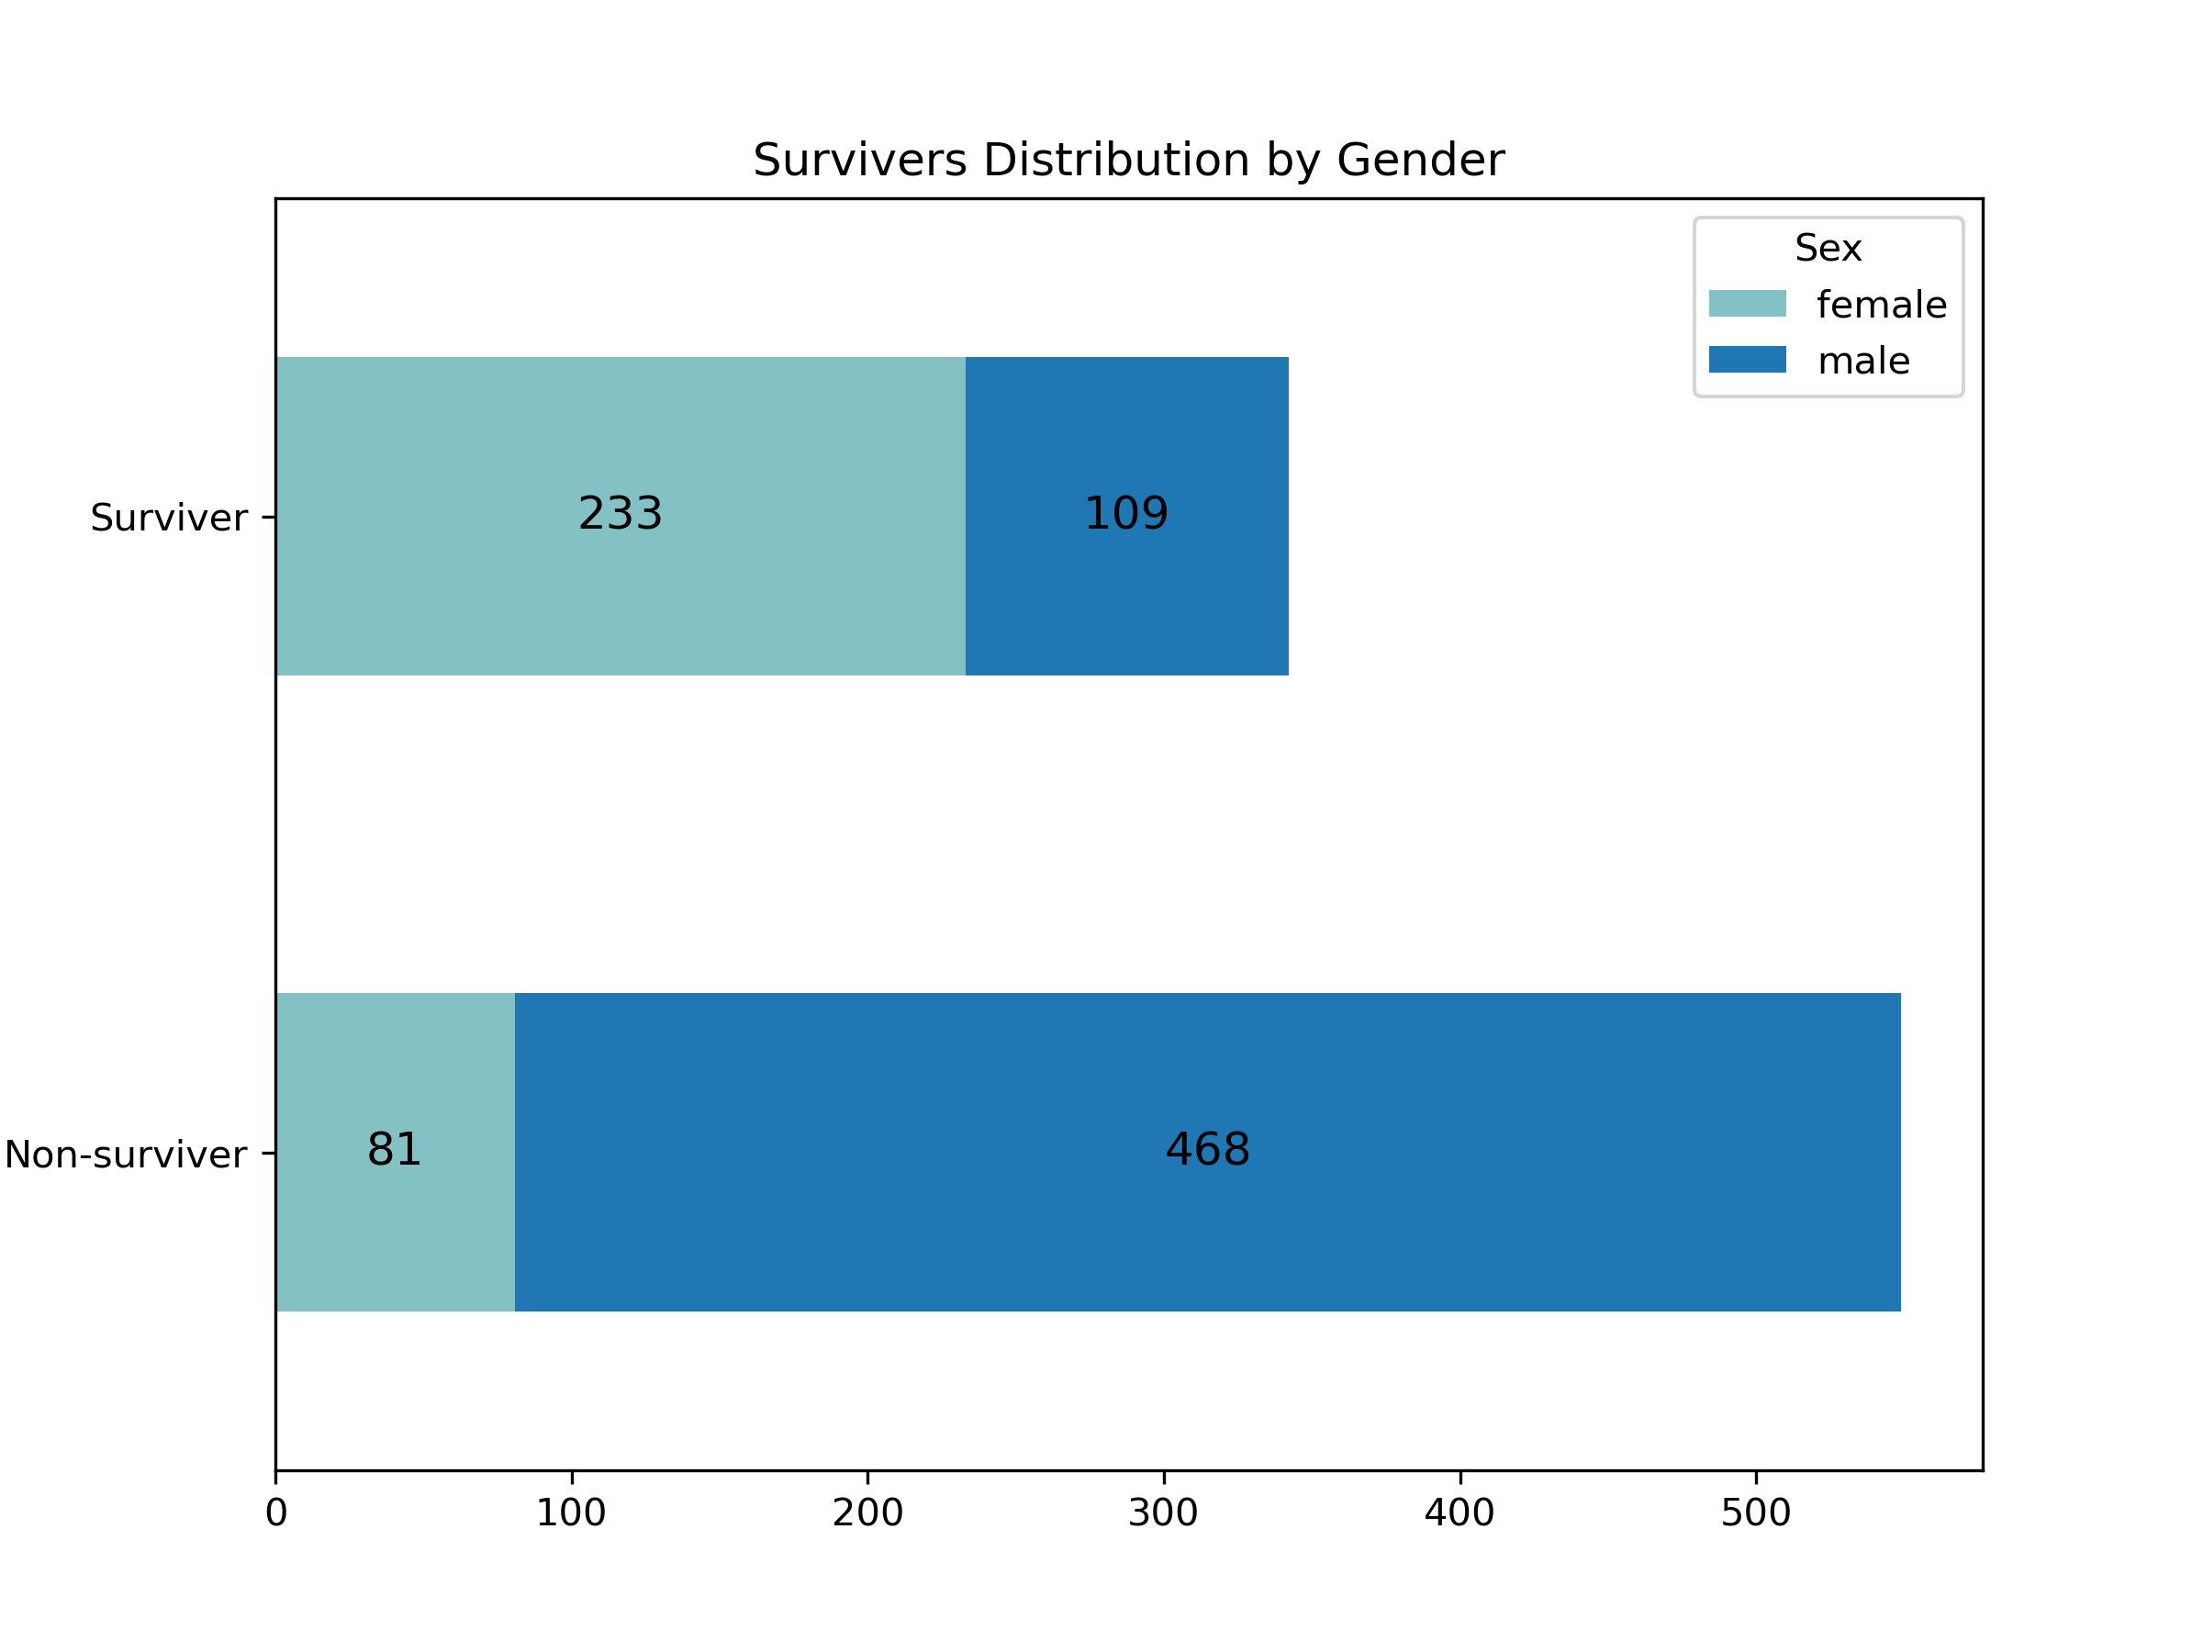
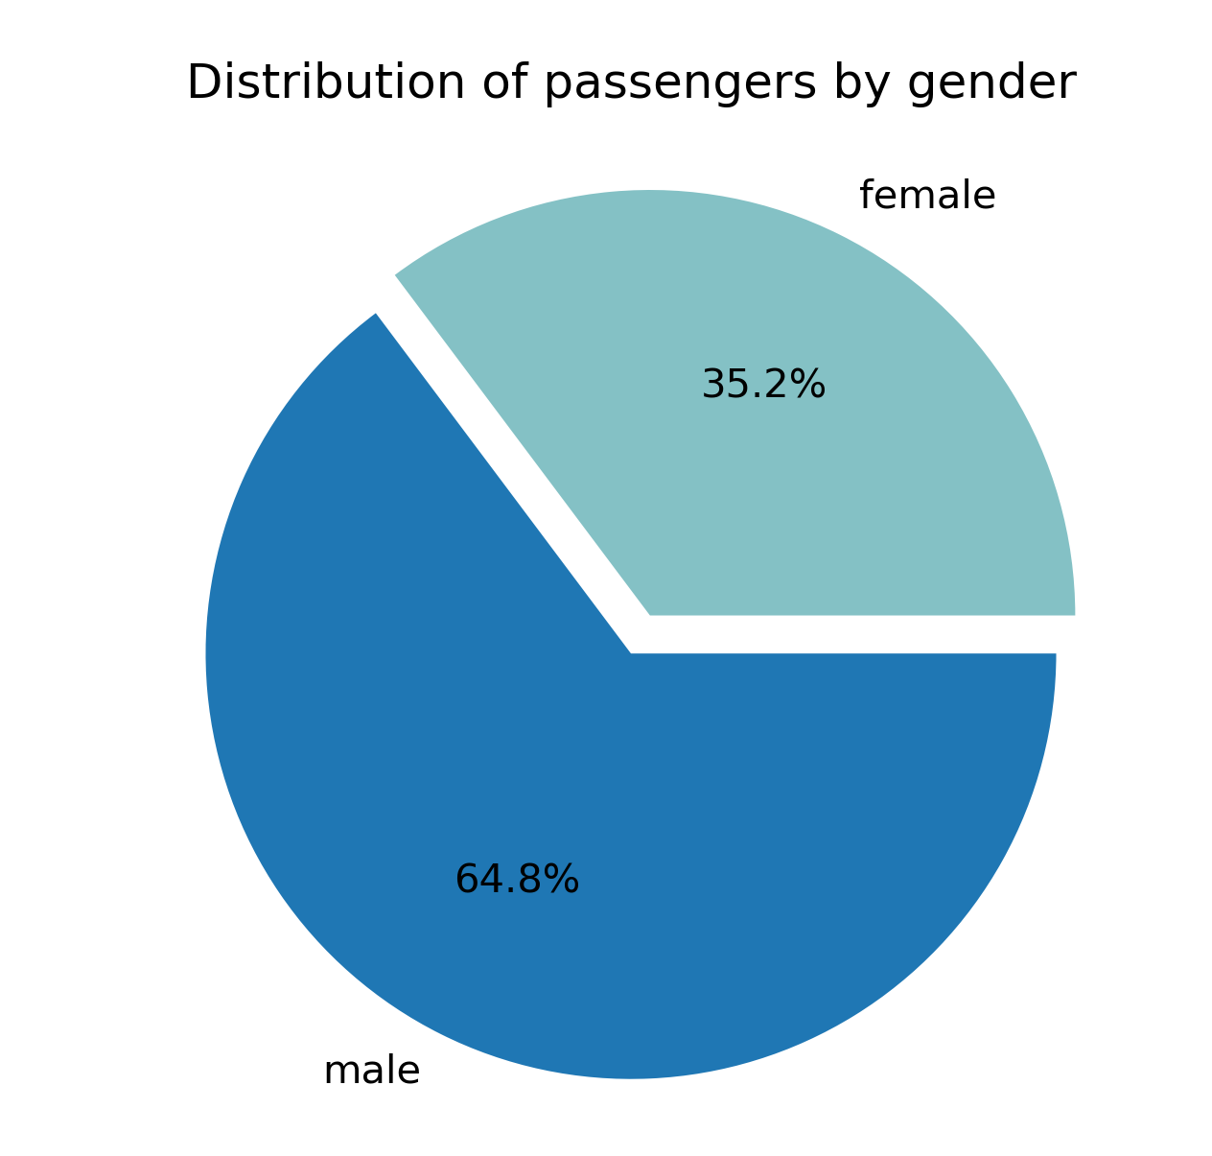
DISTRIBUTION OF PASSENGERS BY GENDER
Men: 577
Women: 314
Total Passengers: 891
Survivers: 342 Non-survivers: 549

Slide 6
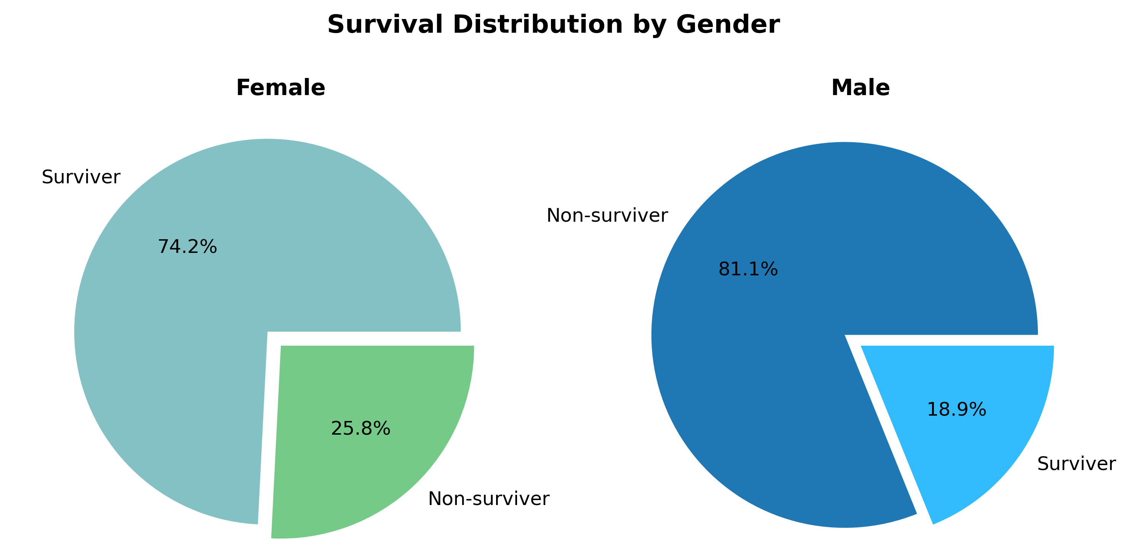
GENDER COMPARISON OF SURVIVERS AND NON-SURVIVERS

Slide 7
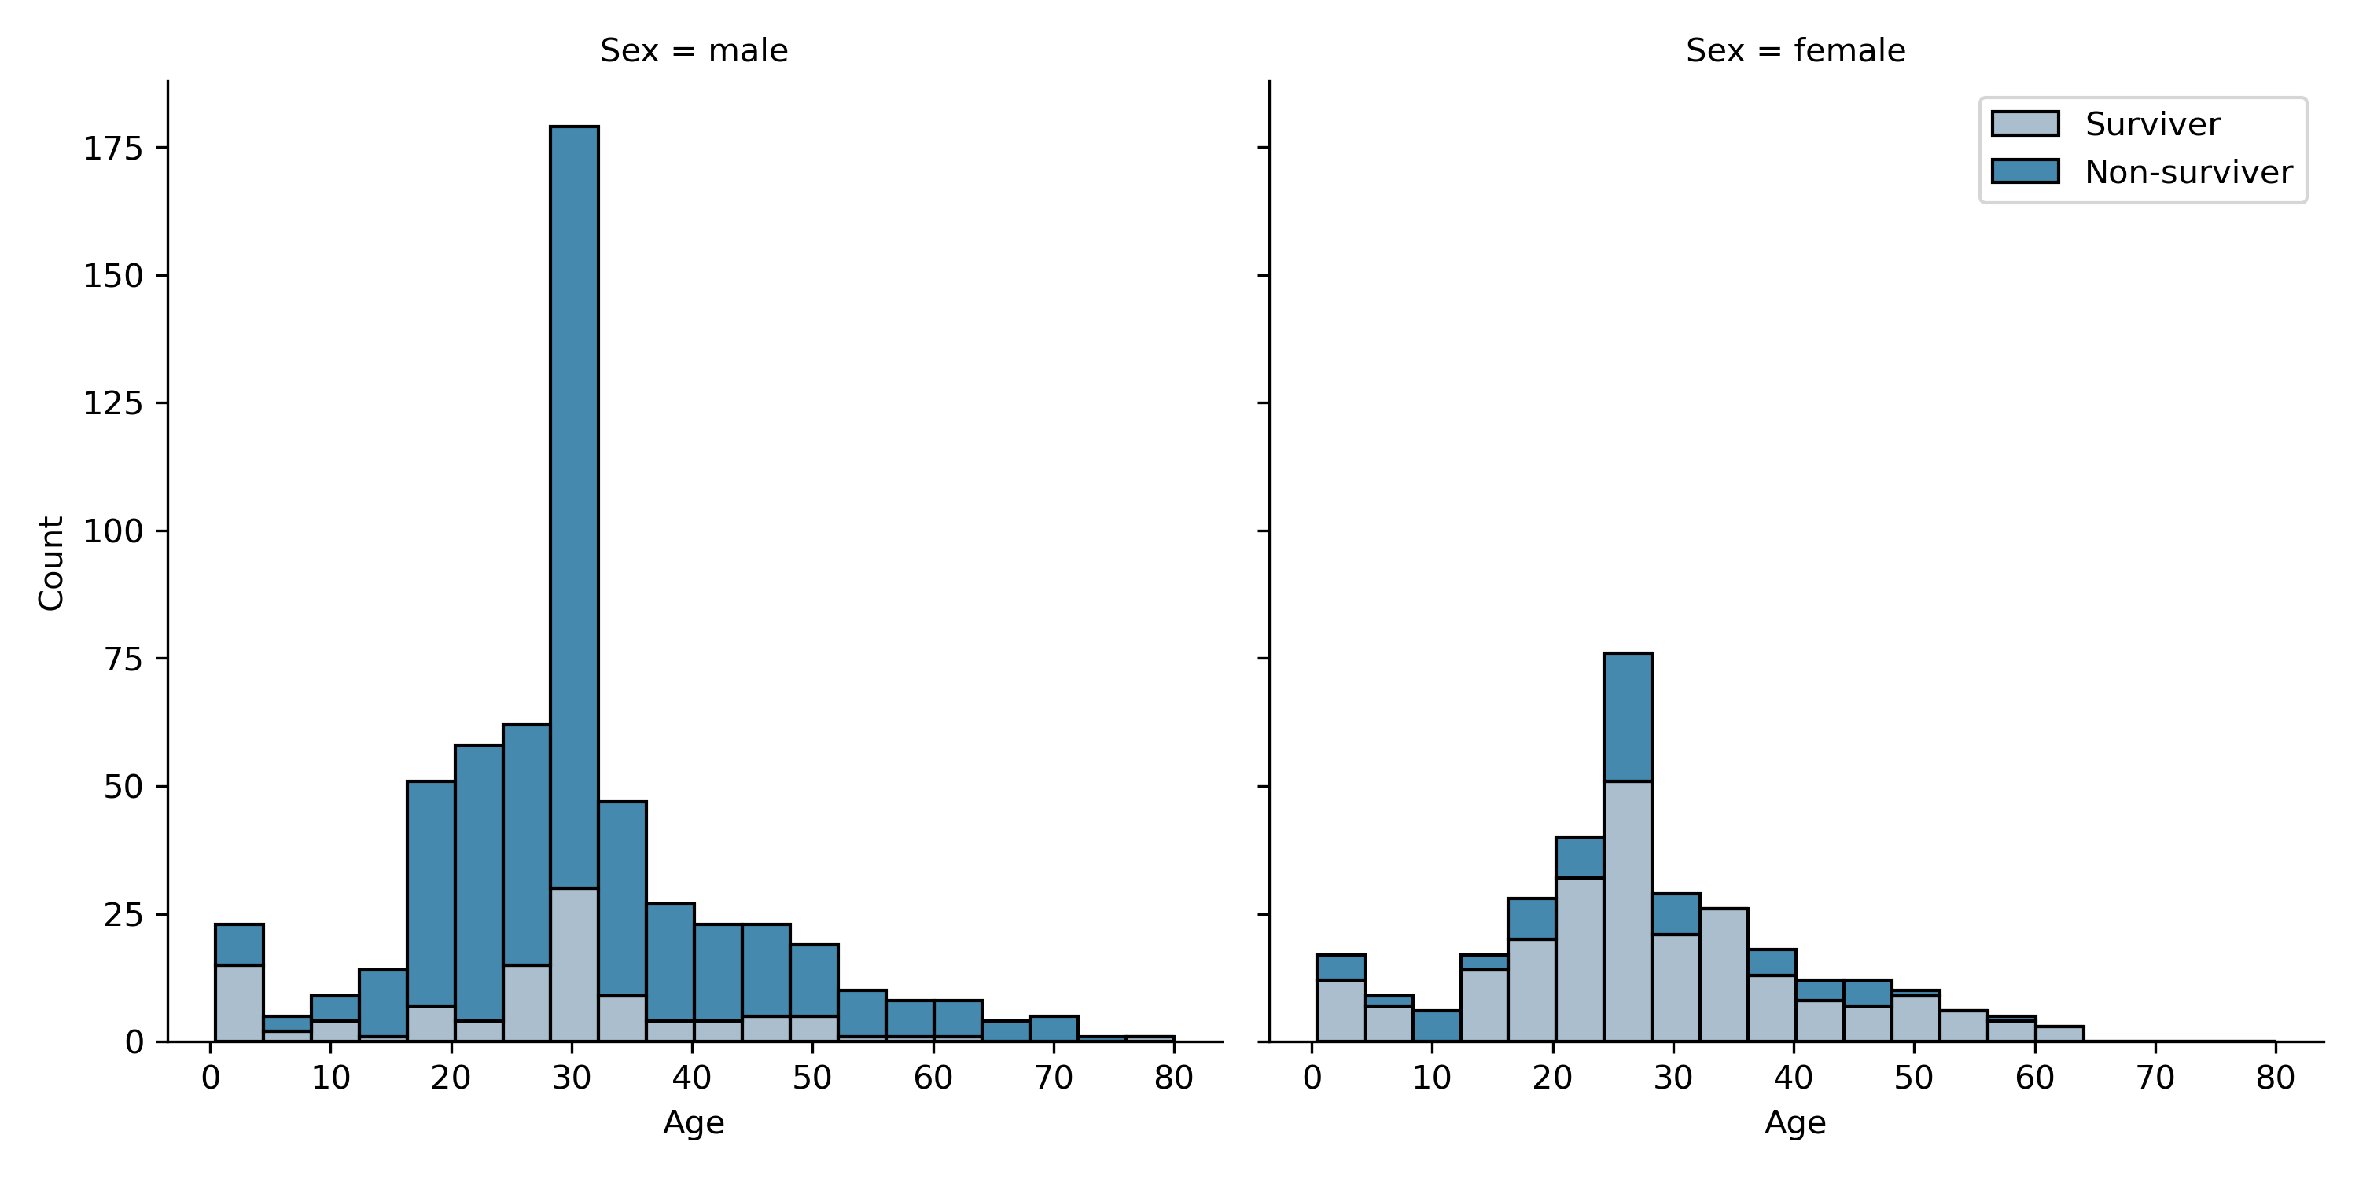
DISTRIBUTION OF SURVIVERS BY GENDER AND AGE
Average Age: 29

Slide 8
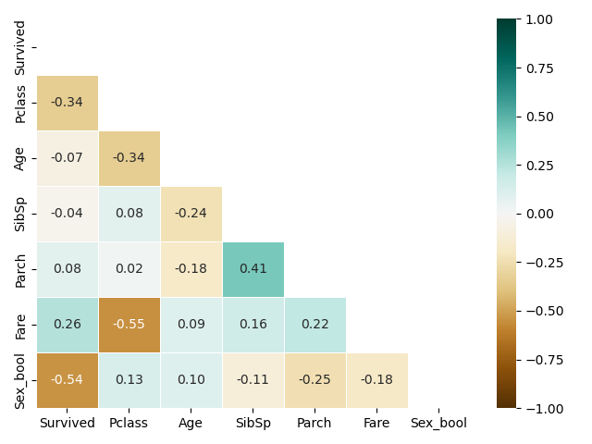
CORRELATION MATRIX - HEATMAP
Strongest Correlations:
Ticket price vs Class
Gender vs Survival
Sibling/Spouses vs Parents/Children
Most meaningful correlations:
  Survival vs Gender
  Survival vs Class
  Survival vs Ticket price

Slide 9
STUDY QUESTIONS

Slide 10
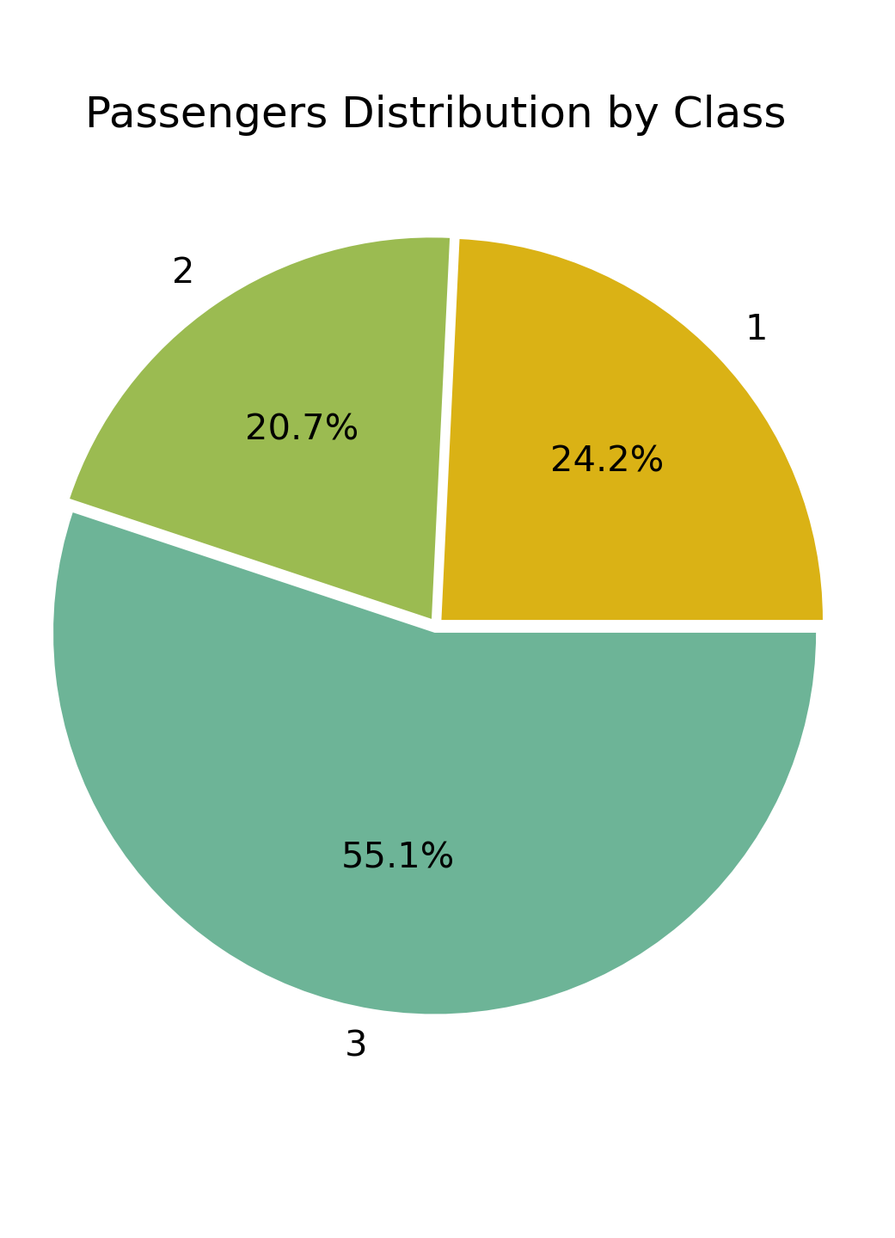
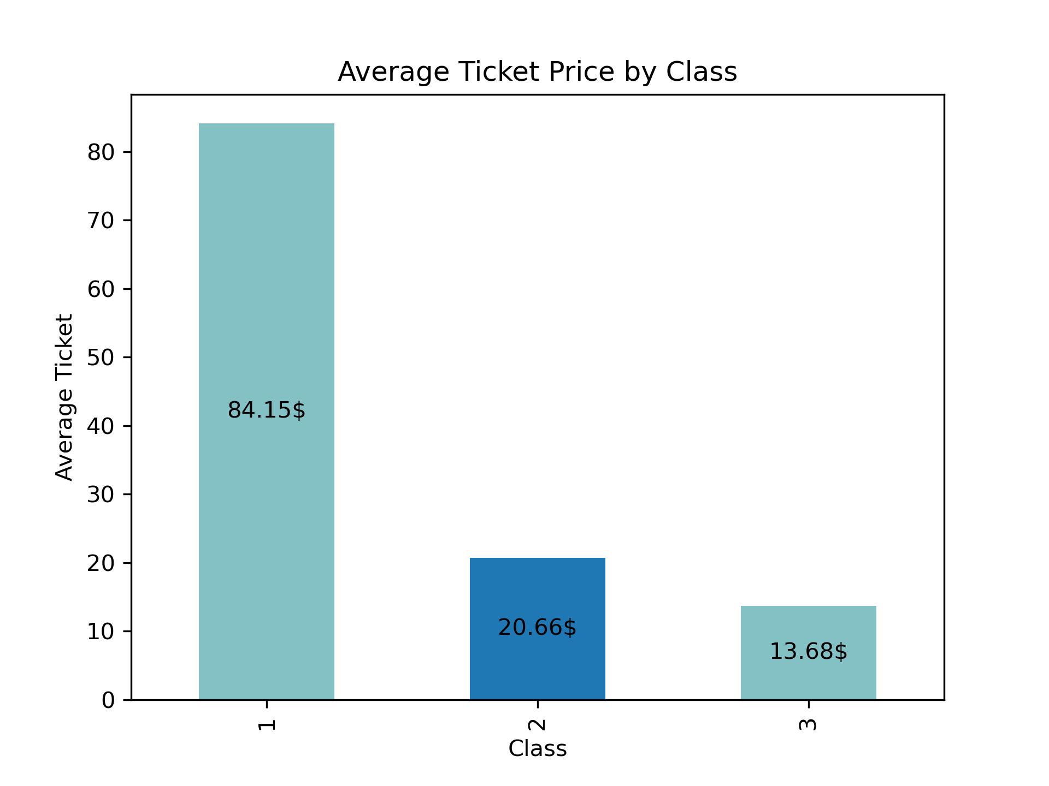
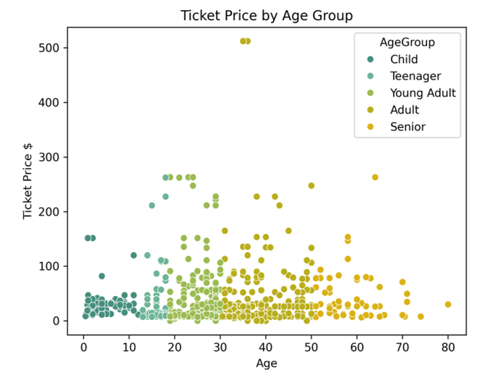

HOW DOES THE SURVIVAL RATE VARY ACROSS PASSENGERS CLASS?
WHAT IS THE AVERAGE FARE ACROSS PASSENGERS CLASS AND HOW IS IT RELATED WITH AGE ?
Average Ticket Price 32$ Most expensive Ticket: 512$

Slide 11
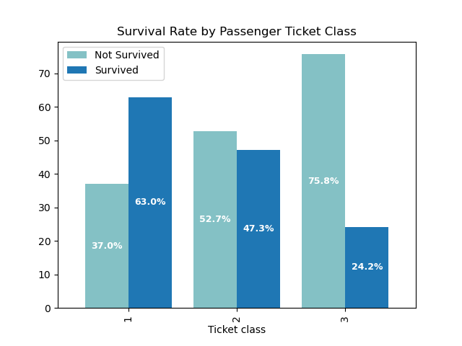
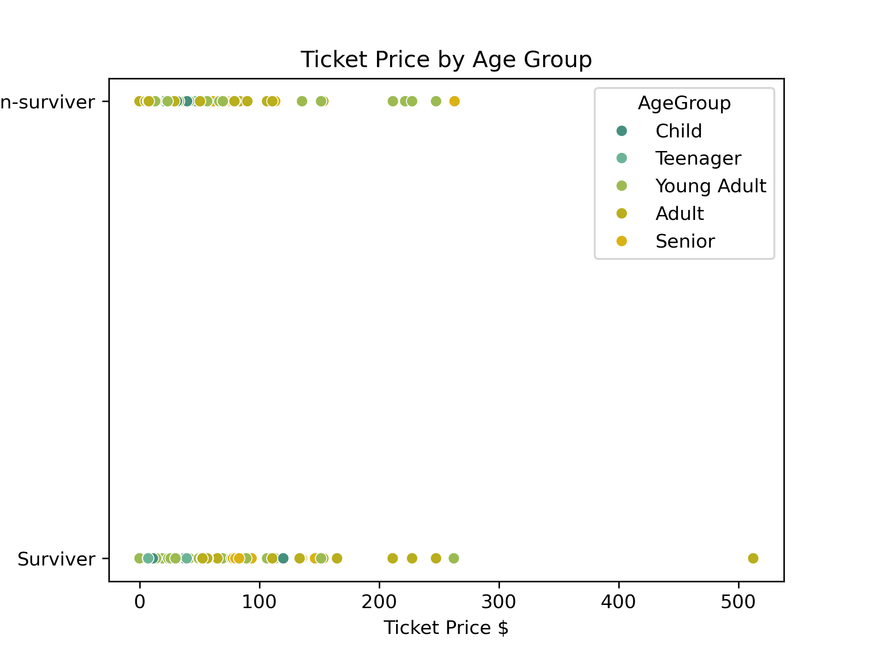
HOW DOES THE SURVIVAL RATE VARY ACROSS PASSENGERS CLASS?
IS THERE A CORRELATION BETWEEN TICKET PRICE AND SURVIVAL RATE?
Death rate by class:
Class 1 – 37% Deaths; Class 2 – 53% Deaths; Class 3 – 76% Deaths

Slide 12
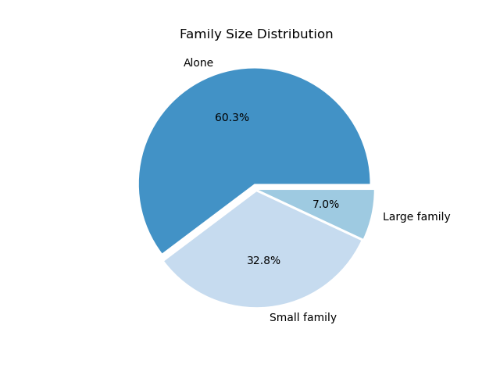
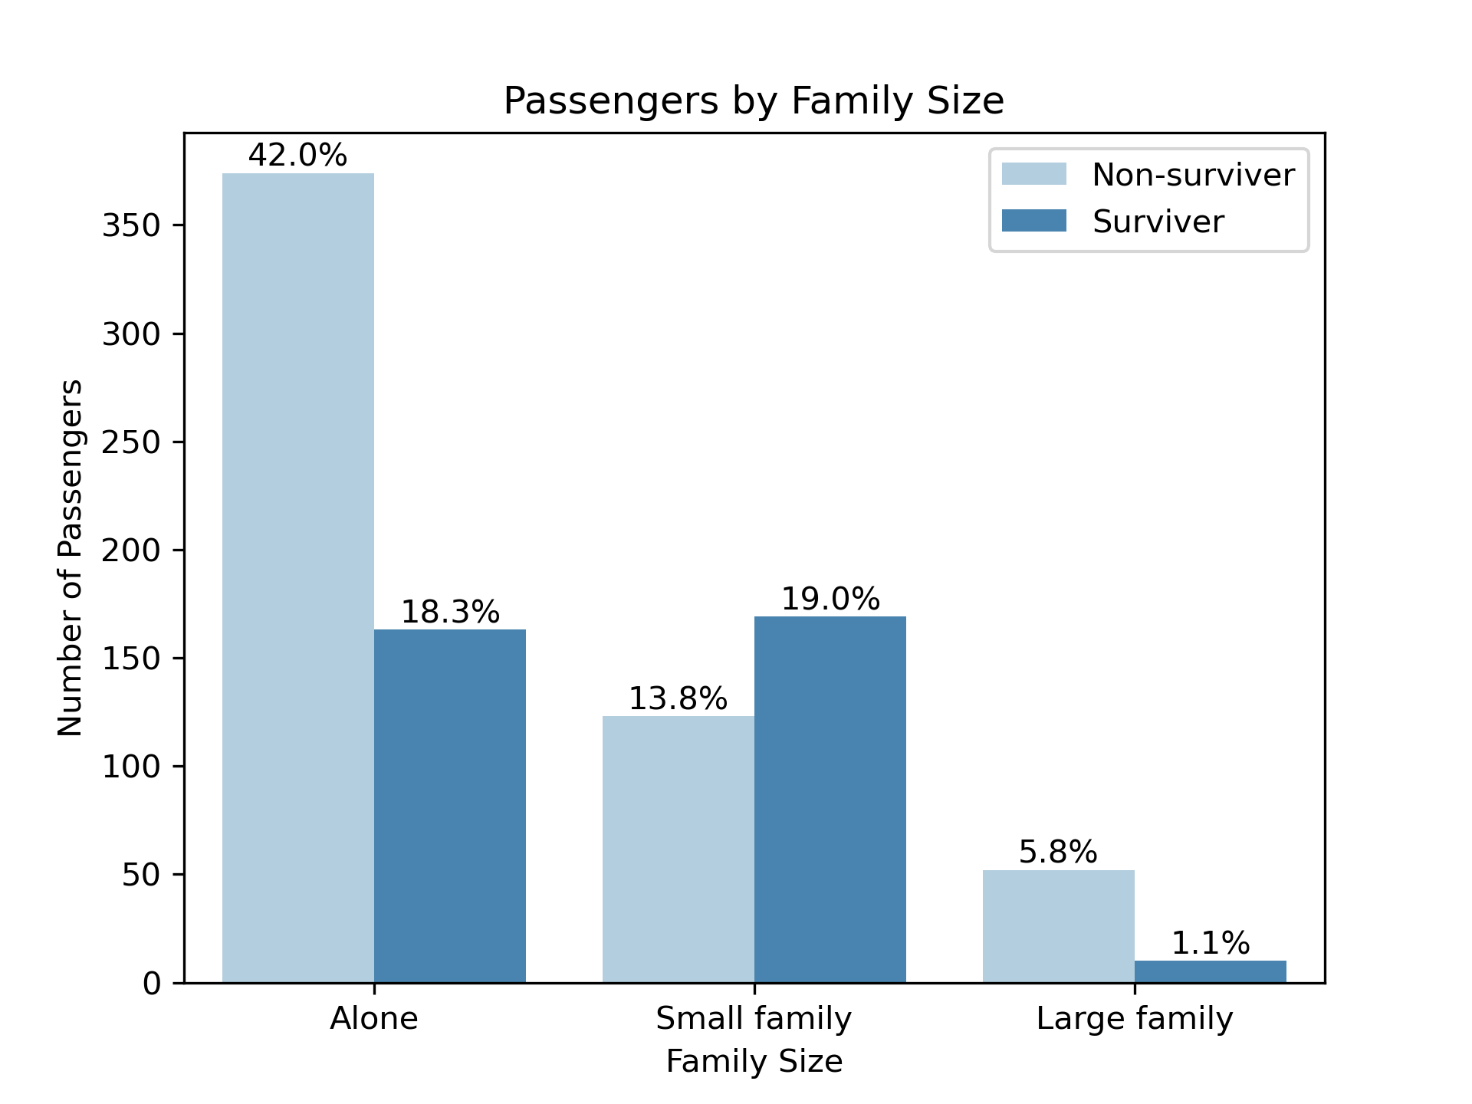
Alone 1
Small family 2 - 4 Large family >5
IS THERE A RELATION BETWEEN SURVIVAL AND FAMILY NUMBER?
Family Size:

Slide 13
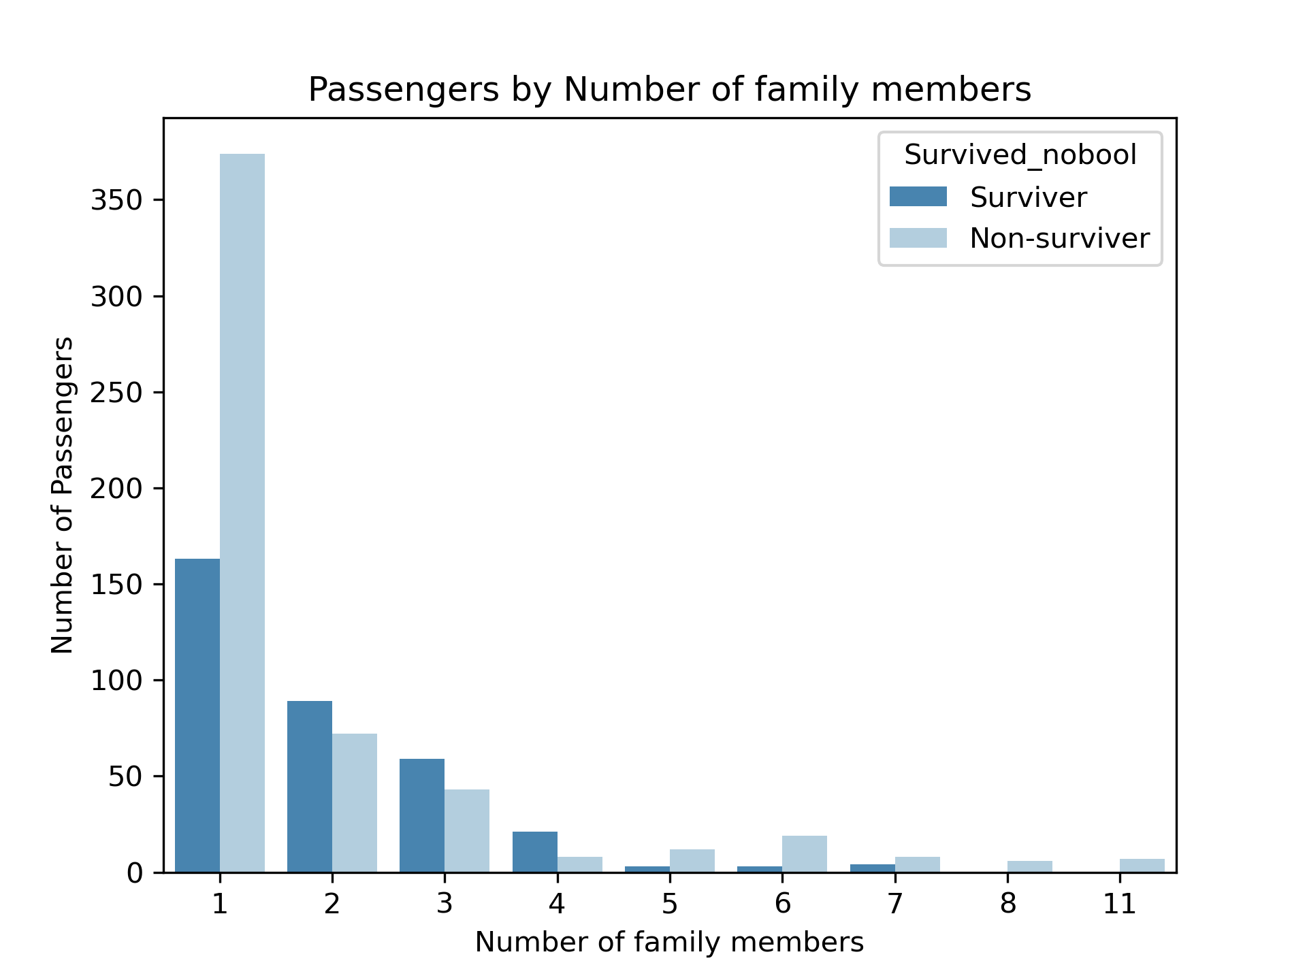
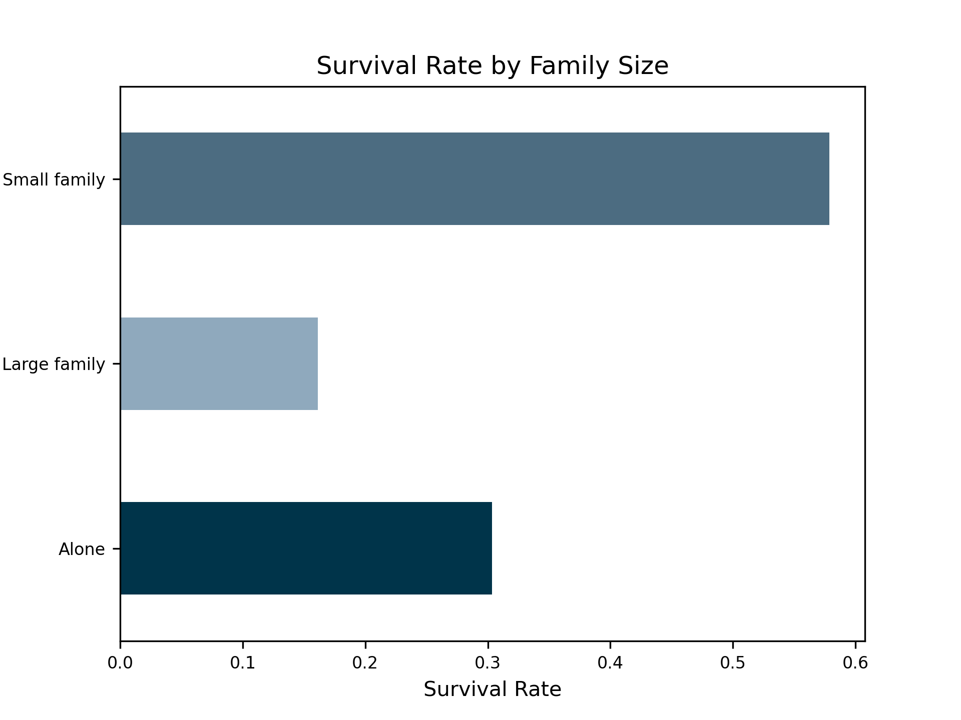
IS THERE A RELATION BETWEEN SURVIVAL AND FAMILY NUMBER?

Slide 14
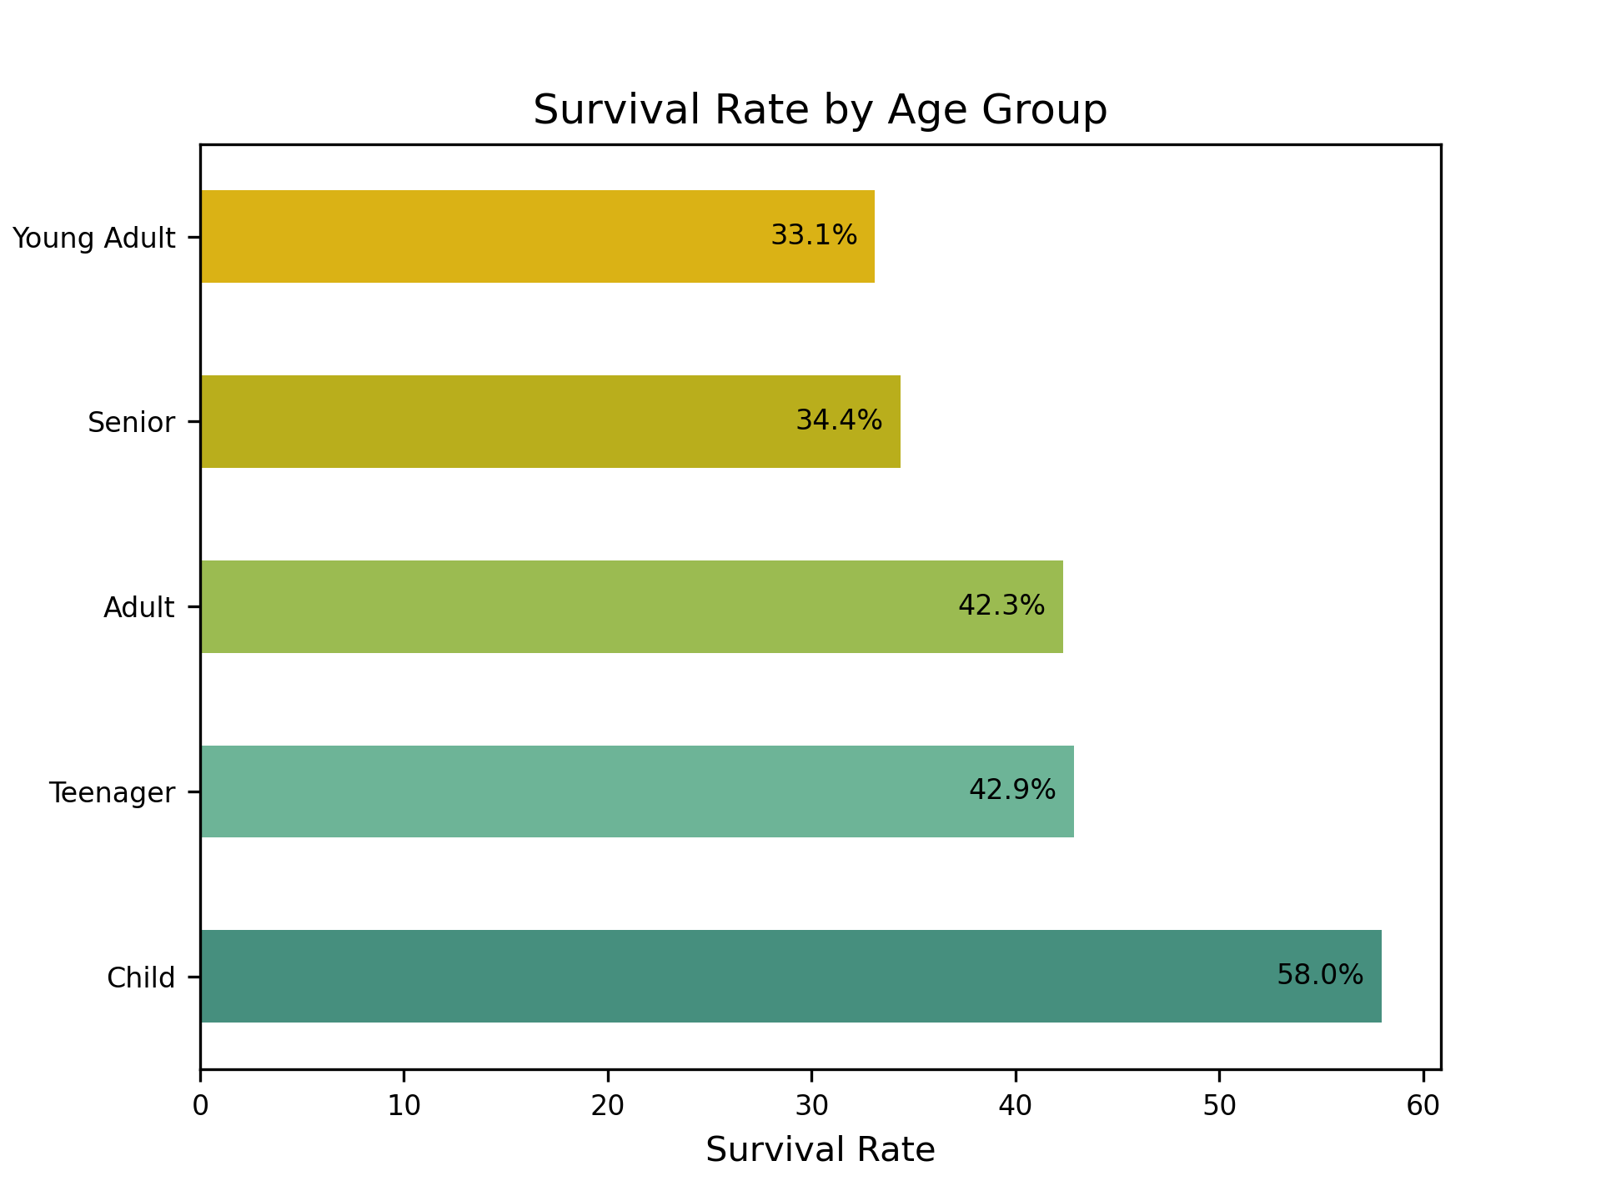
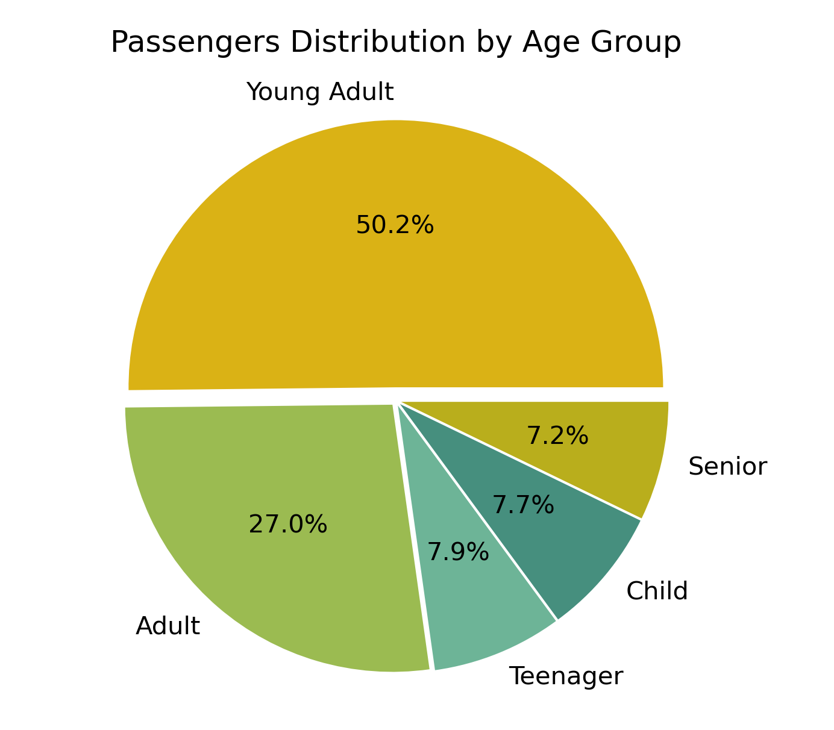
Child < 12
Teenager 13 - 18
Young Adult 19 - 30
Adult 31 - 50
Senior > 51
WHAT IS THE SURVIVAL RATE BY AGE GROUP?
Age Groups:

Slide 15
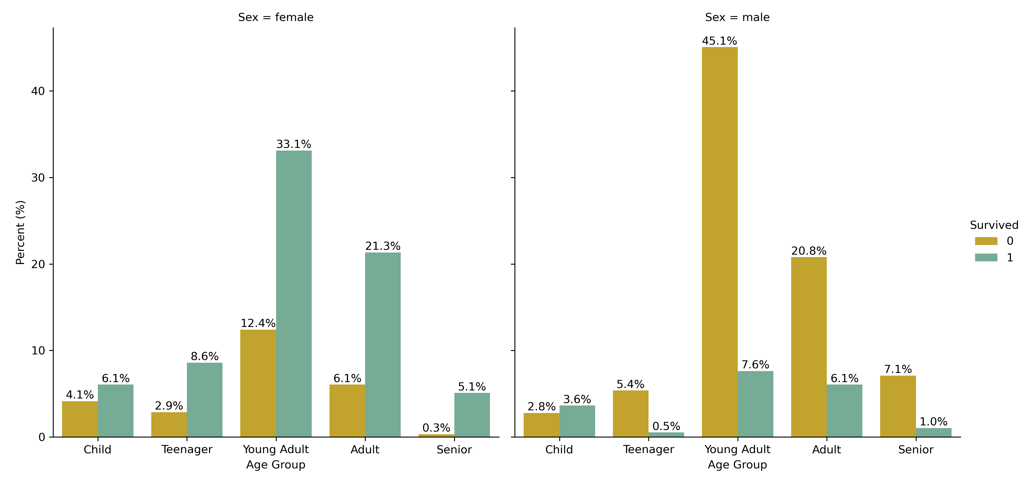
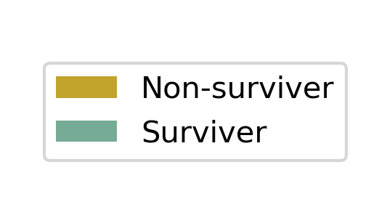
WHAT IS THE SURVIVAL RATE BY AGE GROUP?
Child < 12
Teenager 13 - 18
Young Adult 19 - 30
Adult 31 - 50
Senior > 51
Age Groups:

Slide 16
Of a total 891 passengers, 62% died
Survival rate:
  1/5 men survived
  3/4 women survived
"Women and children first" principle:
  58% children saved
  56% adult women saved
Socioeconomics status had impact:
  High mortality rate in Class 3 (76%)
Family structure:
  Smaller families had higher survival rate
CONCLUSIONS

Slide 17





Survival rate not guaranteed
TITANIC SURVIVAL KIT
Be a child... or a woman!
Travel with family, preferably a small one...
Buy a Class 1 Ticket,
for better position view.

Slide 18

QUESTIONS

