Slide 1

Classifying the severity of road collisions
UK Road Safety (STATS19) · 2021–2025
Joana Curri
Mario D’Angelo
Edy Maria Delcane
Salvatore Zizzi
Notes:
Cover: introduce the Mind the Crash group and the project topic.

Slide 2


THE ROADMAP
01
02
03
04
05
06
Goal
Data
Preprocessing
Models
Performance
Conclusions

Slide 3



GOAL
01
Goal
Data
Preprocessing
Models
Performance
Conclusions

Slide 4
GOAL
Edy
When the call reaches the emergency call centre, predict whether a collision is serious or slight, using only the information the caller can know.
Who we are
The problem
The target
The worst error
the emergency number call centre
sizing the response without knowing the severity
serious (Fatal + Serious) versus slight (Slight)
classifying a serious collision as slight
Data source: STATS19, Department for Transport (UK) · data entered by the police or self-reported

Slide 5
THE DATA
02
Goal
Data
Preprocessing
Models
Performance
Conclusions

Slide 6
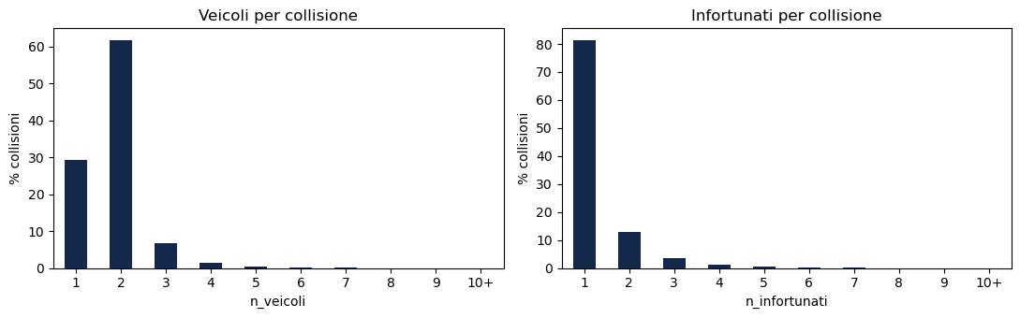
THE DATASET
Edy
513,745 collisions
Vehicles
Casualties
5 years from 2021 to 2025
937,265 rows · 32 columns
type, manoeuvre, point of impact, driver
652,821 rows · 24 columns
casualty class and type, age, pedestrian
24.2% serious collisions
75.8% slight collisions
Collisions
513,801 rows · 44 columns
location, road, weather, light, time
Three STATS19 tables joined at collision level · Source: Department for Transport

Slide 7
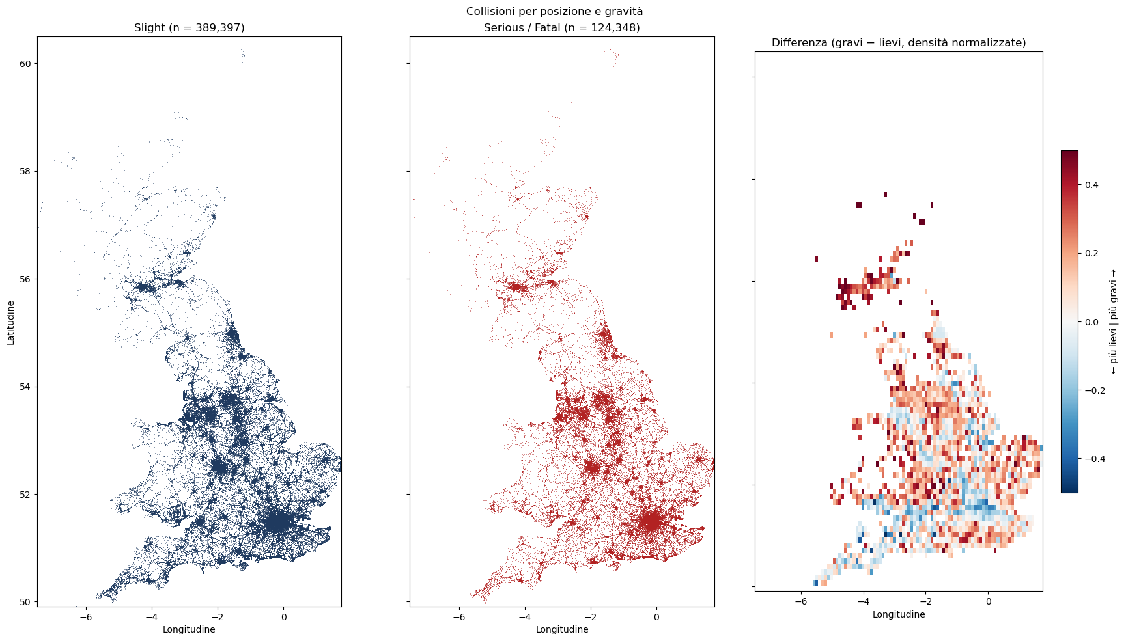
EXPLORATORY ANALYSIS
Edy
Where they happen
Collisions cluster in the large urban areas (London, Midlands, North West).
Where they are most serious
The red areas (more serious) are mostly rural and in the North; the blue ones (slighter) are in the cities.
Notes:
In the charts: red = Serious, blue = Slight, always.

Slide 8
PREPROCESSING
03
Goal
Data
Preprocessing
Models
Performance
Conclusions

Slide 9
FROM THREE TABLES TO THE DATASET
Edy
CLEANING
TRANSFORMATION
AGGREGATION
51 variables removed
Label mapping
Aggregation by collision
ids, keys, post-event data
codes decoded with the DfT data guide
dummy counts and means
Missing-value coding
One-hot encoding
Join of the three tables
missing and unknown made uniform
(−1000 / −2000)
49 categorical → 176 dummies
one row per collision
56 rows dropped
Missing and unknown removed
without latitude and longitude
a value not recorded, not a characteristic
Time bands
morning, afternoon, evening, night
End of the line: 513,745 collisions × 127 columns · one row per collision

Slide 10
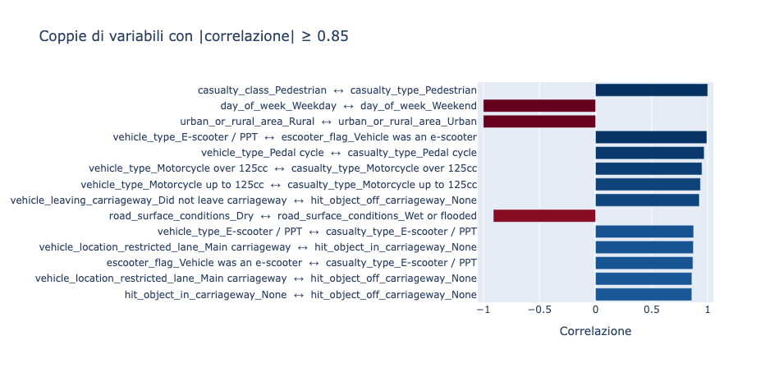
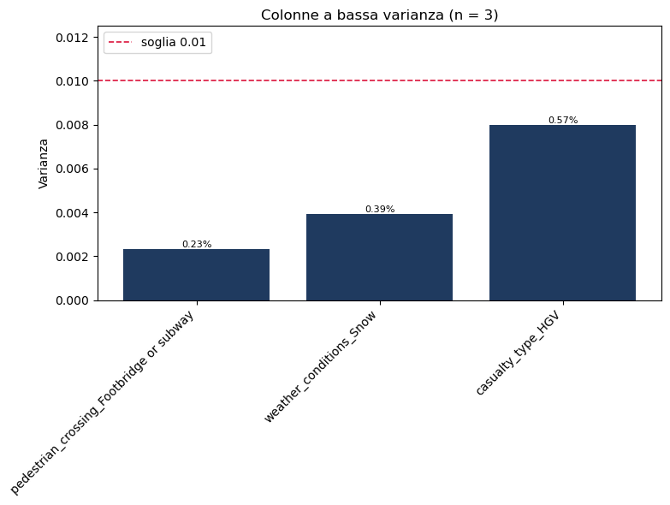
VARIABLE CLEANING
Jo
CORRELATED VARIABLES · |r| ≥ 0.85
NEAR-ZERO VARIANCE · < 0.01
Final dataset: 111 variables · −12 correlated · −3 near-constant
Notes:
In the charts: red = Serious, blue = Slight, always.

Slide 11
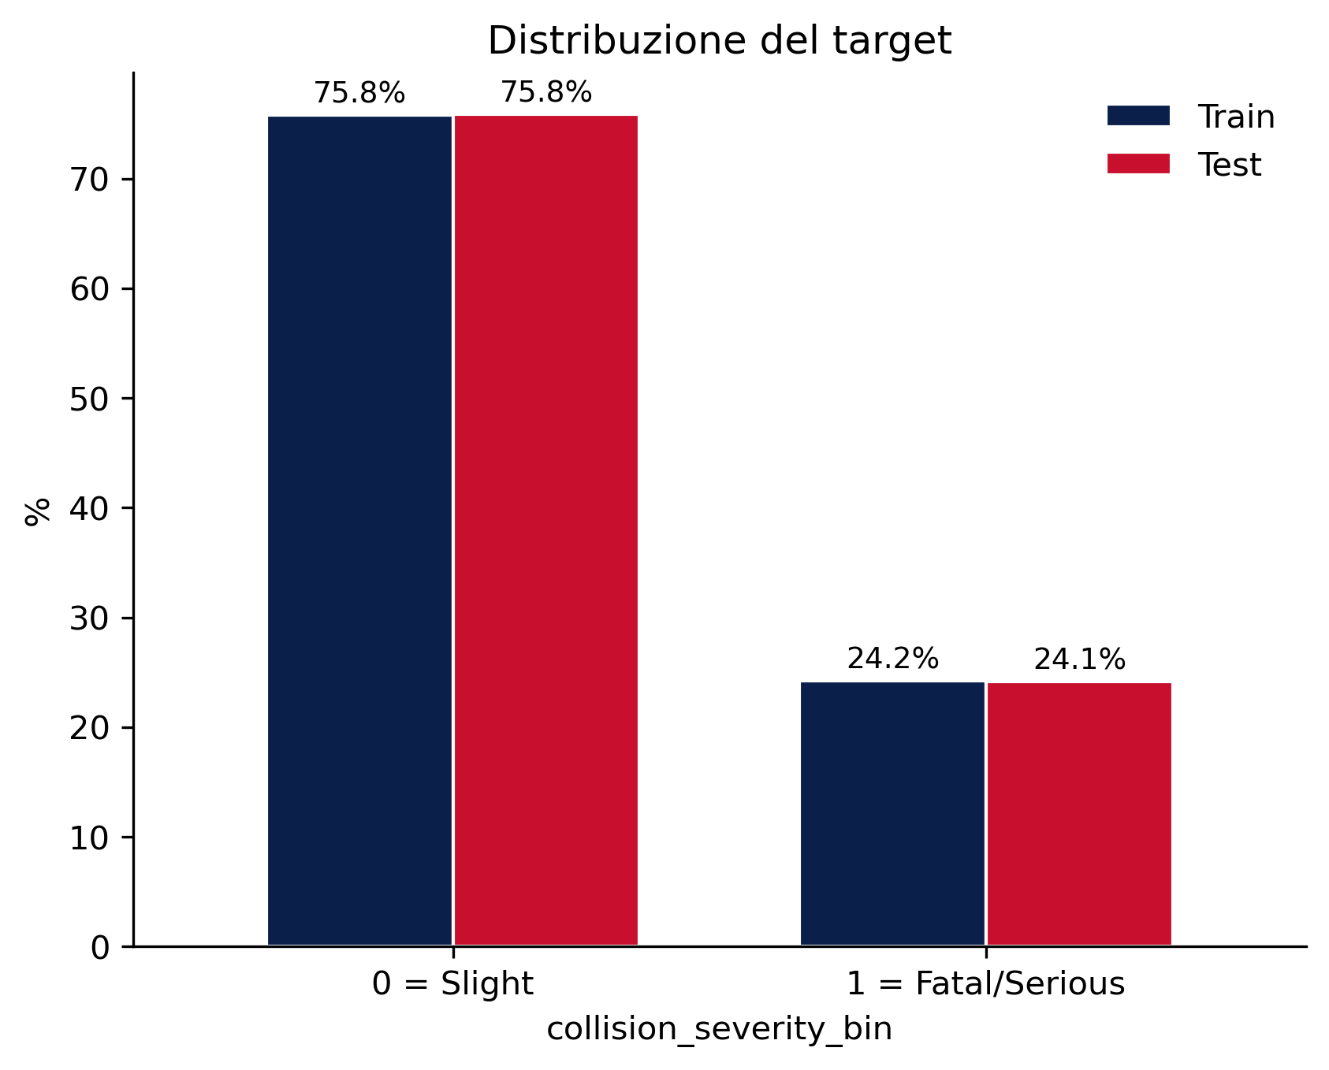
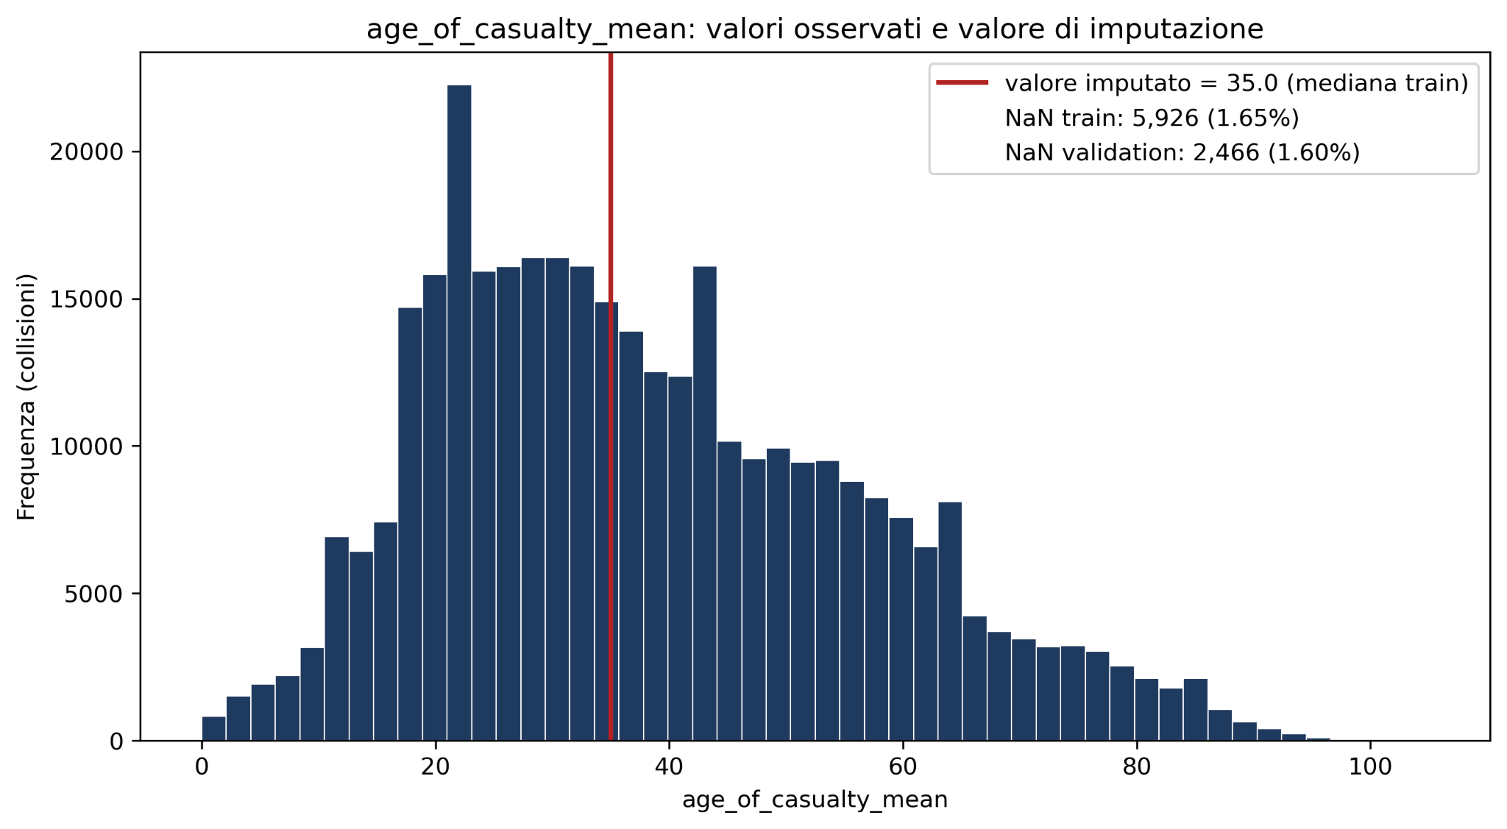
SPLIT AND IMPUTATION
Jo
SPLIT 70 / 30
IMPUTATION
stratified by week of the year: same share of serious collisions in training and test
mean casualty age: 1.6% missing → training median (35 years), also applied to the test set
Training 359,621 · Test 154,124 · median computed on the training set only

Slide 12
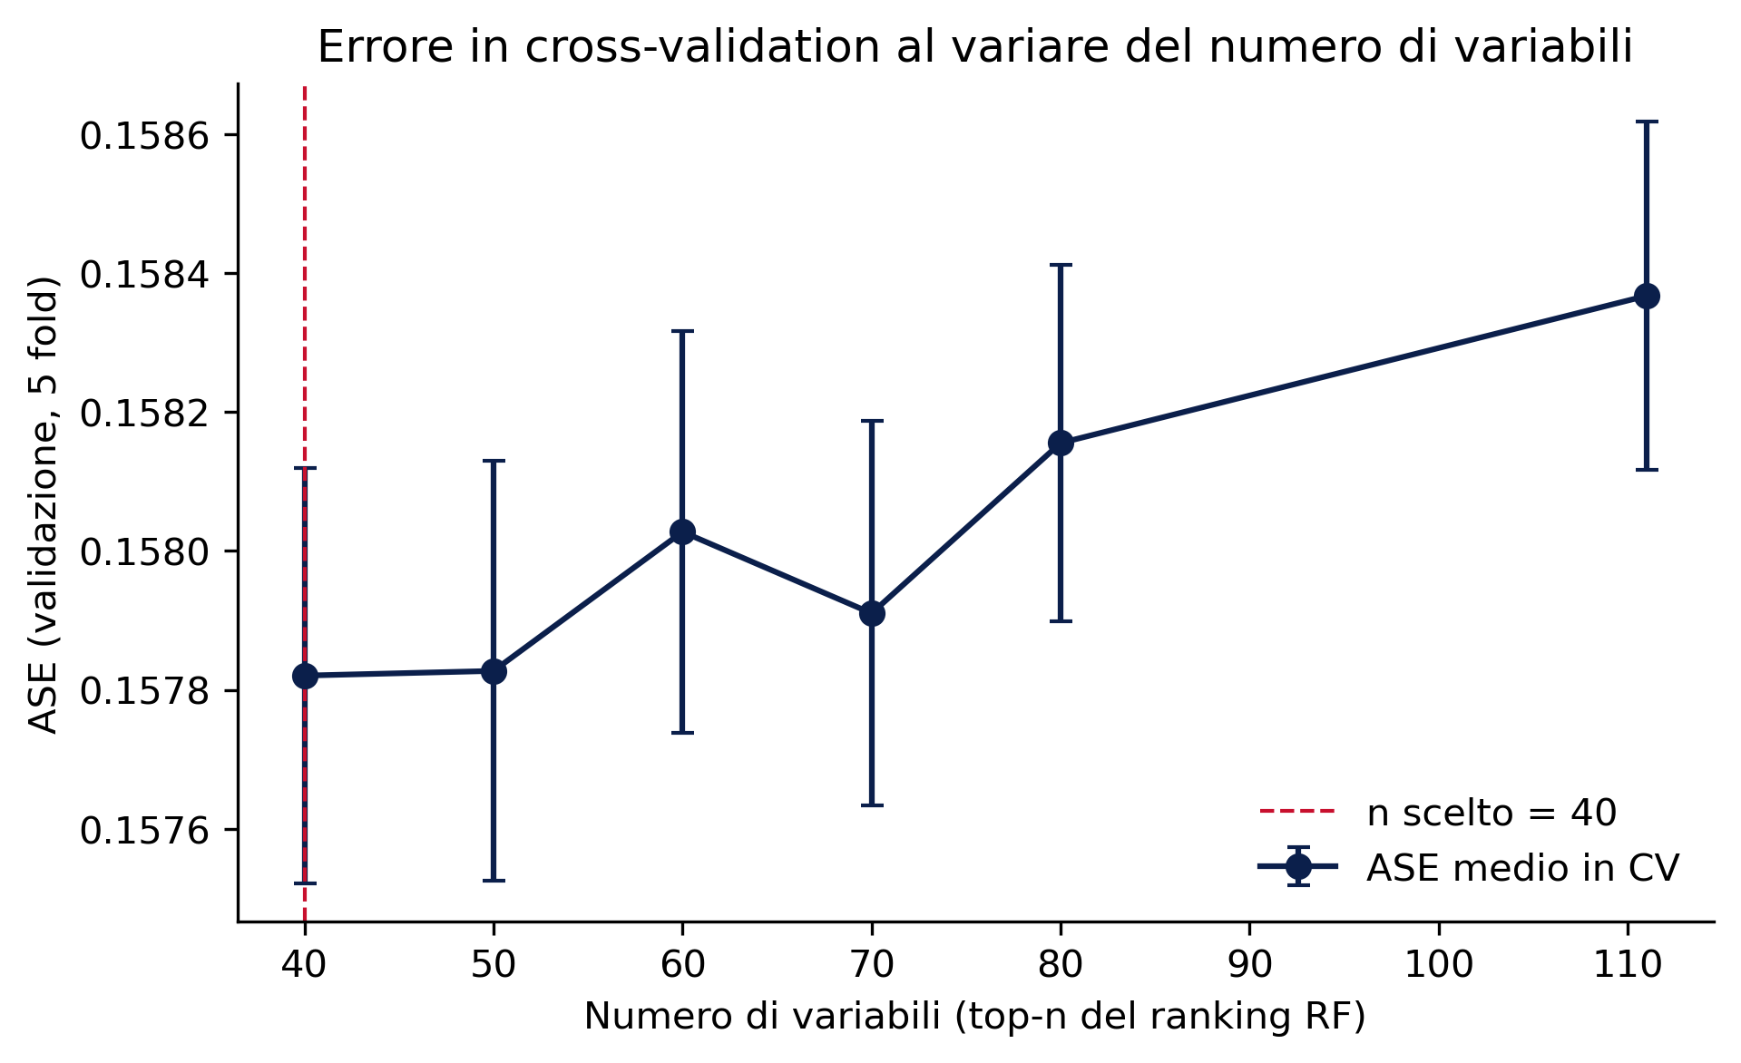
VARIABLE SELECTION
Jo
Ranking inside each fold
Random Forest importance recomputed in each fold (5-fold CV).
Error = ASE
Mean of (y − p)²: quality of the probabilities.
40 VARIABLES

Slide 13
MODELS
04
Goal
Data
Preprocessing
Models
Performance
Conclusions

Slide 14
MODEL SETUP
Salvo
Model | Preprocessing | Tuned hyperparameters
Logistic regression | standardisation | C ∈ {0.1 · 1 · 10}
Random forest | none | min_samples_leaf ∈ {50 · 60 · 80}, max_features = √p
XGBoost | none | learning rate {0.03 · 0.05}, depth {8 · 10}, colsample {0.4 · 0.5 · 0.7}, min_child_weight {5 · 20 · 50}
MLP | standardisation | 2 layers (128, 64), alpha ∈ {0.0001 · 0.001 · 0.01}
Bagging (trees) | none | 100 trees, 50% of the sample: no tuning
Voting (soft) | of the inner models | mean of the probabilities of logistic, RF, XGBoost and MLP
Tuning: Randomized Search, 3-fold CV on the training set, AUC metric · only non-binary variables standardised

Slide 15
TUNED MODELS
Salvo
Model | Chosen + fixed hyperparameters
Logistic regression | C = 10, L2 penalty, max_iter = 2000
Random forest | min_samples_leaf = 50, 300 trees, max_features = √p
XGBoost | learning rate = 0.03, depth = 8, colsample = 0.7, min_child_weight = 50, 600 trees, subsample = 0.8
MLP | alpha = 0.001, 2 layers (128, 64), ReLU, Adam, early stopping, max_iter = 200
Bagging (trees) | 100 trees, 50% of the sample, min_samples_leaf = 20 (no tuning)
Voting (soft) | mean of the probabilities of the tuned logistic, RF, XGBoost and MLP
Final configuration: the values with the highest CV AUC · then refitted on the full training set and evaluated on the test

Slide 16
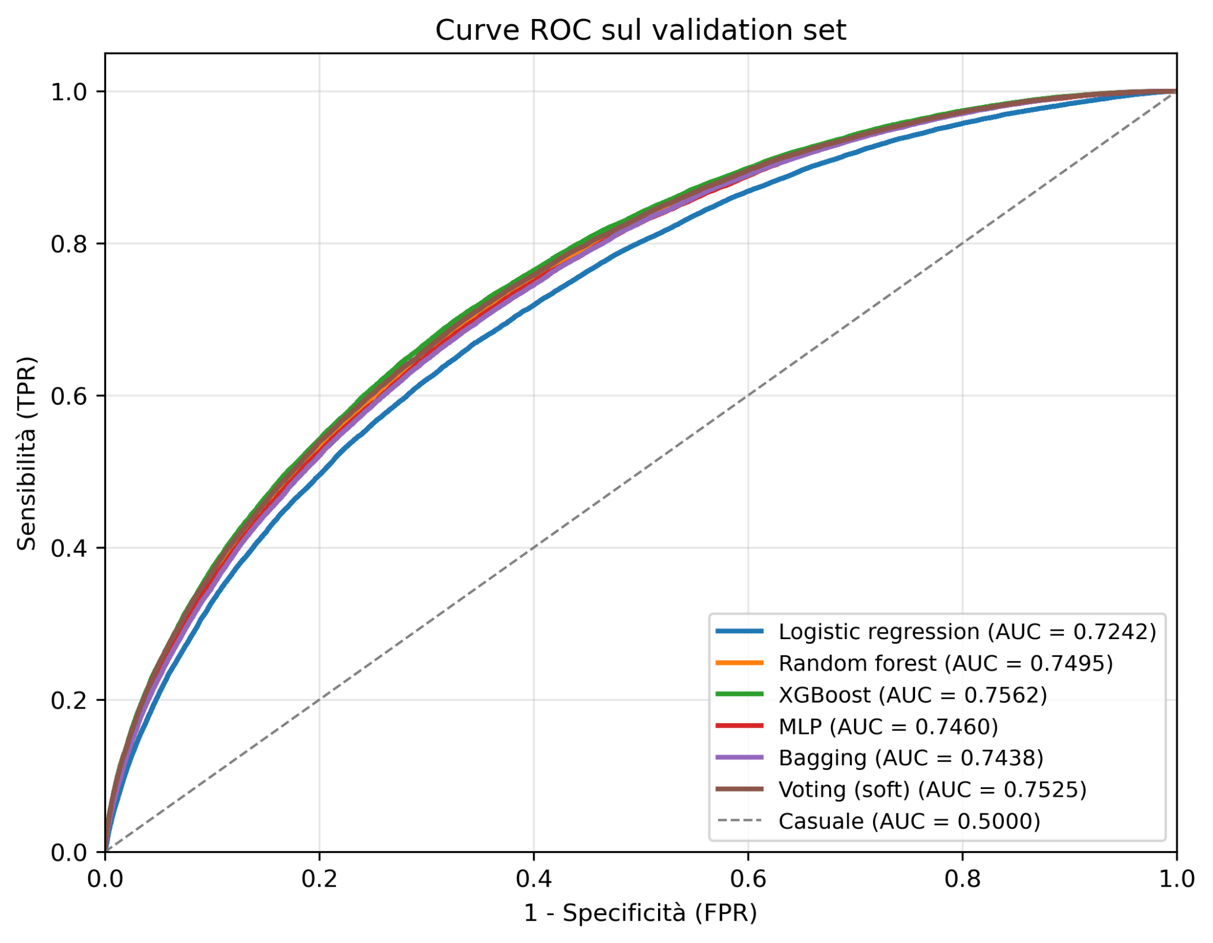
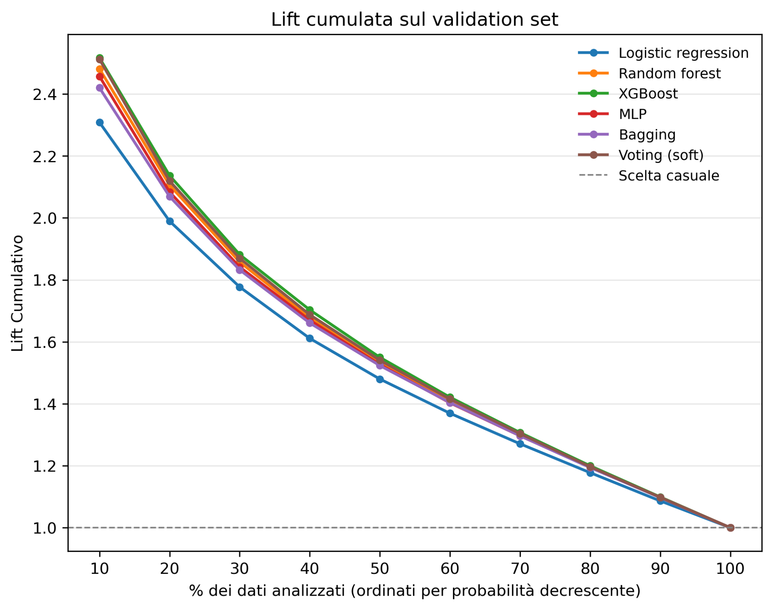
MODEL SELECTION
Salvo
XGBOOST
AUC 0.756 on the test set
best on lift too
All models between 0.72 and 0.76 AUC · XGBoost first on ROC and lift

Slide 17
OVERFITTING CHECK
Salvo
Model | AUC train | AUC test | ASE train | ASE test | ASE gap | Overfitting
XGBoost | 0.781 | 0.756 | 0.148 | 0.154 | 3.9% | no
Voting (soft) | 0.783 | 0.753 | 0.149 | 0.155 | 3.9% | no
Random forest | 0.825 | 0.750 | 0.142 | 0.156 | 9.9% | yes
MLP | 0.763 | 0.746 | 0.152 | 0.156 | 2.5% | no
Bagging | 0.784 | 0.744 | 0.149 | 0.157 | 5.1% | no
Logistic regression | 0.724 | 0.724 | 0.162 | 0.161 | −0.3% | no
MIND THE GAP ASE gap between training and test above 7% = overfitting

Slide 18
MODEL PERFORMANCE
05
Goal
Data
Preprocessing
Models
Performance
Conclusions

Slide 19
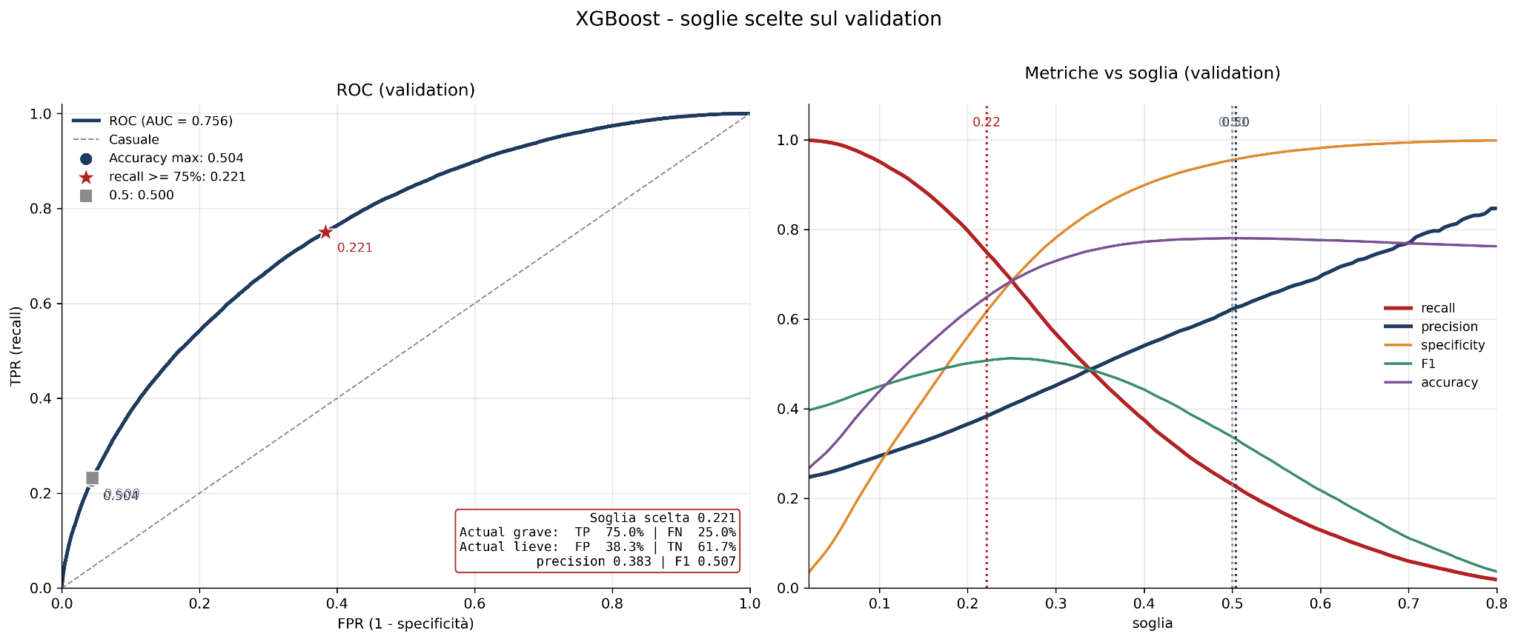
CHOOSING THE THRESHOLD
Jo
THRESHOLD 0.221
the highest with
recall ≥ 75%
Threshold chosen on recall

Slide 20
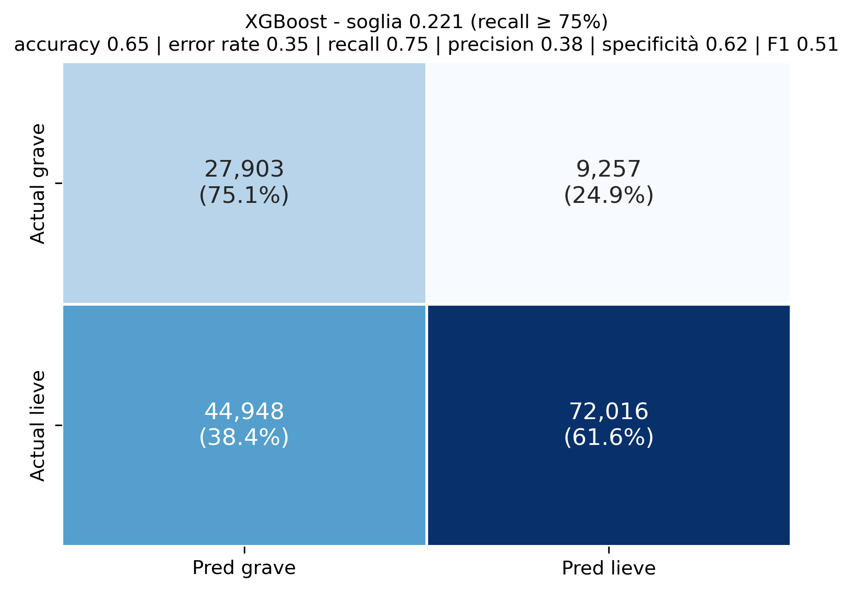
CONFUSION MATRIX
Jo
XGBOOST · THRESHOLD 0.221
0.75 recall: serious recognised
0.38 precision: correct alerts
0.62 specificity: slight recognised
0.65 accuracy
47.3% calls flagged serious
9,257 serious missed (false negatives)

Slide 21
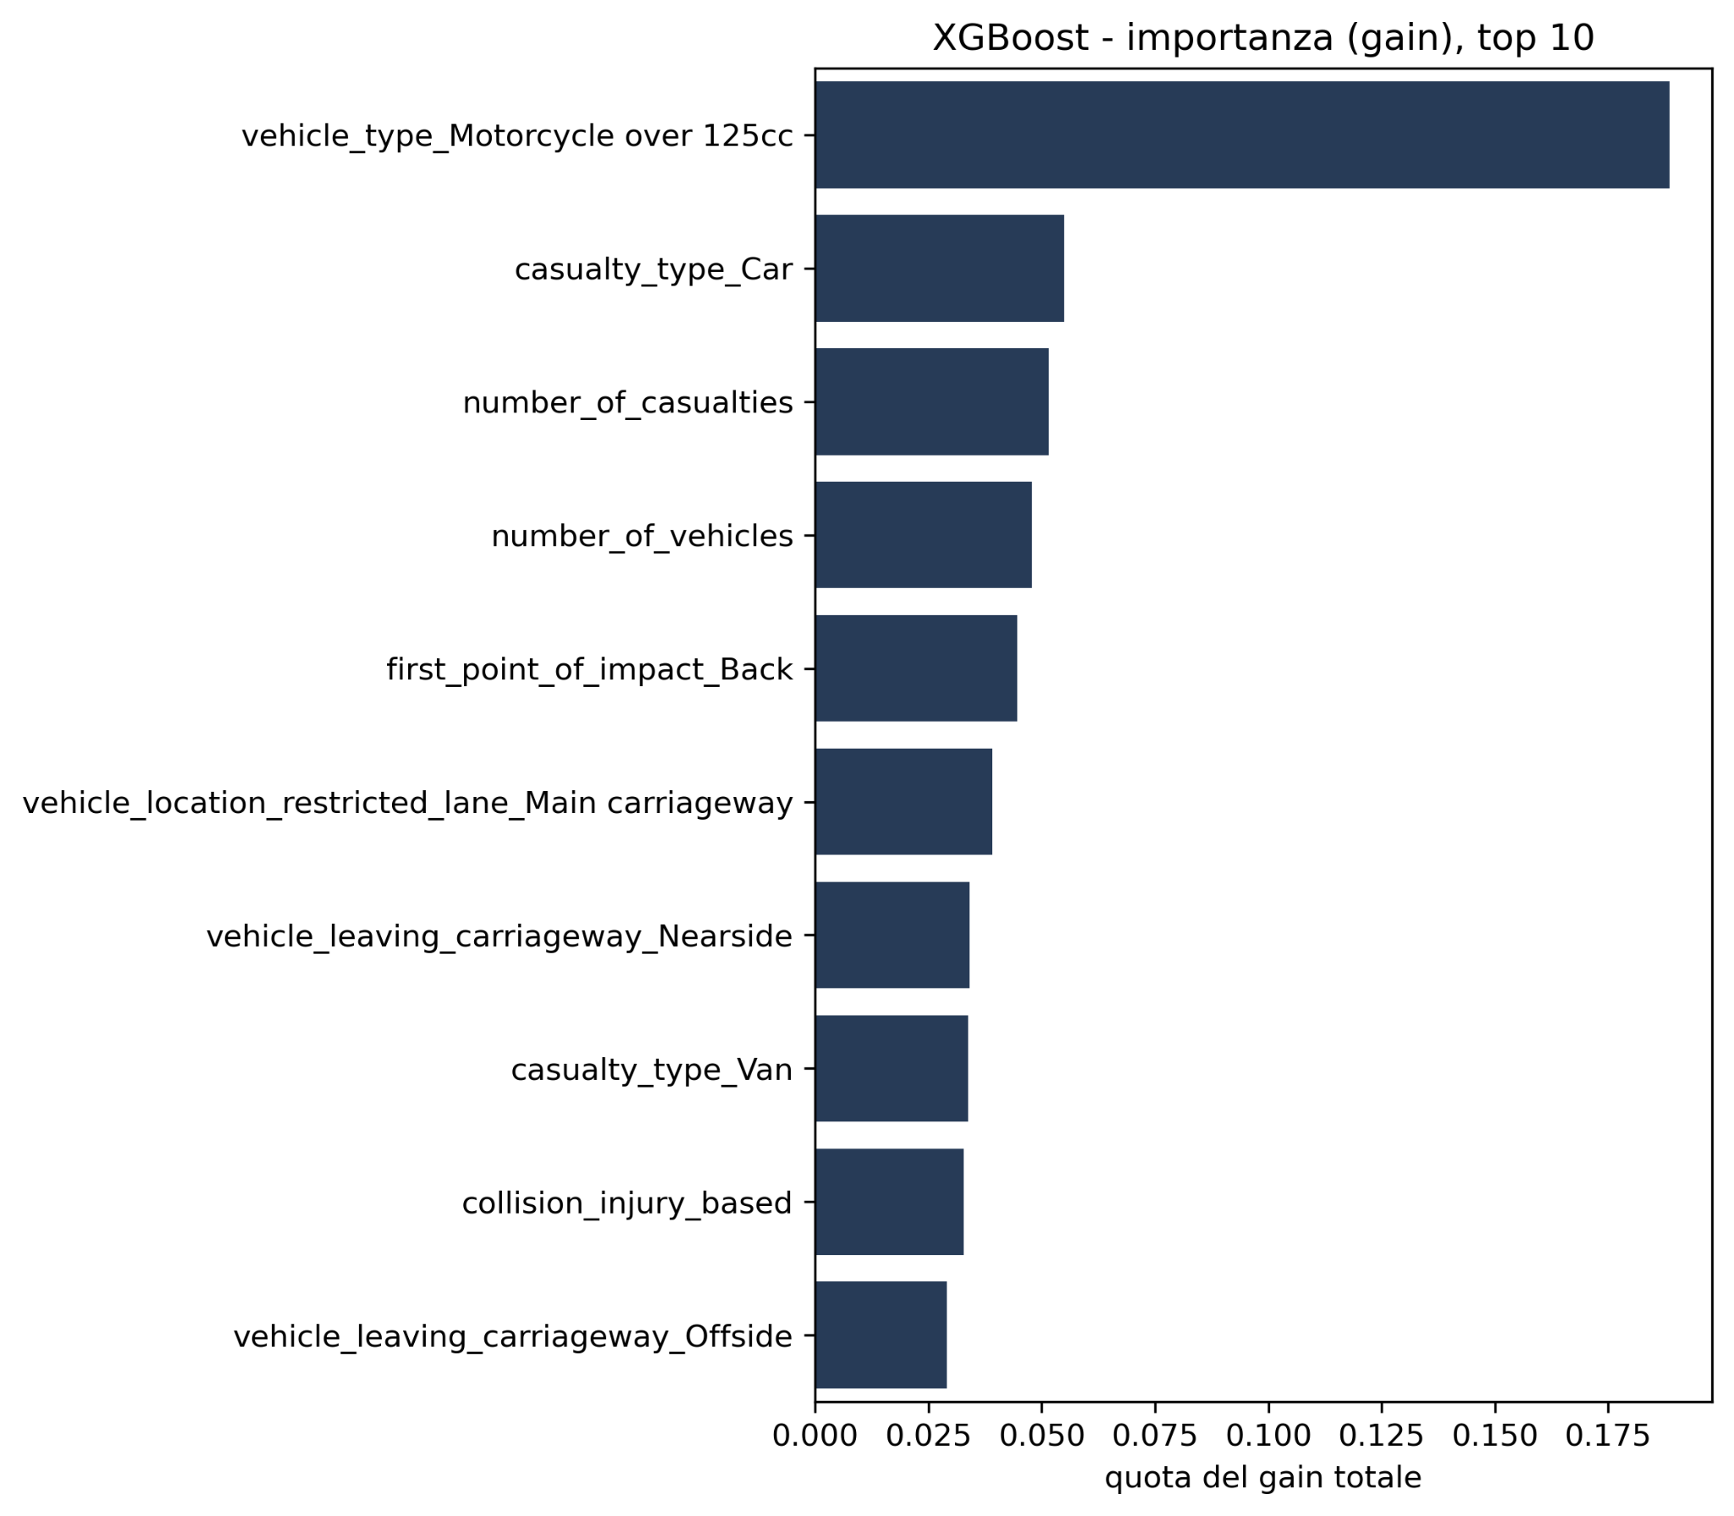
MOST IMPORTANT VARIABLES
Jo
THE TOP FEATURES
Motorcycle over 125cc
Car casualties
Number of casualties
Number of vehicles
KEY TAKEAWAY
Motorcycles over 125cc weigh more than 3 times any other variable

Slide 22
SCORING
Mario
New call
Probability
Decision
information collected by the call handler
XGBoost returns p between 0 and 1
p ≥ 0.221 → serious, otherwise slight
INTERACTIVE DASHBOARD
Try the model: enter the details of a call and see the probability of a serious collision.
LIVE
Open the live demo →

Slide 23
CONCLUSIONS
06
Goal
Data
Preprocessing
Models
Performance
Conclusions

Slide 24
CONCLUSIONS & NEXT STEPS
Mario
65% accuracy
in prediction
3 out of 4 serious collisions recognised
Vehicles and people
matter most
Correct the priors
No cost matrix
Expanding the dataset
The dataset only contains collisions recorded by the police: it does not represent all calls.
In production the probabilities must be recalibrated on the real share of serious collisions in the UK population.
Every casualty is treated by the health service whatever the severity: the cost does not fall on the call centre.
This is why the threshold is chosen on a statistical basis.
Strengthen the model by adding real calls, not only collisions recorded by the police.

Slide 25

THANK YOU FOR YOUR ATTENTION
Mind the Crash Repository

