Slide 1
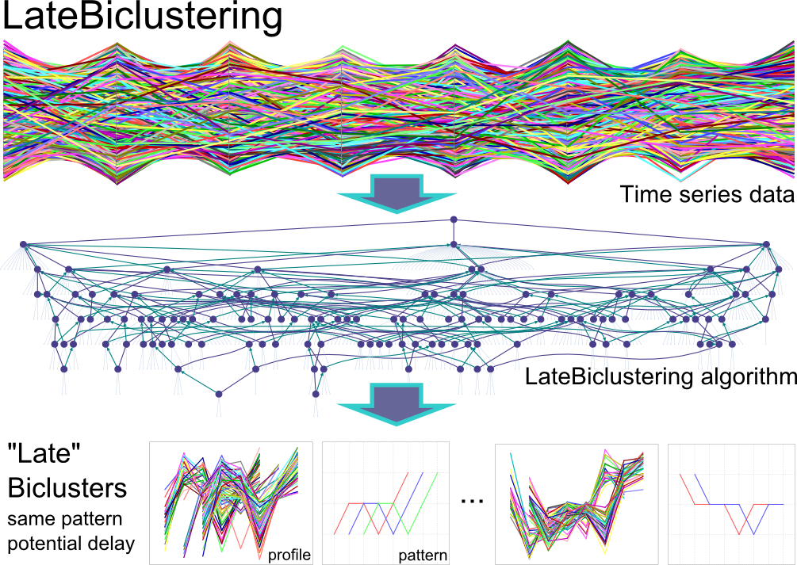
Time
Genes
Sensitive
Resistant
Samples,
Cells, …
…

