Slide 3
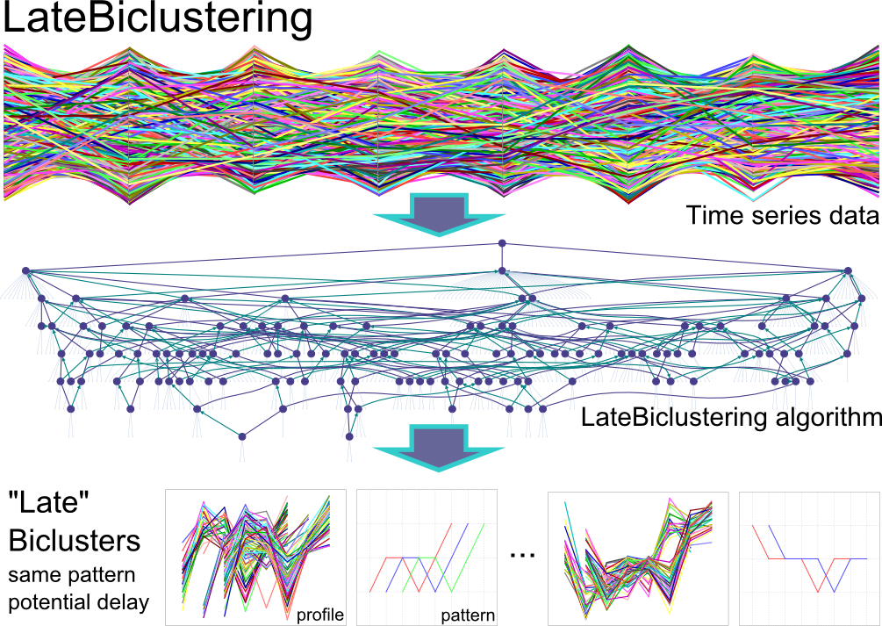
Time
Genes
Sensitive
Resistant
Samples,
Cells, …

