Slide 1

SafeCellApp
Proyecto final DAW – SafeCell (exposición ámbito app)
Alumnos:
Iris Iglesias Baladón, Jose Luís García Torrecillas y Joan Samsó Roig
1. Casos de uso
2. Lógica de la aplicación
3. Partes relevantes del código
4. Escalabilidad de la aplicación

Slide 2
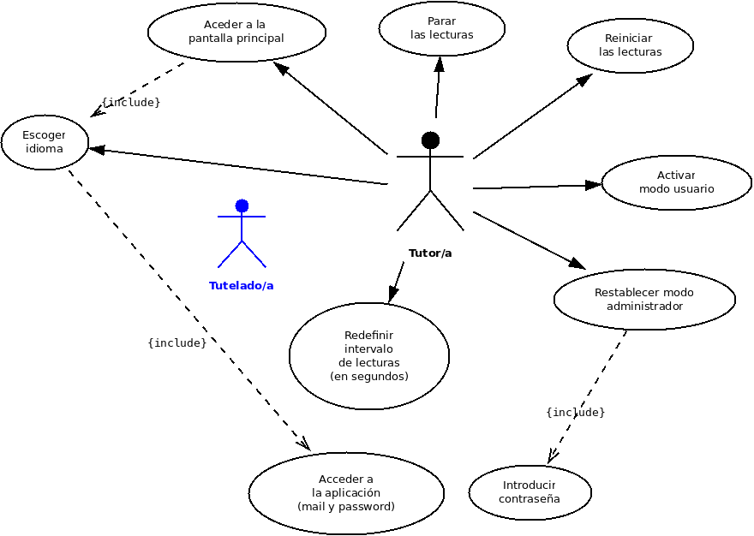
1. Casos DE USO

Slide 3
2. Lógica de la aplicación

Slide 4
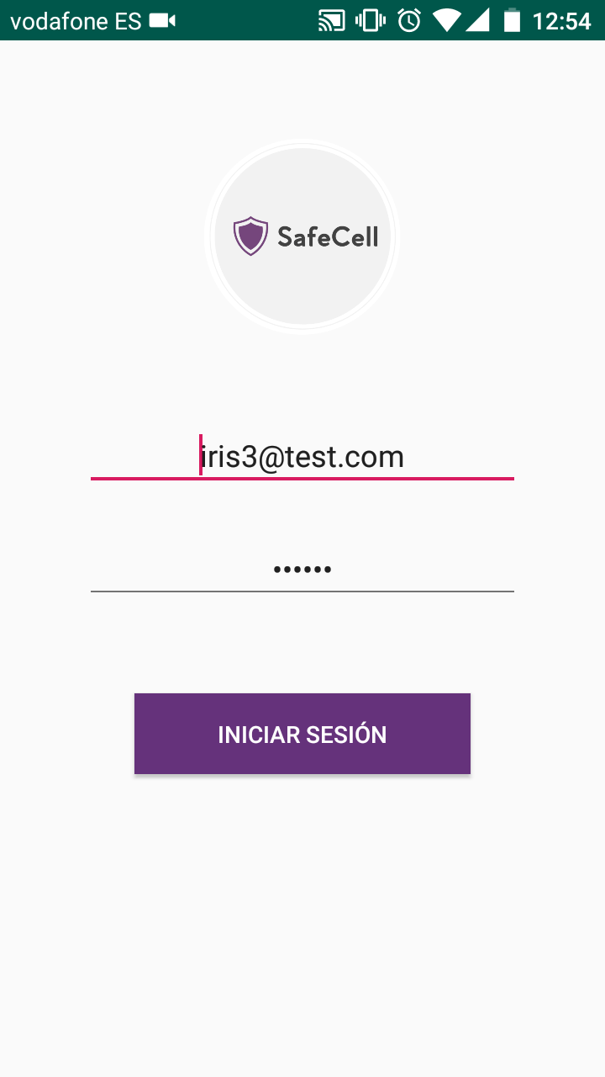
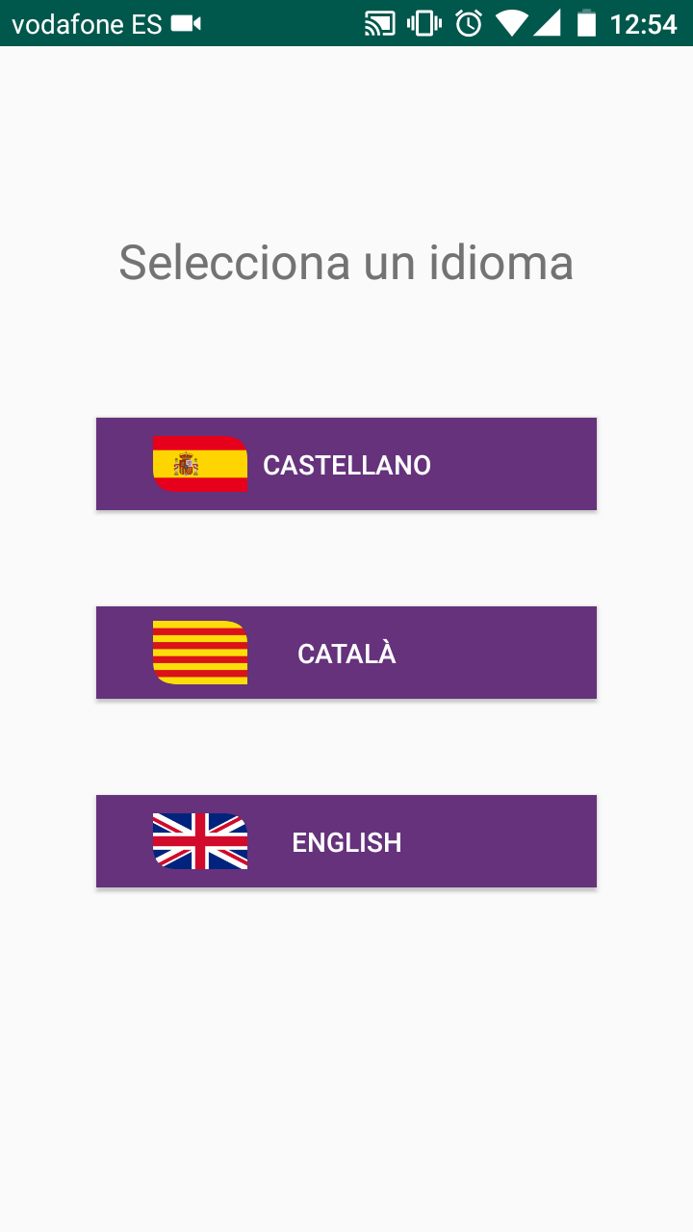

Slide 5
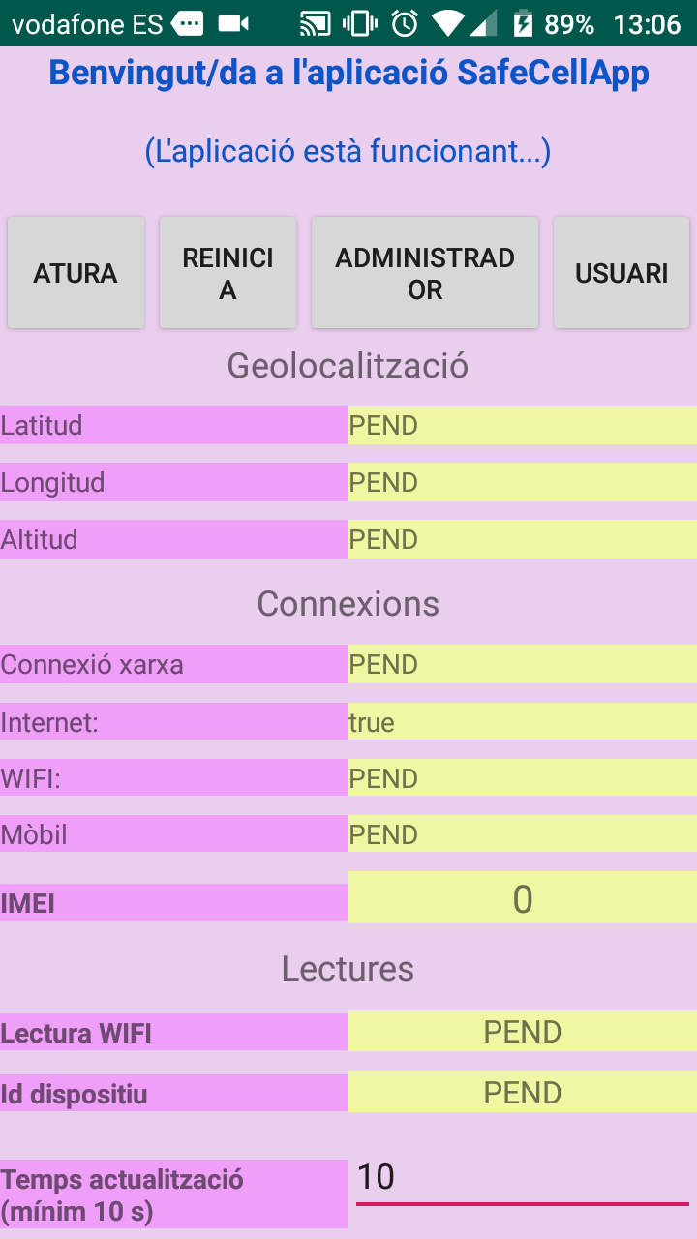
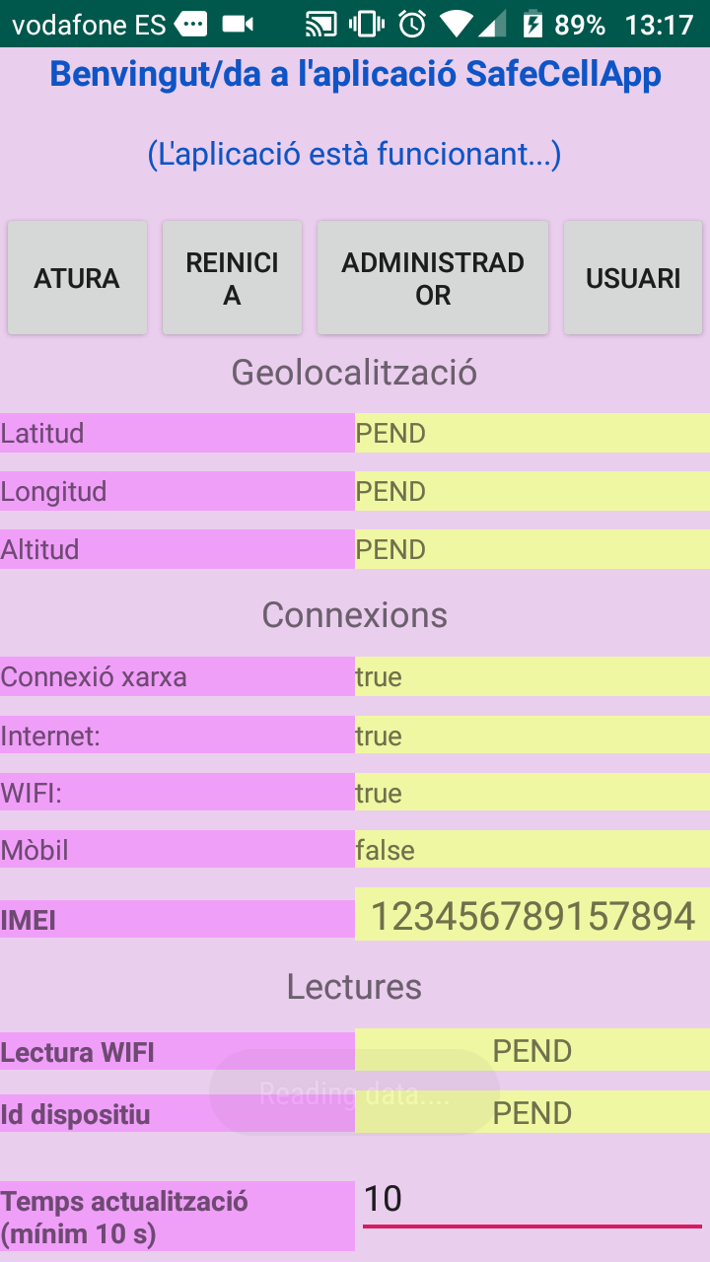

Slide 6
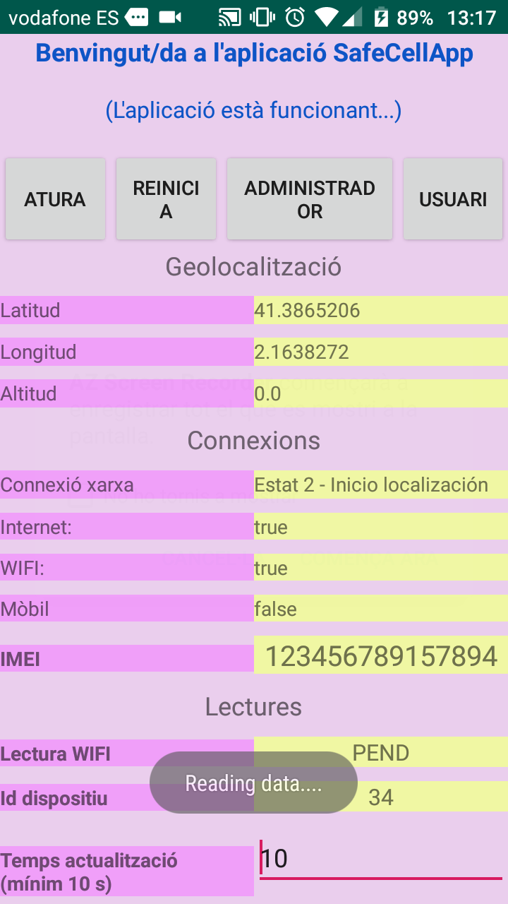
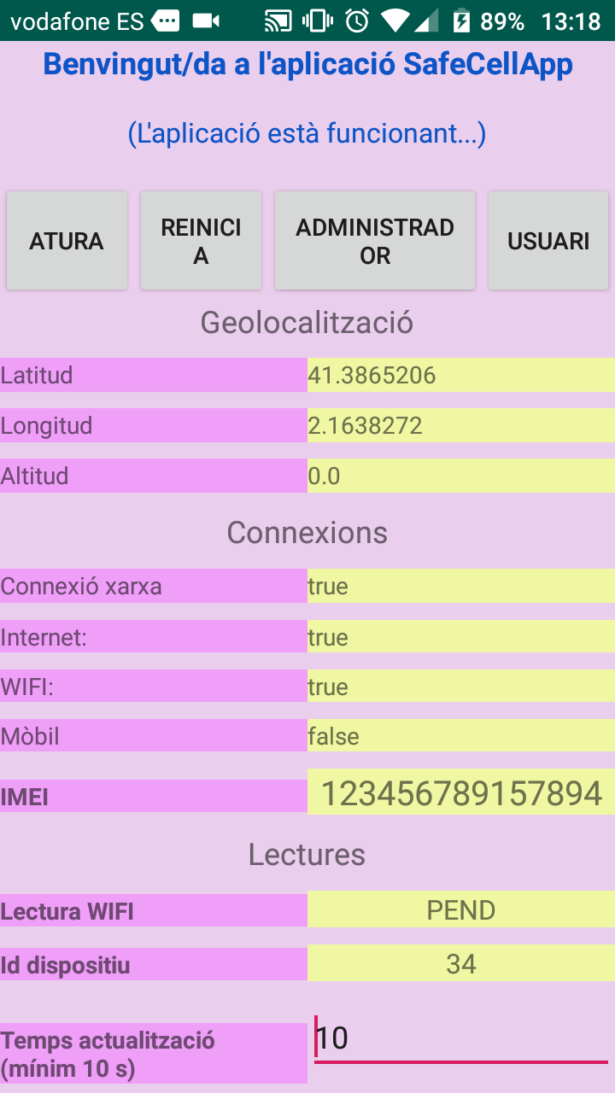

Slide 7
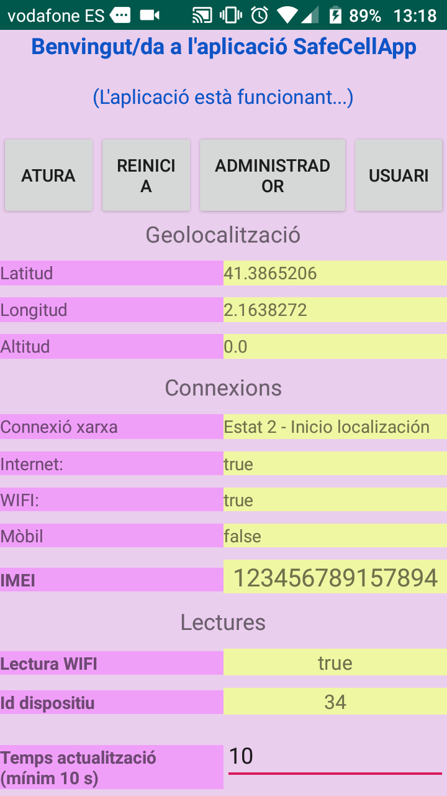
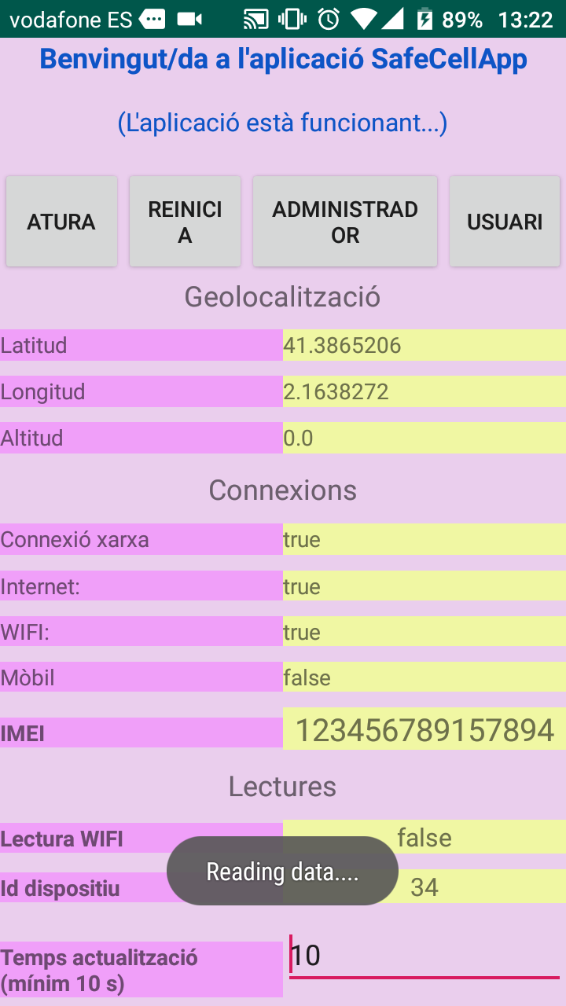

Slide 8

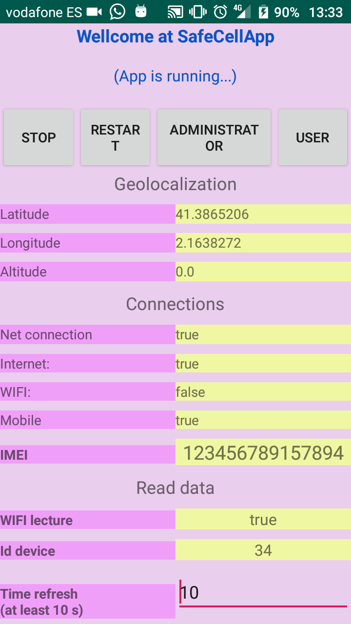

Slide 9
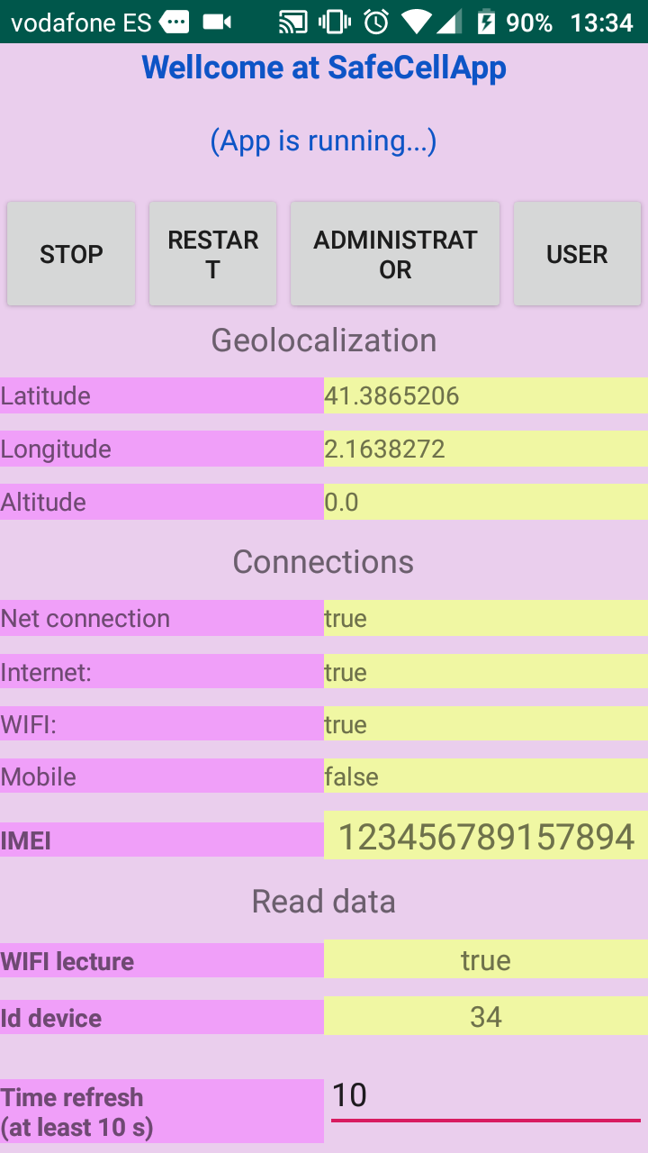
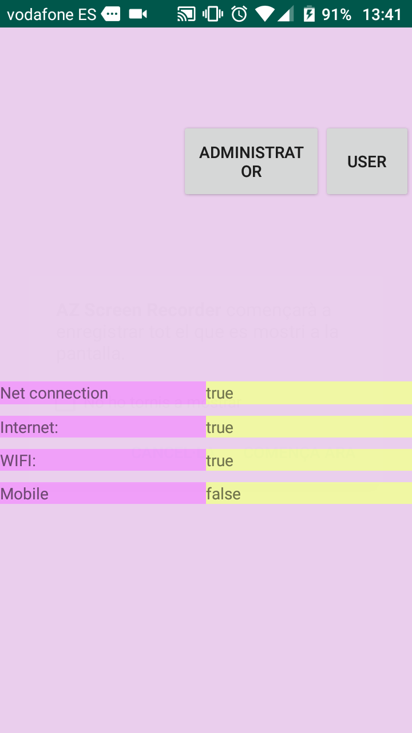

Slide 10
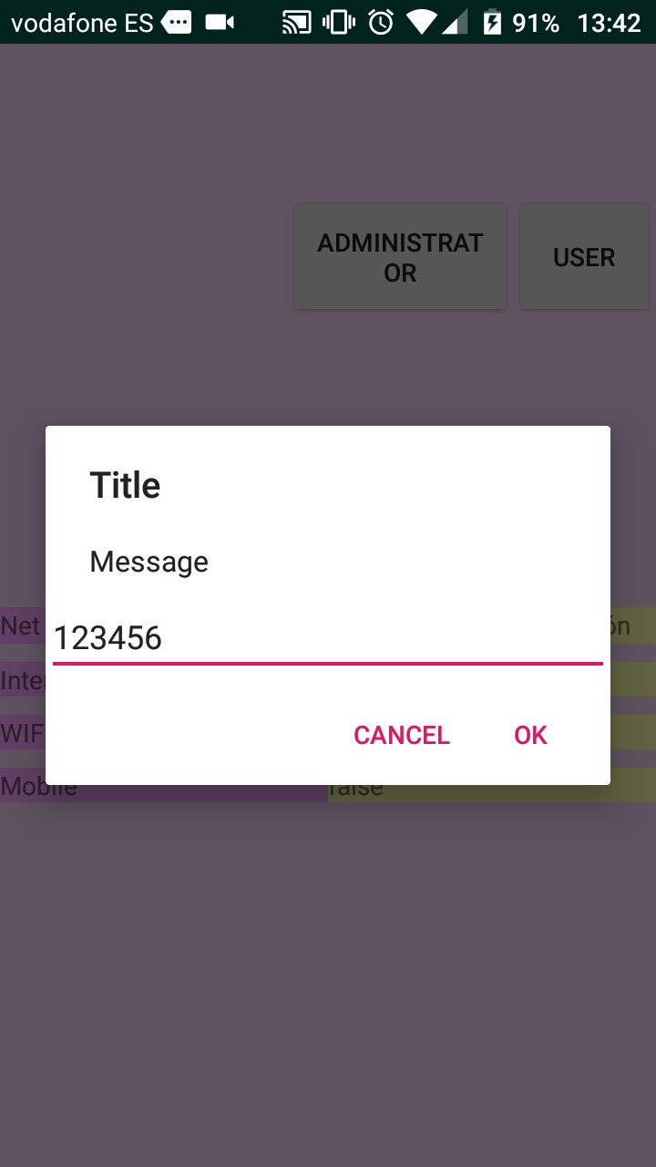
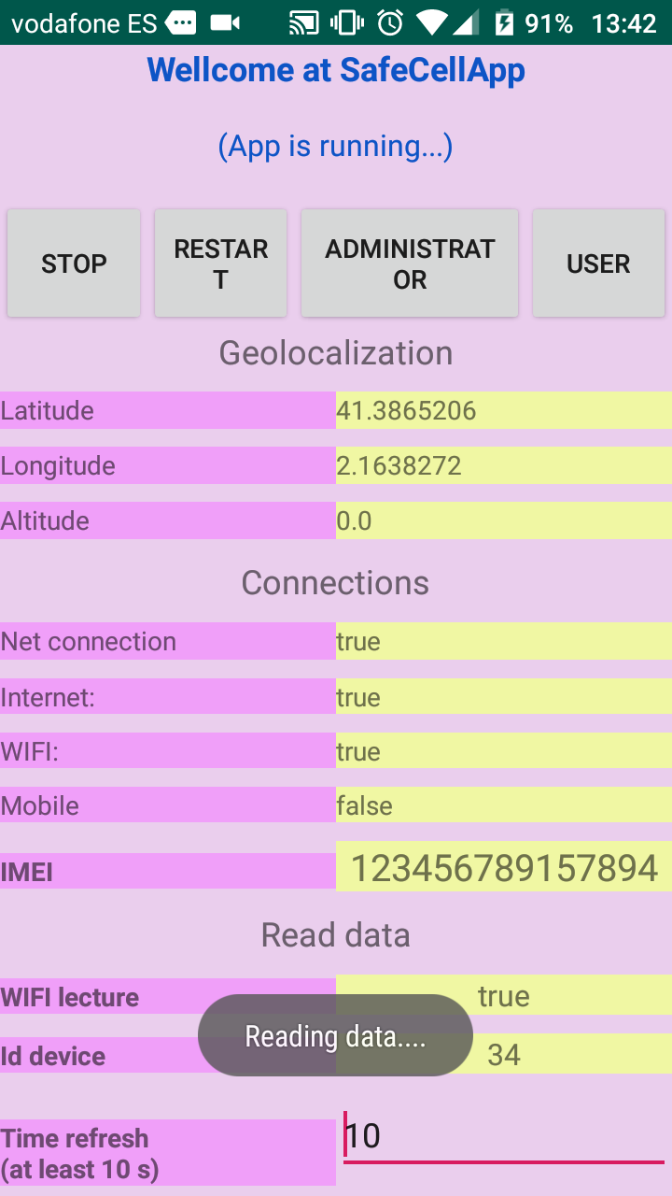

Slide 11
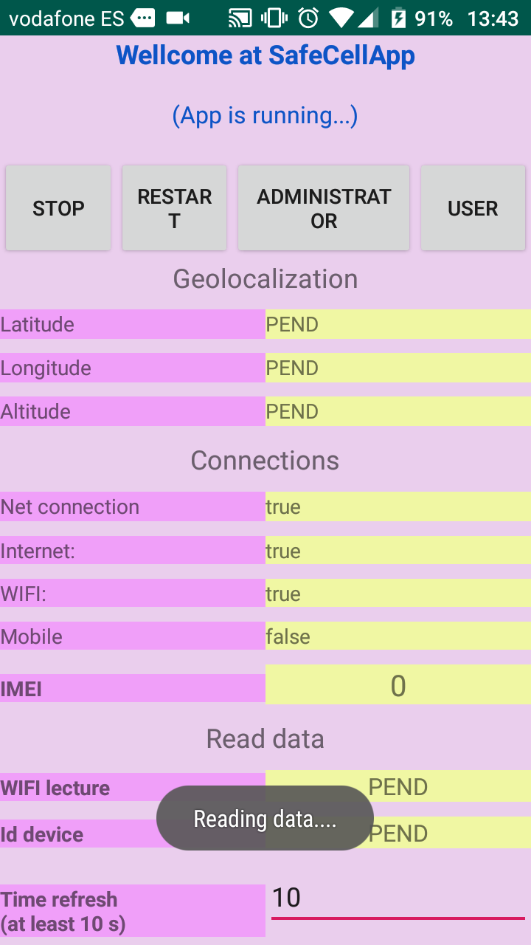
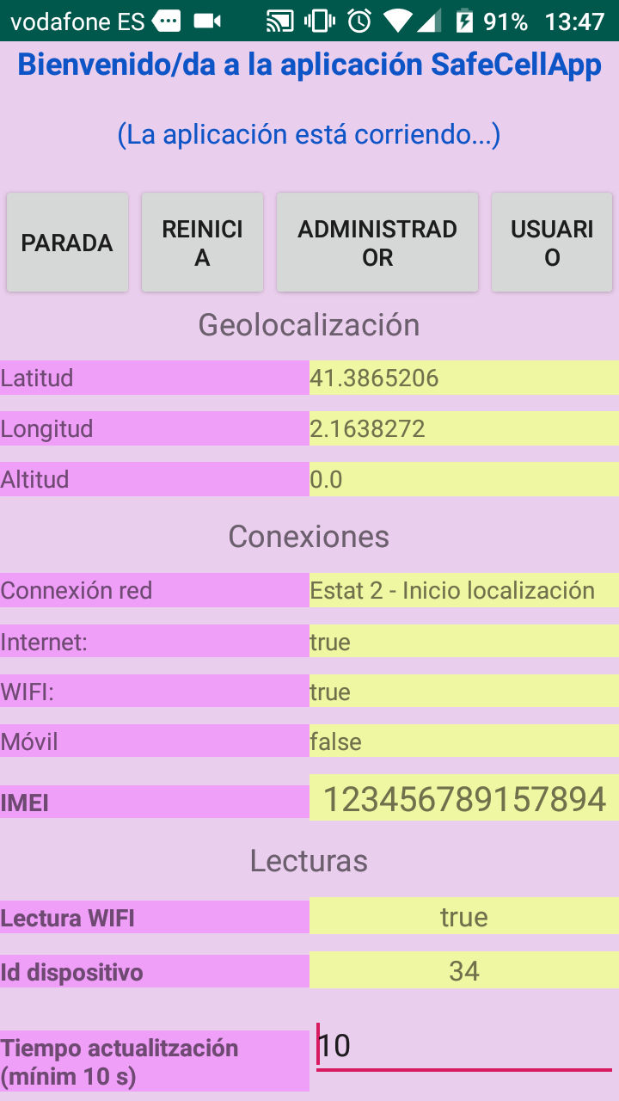

Slide 12
3. Partes relevantes del código:
3.1. Login
3.2. Lecturas periódicas
3.3. Evento “OnChanged”
3.4. Método setEnabledWifi

Slide 13
3.1. Login
fab.setOnClickListener(new View.OnClickListener() {
@Override
public void onClick(View view) {
Snackbar.make(view, "Iniciando sesi?n...", Snackbar.LENGTH_SHORT)
.setAction("Action", null).show();
RequestQueue queue = Volley.newRequestQueue(getApplicationContext());
String url ="https://safe-cell.herokuapp.com/api/auth/login";
StringRequest postRequest = new StringRequest(Request.Method.POST, url,new Response.Listener<String>(){
@Override
public void onResponse(String response) {
fcmToken=response;
try {
jsonObject = new JSONObject(response);
Utilities.getToken = jsonObject.getString("access_token");
//Toast.makeText(getApplicationContext(), "Get token: "+Utilities.getToken, Toast.LENGTH_LONG).show();
intent = new Intent(getApplicationContext(), Activity2.class);
intent.putExtra("param1", "sesion_iniciada_OK");
startActivity(intent);
Log.d("Response", response);
} catch (JSONException e) {
e.printStackTrace();
} } },
new Response.ErrorListener(){
@Override
public void onErrorResponse(VolleyError error) {
//Snackbar.make(getApplicationContext(), "Error_sesion", Snackbar.LENGTH_SHORT).setAction("Action", null).show();
Log.d("Error.Response", String.valueOf(error));
} }) {
@Override
protected Map<String, String> getParams()
{
Map<String, String> params = new HashMap<String, String>();
name1=String.valueOf(eName.getText());
password1=String.valueOf(ePassword.getText());
//Toast.makeText(getApplicationContext(), "editor: ".concat(name1).concat("-").concat(password1), Toast.LENGTH_LONG).show();
params.put("email", name1);
params.put("password", password1);
params.put("remember_me", String.valueOf(true));
Utilities.pwdScreen=password1;
return params;
}
};
queue.add(postRequest);
}
});

Slide 14
3.2. Lecturas periódicas
void getPeriodicReadings2() {
Toast.makeText(getApplicationContext(), "Reading data....", Toast.LENGTH_SHORT).show();
//Comprovació 1 - Permisos
if (Utilities.permisos.equals("false")) {
getPermisosLoc1();
getPermisosLoc2();
}
//Comprovació 2 - numIMEI
if (Utilities.numIMEI_def.length()<2) {
Utilities.numIMEI_def=numIMEI_R; //Pren IMEI real
mostrar_imei.setText(Utilities.numIMEI_def);
}
//Comprovació 3 - idDevice
if (Utilities.idDevice>0) {
getServiceWifi();
if (Utilities.getWifi.equals("false")) {
setEnabledWifi(false);
} else {
setEnabledWifi(true);
}
} else {
getIdDevice();
}
if (Utilities.idDevice>0) {
getLocation();
}
text4_net.setText(String.valueOf(isConnected()));
text6_mobile.setText(String.valueOf(isMobileConnected()));
text5_wfi.setText(String.valueOf(isWifi()));
}

Slide 15
3.3. Evento “OnChanged”
implements LocationListener
@Override
public void onLocationChanged(Location location) {
lat2=String.valueOf(location.getLatitude());
lon2=String.valueOf(location.getLongitude());
alt2=String.valueOf(location.getAltitude());
locationText1_lat.setText(lat2);
locationText2_lon.setText(lon2);
locationText3_alt.setText(alt2);
text4_net.setText(estatLoc);
refreshTransitData();
}
3.4. Método setEnabledWifi
public void setEnabledWifi(boolean block) {
WifiManager wifi = (WifiManager) getApplicationContext().getSystemService(getApplicationContext().WIFI_SERVICE);
wifi.setWifiEnabled(block);
}

Slide 16
3. Escalabilidad de la aplicación

Slide 17
Configuración de idiomas simplificada mediante un array bidimensional
static final String[] msg_ca={
"Benvingut/da a l'aplicaci? SafeCellApp",
"Sessi? iniciada",
"(L'aplicaci? est? funcionant...)",
"Compte",
"Geolocalitzaci?",
"Connexions",
"M?bil",
"Lectures",
"Latitud",
"Longitud",
"Altitud",
"Connexi? xarxa",
"M?bil",
"Lectura WIFI",
"Id dispositiu",
"Temps actualitzaci?\n(m?nim 10 s)",
"ATURA",
"REINICIA",
"Administrador",
"usuari",
""
};
static final String[] msg_es={
"Bienvenido/da a la aplicaci?n SafeCellApp",
"Sessi?n iniciada",
"(La aplicaci?n est? corriendo...)",
"Advertencia",
"Geolocalizaci?n",
"Conexiones",
"M?vil",
"Lecturas",
"Latitud",
"Longitud",
"Altitud",
"Connexi?n red",
"M?vil",
"Lectura WIFI",
"Id dispositivo",
"Tiempo actualitzaci?n\n(m?nim 10 s)",
"PARADA",
"REINICIA",
"Administrador",
"usuario",
""
};
static final String[] msg_en={
"Wellcome at SafeCellApp",
"Session initied",
"(App is running...)",
"Warning",
"Geolocalization",
"Connections",
"Mobile",
"Read data",
"Latitude",
"Longitude",
"Altitude",
"Net connection",
"Mobile",
"WIFI lecture",
"Id device",
"Time refresh\n(at least 10 s)",
"STOP",
"RESTART",
"Administrator",
"User",
""
};
static String[][] lang1={msg_ca, msg_es, msg_en};

Slide 18
Moltes gràcies
per la vostra atenció!
Muchas gracias
por vuestra atención!

