Slide 1

JDBC - Java
Author: Joan Janku

Slide 2
What is JDBC?
JDBC stands for Java Database Connectivity, which is a standard Java API for database independent connectivity between the Java programming language, and a wide range of databases.

Slide 3
What does JDBC do ?
Make a connection to a database.
Create SQLstatements.
Excecute SQL queries in the database.
View & Modify the resulting records.

Slide 4
JDBC Architecture
JDBC Architecture consists of two layers:
JDBC API: This provides the application-to-JDBC Manager connection.
JDBC Driver API: This supports the JDBC Manager-to-Driver Connection.
The JDBC API uses a driver manager and database-specific drivers to provide transparent connectivity to heterogeneous databases.
The JDBC driver manager ensures that the correct driver is used to access each data source. The driver manager is capable of supporting multiple concurrent drivers connected to multiple heterogeneous databases.

Slide 5
Common JDBC Components
DriverManager: This class manages a list of database drivers. Matches connection requests from the java application with the proper database driver using communication subprotocol. The first driver that recognizes a certain subprotocol under JDBC will be used to establish a database Connection.
Driver: This interface handles the communications with the database server. You will interact directly with Driver objects very rarely. Instead, you use DriverManager 9 objects, which manages objects of this type. It also abstracts the details associated with working with Driver objects.
Connection: This interface with all methods for contacting a database. The connection object represents communication context, i.e., all communication with database is through connection object only.
Statement: You use objects created from this interface to submit the SQL statements to the database. Some derived interfaces accept parameters in addition to executing stored procedures.
ResultSet: These objects hold data retrieved from a database after you execute an SQL query using Statement objects. It acts as an iterator to allow you to move through its data.
SQLException: This class handles any errors that occur in a database application
PreparedStatement : The preferred way to submit SQL Statements to database. Why ? Since it checks the parameters before binding them, and ensures that they are the type that is required by the db. It prevents the infamous so-called SQL - Injection

Slide 6
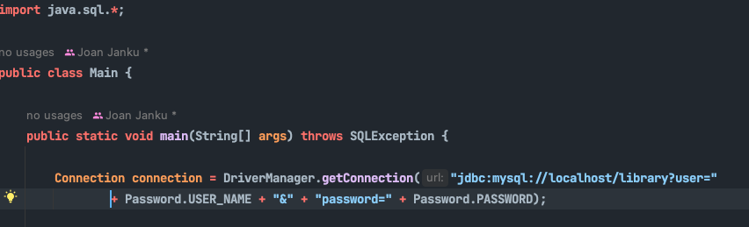
JDBC – Acquring a JDBC Connection
In order for our program to acquire a JDBC Connection with a certain database we need to define and instantiate a class of type Connection in our Java Application.
We can acquire a connection by Java’s getConnection(String url) method residing in the DriverManager class.
We of course need to have the necessary imports for Connection and and DriverManager classes.
The url passed as an argument to the method getConnection contains the url for database connection, the name of the schema and the username and password combination
Port can also be specified: Mysql – 3306 (default)
"jdbc:mysql://localhost/library?user=<USER>&password=<PASSWORD>”
protocol
Host (or IP Address)
username
password
DB server
DB schema

Slide 7
JDBC – Creating an SQL Statement (PreparedStatement)
After acquiring our JDBC Connection, we can use it to issue SQL Statements to the Database. The statements can be of both modifying and querying types.
To create a PreparedStatement we use prepareStatement(String sql) method from the Connection class (from the instance)
The method takes the SQL Statement which will be executed in the DB (be it Insert , Update , Delete, or Select statements or any other statement in SQL)
The created instance of PreparedStatement can take parameters, by calling set<DATATYPE>(int index, String label) on the instance.
Examples : setString(1,”id”), setInt(2,3) etc…
The index refers to the order the ? appears in the statement
When no parameters (?) are present in the statement no parameter is put in the preparedStatement

Slide 8
JDBC – Creating an SQL Statement (PreparedStatement) - Example
? – the parameters in the statement, it can have as many ? (parameters) as we wish
setString(1, String value) – 1 the index of the parameter in the query, Erich Remarque – the string value
PreparedStatement preparedStatement = connection
.prepareStatement("select * from author where full_name = ?"); preparedStatement.setString(1,”Erich Remarque” );
Common parameter methods include:
setString(…)
setInt(…)
setBoolean(…)
setTimestamp(…)
etc…
All the methods with similar signature take the index
(the order the parameter appears in the sql statement,
and the value to be binded)

Slide 9
JDBC – Executing the statement
Depending on the type of statement we need to execute we call 2 different methods
preparedStatement.executeUpdate()→ Used to execute DML on the DB (insert,update,delete) – returns an integer with the number of rows affected
preparedStatement.executeQuery() → Used to execute DQL on the DB (select statements) – returns an object of type ResultSet which contains the data produced by the query

Slide 10
JDBC – Executing the statements
When the statement to be executed is a DML(insert,update,delete) we only need the numbers of rows affect (optionaly)
However, when the statement to be executed is DQL we need to see/access what the query returns. This is achived through the ResultSet object the executeQuery method returns

Slide 11
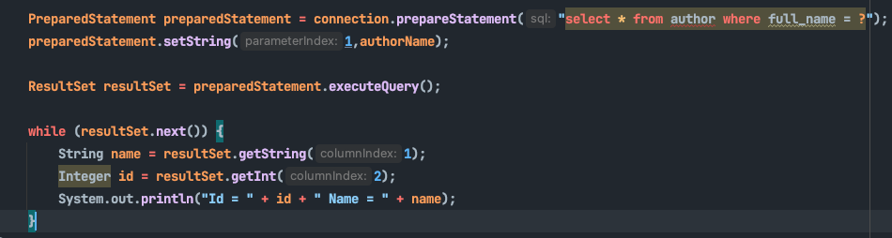
JDBC - ResultSet
The ResultSet object is a special kind of object, which is used to mimic the table retuturned by the SQL Query in the DB.
The ResultSet object maintains a cursor pointing to the current row of data being read. Initially the cursor is positioned before the first row. The next() method moves the cursor to the next row and returns true when there are other rows remaining and false otherwise.
The next() method is usually used inside a while loop to iterate and access the data returned by the query.
ResultSet Iteration Example – The above code
Iterates the result set and prints the content of the first
and second column from the resultset
resultSet.get<DATATYPE> (int index) method is used to
access the value which corresponds to the index column
of the current row. The methods are overloaded
to take the column name as a parameter for easier coding
getString(int index)
getInt(int index)
getDate(int index)
getString(String label)
getInt(String label)
getDate(String label)

Slide 12
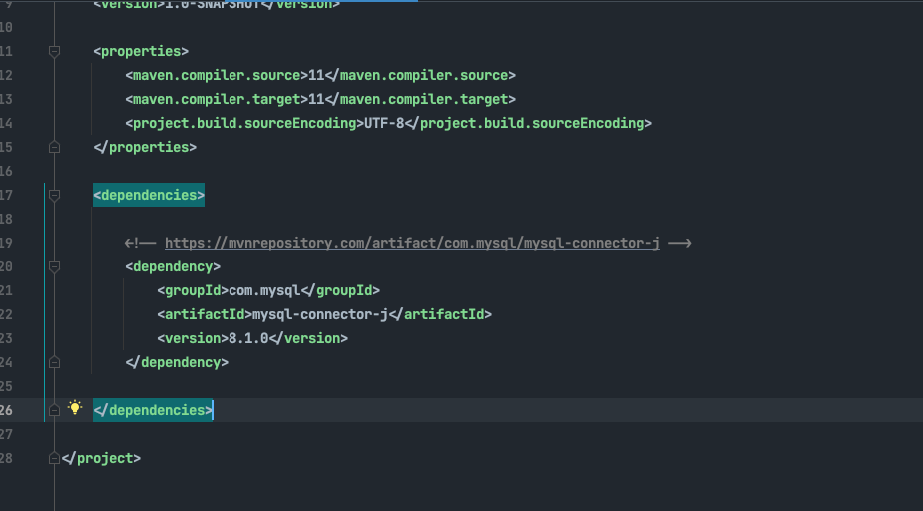
JDBC – Necessary Dependency for mysql connector

Slide 13
Example for acquiring a JDBC Connection and querying our library database
public static void main(String[] args) throws SQLException { Connection connection = DriverManager.getConnection("jdbc:mysql://localhost/library?user=" + Password.USER_NAME + "&" + "password=" + Password.PASSWORD); PreparedStatement preparedStatement = connection.prepareStatement("select * from author limit 4"); ResultSet resultSet = preparedStatement.executeQuery(); while (resultSet.next()) { String name = resultSet.getString(1); Integer id = resultSet.getInt(2); System.out.println("Id = " + id + " Name = " + name); } }

Slide 14
Example for acquiring a JDBC Connection and querying our library database – Passing query params
public static void main(String[] args) throws SQLException { Connection connection = DriverManager.getConnection("jdbc:mysql://localhost/library?user=" + Password.USER_NAME + "&" + "password=" + Password.PASSWORD); String authorName = "A.J. McAllister"; PreparedStatement preparedStatement = connection.prepareStatement("select * from author where full_name = ?"); preparedStatement.setString(1,authorName); ResultSet resultSet = preparedStatement.executeQuery(); while (resultSet.next()) { String name = resultSet.getString(1); Integer id = resultSet.getInt(2); System.out.println("Id = " + id + " Name = " + name); } }

Slide 15
Full Example: Inserting and querying data
public static void main(String[] args) throws SQLException { Connection connection = DriverManager.getConnection("jdbc:mysql://localhost/library?user=" + Password.USER_NAME + "&" + "password=" + Password.PASSWORD); String authorName = "A.J. McAllister"; String authorNameToInsert = "Author test"; PreparedStatement preparedStatementInsert = connection.prepareStatement( "insert into author(full_name) values (?)"); preparedStatementInsert.setString(1,authorNameToInsert); preparedStatementInsert.executeUpdate(); PreparedStatement preparedStatement = connection.prepareStatement("select * from author where full_name = ?"); preparedStatement.setString(1,authorNameToInsert); ResultSet resultSet = preparedStatement.executeQuery(); while (resultSet.next()) { String name = resultSet.getString(1); Integer id = resultSet.getInt(2); System.out.println("Id = " + id + " Name = " + name); } } }

