Slide 1
Lumière; week 2
Young scholar: Ashuova Saniya Nurzhankyzy
Mentor: Joan Damiens

Slide 2
Our topic:
Youth, Gender, and Educational Inequality in Post-Soviet and Emerging Contexts

Slide 3
Education and social inequality
Education: at the corner of personal advancement and societal development.
Pathway to opportunity, empowerment and upward social mobility.
Education can try to provide equal opportunities
  It can also reflect or reinforce pre-existing social hierarchies.
  Access to high-quality education is not distributed equally; it is shaped by many factors
Source:
  Bourdieu, P., & Passeron, J.-C. (1977). Reproduction in Education, Society and Culture. Sage.

Slide 4
Stratification within education systems
There exists some selection, streaming or tracking of students into different educational paths (vocation vs. academic; scientific vs. humanities).
Disparities in school funding, teaching quality, and learning resources mean that students from privileged backgrounds start with advantages and maintain them.
Hidden curriculum (unspoken norms and expectations) may socialise students differently based on their background.
Sources:
  UNESCO (2020). Global Education Monitoring Report: Inclusion and Education – All Means All.
  Gamoran, A. (2001). “American Schooling and Educational Inequality: A Forecast for the 21st Century.” Sociology of Education, 74, 135–153.

Slide 5
Factors of access to education
Household socioeconomic position (SEP)
  Household income: pay tuition, afford private tutoring or digital tools
  Parental education strongly correlated with children’s educational attainment
Gender norms and expectations
  Traditional roles: prioritise boys’ education
  Early marriage and caregiving duties may limit girls’ schooling (especially in rural areas)
  Fields: STEP are viewed as masculine
Geography and infrastructure
  Rural areas may lack: schools, transport, and qualified teachers
Language and ethnicity
  Minority or migrant backgrounds might face language barriers or cultural exclusion
  Does the curriculum reflect their identity or history?
Policy and institutional barriers
  Underfunded education policy
  Political instability, conflicts or post-conflict situations
  Crises (e.g. Covid)

Slide 6
Meritocracy: a myth
Education is increasinlgy a gatekeeper for labour market access
The idea of meritocracy often masks the structural barriers certain groups can face.

Slide 7
Gender and education, some persistent inequalities
Despite formal progress in gender parity in enrollment,
  https://data.worldbank.org/indicator/SE.SEC.ENRR?locations=KZ-US-FI
we still see some substantive inequalities:
  Access to quality education
  Fields of study (STEM vs. humanities)
  Outcomes in learning and career trajectories
Gender norms shape educational and professional aspirations, self-concept and performance from early childhood.

Slide 8
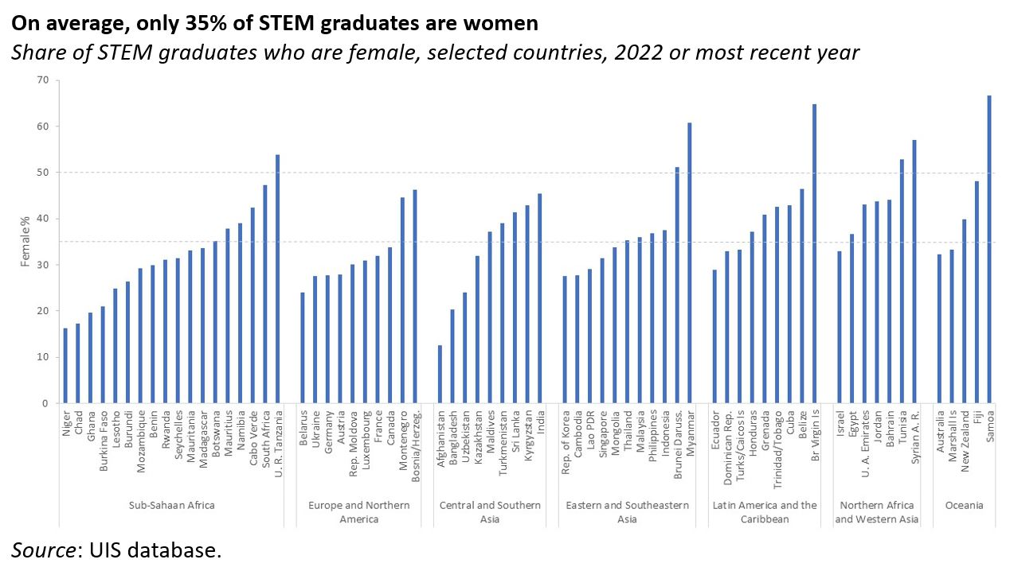

Slide 9
Source of the graph:
  Montoya S. (2024). New UIS data show that the share of women in STEM graduates stagnant for 10 years. UNESCO World Education blog. URL: https://world-education-blog.org/2024/04/25/new-uis-data-show-that-the-share-of-women-in-stem-graduates-stagnant-for-10-years/

Slide 10
Gender inequalities in education: some factors
Stereotypes are internalised early and affect course selection and confidence
  E.g. ”Boys are better at maths”
Curricula and teacher bias can reinforce traditional gender roles
  E.g. Women are expected to enter a marriage and caretaking roles
School environments often normalise male dominance in technical subjects and leadership roles
  E.g. lack of role-models
Intersectionality: these gendered barriers can be even more visible for lower socioeconomic classes, in rural areas, according to the ethnic or migration status.
Gendered expectations → subject selection → career pathways → influence on others’ expectations…

Slide 11
How to measure educational inequalities?
Access
  Enrollment rates (by:primary, secondary, higher educations)
  Out of school rates: especially for marginalised groups
    NEET: Not in education, employment or training (often used for young adults)
  Age at school entry : delayed education is already a signal
Completion, attainment:
  Completion rates at each educational level
  Dropout rates, or school-leaving age
  Highest level of education attained
    e.g. % of the adults with tertiary education
Learning outcomes
  (standardised) Test scores
    E.g. PISA, TIMSS
  Literacy and numeracy rates
  Gender or ethnic gaps in performance
  Répartition in the fields of education
    E.g. % of the students enrolled in STEM

Slide 12
How to measure educational inequalities? (2)
Resources and education quality
  Pupil-teacher ratio
  School funding per student
  School infrastructure
    E.g. electricity, safety
Equity indicator
  Disaggregation of the indicators by gender, income, region, ethnicity, disability, language, migration status…
  Rural vs. urban locations
Subject segregation (horizontal inequality)
  Gender distribution across academic fields
  Vocational vs. academic tracking
Social mobility
  Intergenerational education mobility
    E.g. how often children surpass their parents’ level of education?
    Retur on education
      Labour market outcomes (e.g. unemployment, income) stratified by education level and gender

Slide 13
Any question?

Slide 14
How to read a scientific paper?

Slide 15
What to draw from a paper?
Basic information: author, journal, date, number of citations
Context:
  Place, time of the study
  What is known already?
  What type of study: review, quantitative, qualitative study?
Research question and hypotheses
Data and methods
Results
Limitations and conclusion
What does it bring to your paper?
  Indicates what is missing in the literature (how can you go one step further?)
  Helps you formulate your questions and methods
  Helps you interpret your results

Slide 16
Difficulties?

Slide 17
Ideas for research questions?

Slide 18
Any ideas?
Gender inequality in STEM
What I identified as missing (suggestions)
  The effect of the pandemic?
  The intergenerational aspect?
What else could you identify?
Quali, quanti, literature review?

