Slide 1

Uber JVMProfiler

Slide 2
Feature List
Uber JVM Profiler supports following features:
Debug memory usage for all your spark application executors, including java heap memory, non-heap memory, native memory (VmRSS, VmHWM), memory pool, and buffer pool (directed/mapped buffer).
Debug CPU usage, Garbage Collection time for all spark executors.
Debug arbitrary java class methods (how many times they run, how much duration they spend). We call it Duration Profiling.
Debug arbitrary java class method call and trace it argument value. We call it Argument Profiling.
Do Stacktrack Profiling and generate flamegraph to visualize CPU time spent for the spark application.
Debug IO metrics (disk read/write bytes for the application, CPU iowait for the machine).

Slide 3
运行 JVM Profiler
监控一个java 类
java -javaagent:jvm-profiler-1.0.0.jar=reporter=com.uber.profiling.reporters.ConsoleOutputReporter,metricInterval=5000,ioProfiling=true -cp jvm-profiler-1.0.0.jar com.uber.profiling.examples.HelloWorldApplication
监控spark作业
spark-submit --deploy-mode cluster --master yarn --conf spark.jars=hdfs://hdfs_url/lib/jvm-profiler-0.0.5.jar --conf spark.driver.extraJavaOptions=-javaagent:jvm-profiler-0.0.5.jar --conf spark.executor.extraJavaOptions=-javaagent:jvm-profiler-0.0.5.jar --class com.company.SparkJob spark_job.jar

Slide 4
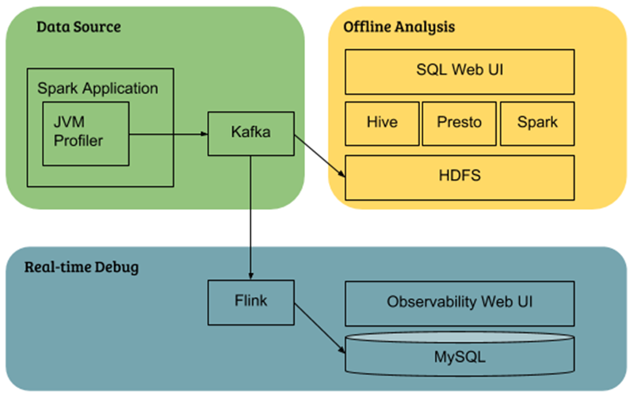
数据基础设施整合

Slide 5
相关原理
内存:
/proc/self/status
Cmdline：
/proc/self/cmdline
CPU:
memoryMXBean = ManagementFactory.getMemoryMXBean();
MemoryUsage memoryUsage = memoryMXBean.getHeapMemoryUsage();
memoryUsage = memoryMXBean.getNonHeapMemoryUsage();
4. GC:
gcMXBeans = ManagementFactory.getGarbageCollectorMXBeans();
5. IO ：/proc/self/io
6. Stacktrace
private ThreadMXBean threadMXBean = ManagementFactory.getThreadMXBean();
ThreadInfo[] threadInfos = threadMXBean.dumpAllThreads(false, false);

Slide 6
适配spark 监控所做的修改
修改队列名称
增加具体的指标类型
ProcessInfo
usedCpuMem
IOInfo
3. 将 jdk 1.8 改为 jdk1.7
4. 增加CPU使用率指标 cpuUsage
5. 增加IO读写速率指标 readMBps , writeMBps

Slide 7
参考
https://github.com/uber-common/jvm-profiler
https://zhuanlan.zhihu.com/p/57352447
https://www.infoq.cn/article/zr-cVbiyJy5RQZqaxzWr

