Slide 1
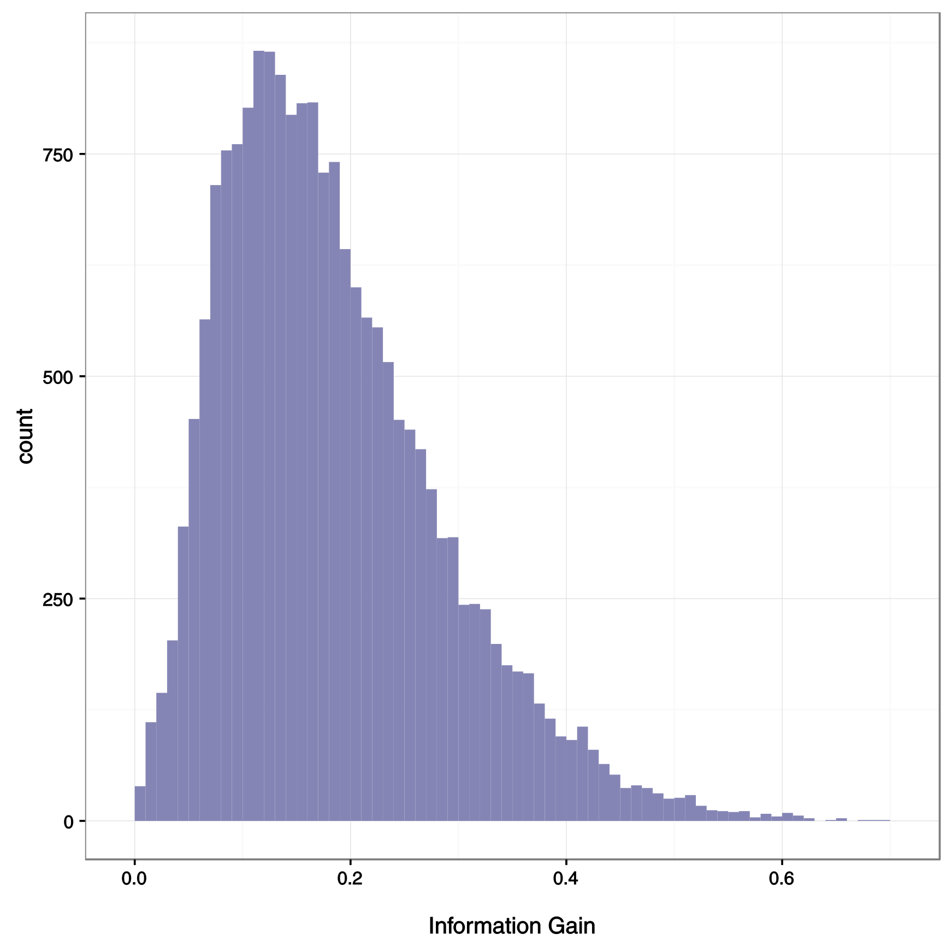

1. Results
Foreach Gene
IG(Cancer,Gene) =
H(Cancer) – H(Cancer | Gene)
IG
Gene is a better classifier!

Slide 2
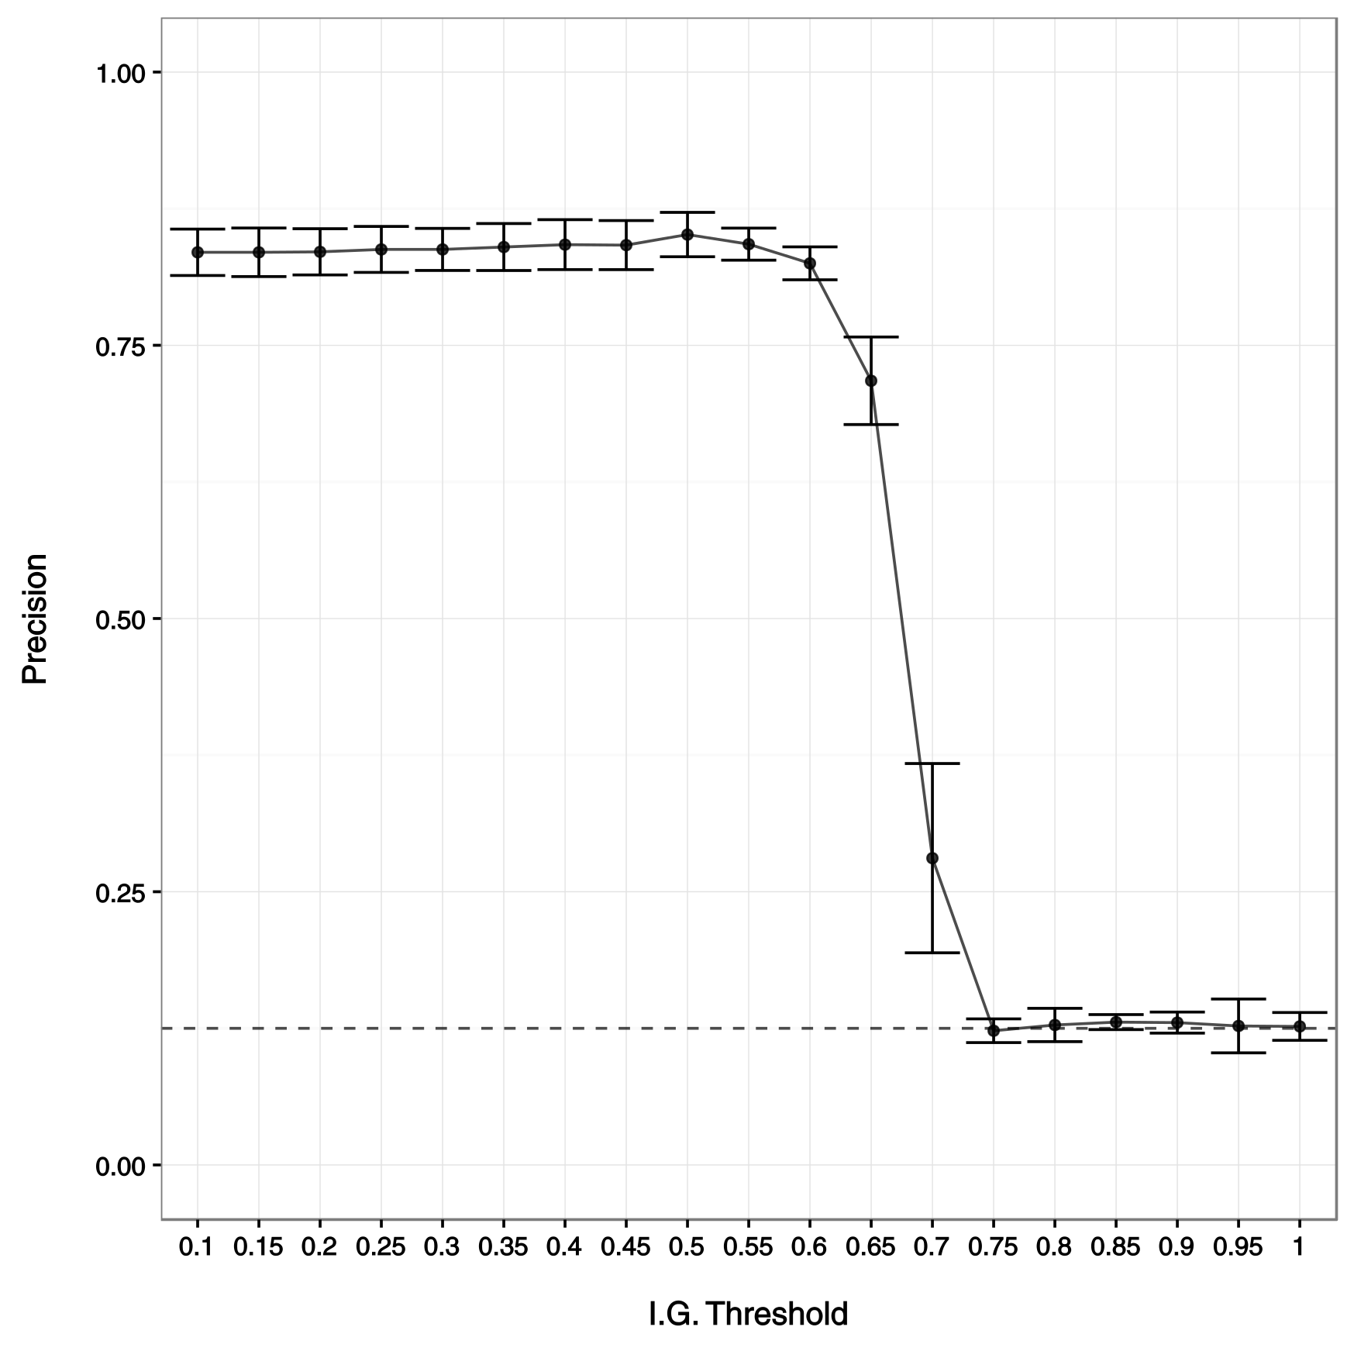
1. Results
Selection of the relevant attributes (genes)
Precision seems independent from I.G.
~ 85% Precision
Until…

Slide 3
1. Results
1. Results
Selection of the relevant attributes (genes)
Precision seems independent from I.G.
~ 85% Precision
Until…
No more genes:
Random label
Probability = 1/8

Slide 4
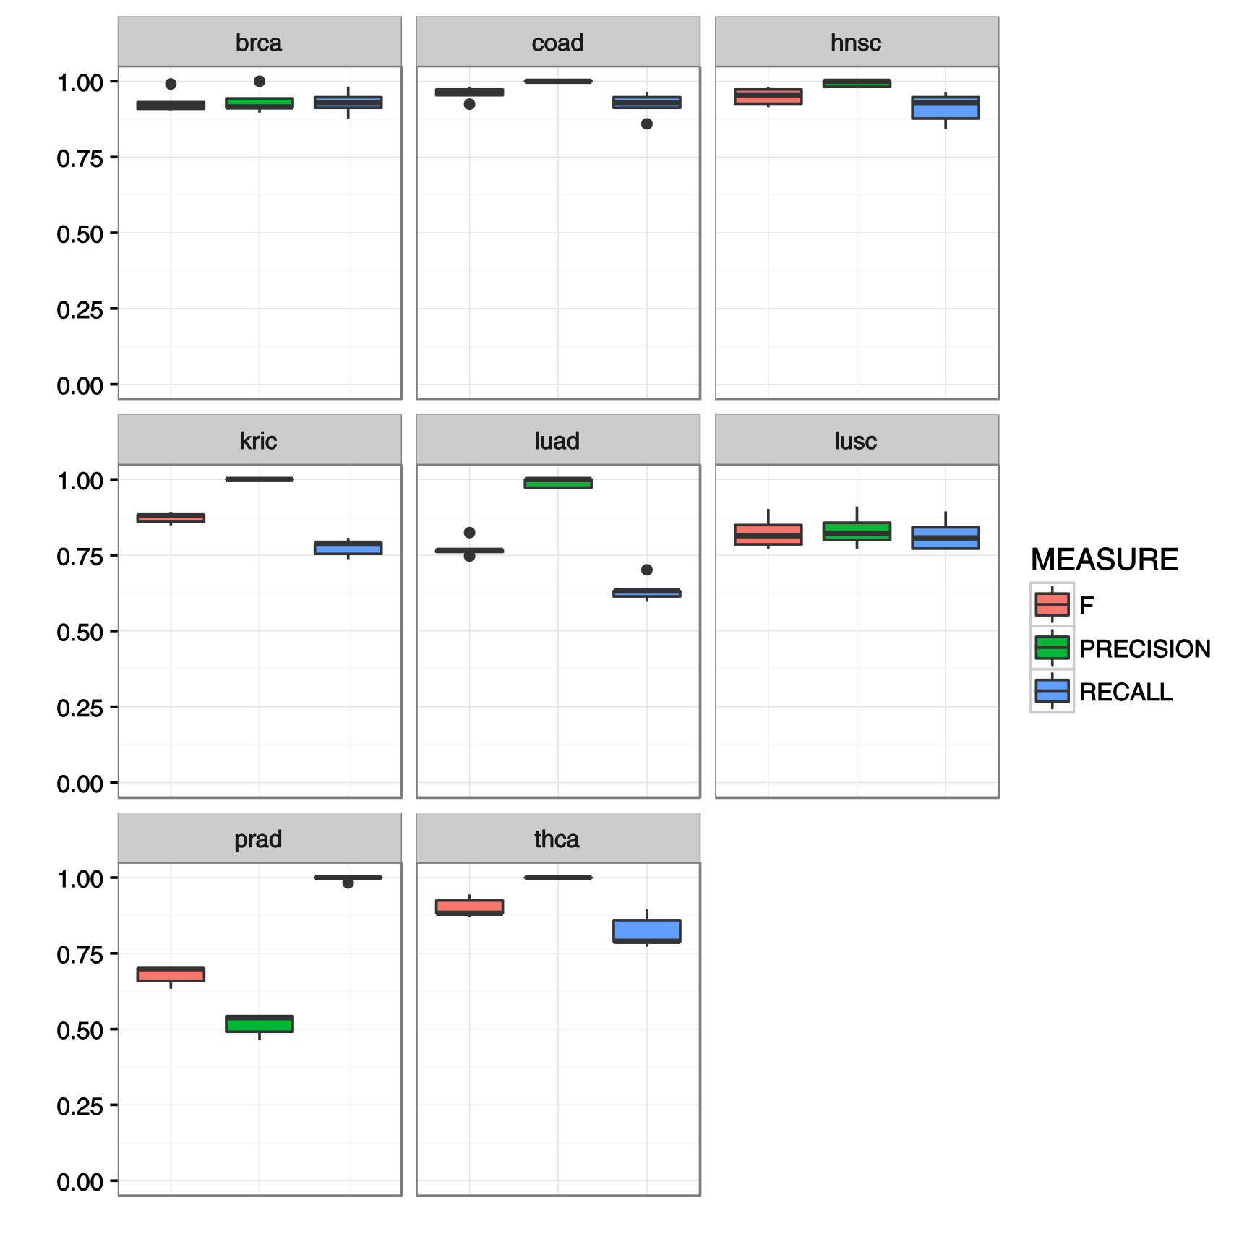
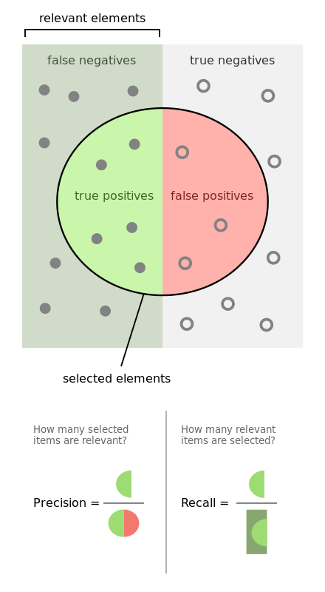
1. Results
How good is our classifier for each tumor type?

Slide 5
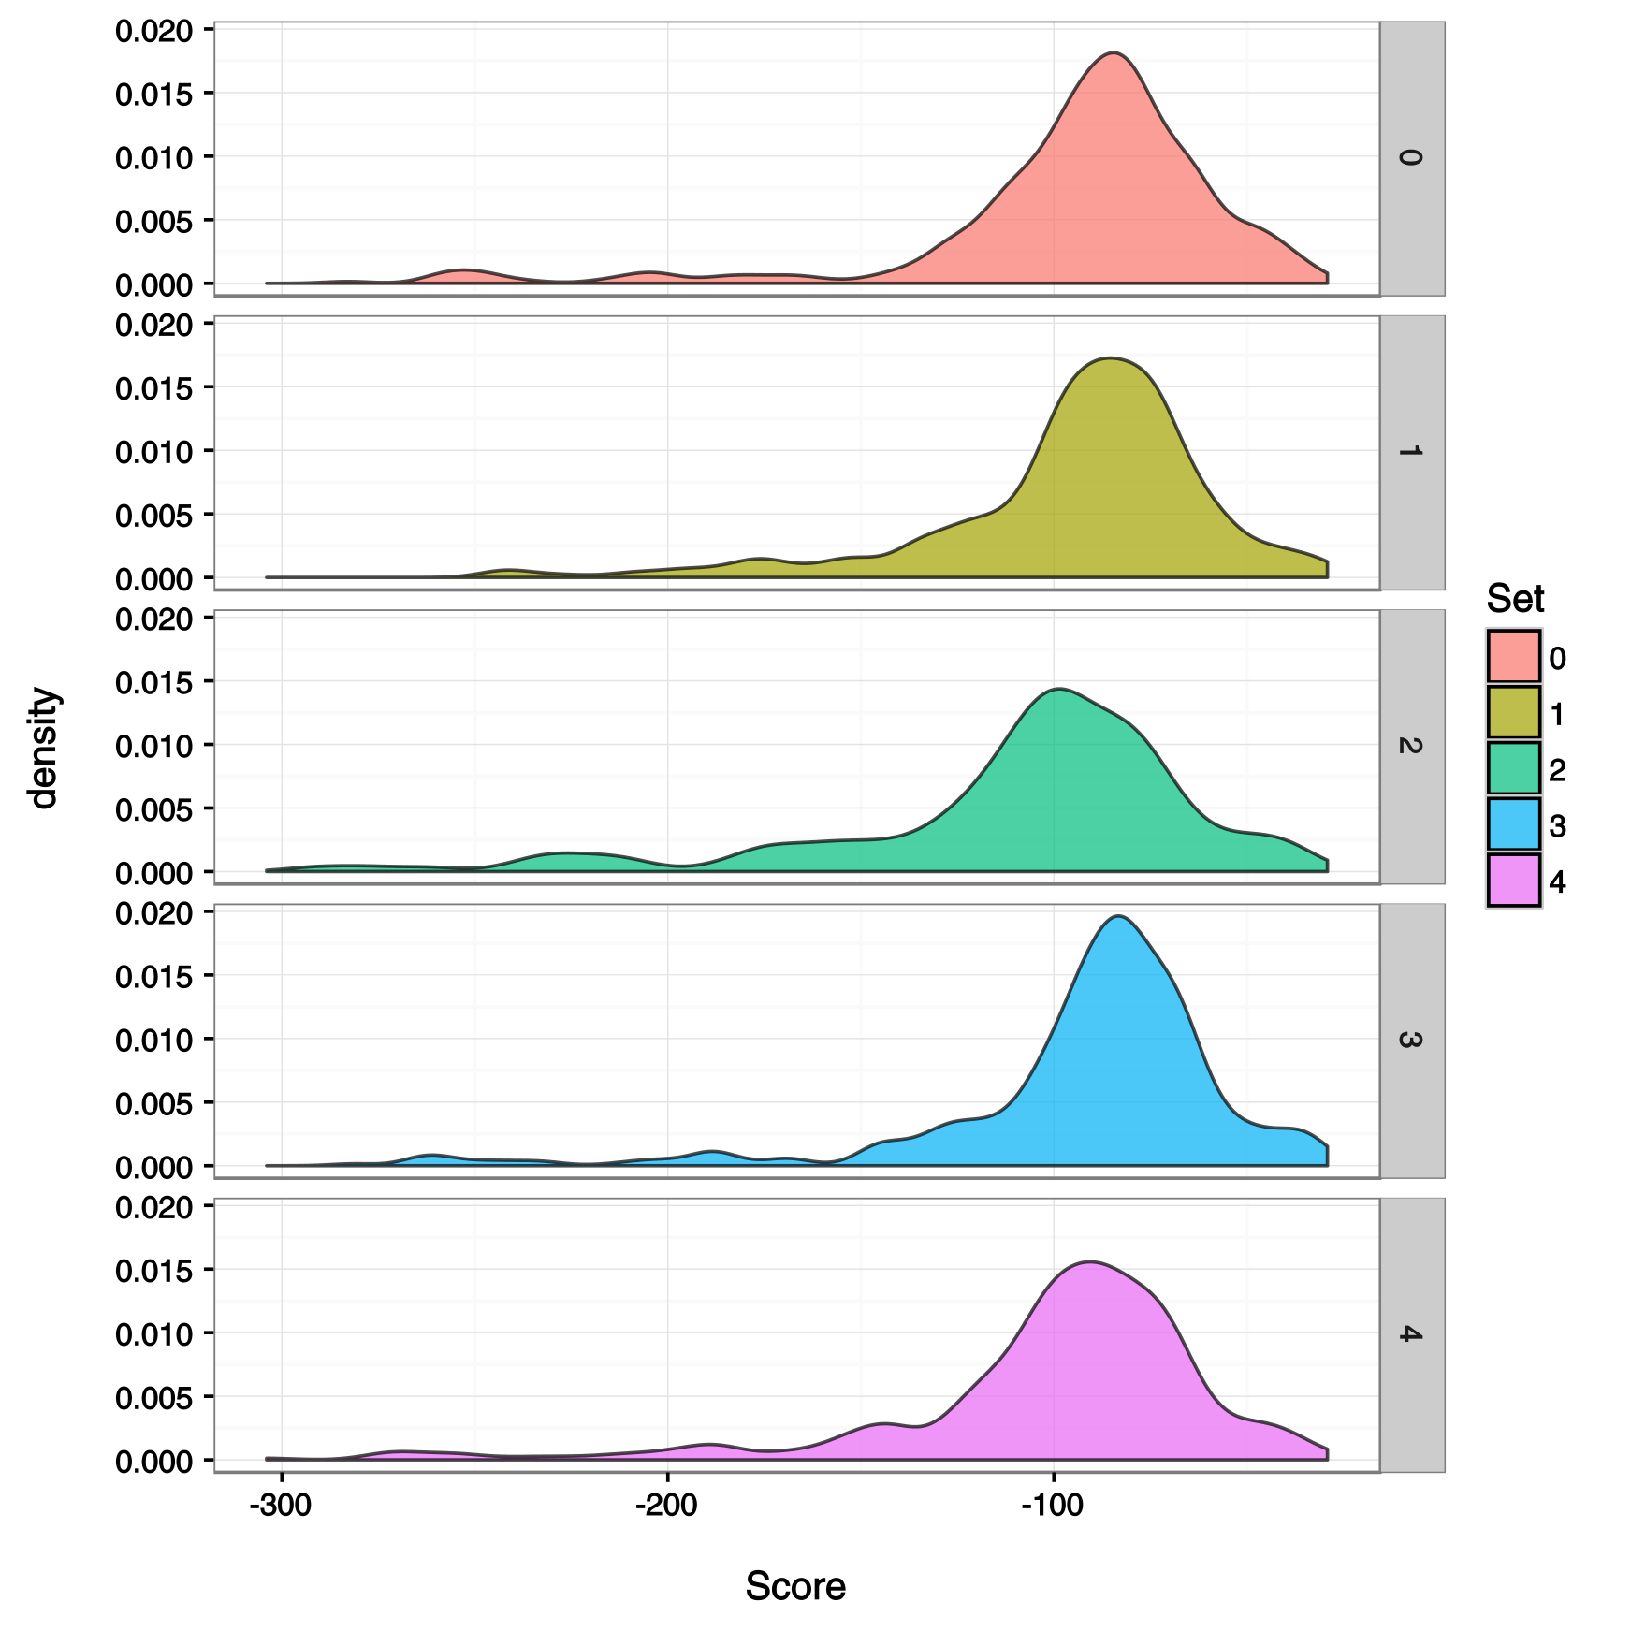
1. Results
1. Results
Can we improve our classifier by filtering
the results?
Filter by score
Filter by probability

Slide 6
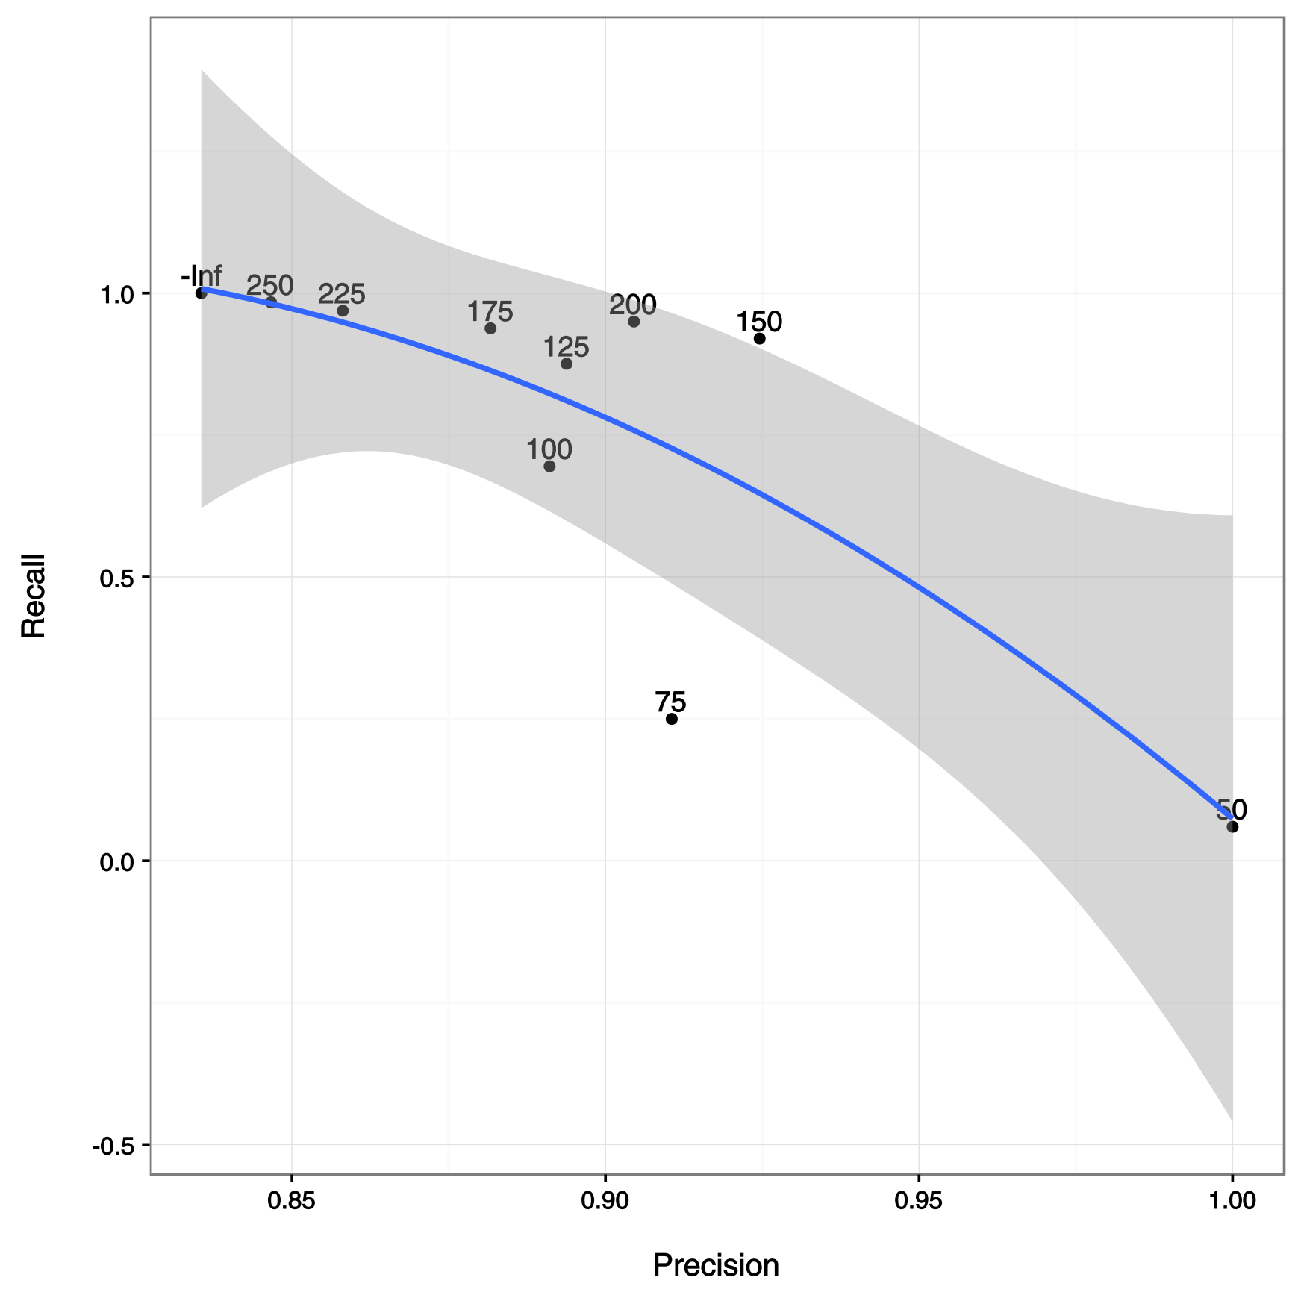
1. Results
Can we improve our classifier by filtering
the results?
Filtering by score
More precision → Less Recall
Best seems to be between
-100 and -200

