Slide 1


Slide 2
1. Goals
It is known that cancers have gene expression signatures.
The aim of this study is to develop a useful classifier of cancer types from cancer samples.
  Entropy and Information Gain
  Naive Bayes predictor
Notes:
Photo1) GTEx collects tissues from living humans (easy straction or from biopsies). Extract (R|D)NA. Sequencing, assembling.
- Expression of mRNA genes
- Treat variation of mDNA between subjects as eQTL gen-phen correlation.
- Diseases.
Photo2) Number of samples per tissue, tissues sampled and number of samples by patient.

Slide 3

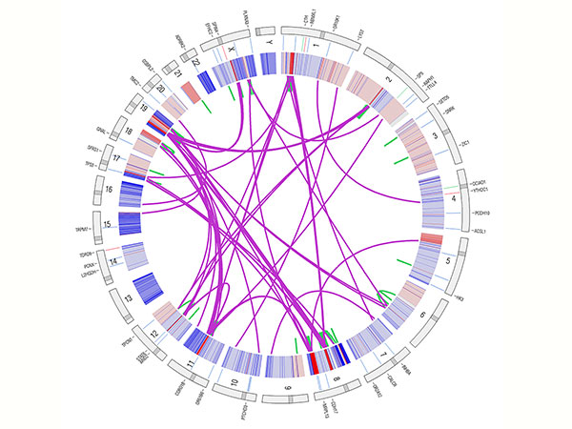
2. Samples
Data retrived from The Cancer Genome Atlas (TCGA) Project.
Samples of cancer are derived from:
  BRCA: Breast Invasive Carcinoma
  COAD: Colon adenocarcinoma
  HNSC: Head and neck squamous cell carcinoma
  KIRC: Kidney renal clear cell carcinoma
  LUAD: Lung adenocarcinoma
  LUSC: Lung squamous cell carcinoma
  PRAD: Prostate adenocarcinoma
  THCA: Thyroid carcinoma
A0B3N A0CEN A0DLT A0E0T ...
NUMB|8650 0.726962953358609 -0.819445899559172 -2.52666637657443 -4.34178657444036 ...
QKI|9444 -0.225271888363044 -0.46746965408111 4.98501111091547 -2.45043798356706 ...
MYC|4609 0.95324816129648 0.317154963268593 2.4732208853073 3.17861940608758 ...
Notes:
We select liver as our target tissue for this study because:
1) It has a central rol in metabolism and detox function.
2) Has some rol with the innate immunity.
3) Regenerative ability.
4) Signalling function.

Slide 4


2. Workflow – tt_separator.pl
TCGA
Filtering
Discrete
NA
z>2 => UP
not_valid.txt
BRCA
-INF
COAD
-2 < z < 2 = >
NO CHANGE
DATA
DATA
...
KRIC
DATA
z<-2 => DOWN
> 288
PRAD
Notes:
We select liver as our target tissue for this study because:
1) It has a central rol in metabolism and detox function.
2) Has some rol with the innate immunity.
3) Regenerative ability.
4) Signalling function.

Slide 5

2. Workflow – tt_separator.pl
Randomise
K-Fold
SET0
SET1
SET1
DATA
What is
K-fold validation?
SET2
...
SET4

Slide 6
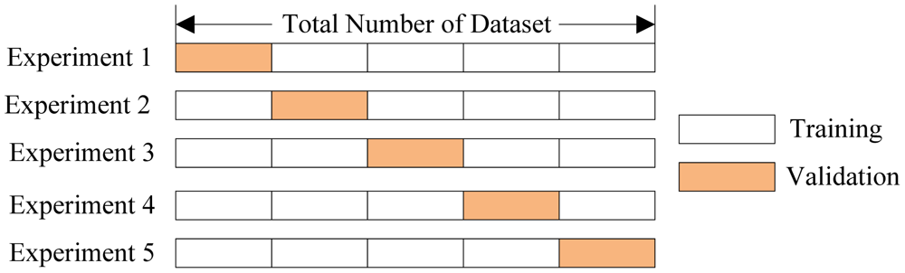
2. K-fold validation

Slide 7
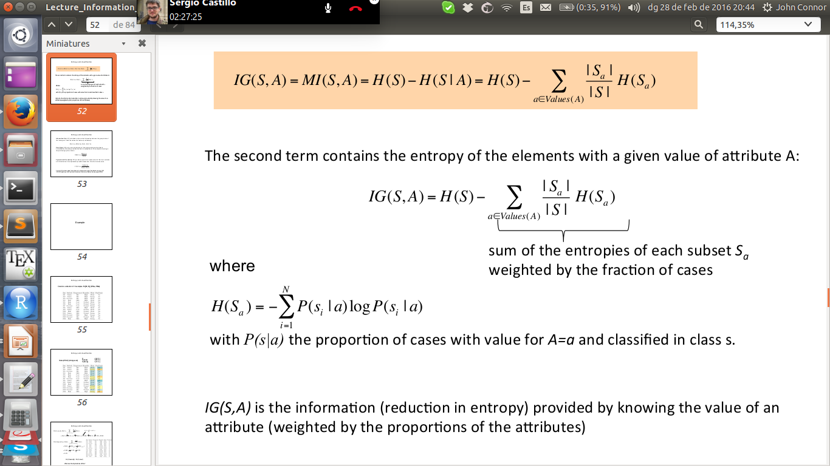
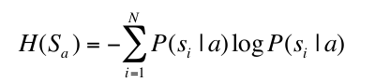
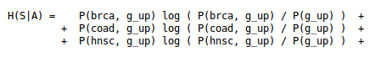
2. Workflow – NotSoNaive.pl
SET0
Equality of prios
FOR EACH
SET
SET1
SET1
FOR EACH
CANCER TYPE
SET2
Relevant attributes
...
Prediction
SET4

Slide 8
5. Conclusions
Notes:
Log ratio of RPKM (read per kilobase)
7,116 HK MAX EXP 27174
579 TS MAX EXP 17448
COD MAX EXP 39314
NONCOD MAXEXP 37852

