Slide 1
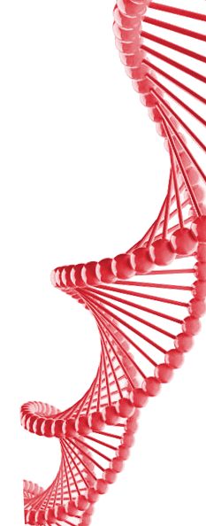

Slide 2
1. Goals
Notes:
Photo1) GTEx collects tissues from living humans (easy straction or from biopsies). Extract (R|D)NA. Sequencing, assembling.
- Expression of mRNA genes
- Treat variation of mDNA between subjects as eQTL gen-phen correlation.
- Diseases.
Photo2) Number of samples per tissue, tissues sampled and number of samples by patient.

Slide 3
2. Methods
Notes:
We select liver as our target tissue for this study because:
1) It has a central rol in metabolism and detox function.
2) Has some rol with the innate immunity.
3) Regenerative ability.
4) Signalling function.

Slide 4
3. Workflow

Slide 5
4. Results

Slide 6
5. Conclusions
Notes:
Log ratio of RPKM (read per kilobase)
7,116 HK MAX EXP 27174
579 TS MAX EXP 17448
COD MAX EXP 39314
NONCOD MAXEXP 37852

