Slide 1
Basic information about affiliation
Autor Iksiński
Braniewo, 2011

Slide 2


Warsaw University of Technology
more than 2500 academic teachers
more than 35000 full-time students
www.pw.edu.pl
Main building

Slide 3
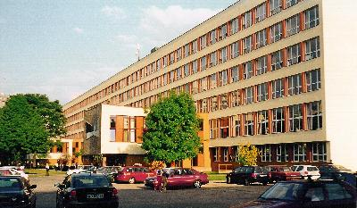

Faculty of Electronics and Information Technology
more than 300 academic staff
more than 3800 full-time students
www.elka.pw.edu.pl
The Faculty (the largest at the Warsaw University of Technology) is composed of several central units and of six institutes:
Institute of Control And Computation Engineering
Institute of Computer Science
Institute of Microelectronics And Optoelectronics
Institute of Radioelectronics
Institute of Electronic Systems
Institute of Telecommunication

Slide 4
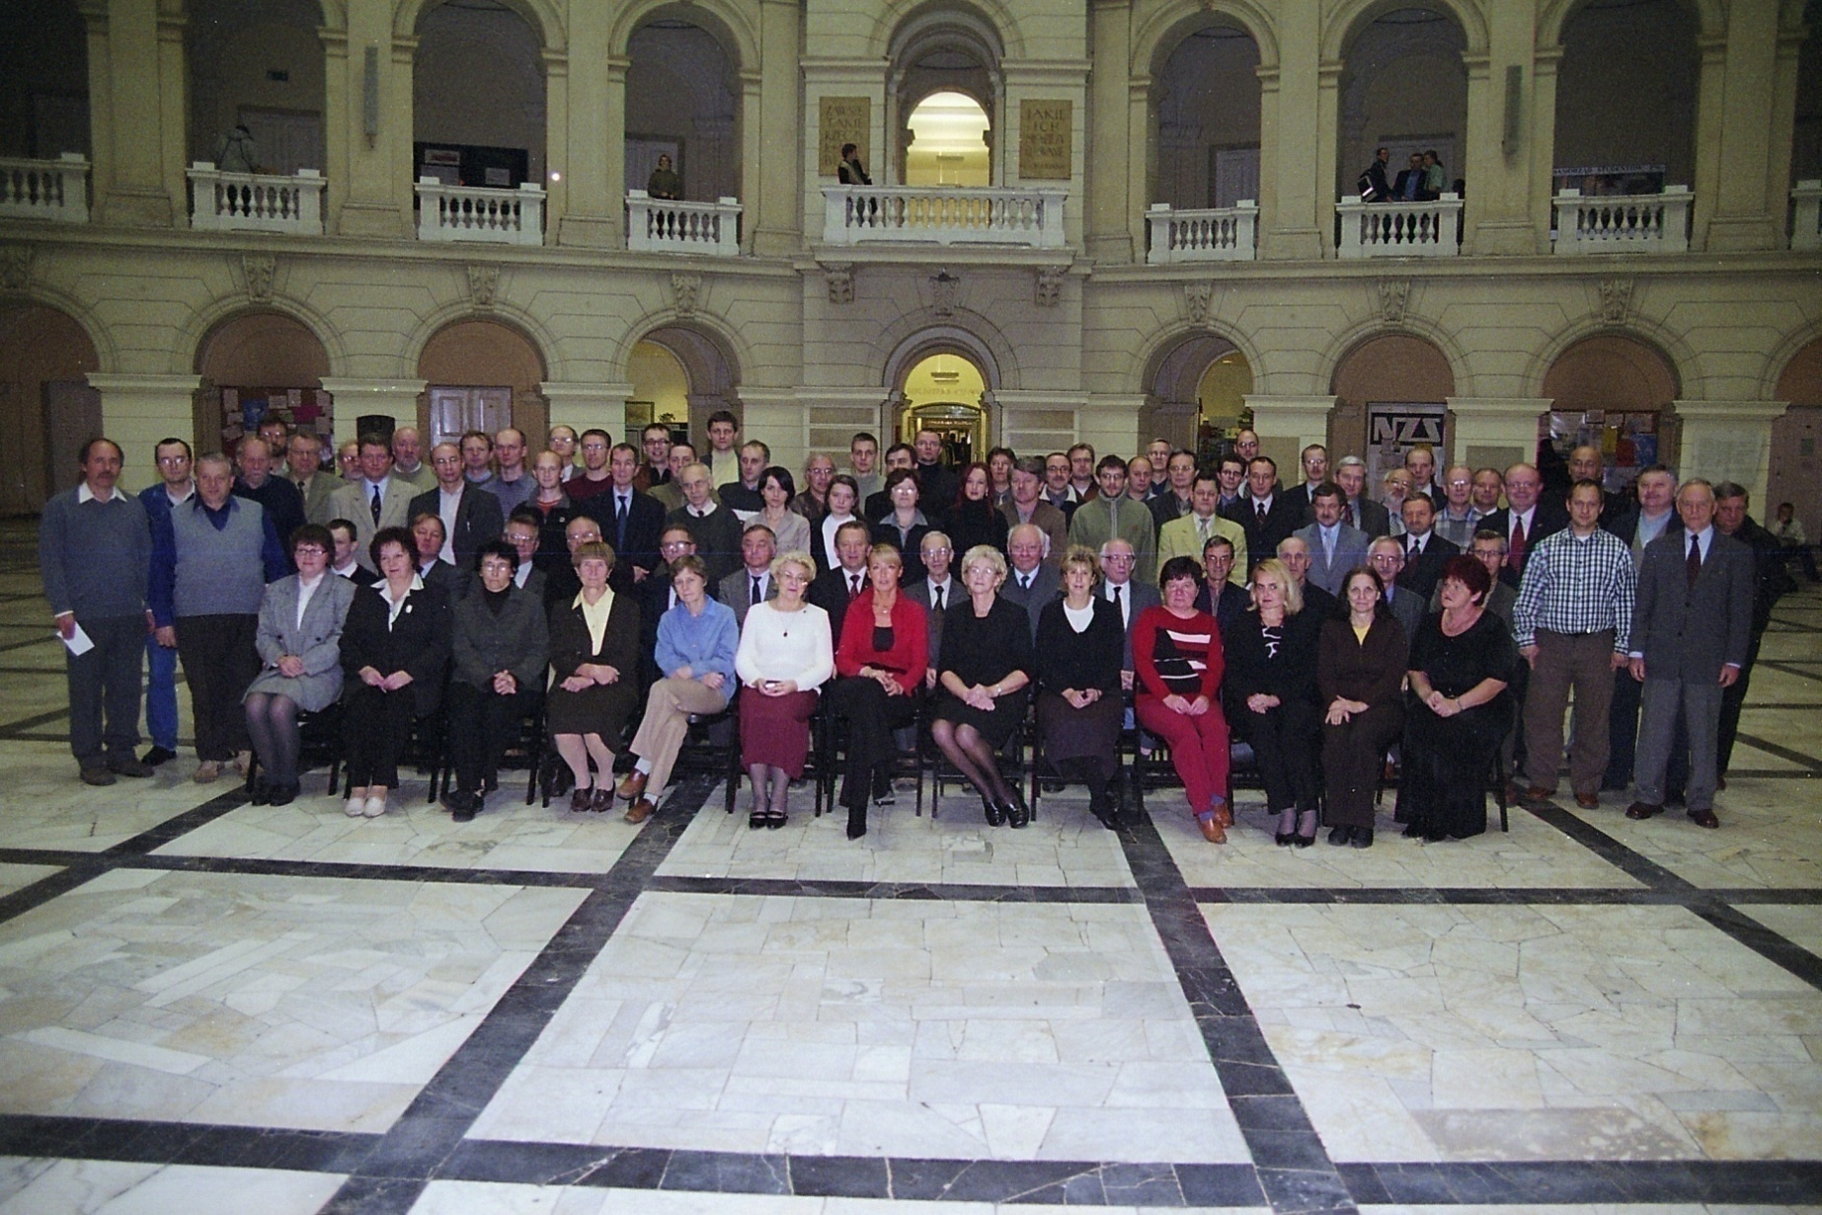
Institute of Radioelectronics

Slide 5
Institute of Radioelectronics
6 Divisions
Electroacoustics Division
Microwave & Radiolocation Engineering Division
Nuclear and Medical Electronics Division
Radio-Engineering Division
Radiocommunications Division
Television Division
105 Employees
40 Ph.D. students
13 Professors
5 Docents
42 Assistant Professors
8 Lecturers

Slide 6
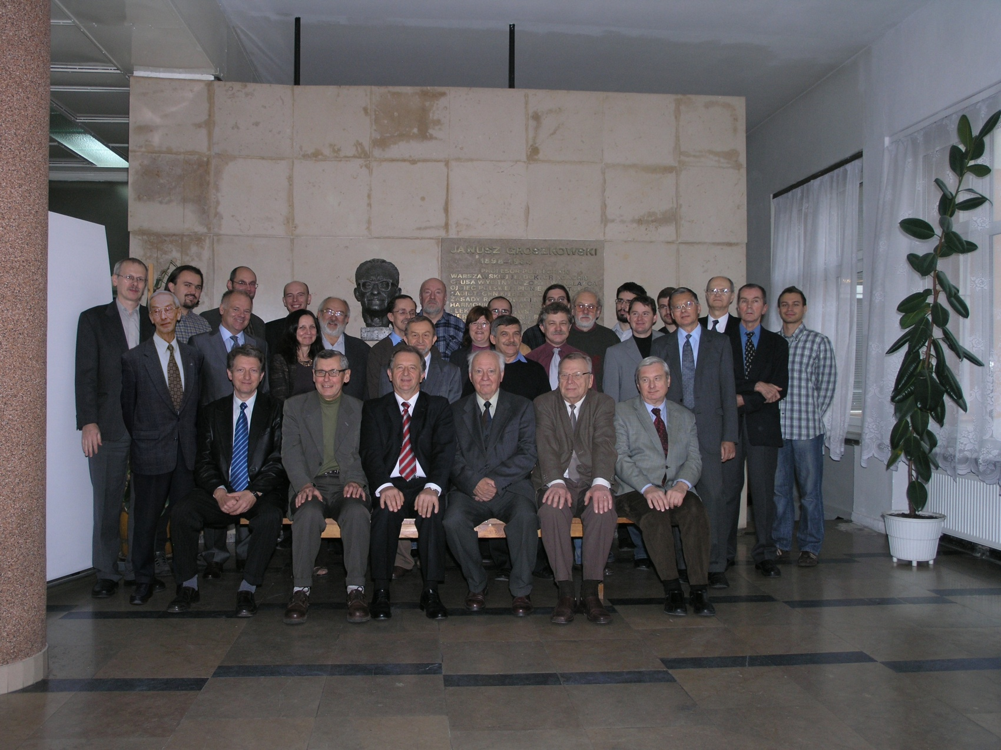
Radiocommunications Division

