Slide 1
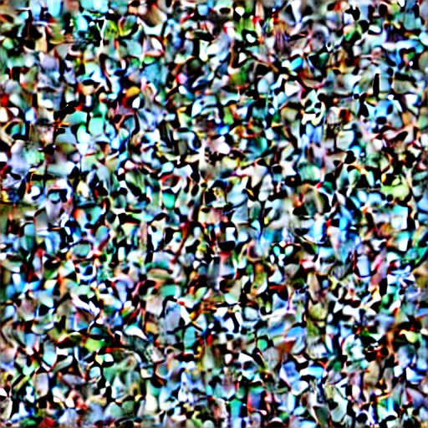

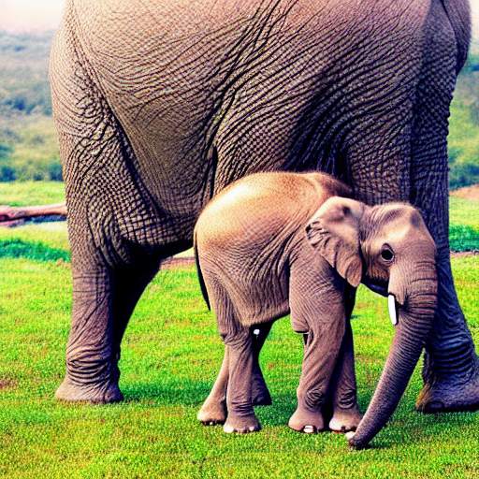
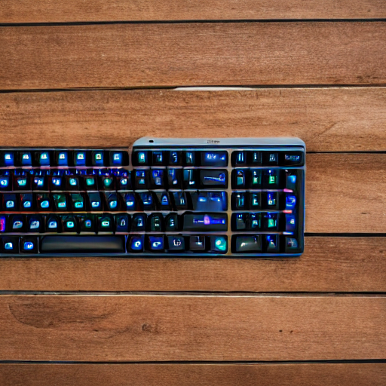
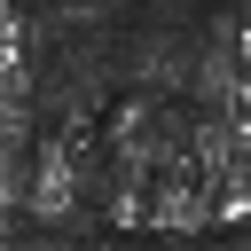
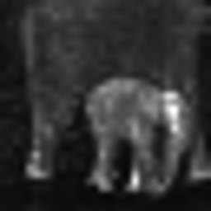
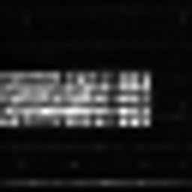
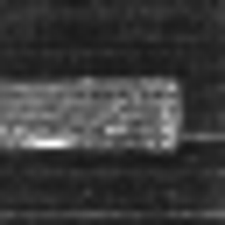


Denoise with a text prompt
Denoise with a text prompt
An elephant next to an apple.
A keyboard and a mouse.
Stable Diffusion
Generated Image
Stable Diffusion
Generated Image
Cross
Attention Map
Cross
Attention Map
apple
elephant
keyboard
mouse

Slide 2


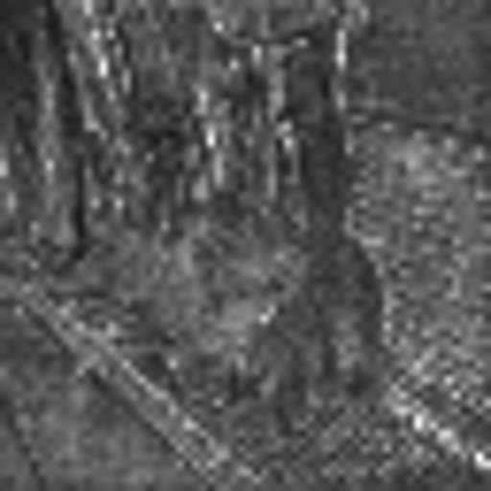


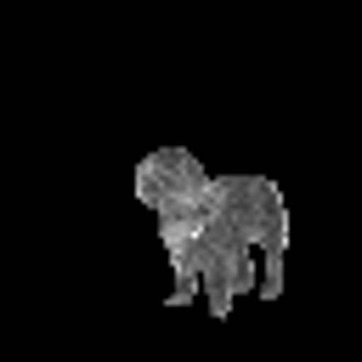
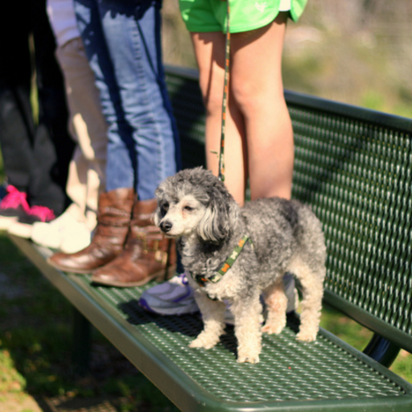
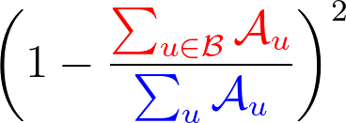



Denoise with a text prompt
$𝓛$_{pixel} for each pixel:
a small dog standing on a green bench with four people.
Cross Attention Map
U-Net
dog
dog
$$⨂$$
Pixel-wise
multiplication
Denoised Image
Binary Seg.
Mask
Sum of Activations
Sum of Activations
$𝓛$_{token} for each token:

