Slide 1

SAMSUNG PRISM
Generative AI
Hackathon
3rd Edition 2026 – 27
Theme ID - 05
Team Name – SamSung, We Coded
College Name – MS Ramaiah Institute Of technology
Member Name & Email 1- P Nishant & 1ms25cs127@msrit.edu
Member Name & Email 2- Joanna Mariya James & 1ms25cs073@msrit.edu
Member Name & Email 3- Lakshya Jaiswal & 1ms25cs090@msrit.edu
Member Name & Email 4- Pranav Agrawal & 1ms25ad048@msrit.edu
Submission Github link - https://github.com/joannamariyajames/interjectsamsung

Slide 2
Theme
THEME 05 · INTERRUPTIBLE REAL-TIME AGENTS
People don't talk in turns. They pause, change their minds and cut in.
A voice agent has to keep up — without going silent, redoing work or acting on what the user took back.
1
Stay responsive
2
Work asynchronously
3
Recover cleanly
Acknowledge at once. Never go silent while thinking, and never say something is done before it is.
Start retrieval and tools while the user is still speaking. Stream the answer and keep it interruptible.
When cut off or corrected, drop the stale work, keep what is still useful, and never run an action twice.
Measured on Full-Duplex-Bench v3: 100 real recordings full of pauses, fillers, hesitations, false starts and self-corrections, across 4 domains (e-commerce, finance, housing, travel) and 12 tools. The agent must call the right tool with the user's final intent.

Slide 3
Existing Solutions & Gaps
Today's voice agents are built for turn-taking. Interruptions are treated as noise, not as a signal.
Approach
How it works
Gap
Turn-based voice pipelines
Wait for silence → speech-to-text → LLM → speech
A mid-sentence pause ends the turn early, so the agent acts on half a request. Dead air while the model thinks. Barge-in just stops the audio and throws the work away.
Speech-to-speech realtime models
One model hears and speaks directly
Usually paid and closed. Little control over when tools fire, so a correction can still trigger the stale action. Hard to reproduce a score.
Chat assistants with tools
Text in, tool calls out
Act on the first value heard. “Agra… actually no, Jaipur” can leave an Agra booking behind, or repeat an action twice.
The missing piece: treat the interruption itself as a first-class event — stop at once, keep the useful work, drop what was superseded, and make every action happen at most once.

Slide 4
Our Solutions & Architecture Diagram
Interject: a LiveKit voice agent whose every tool call passes through BACKSPACE, our interruption-aware gate.
You speak
LiveKit + Silero VAD
Groq Whisper
LLM
BACKSPACE gate
12 benchmark tools
pauses, fillers,
self-corrections
turn ends after
1.2 s of silence
speech → text
(whisper-large-v3-turbo)
NVIDIA gpt-oss-20b
backup: Groq gpt-oss-120b
blocks stale calls,
at most once
orders, flights, rates,
housing… (official)
reply
tool results
Piper voice, local · spoken reply, interruptible
BACKSPACE gate
Built to stay up
Same core in the web app
• A call whose inputs were superseded by a correction is blocked before it runs
• Every action is committed at most once
• Values normalised: spelled codes joined, dates kept as spoken
• Backup LLM takes a turn when NVIDIA errors or stays silent for 10 s
• Turn ends after 1.2 s of silence, so a pause is not a finished request
• Every call logged for the official evaluator
• Retrieval starts on partial speech, before you finish
• Cut in → turn cancelled, checkpoint kept; “go on” resumes
• Goal stack parks a detour; a harness refuses unsafe tools

Slide 5
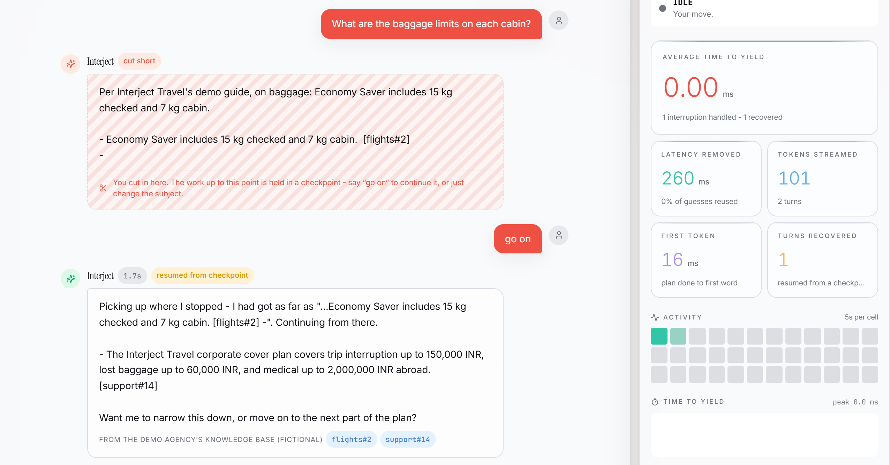
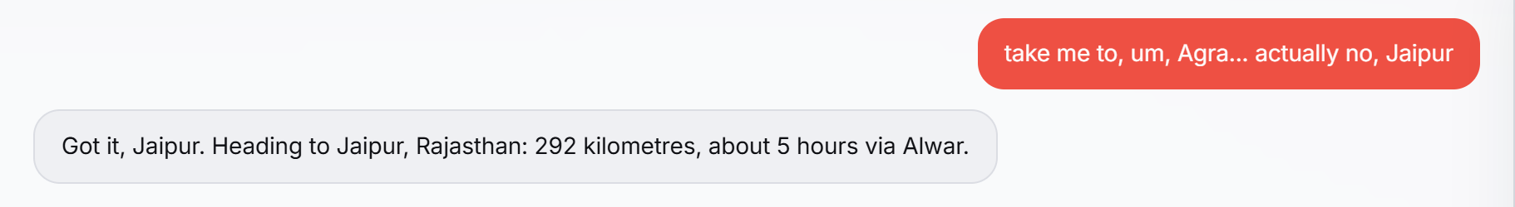
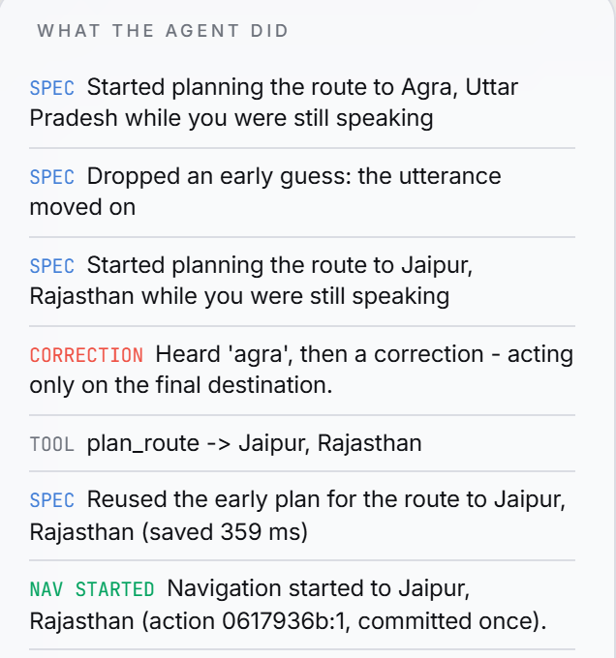
Demo & Product Walkthrough
Two live surfaces: the assistant you can talk over, and Drive, an in-car assistant built on the same core.
Drive
“Take me to, um, Agra… actually no, Jaipur”
Plans Agra while you speak, drops it on the correction, and starts navigation once — to Jaipur.
Assistant: cut in mid-answer → it stops at once (0.00 ms average time to yield), holds a checkpoint, and “go on” continues from the exact words.
Demo video (under 5 min): https://www.youtube.com/watch?v=UI59hoOJY4A

Slide 6
Tools and tech stack used
Everything runs on free tiers or locally — no paid API or service anywhere in the stack.
Voice agent (benchmark)
Web app & Drive
Evaluation & quality
LiveKit Agents 1.8.3
rooms, turn handling, fallback
Python 3.11 · FastAPI
WebSocket streaming backend
Full-Duplex-Bench v3
pinned commit, official scripts
Silero VAD
voice activity, local
React · Vite · Zustand
live UI
run_fdb_v3.sh
one command: install → run → score
Groq whisper-large-v3-turbo
speech-to-text
Tailwind CSS v4
light & dark themes
pytest
871 backend tests
NVIDIA gpt-oss-20b
tool-calling LLM, seed 7, temp 0
Web Speech API
mic + voice in Chrome/Edge
Playwright
7 real-browser suites
Groq gpt-oss-120b
backup LLM
SQLite + scrypt
accounts, hashed sessions
GitHub Actions
CI on every push
Piper en_US-ljspeech-medium
local voice, SHA-256 pinned
Groq gpt-oss-120b
general answers (optional)
Pinned versions
requirements + seed recorded

Slide 7
Impact & Use case
Where interruptions matter most: a driver who can't look at a screen and changes plans mid-sentence.
Use case: Drive — an in-car voice assistant for India
Safer hands-free use
The driver corrects by voice; no need to look at or tap a screen to undo a mistake.
Change of mind mid-sentence
“Agra… actually no, Jaipur” → acts only on Jaipur
“Hold on” / “go on”
pauses on request, resumes from where you stopped listening
No double or stale actions
At-most-once commits: no second booking, payment or navigation from a repeated or corrected request.
Add stops on the way
the old route goes stale and is recomputed with the stop
Ask twice, start once
a repeated request never starts navigation a second time
Beyond the car
Works offline
no map service or API key needed for the demo
Same gate works for support, banking, travel and housing — the four domains of the benchmark.

Slide 8
Innovation highlights, results and limitations
56%
99%
97%
4.45 s
strict pass rate
all 100 recordings, audio via LiveKit
turn-taking
the agent answered 99 of 100
right tool chosen
tool selection accuracy
average latency
end of speech → reply
Innovation highlights
• BACKSPACE gate: stale tool calls blocked before they run
• Backup LLM answered 12 of 384 requests while NVIDIA was failing
• Speculative retrieval + checkpoint resume; time to yield < 1 ms
Limitations (and what caused them)
• Pauses read as the end of a request: most of the 16 audio-only failures
• Spelled codes misheard (“F a s t nine nine” for FAST99)
• 3-step requests pass 25%; average latency 4.45 s

Slide 9
What’s next
Each next step comes straight from a measured failure, so each one can be checked with the same benchmark.
NOW
NEXT
LATER
Measure the fixes
Faster and smarter
Take Drive on the road
Rerun all 100 recordings with the 1.2 s turn wait
targets the pause failures
Streaming speech-to-text
cut the 4.45 s average latency
Real maps and live traffic
replace the offline route data
Join spelled-out codes into one ID
“F a s t nine nine” → FAST99
Stronger model for 3-step requests
tested on the free text replay first
Hindi and Hinglish
how Indian drivers actually speak
Report both runs side by side
keep the better setting
Tune LiveKit's turn detector
fewer premature turns
On-device models
keep working without a signal

Slide 10
Brownie points slide( differentiation)
What sets Interject apart: it is free to reproduce, tested end to end, and honest about what it knows.
₹0
871
12
to reproduce
backend tests
backup answers
Every provider is a free tier or local. One command installs, runs and scores the benchmark.
Plus 7 real-browser suites and CI on every push. No test weakened to pass.
In the full run the backup model answered 12 of 384 requests while NVIDIA’s free endpoint was failing.
< 1 ms
0
Honest
to stop talking
hardcoded answers
by design
A barge-in cancels the turn at once, and the checkpoint keeps what was already said.
A test proves the agent's rules never quote benchmark data; fixes are general rules.
Offline mode says so, the demo knowledge base is marked fictional, and no action is claimed unless it ran.

Slide 11
Checklist- Updated on Public GitHub
Working prototype code — public or shared GitHub repo (Y/N) Y
README with reproducible setup instructions (Y/N) Y
Demo video, max 5 minutes (YouTube or Drive link) https://www.youtube.com/watch?v=UI59hoOJY4A
Presentation file (PPT or PDF) (Y/N) Y
Repository: github.com/joannamariyajames/interjectsamsung
README: judges' quick start (no keys needed for the app) and a one-command benchmark run.

Slide 12
Thank you
Organised by the Language AI Team and the PRISM Team, Samsung R&D Institute India
Notes:
Closing slide. Add the Google Form URL and a contact email before sharing. Edition 2 organising team for reference: Language AI - Sourabh Tiwari, Gaurav, Sanjeeth Pothireddy, Gorang Maniar; PRISM - Binny Lakra, Prakhar Chandrakar, Vishu Kumar; Kick-off and mentors - Giridhar Jakki, Deepraj Prabhakar Patkar (Language AI), Srimanu Prasad Nagaraju, Ashish Kumar (Tech Strategy).

