Slide 1
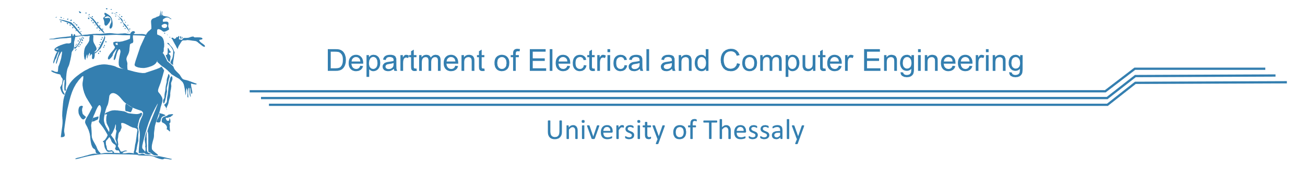
CE327 - Digital VLSI Systems
Semester Project part A
Presentation Fall Semester - 2022
Ioanna-Maria Panagou
2962

Slide 2
XOR Gate
XNOR Gate
D Flip-flop
D Flip-flop with asynchronous preset and clear

Slide 3
XOR Gate
There are 2 ways to construct the XOR gate in static CMOS logic:
Observing the truth table
Using De Morgan’s Law

Slide 4
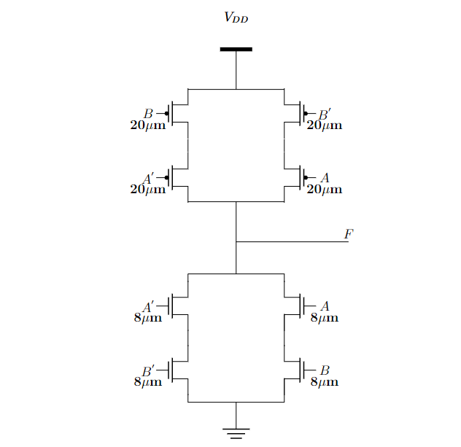
XOR Gate (I)
A | B | F
0 | 0 | 0
0 | 1 | 1
1 | 0 | 1
1 | 1 | 0

Slide 5
XOR Gate (I)
A | B | F
0 | 0 | 0
0 | 1 | 1
1 | 0 | 1
1 | 1 | 0

Slide 6
XOR Gate (I)
A | B | F
0 | 0 | 0
0 | 1 | 1
1 | 0 | 1
1 | 1 | 0

Slide 7
XOR Gate (I)
A | B | F
0 | 0 | 0
0 | 1 | 1
1 | 0 | 1
1 | 1 | 0

Slide 8
XOR Gate (I)
A | B | F
0 | 0 | 0
0 | 1 | 1
1 | 0 | 1
1 | 1 | 0

Slide 9
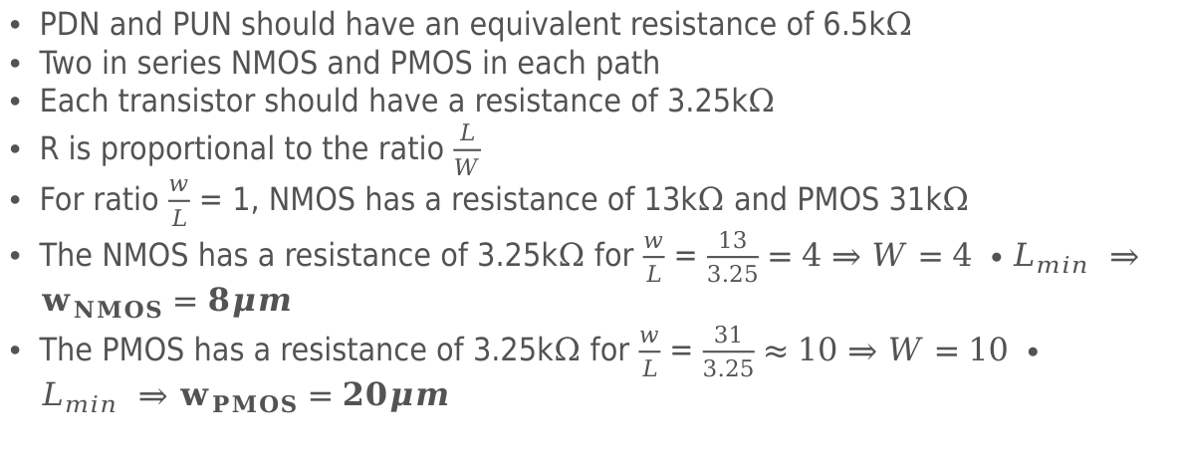
XOR Gate (I)
PDN and PUN should have an equivalent resistance of 6.5k$Ω$
Two in series NMOS and PMOS in each path
Each transistor should have a resistance of 3.25k$Ω$
R is proportional to the ratio $\frac{L}{W}$
For ratio $\frac{w}{L}$ = 1, NMOS has a resistance of 13k$Ω$ and PMOS 31k$Ω$
The NMOS has a resistance of 3.25k$Ω$ for $\frac{w}{L}$ = $\frac{13}{3.25}=4$ $⇒W=4 ∙L_{min} ⇒w_{NMOS}=8μm$
The PMOS has a resistance of 3.25k$Ω$ for $\frac{w}{L}$ = $\frac{31}{3.25}≈10$ $⇒W=10 ∙L_{min} ⇒w_{PMOS}=20μm$

Slide 10
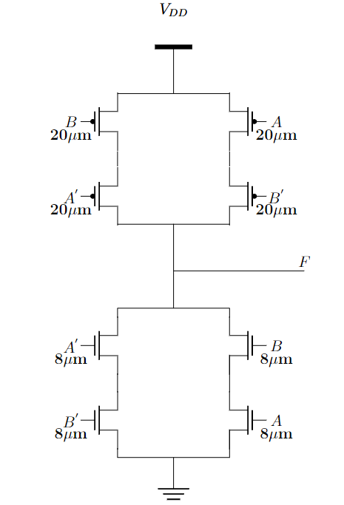
XOR Gate (I)

Slide 11
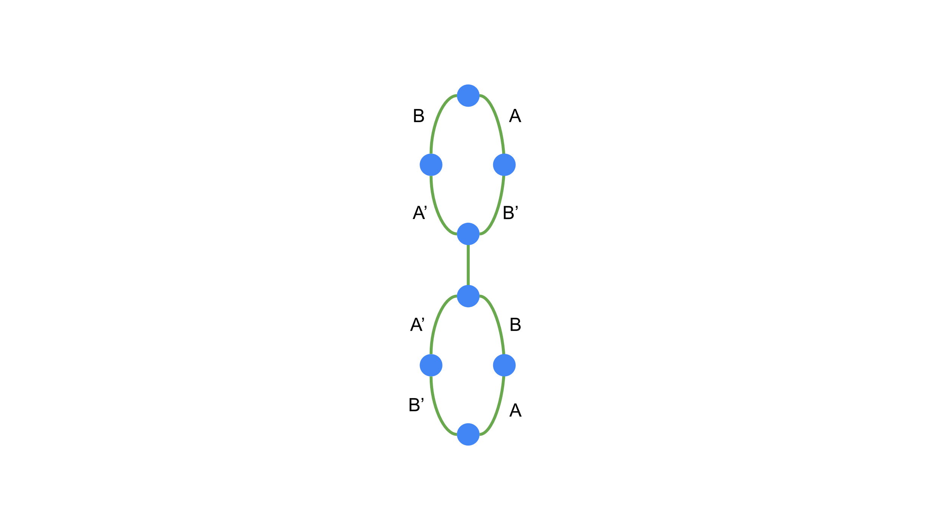
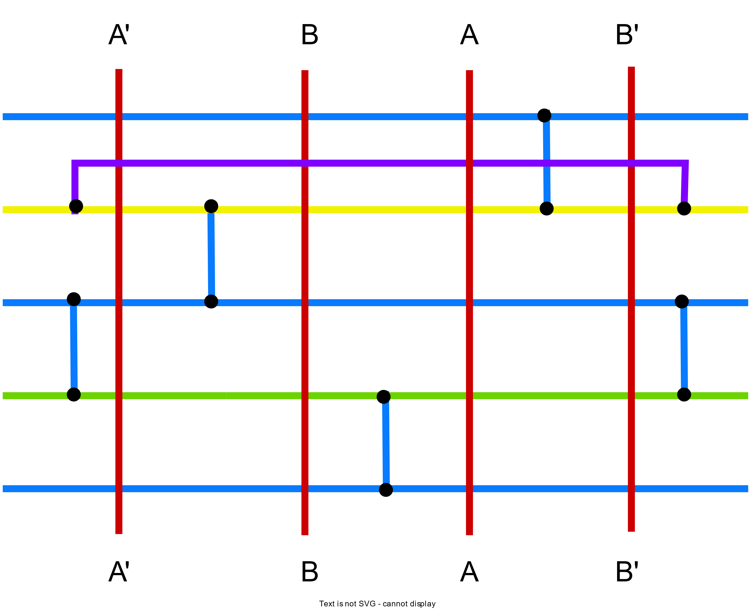
XOR Gate (I)

Slide 12
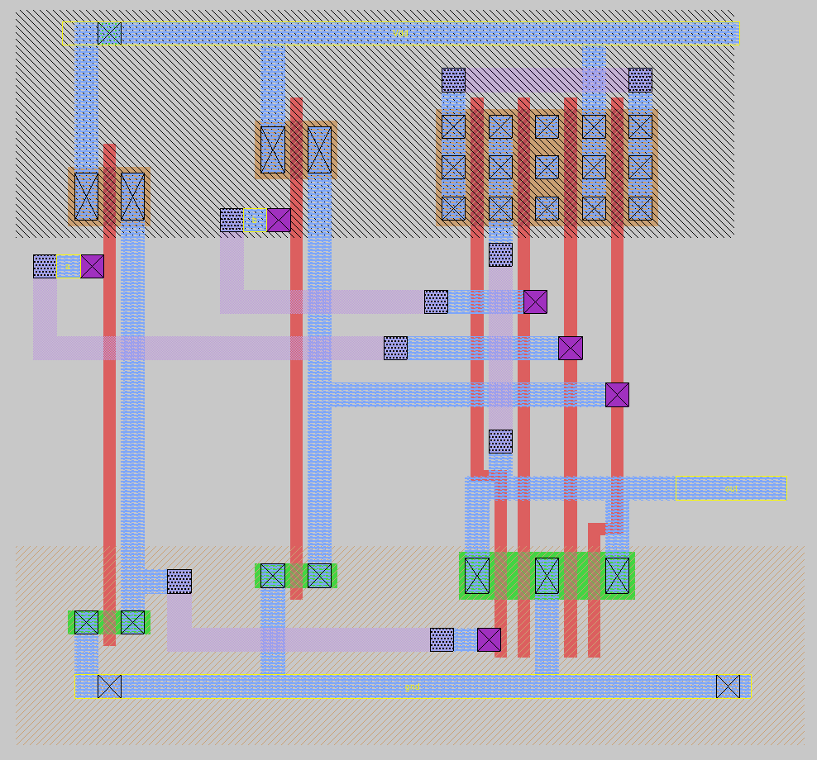
XOR Gate (I)

Slide 13
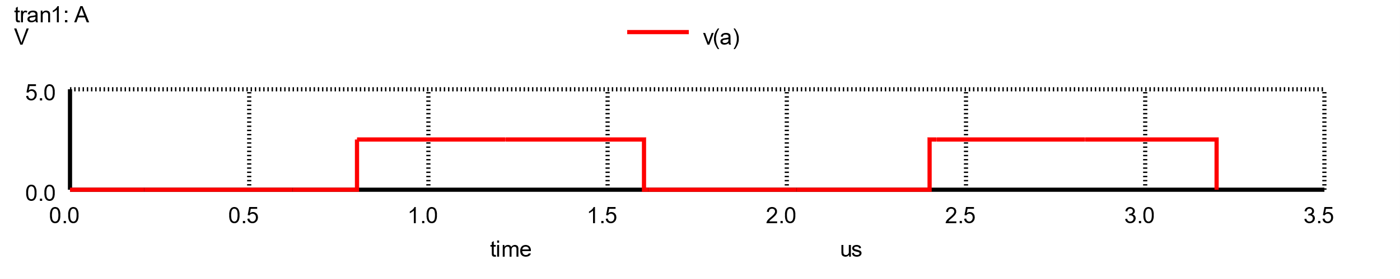
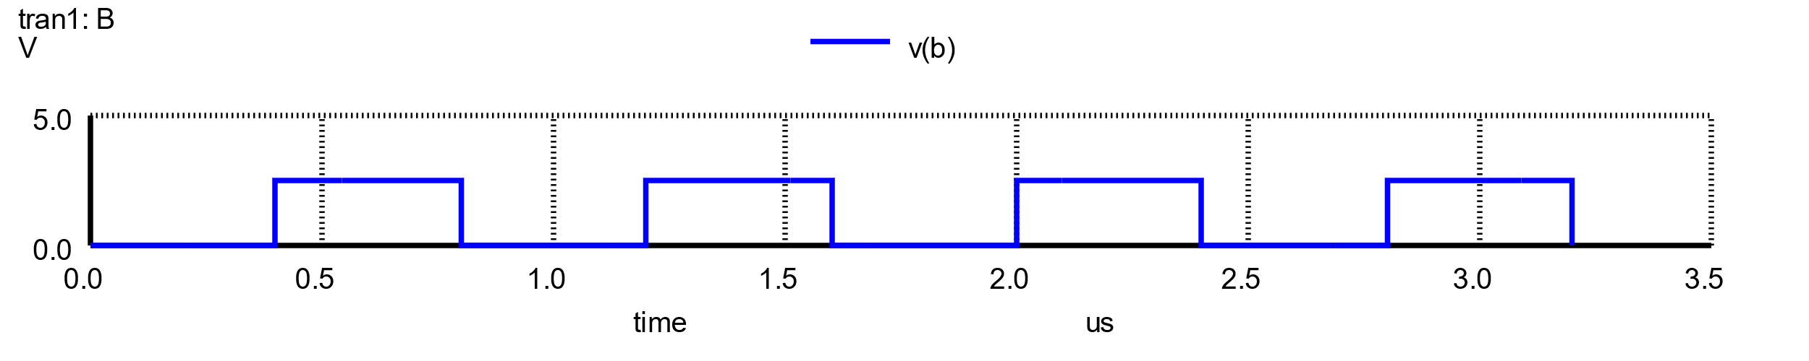
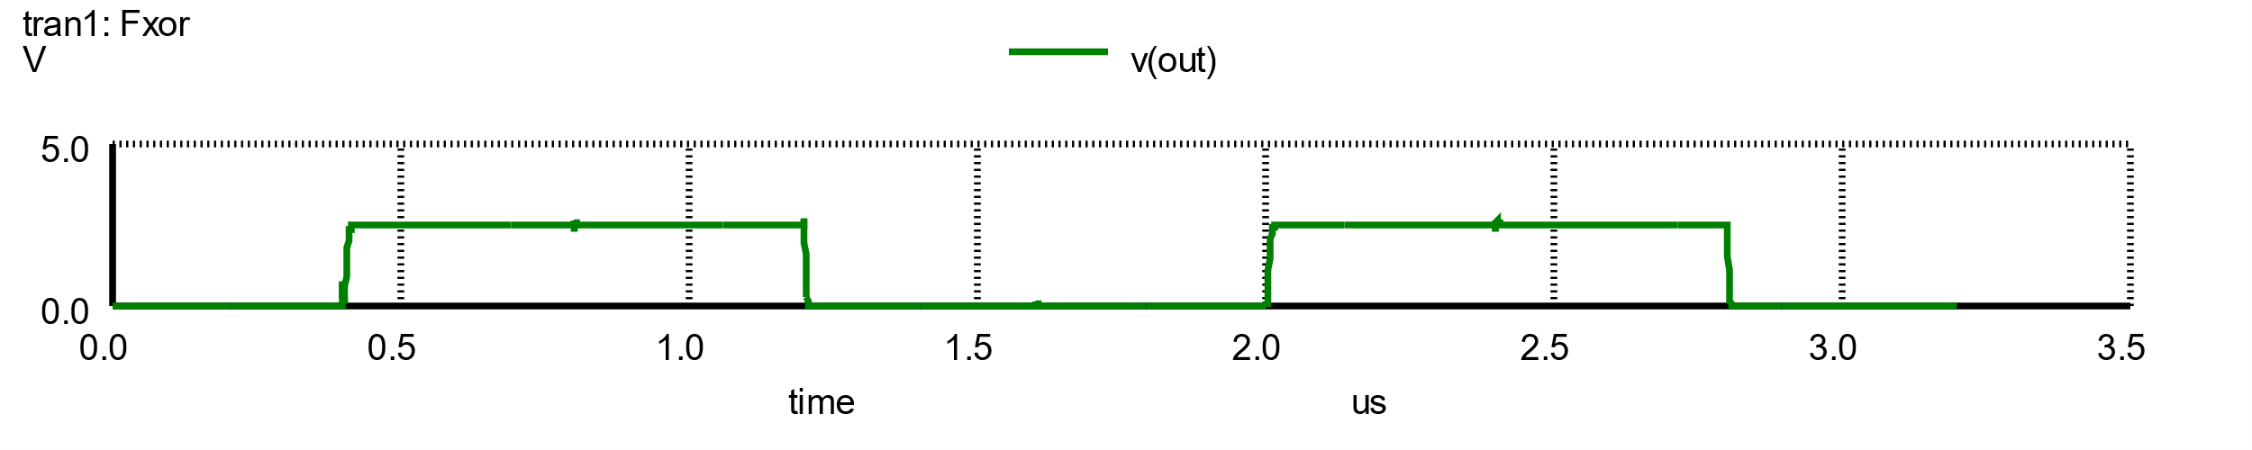
XOR Gate (I)

Slide 14
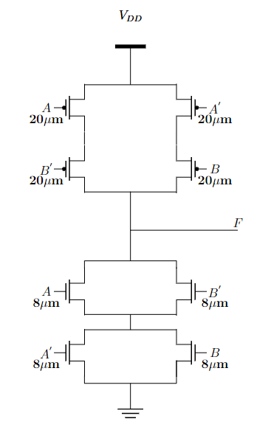
XOR Gate (II)
$$F=A^{′}B+AB^{′}$$
De Morgan’s Law
$$F′=\overline{\left(A^{′}+B\right)\left(A+B^{′}\right)}$$

Slide 15
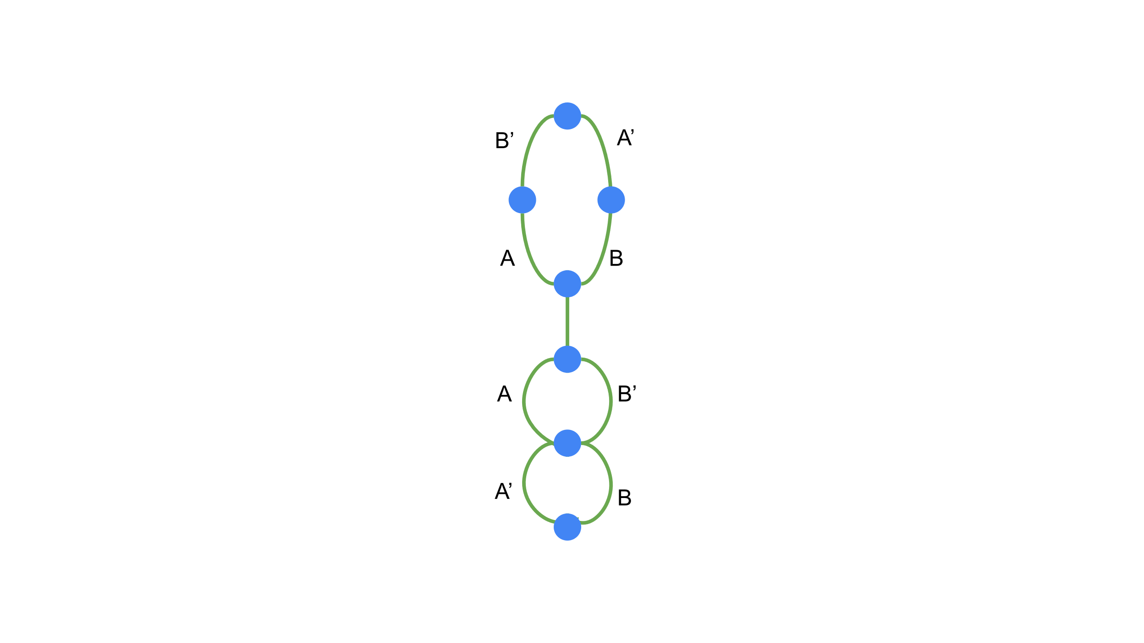
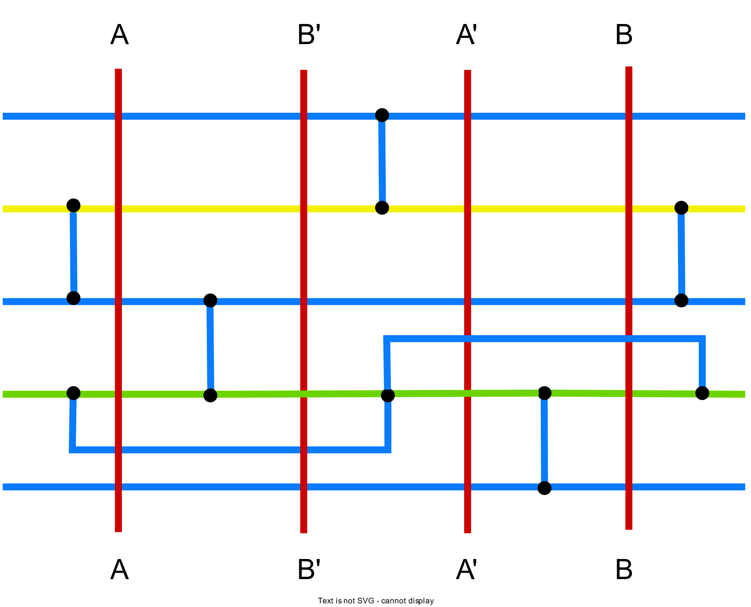
XOR Gate (I)

Slide 16
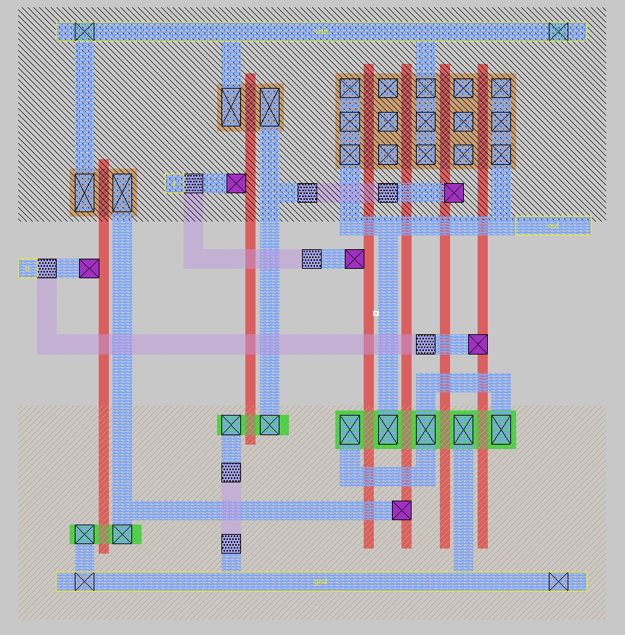
XOR Gate (I)

Slide 17
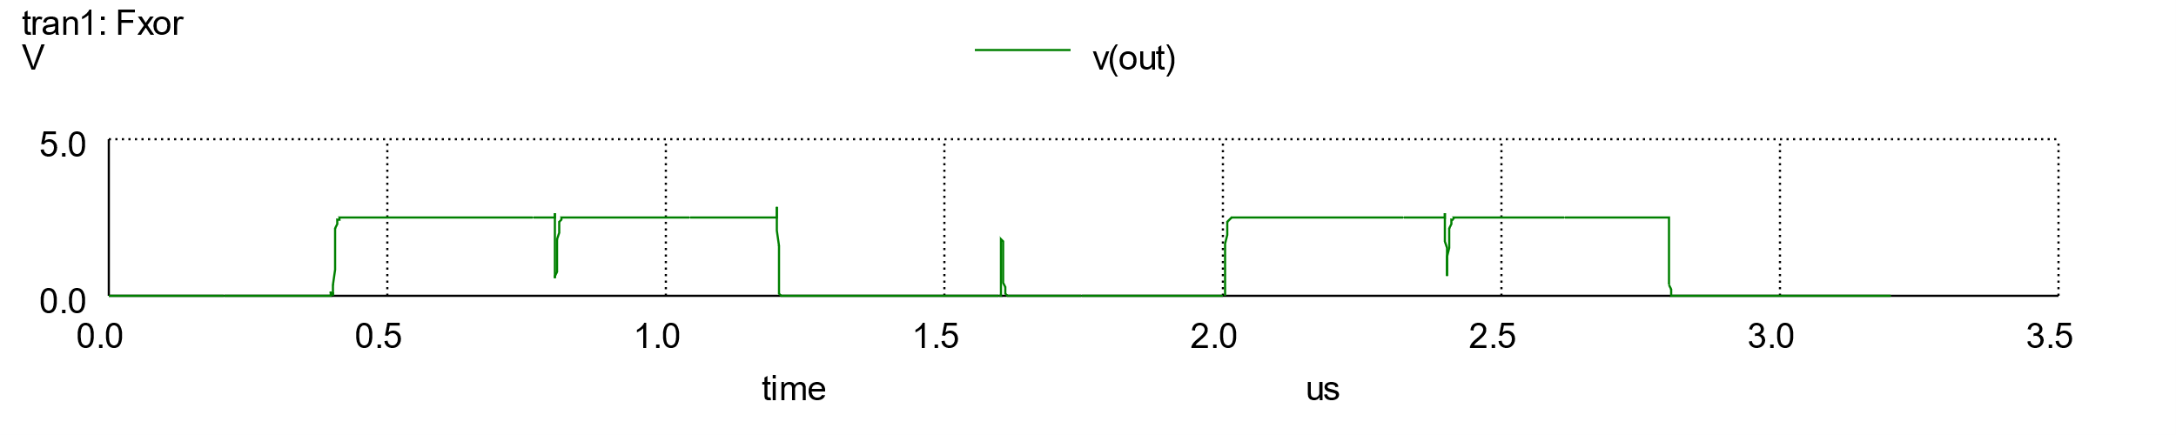
XOR Gate (I)

Slide 18
XOR Gate
XNOR Gate
D Flip-flop
D Flip-flop with asynchronous preset and clear

Slide 19
XNOR Gate
There are 2 ways to construct the XNOR gate in static CMOS logic:
Observing the truth table
Using De Morgan’s Law

Slide 20
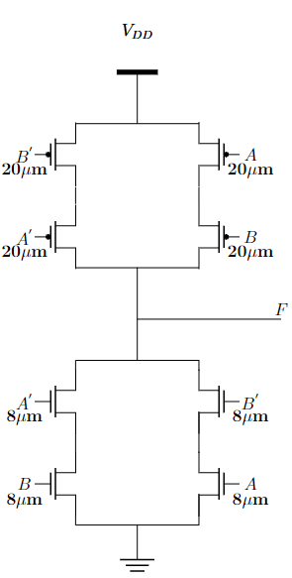
XNOR Gate (I)
A | B | F
0 | 0 | 1
0 | 1 | 0
1 | 0 | 0
1 | 1 | 1

Slide 21
XNOR Gate (I)
A | B | F
0 | 0 | 1
0 | 1 | 0
1 | 0 | 0
1 | 1 | 1

Slide 22
XNOR Gate (I)
A | B | F
0 | 0 | 1
0 | 1 | 0
1 | 0 | 0
1 | 1 | 1

Slide 23
XNOR Gate (I)
A | B | F
0 | 0 | 1
0 | 1 | 0
1 | 0 | 0
1 | 1 | 1

Slide 24
XNOR Gate (I)
A | B | F
0 | 0 | 0
0 | 1 | 1
1 | 0 | 1
1 | 1 | 0

Slide 25
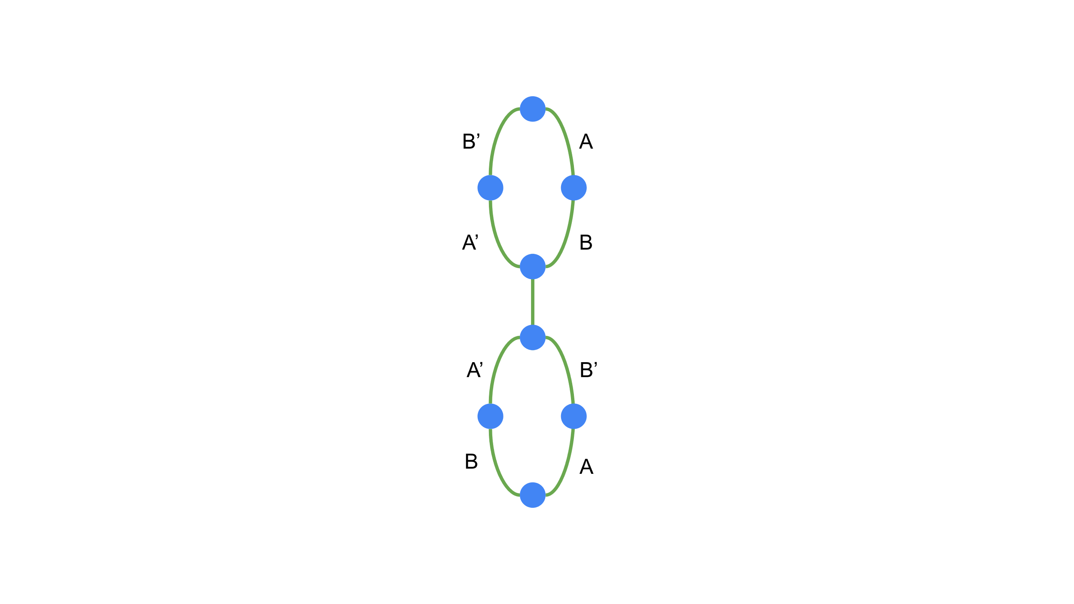
XNOR Gate (I)

Slide 26
XNOR Gate (I)

Slide 27
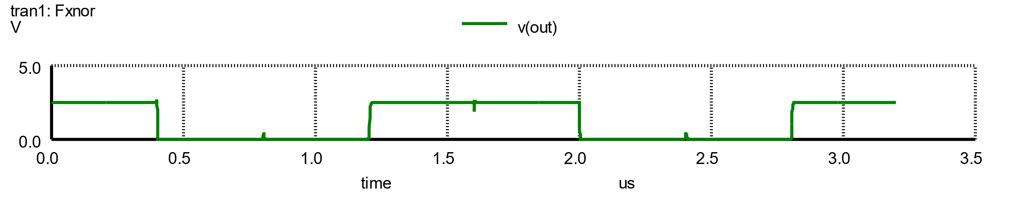
XNOR Gate (I)

Slide 28
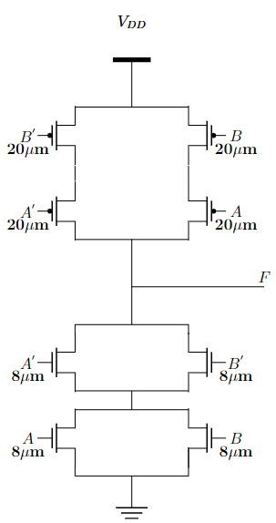
XNOR Gate (II)
$$F=A^{′}B′+AB$$
De Morgan’s Law
$$F′=\overline{\left(A+B\right)\left(A′+B^{′}\right)}$$

Slide 29
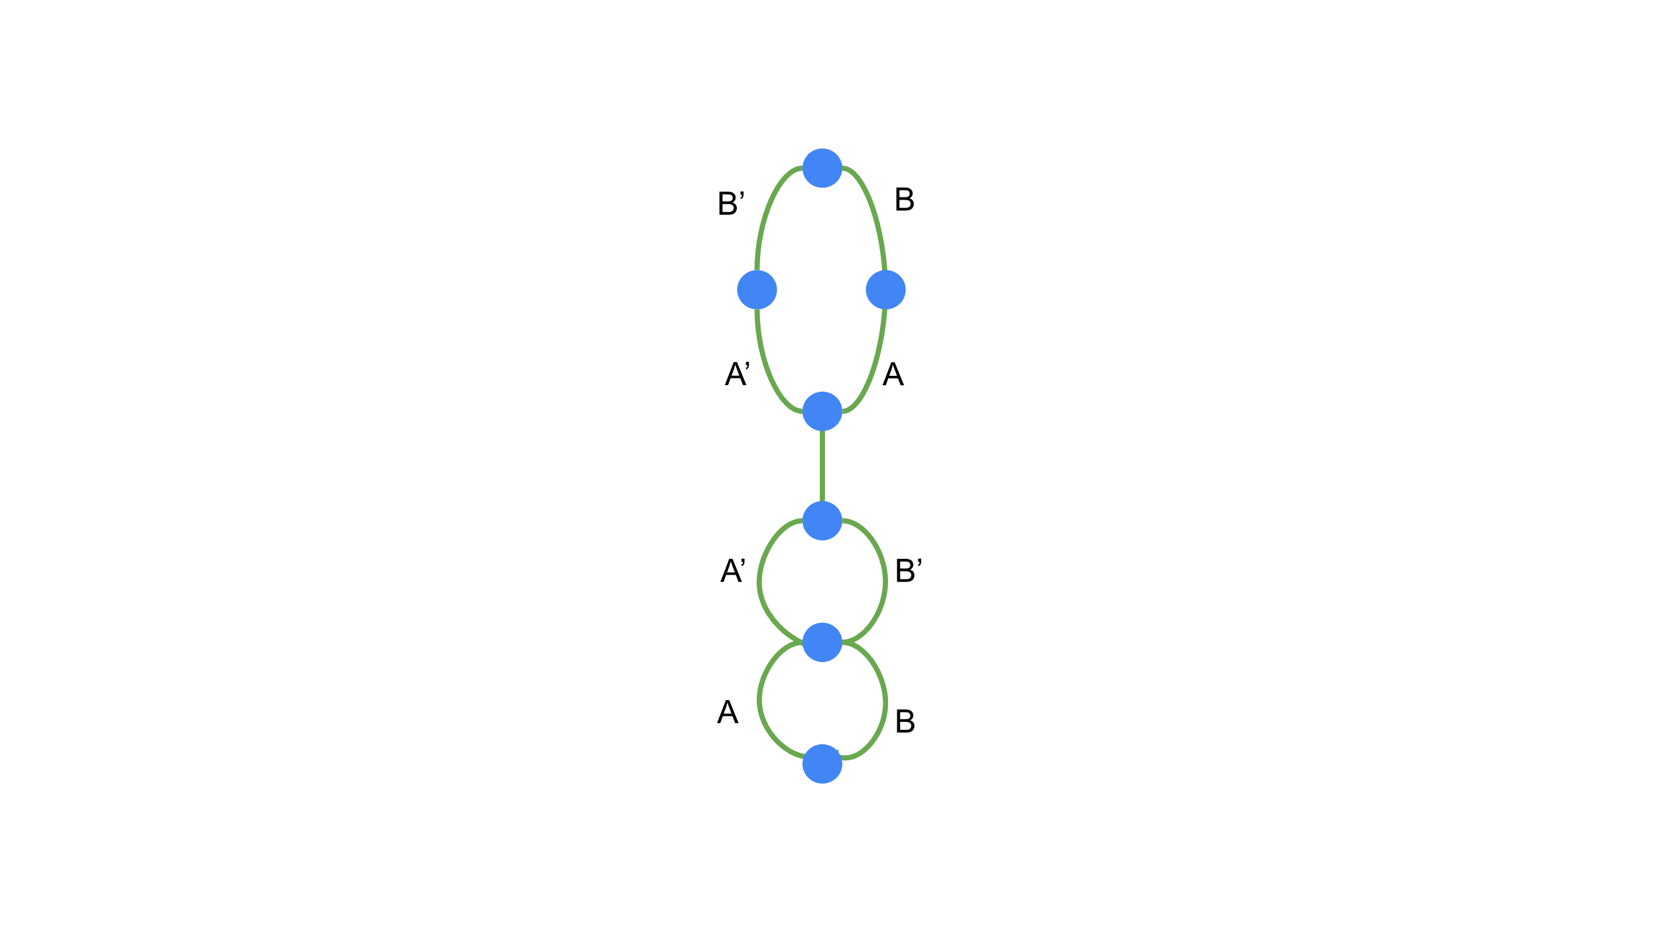

XNOR Gate (II)

Slide 30
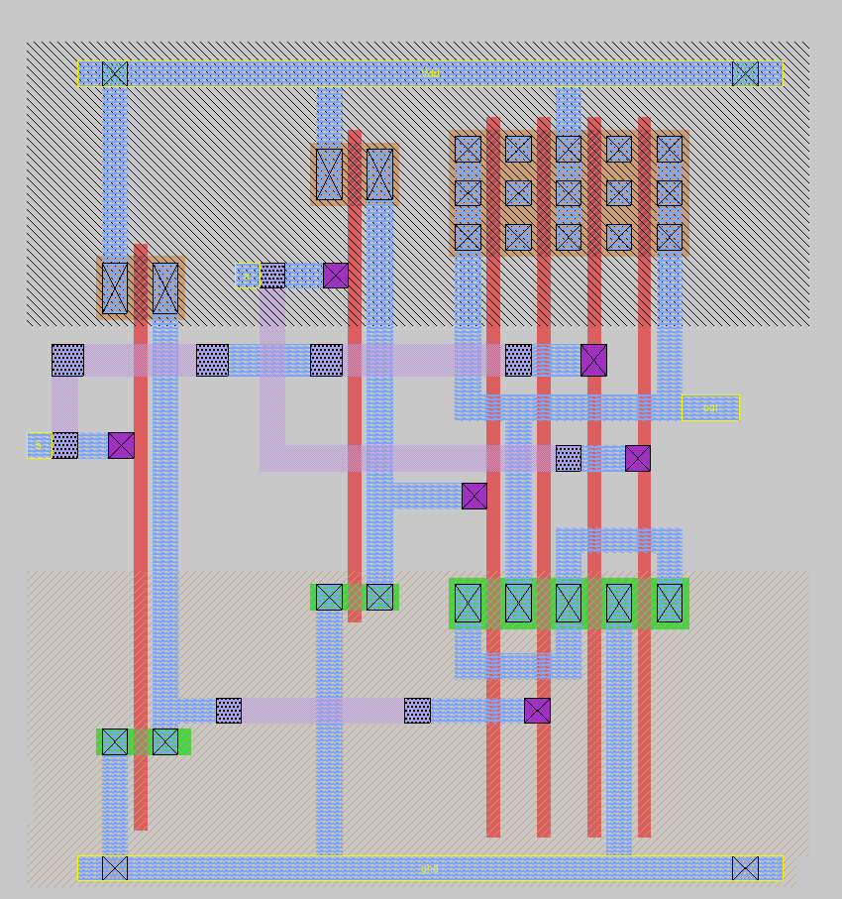
XNOR Gate (II)

Slide 31

XNOR Gate (II)

Slide 32
XOR Gate
XNOR Gate
D Flip-flop
D Flip-flop with asynchronous preset and clear

Slide 33
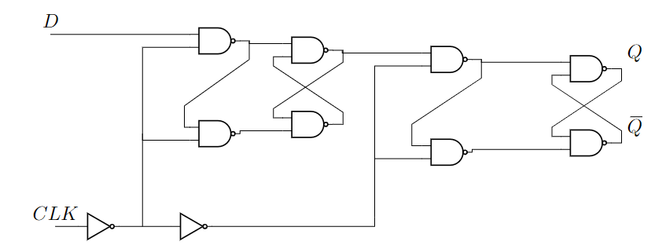
D Flip-Flop (I)
☹ 36 transistors in total

Slide 34
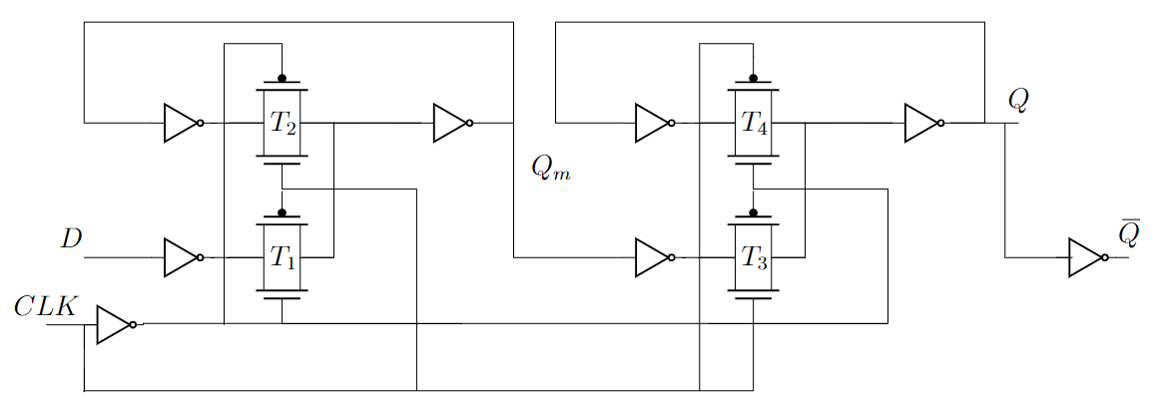
D Flip-Flop (II)
☺ 24 transistors
☹ High capacitative load to the clock signal

Slide 35
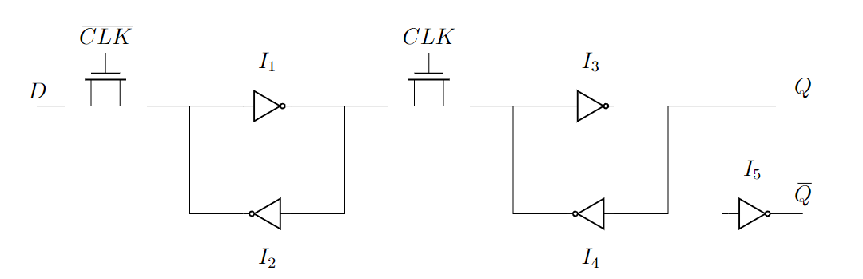
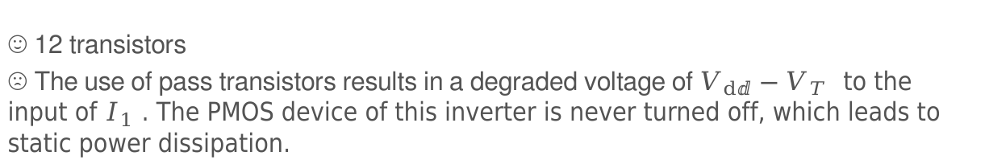
D Flip-Flop (III)
☺ 12 transistors
☹ The use of pass transistors results in a degraded voltage of $V_{dⅆ}−V_{T}$ to the input of $I_{1}$ . The PMOS device of this inverter is never turned off, which leads to static power dissipation.

Slide 36
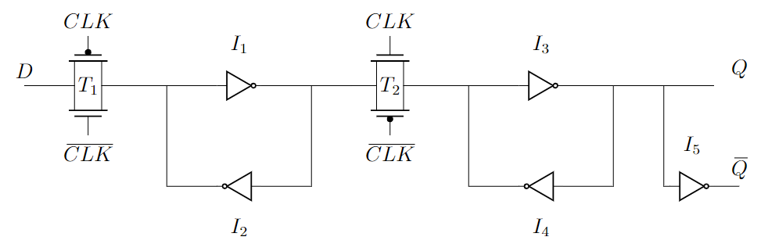
Final D Flip-Flop Implementation
☺ 14 transistors
☺ No pass transistors -> Less power dissipation
☹ Increased Design Complexity

Slide 37
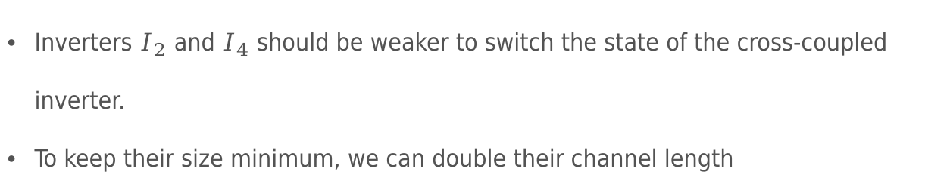
Final D Flip-Flop Implementation
Inverters $I_{2}$ and $I_{4}$ should be weaker to switch the state of the cross-coupled inverter.
To keep their size minimum, we can double their channel length

Slide 38
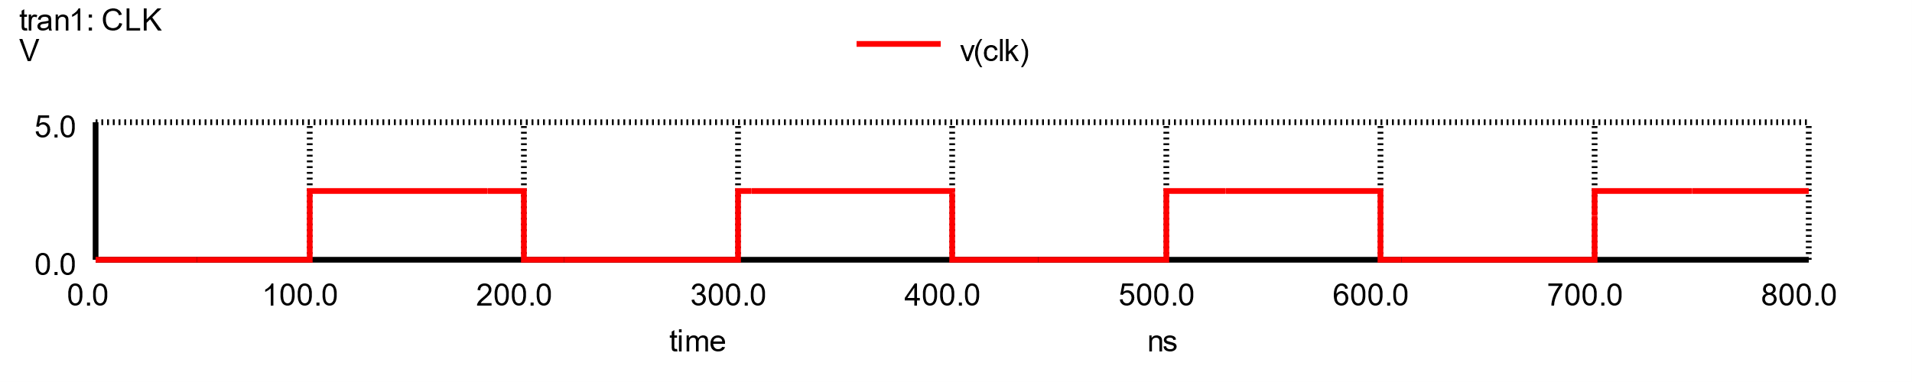
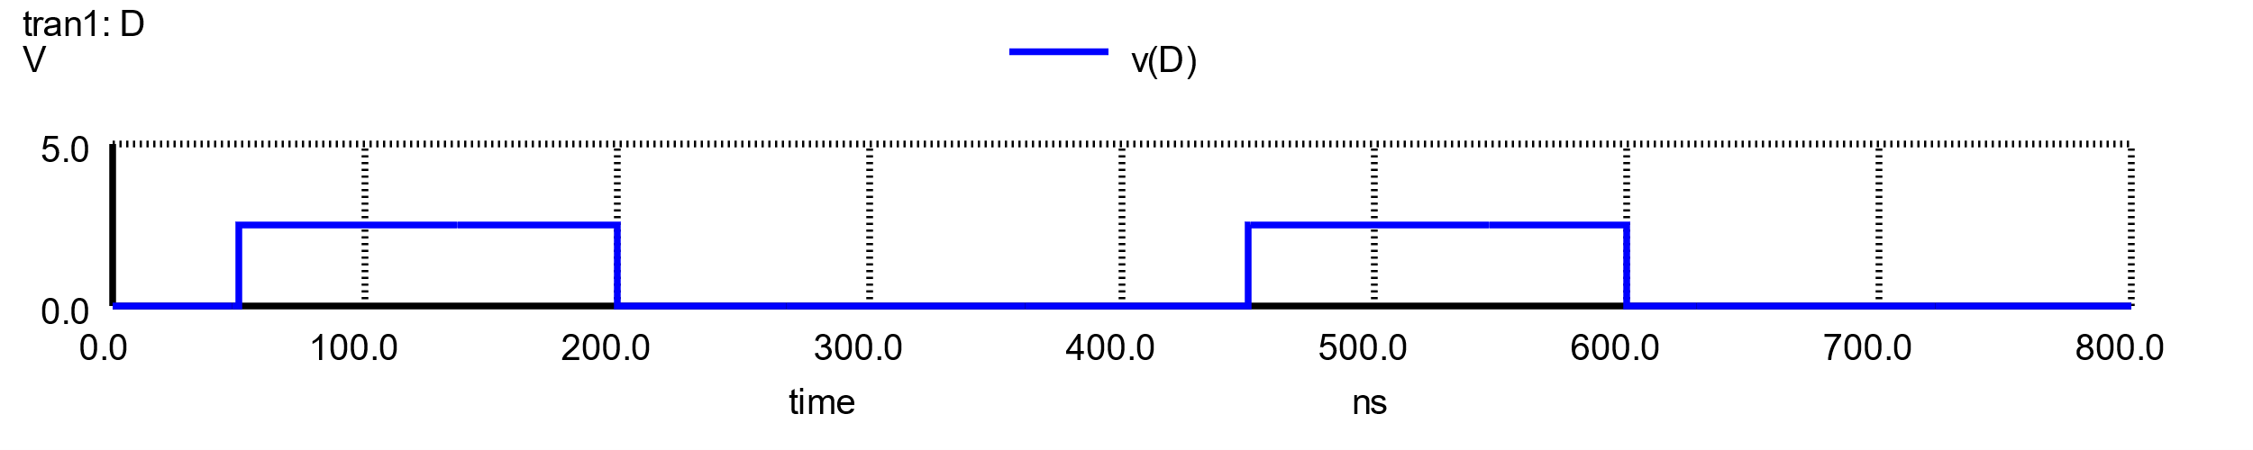
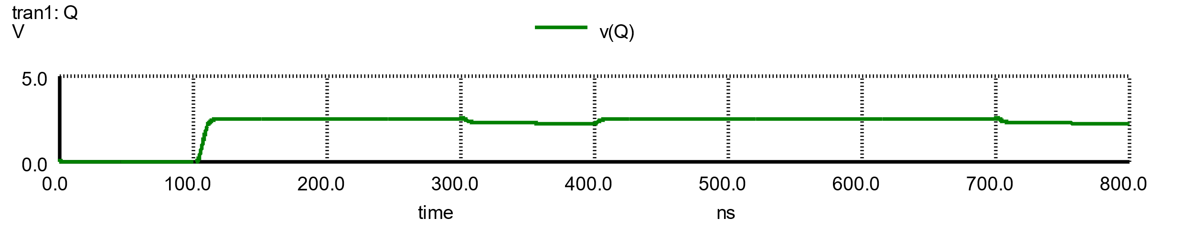
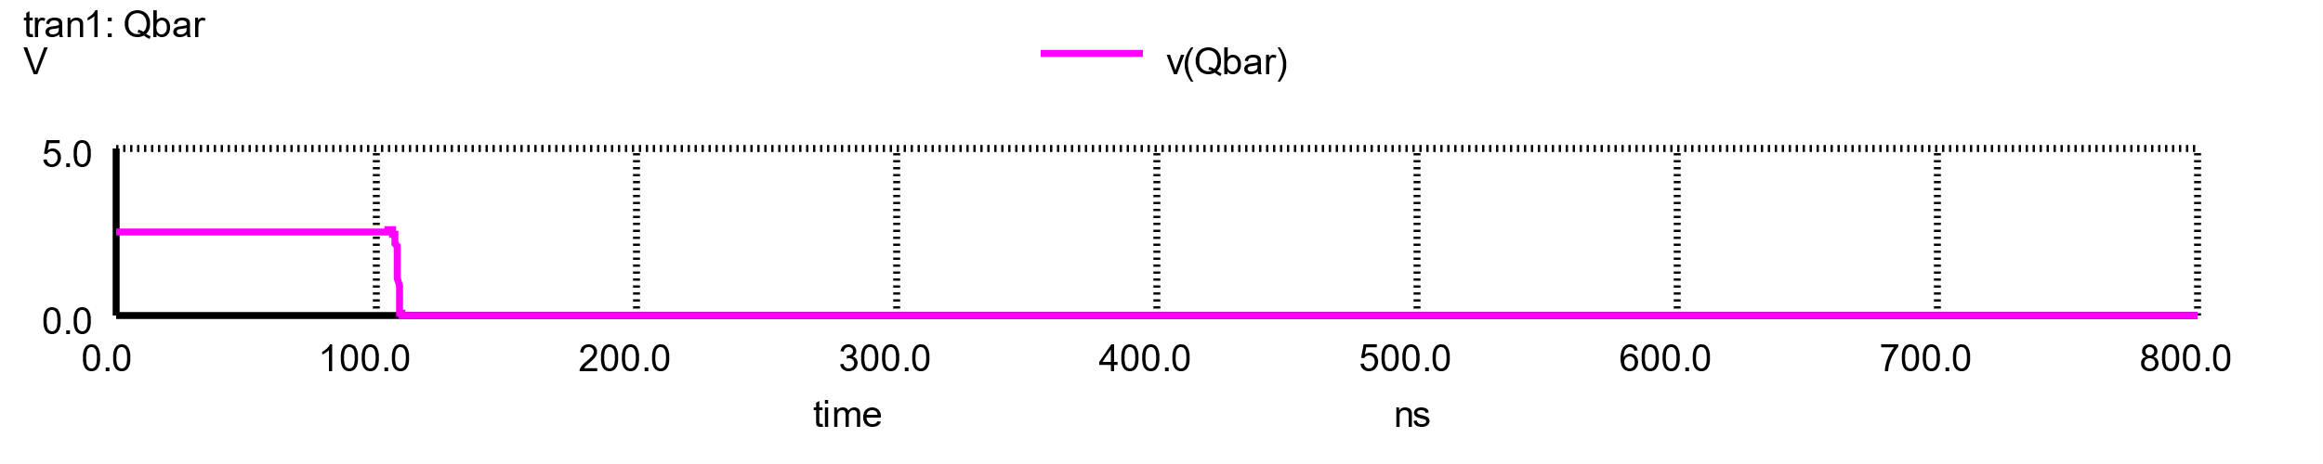
Final D Flip-Flop Implementation
As we can see from the simulations, the inverters were not weak enough and we couldn’t successfully change the state.

Slide 39
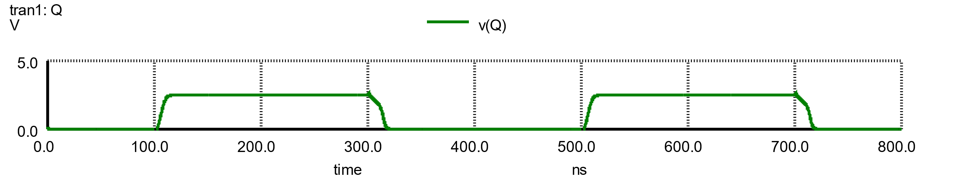
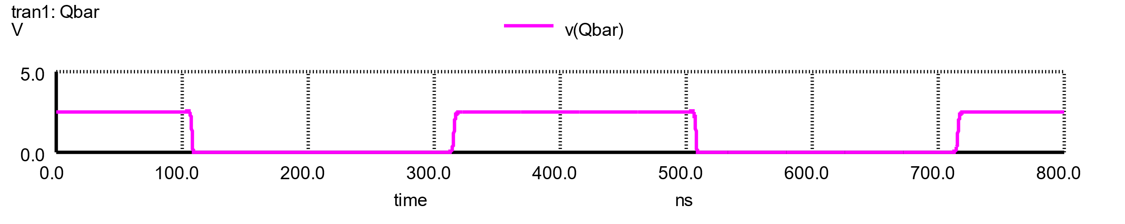
Final D Flip-Flop Implementation
The solution was to double the size of the pass gates

Slide 40
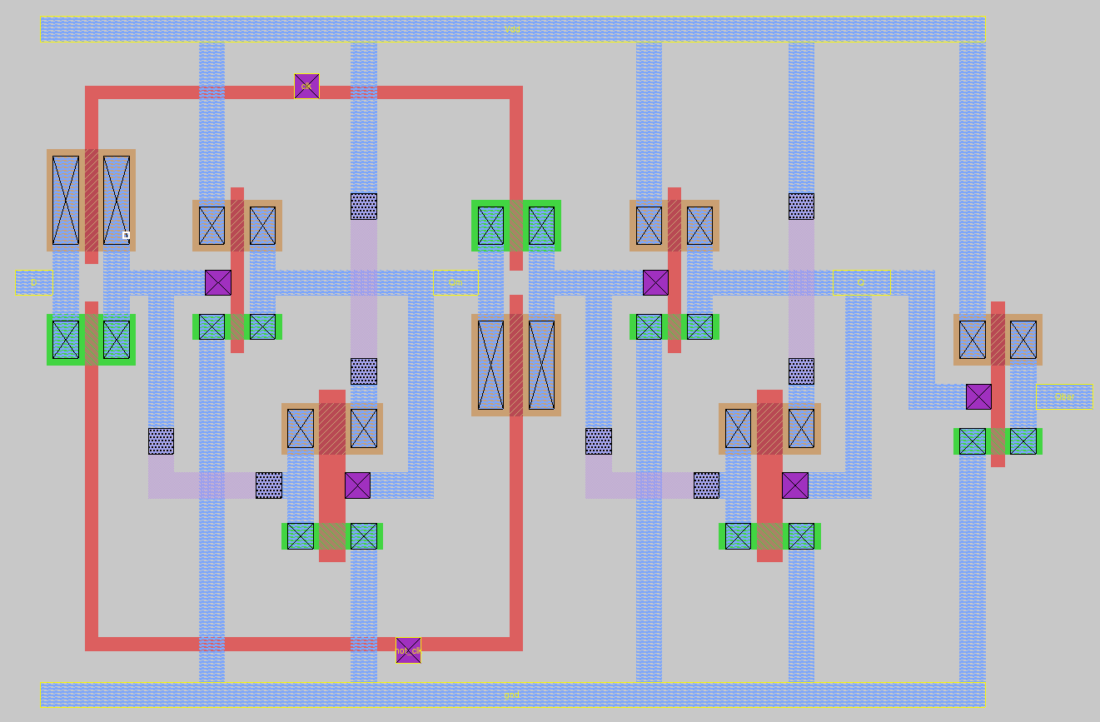
Final D Flip-Flop Implementation

Slide 41
XOR Gate
XNOR Gate
D Flip-flop
D Flip-flop with asynchronous preset and clear

Slide 42
D Flip-Flop with Asynchronous Preset & Clear (DFFRS)
CLK | D | S | R | Q | Qbar
X | X | 1 | 0 | 1 | 0
X | X | 0 | 1 | 0 | 1
X | X | 1 | 1 | ? | ?
↑ | 1 | 0 | 0 | 1 | 0
↑ | 0 | 0 | 0 | 0 | 1
Truth Table

Slide 43
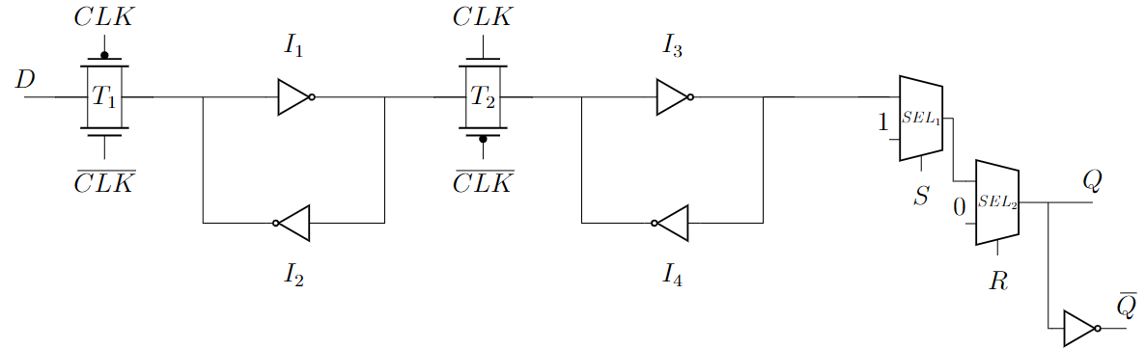
D Flip-Flop with multiplexer-based asynchronous preset (S) and clear (R) (I)

Slide 44
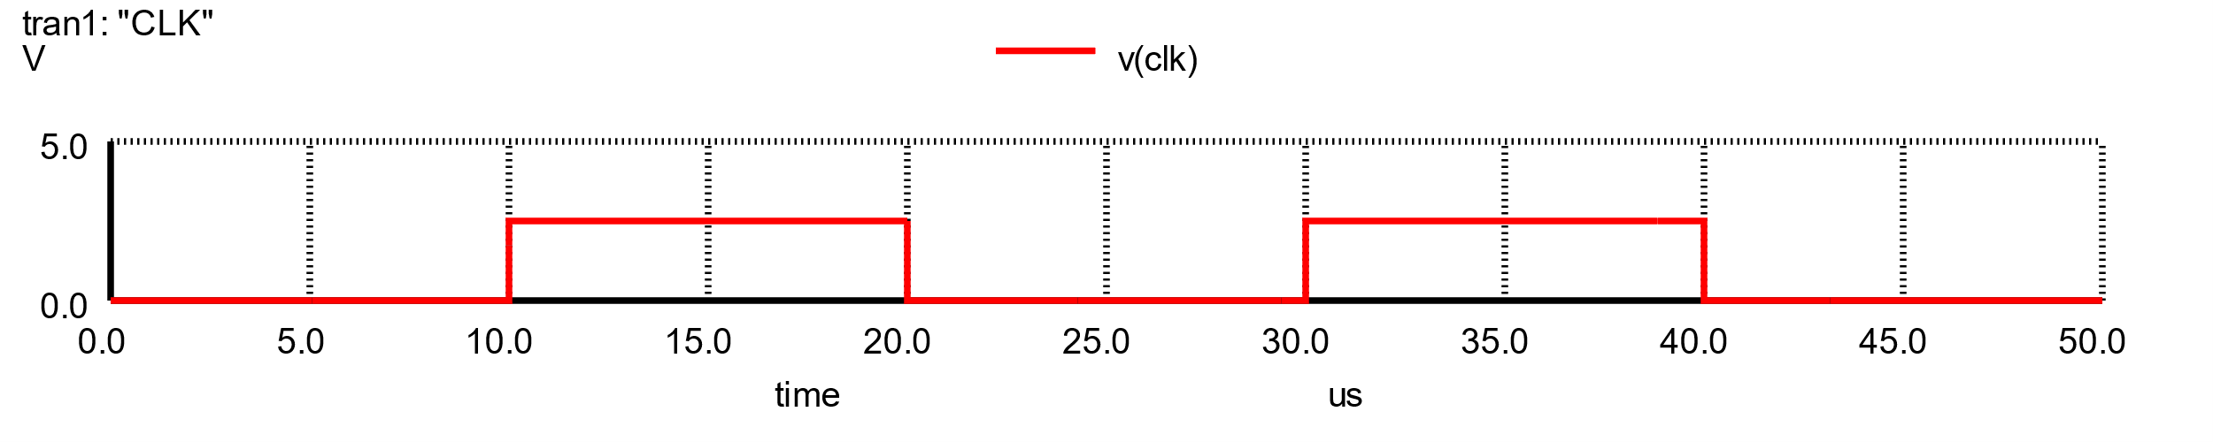
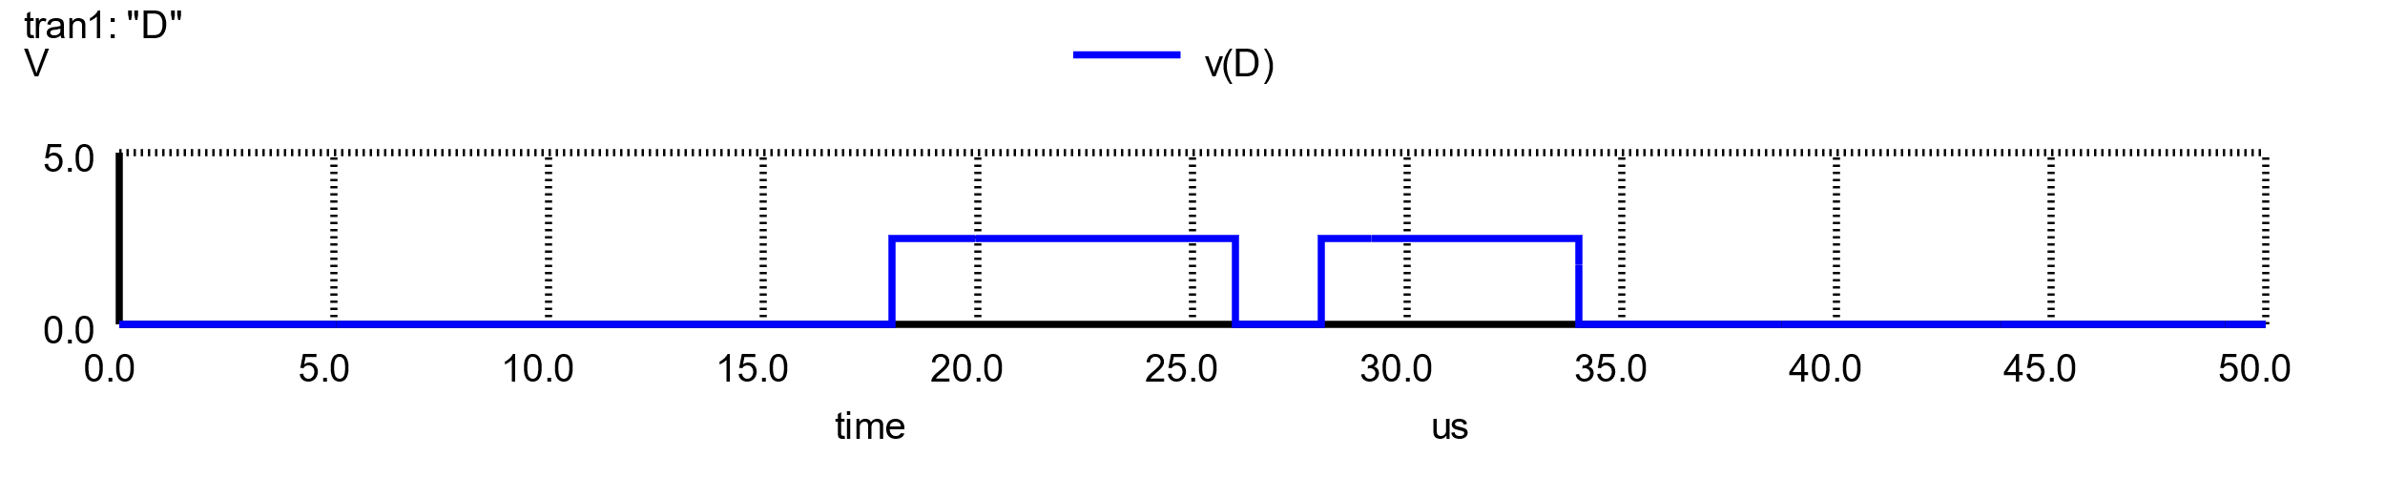
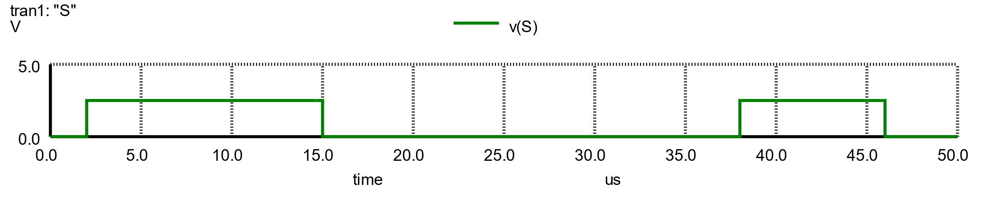
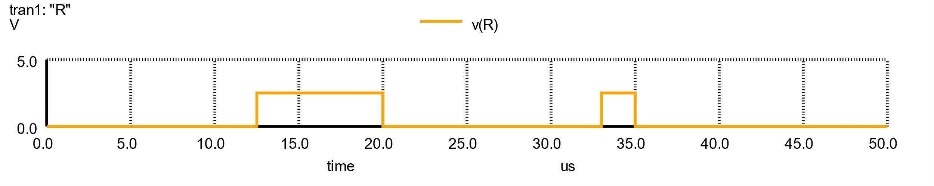
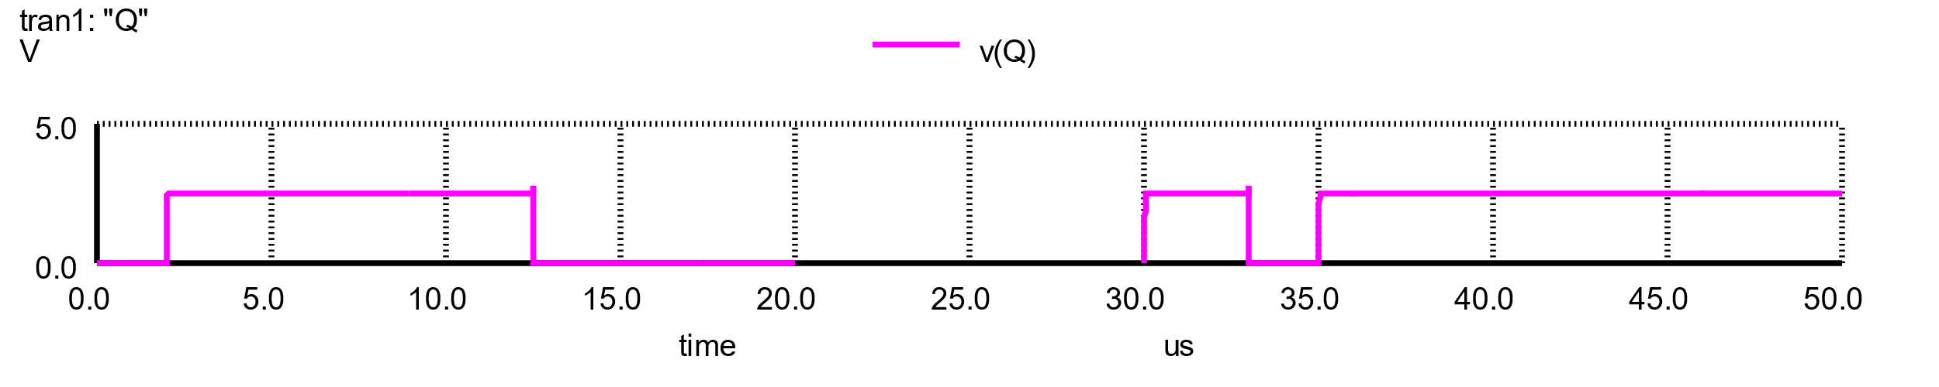
D Flip-Flop with multiplexer-based asynchronous preset (S) and clear (R) (I)
When S or R becomes 1, the output goes to 1 or 0 respectively, with R having a higher priority over S.
However, as soon as R or S are unset, the flip flop returns to the state that it had previously stored.

Slide 45
D Flip-Flop with multiplexer-based asynchronous preset (S) and clear (R) (I)
When S or R becomes 1, the output goes to 1 or 0 respectively, with R having a higher priority over S.
However, as soon as R or S are unset, the flip flop returns to the state that it had previously stored.

Slide 46
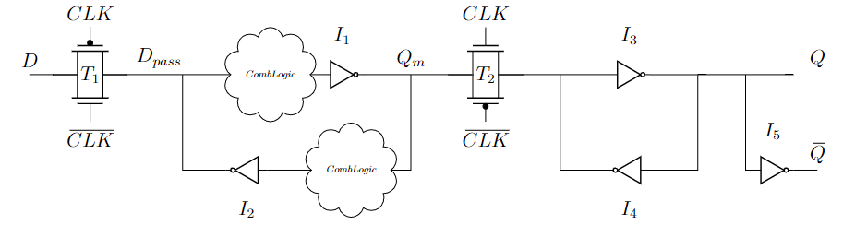
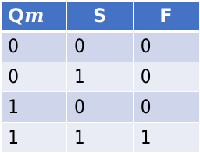
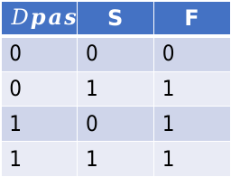
D Flip-Flop with Synchronous Set
1
0
0
1
0
$$Dpass$$ | S | F
0 | 0 | 0
0 | 1 | 1
1 | 0 | 1
1 | 1 | 1
Q$m$ | S | F
0 | 0 | 0
0 | 1 | 0
1 | 0 | 0
1 | 1 | 1

Slide 47
D Flip-Flop with Synchronous Set
1
0
0
1
0
$$Dpass$$ | S | F
0 | 0 | 0
0 | 1 | 1
1 | 0 | 1
1 | 1 | 1
Q$m$ | S | F
0 | 0 | 0
0 | 1 | 0
1 | 0 | 0
1 | 1 | 1
OR gate
AND gate

Slide 48
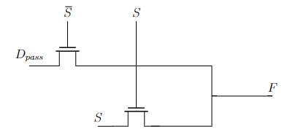
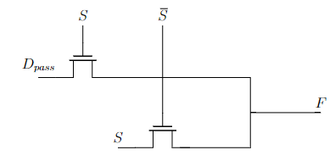
D Flip-Flop with Synchronous Set
1
0
0
1
0
$$Dpass$$ | S | F
0 | 0 | 0
0 | 1 | 1
1 | 0 | 1
1 | 1 | 1
Q$m$ | S | F
0 | 0 | 0
0 | 1 | 0
1 | 0 | 0
1 | 1 | 1
OR gate
AND gate
OR gate
AND gate

Slide 49
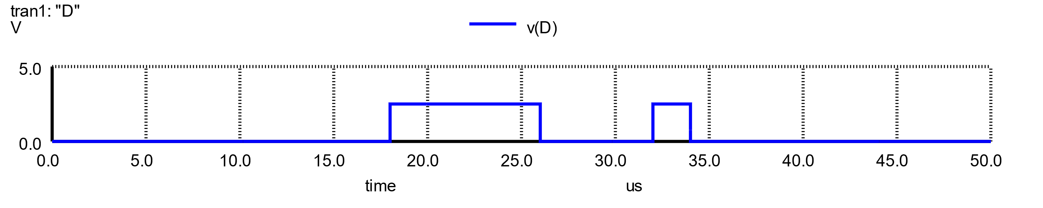

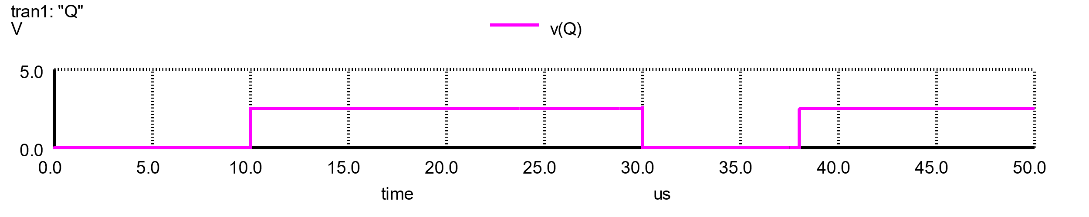
D Flip-Flop with Synchronous Set

Slide 50
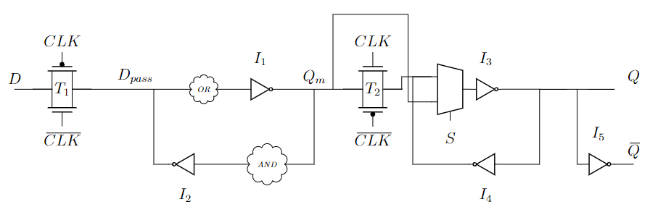
D Flip-Flop with Asynchronous Set
Multiplexer controls if the output of the pass gate or Qm propagates through inverter I3

Slide 51
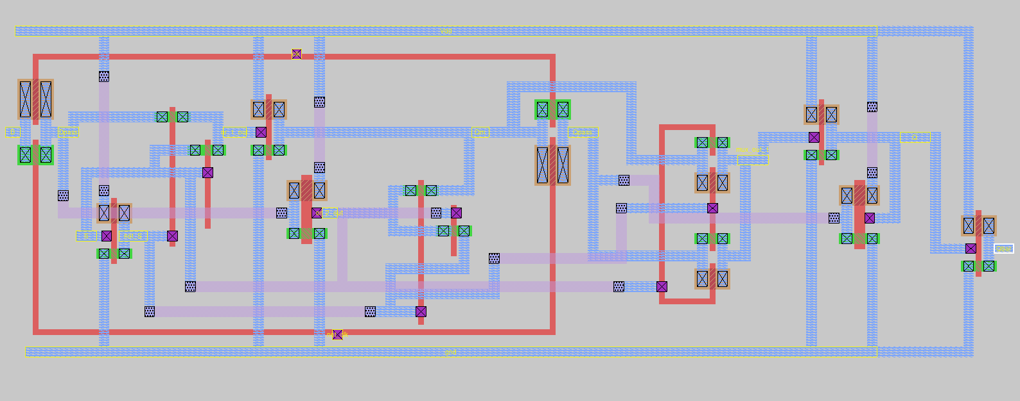
D Flip-Flop with Asynchronous Set

Slide 52

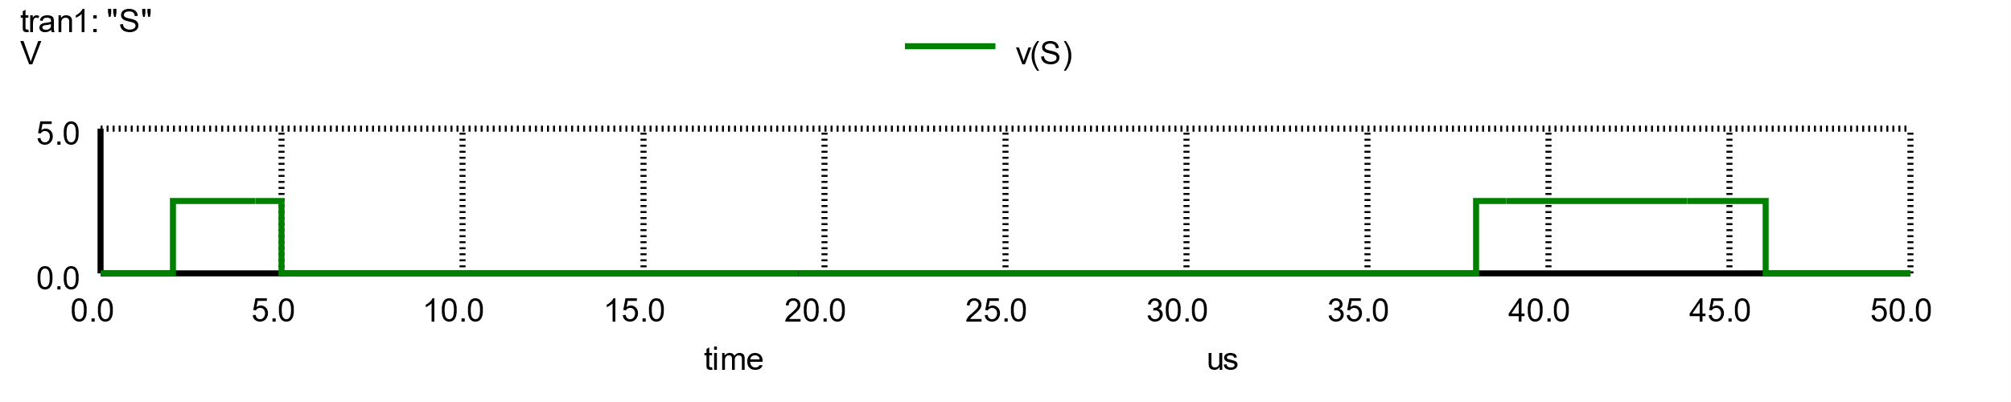

D Flip-Flop with Asynchronous Set

Slide 53



D Flip-Flop with Asynchronous Preset & Clear (DFFRS)
Dset1
Dset2
$$Dset1$$ | R | F
0 | 0 | 0
0 | 1 | 0
1 | 0 | 0
1 | 1 | 1
$$Dset2$$ | R | F
0 | 0 | 0
0 | 1 | 1
1 | 0 | 1
1 | 1 | 1
AND gate
OR gate

Slide 54
D Flip-Flop with Asynchronous Preset & Clear (DFFRS)
Dset1
Dset2
34 transistors in total
4 transistors for the transmission gates
16 transistors for the inverters
6 transistors for the OR gates
4 transistors for the AND gates
4 transistors for the multiplexer

Slide 55






D Flip-Flop with Asynchronous Preset & Clear (DFFRS)

Slide 56

D Flip-Flop with Asynchronous Preset & Clear (DFFRS)

