Slide 1
Capstone of
Statistics & Modeling
Coding with Performance on Big Data
Joanna Riascos
Communicating Results for Decision-Making
Venn Diagram of Data Science Skills

Slide 2
Contribution of Competitor’s Article
According to a study by the Union of Concerned Scientists (UCSUSA), “search for parking contributed more than half of the carbon monoxide and nitrogen oxides, and almost a quarter of the hydrocarbons emitted into our air.”
One of the cities that have introduced the concept of the smart parking assistance program is in Ellicott City, Md.
They have developed a smart parking system that utilizes sensors to detect whenever a parking space is open and then it sends the data information to the drivers to let them know which parking spot is vacant.

Slide 3
Description of Your Contribution
Car emissions are one of the main contributors for causing air pollution.
The investigation that we have purposed is to explore how smart parking can help solve environmental issues caused by traffic congestion
By having a smart parking system there will be a reduction in traffic since there will be less cars looking for an available and open parking space.

Slide 4
Data Source and Content
The parking dataset comes from the City of Aarhus in Denmark. It contains data from February 2015 until October 2015.
The data file contains the following fields: vehicle count, update time, id, total spaces, and garage code.
We merged the parking and the pollution dataset in order to add the "ozone” column.

Slide 5
Your Method
Our algorithm consists of running a linear regression and a time series analysis.
With linear regression we can fit a predictive model with the dependent and independent variables. We took the “ozone” field as the dependent variable and the “vehicle count,” “total spaces,” and “garage code” as the independent variables.
We then performed the time series analysis to get a better understanding of the impact that our variables had on the ozone layer.

Slide 6
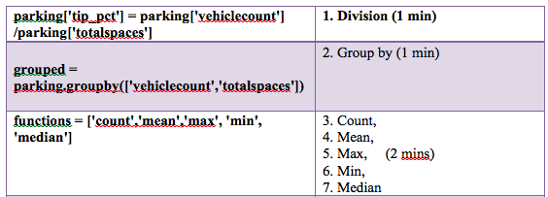
Quantitative Results 1

Slide 7
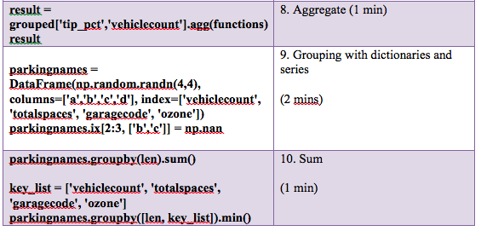
Quantitative Results 2

Slide 8
Discussion: Comparison With Your Competitor
Competitor’s Results
Your Results
The results show that the algorithm helps improve the probability of successful parking and minimizes the user waiting time.
Also, the results depict that the proposed reservation-based parking policy has the potential to simplify the operations of parking systems, as well as alleviate traffic congestion caused by parking searching.
We used multiple linear regression to better understand the relationship between the independent and the dependent variables.
Then we used time series to help us identify the numerous patterns in the correlated data. As well, we performed the time series analysis to get a better understanding of the impact that out variables had on the ozone layer.

Slide 9
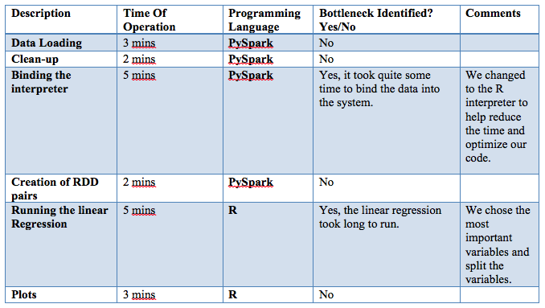
Performance on Big Data: Time Measurements

Slide 10
Conclusion
By running all of these analyses we were able to distinguish which variables had the most impact on our model and which of these variables had the most impact on the ozone layer. In particular, the time series analysis helped us in extracting meaningful data and helped us identify several patterns in the correlated data.
By implementing smart parking we will be able to spend less money on gas, reduce traffic and stress, improve air quality, real-time data and trend insight, new revenue streams, increased safety, optimized parking, less accidents, less time spent, decreased management costs, and enhanced driver experience. As well, it helps in reducing traffic congestion and reducing the amount of traffic volume while searching for a parking spot.

Slide 11
Quiz for Your Classmates
What statistical method was used?
What programming tool was used?
What scientific contribution was made?
What idea could be useful for your project?

