Slide 1
Healthcare is expensive
& it is getting more expensive

Slide 2


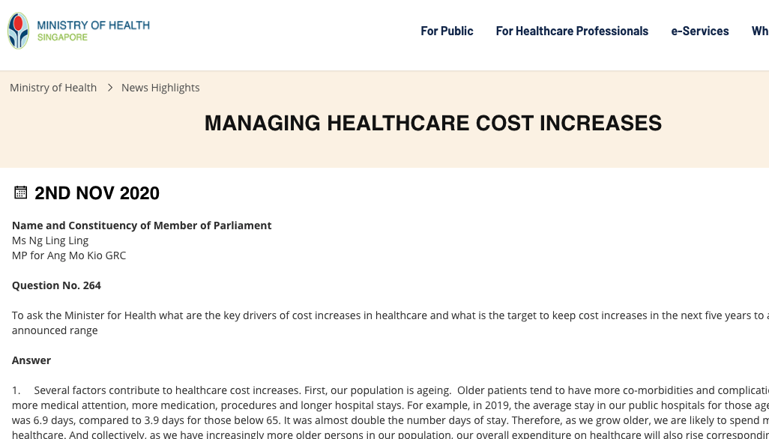
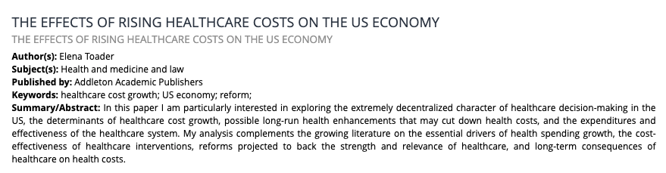
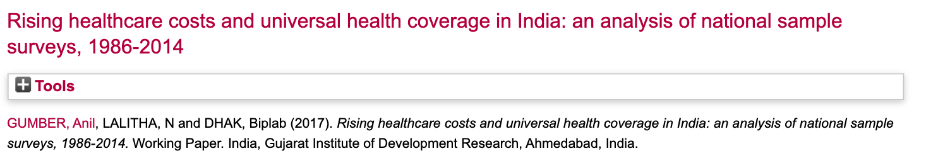


Slide 3
Assessing key cost drivers associated with inpatient admission of patients with condition X

Slide 4
Project Flow
Load into Database
Data Cleaning (SQL)
Deep Dive
Identify Key Variables
Understand Data
(EDA)
Interpret
Discussion
￼

Slide 5
Contents
Our Data
New Variables & Clean Up
Length of Stay & Target Variable
Demographics
Which variable matters?
Decision Tree for Feature Importance
Correlation Coefficient Matrix
Patient Level Data vs Admission Clinical Data
Encounter per year
Medical History
Body Mass Index (BMI)
Model & Interpretation
Use Case Discussion
Given more time …
￼

Slide 6
Our Data
A summary of our dataset .

Slide 7
Our Data
Clinical and financial data of patients hospitalised for a certain (X) condition
3,400 inpatient admission
3,000 unique patients
5 year data (2011 - 2015)
Per row per inpatient admission
Clinical (Admission)
Patient
Financial
Date of admission/discharge
Pre-Op Medication
Symptoms
Lab Results
Weight / Height
Demographics
Medical History
Total Bill per admission
￼
Notes:
A summary of the dataset we have. We 3,400 ip admission data per row of patients hospitalised with a certain condition. Let’s call it condition X. I’ve also categorise the variables into 3 groups - clinical data obtained from the admission, patient level data and financial data.

Slide 8
New Variables
Number of encounter per patient (in 5 years)
Length of Stay
Age
BMI
BMI Risk Level
Year / Quarter of admission
30 Days Readmission
Number of Medical History
Number of Symptoms
Number of Pre-Op Medications
Clean-Up
Standardising strings
Converting into numeric
Imputing null values
￼
Notes:
Based on the data we have, I’ve come up with some new variables that I can think of. Some of them are useful some may not be. But it still worth to have a look, who knows we might find it useful.

Slide 9
Length of Stay
Pearson Correlation Coefficient
R = 0.0090
P-value = 0.5996
￼
Notes:
The first thing that came to my mind for the variable length of stay, is the effect of ward costs to the total bill. I thought it makes logical sense that the total bill will increase with longer stay in the hospital. However, I did a correlation coefficient analysis on los to the total bill and it proved my theory wrong. I will not be using this variable, and will use the total bill as a target variable.

Slide 10
Target Variable
Distribution
Natural Log
Skewed Right
Total Bill
Total Bill (Log)
To ensure approximate normality
￼
Notes:
Since the cost of care is the main target that we are looking into for this project, I plotted a distribution graph to see what we are dealing with. As you can see our distribution is skewed to the right and that is not helpful for most statistical tools. Hence, I have transformed it using a natural log to ensure approximate normality and more useful in terms of interpretation of our model later on.

Slide 11
Demographics
 |  | Count (per patient) | Total Bill (per adm)
 |  |  | Mean | P-Value
Total |  | 3,000 | 21,859
Gender | Female (1) | 1,497 | 21,273 | <0.01*
 | Male (0) | 1,503 | 22,446
Resident Status | Singaporean (0) | 2,392 | 20,211 | <0.01*
 | PR (1) | 465 | 24,370
 | Foreigner (2) | 143 | 41,704
Race | Indian (1) | 295 | 23,682 | <0.01*
 | Chinese (2) | 1,915 | 19,118
 | Malay (3) | 629 | 29,506
 | Others (4) | 161 | 21,320
Age | < 55 | 1,755 | 19,334 | <0.01*
 | > 55 | 1,252 | 25,398
* Not tested for homogeneity and normality assumptions due to time constraint. One-way ANOVA is used
￼
Notes:
Descriptive analytics of demographics of our patient population to have a look at the distribution. One-way ANOVA is used to see if there are significant differences between each demographics groups with respect to the total bill.
Total bills varies between all demographics groups.

Slide 12
Gender
Resident Status
Male
Female
Singaporean
Permanent
Resident
Foreigners
Almost equal representation between male and female
Male having 5.5% higher mean than female
Singaporean have higher subsidies than PR and foreigners
￼

Slide 13
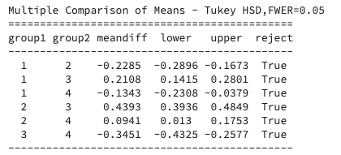
Race
Others
Malay
Chinese
Indian
Indian
Chinese
Malay
Others
There are more Chinese represented in our data
Malays have the highest mean out of all races
￼
Not tested for homogeneity assumptions due to time constraint. Tukey's Honestly Significant Difference

Slide 14
Age
Bimodal Distribution - We have 2 groups - above 55 and below 55
Patients > 55 years old have ~31% higher mean total bill than those < 55
￼
Notes:
Distribution of age is bimodal - which means that we have 2 population groups.

Slide 15
Which variable matters?
A quick way to help us focus on what matters .
￼

Slide 16
Decision Tree
A quick dirty way to help zoom into important variables
Top 10
Symptom 5
Race
Number of Symptoms
Age
Resident Status
Medical History 1
Medical History 6
BMI (Height & Weight)
Lab Result 3
Lab Result 2
￼
Notes:
With so much information, I was at lost of how I should start. I would love to analyse every single variable and every single permutation, it is just not feasible with the limited amount of time. I need a way to help me focus into the things that matter. so I decided to load all the data into a decision tree to have a quick look of the importance of each variable with respect to the total bill for each admission.

Slide 17
Correlation Coefficient Matrix
On continuous variables
Some positive correlation
Age
Number of medical history
Number of symptoms
BMI
￼
Notes:
I also did a quick analysis of our some of our continuous variables to observe their relationship with the total bill per admission. There’s evidence to show that these are the variables that shows some positive correlation with total bill. Example: age - total bill tend to increase with age

Slide 18
Patient Level vs Admission Level
It depends on what we want to achieve .
￼

Slide 19
Patient
Clinical (Admission)
Race
Age
Resident Status
BMI
Number of Medical History
Medical History 1
Medical History 6
Symptom 5
Number of Symptoms
Lab Result 3
Lab Result 2
￼
Notes:
I’ve split the variables into the category groups - clinical data that can only be obtain during the admission and patient level data. Insights obtained from these category groups will have different use cases.

Slide 20
Patient
Clinical (Admission)
Race
Age
Resident Status
BMI
Number of Medical History
Medical History 1
Medical History 6
Symptom 5
Number of Symptoms
Lab Result 3
Lab Result 2
￼
Notes:
Firstly, I would like to take a look into patient level data. At first glance, it seems like insights into these variables will be of interest in term of population health initiatives.

Slide 21
Our Data
Clinical and financial data of patients hospitalised for a certain (X) condition
Per row per patient’s total bill per year
3,314 rows
3,000 unique patients
5 year data (2011 - 2015)
￼
Notes:
Since we are not looking into per admission data, I further aggregate the target variable into per patient’s total bill per year.

Slide 22
Variables
Number of encounter per year (continuous)
Readmission (> 1 encounter per year) (binary)
Age (continuous)
Age (<55, >55) (categorical)
BMI (continuous)
BMI Risk Level (categorical) (healthhub.sg)
Number of Medical History (continuous)
Medical History 1 through 7 (binary)
Target Variable
Patient’s total bill per year
￼
Notes:
Summary of variables

Slide 23
Number of Encounters/Year
 |  | Count | Total Bill (per yr)
 |  |  | Mean | P-Value
Total |  | 3,314
Number of Encounter / Year | 1 | 2,928 | 21,828 | <0.01*
 | 2 | 84 | 45,140
 | 3 | 1 | 43,490
Not tested for homogeneity and normality assumptions due to time constraint. One-way ANOVA is used
￼

Slide 24
Number of Encounters / Year
P-Value < 0.01 for both age groups
Not tested for homogeneity and normality assumptions due to time constraint. One-way ANOVA is used
￼

Slide 25
CHI-Square Test
P-values
The presence of medical history 1, 6 and 7 have high correlation with > 1 encounter per year
P-values < 0.01
￼
Notes:
Did a chi-square test to see whether there is a relation between other variable and number of encounter per year.

Slide 26
Target Variable
Distribution
Natural Log
Skewed Right
Total Bill / year
Number of Encounters / year
Total Bill / year
Number of Encounters / year
(Log)
To ensure approximate normality
￼
Notes:
Since the number of encounter per year has high multicollinearity with medical histories, we can take this variable into account by dividing the total bills per year by the number of encounters.

Slide 27
Medical History
 |  | Count | Avg Total Bill (per enc per yr)
 |  |  | Mean | P-Value
Total |  | 3,314
Number of Med History | 0 | 795 | 19,497 | <0.01*
 | 1 | 1,258 | 21,463
 | 2 | 800 | 24,696
 | 3 | 310 | 26,532
 | 4 | 47 | 31,191
 | 5 | 7 | 36,853
Med Hist 1 |  | 562 | 26,850 | <0.01*
Med Hist 2 |  | 953 | 22,357 | 0.086
Med Hist 3 |  | 459 | 22,205 | 0.023
Med Hist 4 |  | 175 | 21,480 | 0.943
Med Hist 5 |  | 196 | 23,129 | 0.018
Med Hist 6 |  | 839 | 24,175 | <0.01*
Med Hist 7 |  | 842 | 22,484 | 0.040
Not tested for homogeneity and normality assumptions due to time constraint. One-way ANOVA is used
￼
Notes:
One-way ANOVA is used to see if there are significant differences between each medical history.
Aligned with the feature importance we did earlier on.

Slide 28
Medical History 1
Total Count: 562 / 3,000 (18.7%)
18.7% of patients with medical history 1 contributes 21.7% of the avg total bills.
P-Value < 0.01 for both age groups
Not tested for homogeneity and normality assumptions due to time constraint. One-way ANOVA is used
￼

Slide 29
Medical History 6
Count: 839/ 3,000 (28.0%)
28% of patients with medical history 6 contributes 29.44% of the avg total bills.
P-Value < 0.01 for both age groups
Not tested for homogeneity and normality assumptions due to time constraint. One-way ANOVA is used
￼

Slide 30
Body Mass Index (BMI)
Mean BMI = 28.95 (high risk)
63.6% patient population have high BMI risk
￼
Notes:
Condition X is related to BMI ?

Slide 31
Body Mass Index (BMI)
 |  | Total Bill (/enc/yr)
 |  | Mean | P-Value
BMI Risk Level | Deficiency | 11,200 | <0.01*
 | Normal | 19,389
 | Moderate | 20,774
 | High | 22,651
R: 0.140, P-value: <0.01*
There is significance between BMI Risk and Avg total bill per year at 0.01 significance level
Positive correlation between BMI and avg total bill
￼
Not tested for homogeneity and normality assumptions due to time constraint. One-way ANOVA is used

Slide 32
Model & Interpretation
Explainability matters .
￼

Slide 33
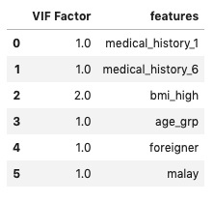
Variance Inflation Factor
To check for multicollinearity between variables
No variables have a VIF of more than 5
￼

Slide 34
Linear Regression Model
Y = β0 + β1 medical history 1 + β2 medical history 6 + β3 high bmi risk
+ β4 age > 55 + β5 foreigner + β6 malay
 | Parameter | Estimate | Standard Error | P-Value
Model 2 | Intercept | 9.51 | 0.012 | <0.01*
 | Medical History 1 | 0.26 | 0.016 | <0.01*
 | Medical History 6 | 0.17 | 0.014 | <0.01*
 | High BMI risk | 0.11 | 0.012 | <0.01*
 | Age > 55 | 0.25 | 0.012 | <0.01*
 | Foreigner | 0.68 | 0.028 | <0.01*
 | Malay | 0.40 | 0.015 | <0.01*
R-squared = 0.415
Not tested for homogeneity and normality assumptions due to time constraint. One-way ANOVA is used
￼

Slide 35
Linear Regression Model
Y = β0 + β1 medical history 1 + β2 medical history 6 + β3 high bmi risk
+ β4 age > 55 + β5 foreigner + β6 malay
Interpretation:
Average total bill per year for patients with condition X and have/is
medical history 1 is ~ 29.11 % higher when compared to patients without
medical history 6 is ~ 18.71 % higher when compared to patients without
high BMI risk is ~ 11.37 % higher when compared to patients doesn't
age > 55 years old is ~ 27.86 % higher when compared to patients < 55
a foreigner is ~ 96.83 % higher when compared to patients who are Singaporeans or PR
malay is ~ 49.05 % higher when compared to patients of other races
￼
Notes:
* ethical concerns regarding race as a factor to estimate costs

Slide 36
Use Case Discussion
Identify patient population at risk of higher admission cost for condition X for intervention
Findings suggest that admission cost per year are significantly affected by
Number of admitted encounters,
Medical history,
Body Mass Index
Age
Demographics
￼

Slide 37
Use Case Discussion
Identify patient population at risk of higher admission cost for condition X for intervention
Findings suggest that admission cost per year are significantly affected by
Number of admitted encounters
Medical history
Body Mass Index
Age
Demographics
Cost per year increases with frequent admissions
Highly correlated to medical history
Consider continuity of care for these patients after discharge to prevent readmission
￼

Slide 38
Use Case Discussion
Identify patient population at risk of higher admission cost for condition X for intervention
Findings suggest that admission cost per year are significantly affected by
Number of admitted encounters
Medical history
Body Mass Index
Age
Demographics
Increases complexity, more complications, more need for healthcare attention
Preventive care for patients without existing conditions through regular screenings
Medical History 1 and 6 have bigger impact than others
Not enough information
￼

Slide 39
Use Case Discussion
Identify patient population at risk of higher admission cost for condition X for intervention
Findings suggest that admission cost per year are significantly affected by
Number of admitted encounters
Medical history
Body Mass Index
Age
Demographics
Not surprising that patients with high health risk to have more complications and require more interventions
Better manage patient’s BMI by encouraging them to participate in health programmes
Frequent health screenings
￼

Slide 40
Use Case Discussion
Identify patient population at risk of higher admission cost for condition X for intervention
Findings suggest that admission cost per year are significantly affected by
Number of admitted encounters
Medical history
Body Mass Index
Age
Demographics
Expected that elderly patients would need more medical attention than younger population
Non-Singaporeans have less subsidies
Non-modifiable variables, but allows healthcare providers/ministry of health to target population for policy planning and interventions
￼

Slide 41
Given more time…
Adjusted for confounders (demographics group) rather than using it as a factor
Test for homogeneity and normality assumptions
Look into admission level data for more use cases
Symptoms affect cost per admission
Useful for pharmaceutical companies
Interactive dashboards to show how each variable varies
Improve on visualisation and story-telling
￼
Notes:
Demographics factors are useful for stratifying population for intervention, but there may be ethical considerations if used for cost estimations

