Slide 1
Allegro Game with OOP
2024 I2P(II) Hackathon & MiniProject2 & Final Project

Slide 2
Tower Defense
2024 I2P(II) Hackathon & MiniProject2

Slide 3
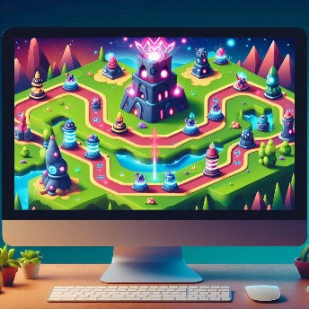
About Hackathon & MiniProject2
This game is a tower defense game, the player needs to place the turrets to defend all the enemies.
We will complete the project in stages.
Hackathon: Fix the bugs and complete basic functions.
MiniProject2: Add new features to the game.
Final Project: Base on MiniProject2 to develop your own game!
We have provided questions for you to validate your understanding of the project the concept of OOP.

Slide 4
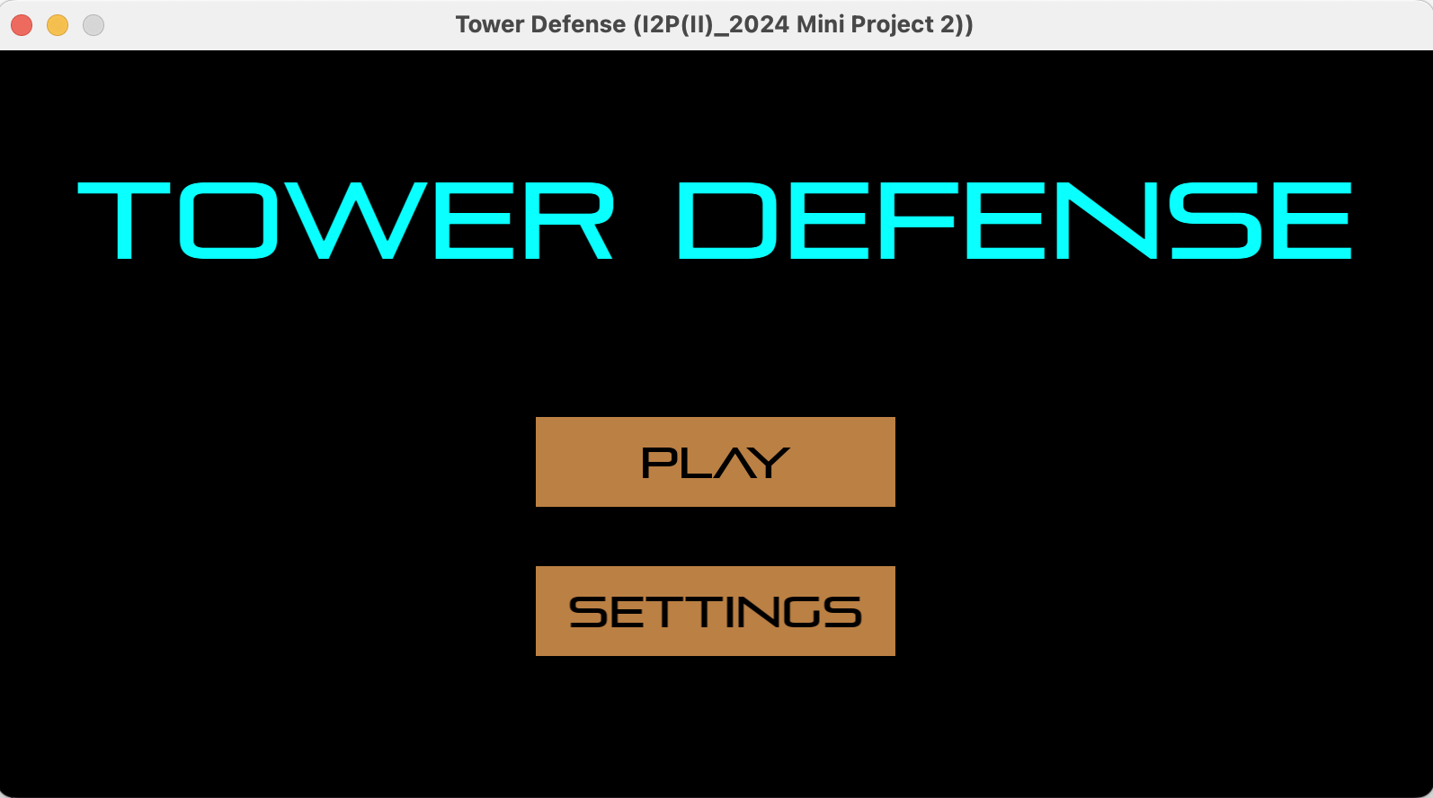
Hackathon Demo

Slide 5
Outline
Allegro5 game development process
01
03
User Extension
Hackathon schedule
02
Template: StartScene
04

Slide 6
01
Allegro5 game development process

Slide 7
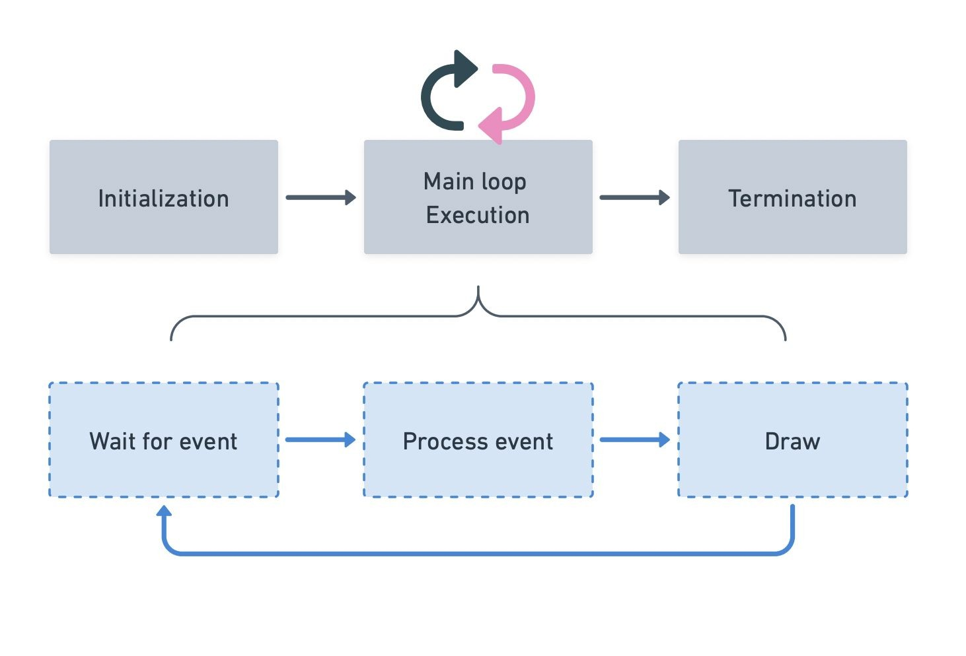
Main Process

Slide 8
Loop execution
Mainly consists of two parts:
Events: Keyboard, mouse, timer…
Draw: Object painting
Wait for event
Process event
Draw

Slide 9
Core Structure
IControl
IObject
GameEngine
Resources
Group
IControl IObject
Image
IObject
Label
IObject
Collider
IScene
Group
ImageButton
IControl Image

Slide 10
02
Template: StartScene

Slide 11
Template
01
02
03
04
05
GameEngine, Resources, Collider
Label
ImageButton
IScene
Scene Extension

Slide 12
Template
01
02
03
04
05
GameEngine, Resources, Collider
Label
ImageButton
IScene
Scene Extension

Slide 13
Start Scene

Slide 14
IControl
GameEngine
Resources Collider
IObject
Group
IControl IObject
Image
IObject
Label
IObject
IScene
Group
ImageButton
IControl Image

Slide 15
IControl
IObject
GameEngine
Resources
Group
IControl IObject
Image
IObject
Label
IObject
Collider
IScene
Group
ImageButton
IControl Image

Slide 16
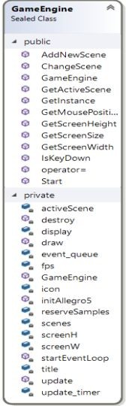
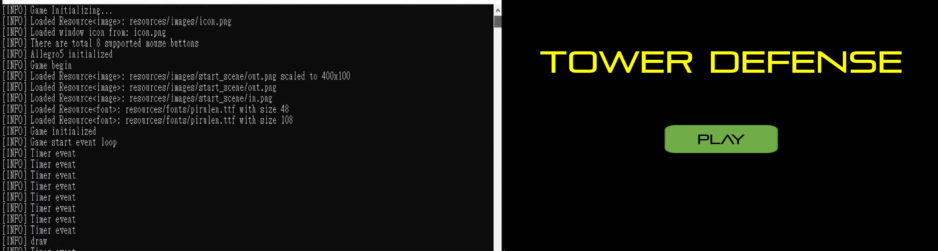
Game Engine
Abstract the entire message loop
Manage current scene and scene change

Slide 17
IControl
IObject
GameEngine
Resources
Group
IControl IObject
Image
IObject
Label
IObject
Collider
IScene
Group
ImageButton
IControl Image

Slide 18
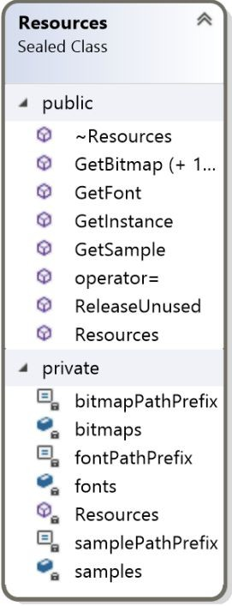
Resources
Abstract all resources loading and destroy
Resources can be retrieved from this class directly
1
7

Slide 19
IControl
IObject
GameEngine
Resources
Group
IControl IObject
Image
IObject
Label
IObject
Collider
IScene
Group
ImageButton
IControl Image

Slide 20
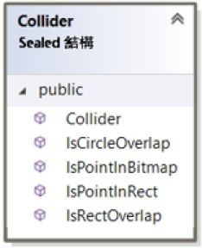
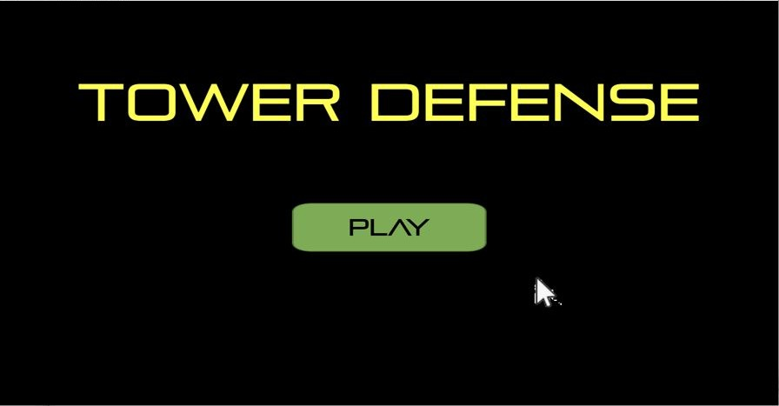
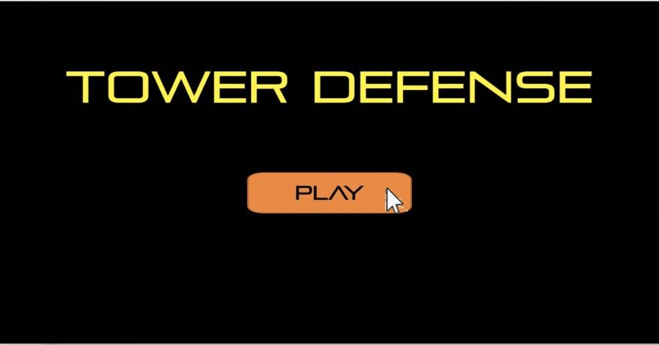
Collider (struct)
Calculating physical collision, overlap, point in region.

Slide 21
Template
01
02
03
04
05
GameEngine, Resources, Collider
Label
ImageButton
IScene
Scene Extension

Slide 22
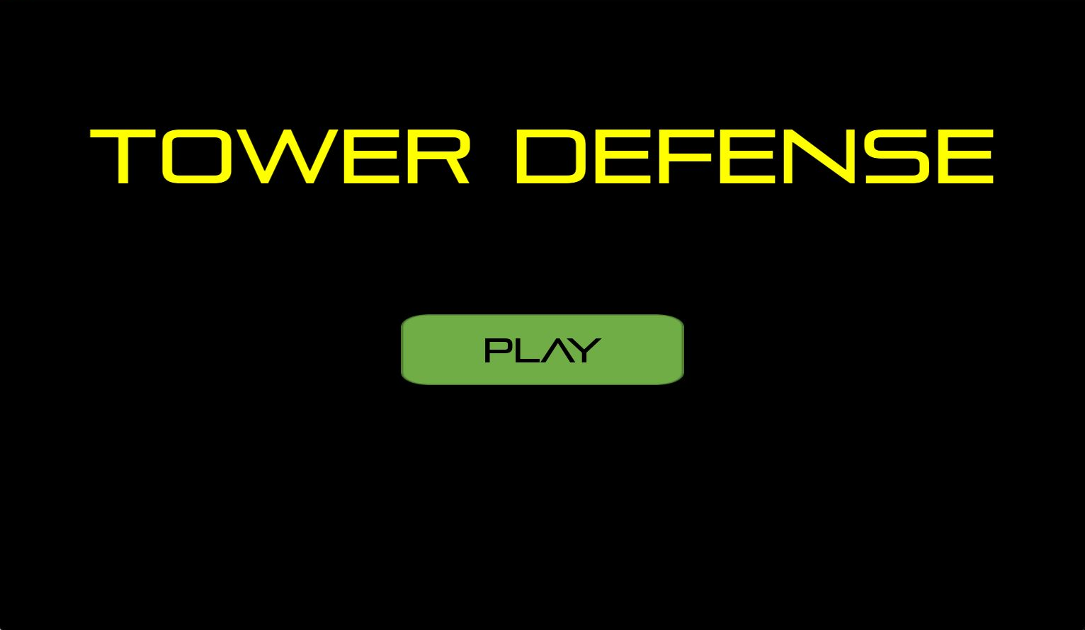
StartScene Label
Relevant class
IControl
IObject
GameEngine
Group
IControl IObject
Image
IObject
Label
IObject
Resources
Collider
IScene
Group
ImageButton
IControl Image

Slide 23
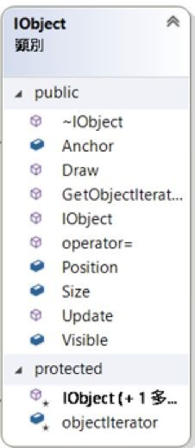
IObject
The base class of objects that need to be drawn (i.e. show on the display)
Main deﬁnition of Draw() and Update()
Wait for event
Process event
Draw

Slide 24
Label
Derived from IObject class
A simple static text object
Label (Tower defense)
“Tower Defense”
“pirulen.ttf”
1
“pirulen.ttf”
Public
IObject
Label::Label()
2
Resource::getfont()
Success
3
Finish !
Draw
Label::Draw()

Slide 25
Template
01
02
03
04
05
GameEngine, Resources, Collider
Label
ImageButton
IScene
Scene Extension

Slide 26
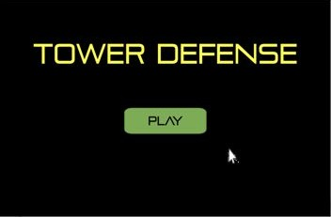
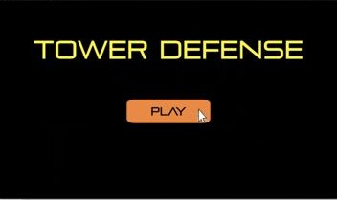


StartScene ImageButton
Relevant class
IControl
IObject
GameEngine
Resources
Group
IControl IObject
Image
IObject
Label
IObject
PLAY
Collider
IScene
Group
ImageButton
IControl Image

Slide 27
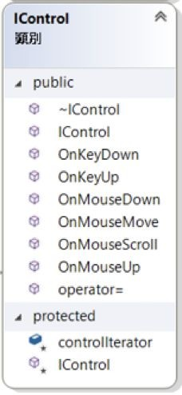
IControl
The base class of objects that can process event
Wait for event
Process event
Draw

Slide 28
Image
“green.png”
1
Image (green.png)
“green.png”
Public
Image::Image(
IObject
2
Resource::Image()
)
3
Finish !
Image::Draw()

Slide 29
ImageButton
Derive from IControl, Image
A clickable button which process events when mouse enter / leave.
“green.png”
1
“green.ttf”
Public
ImageButton:: ImageButton()
IControl
2
Resource::Image()
3
ImageButton:: OnMouseDown()
Process Event

Slide 30
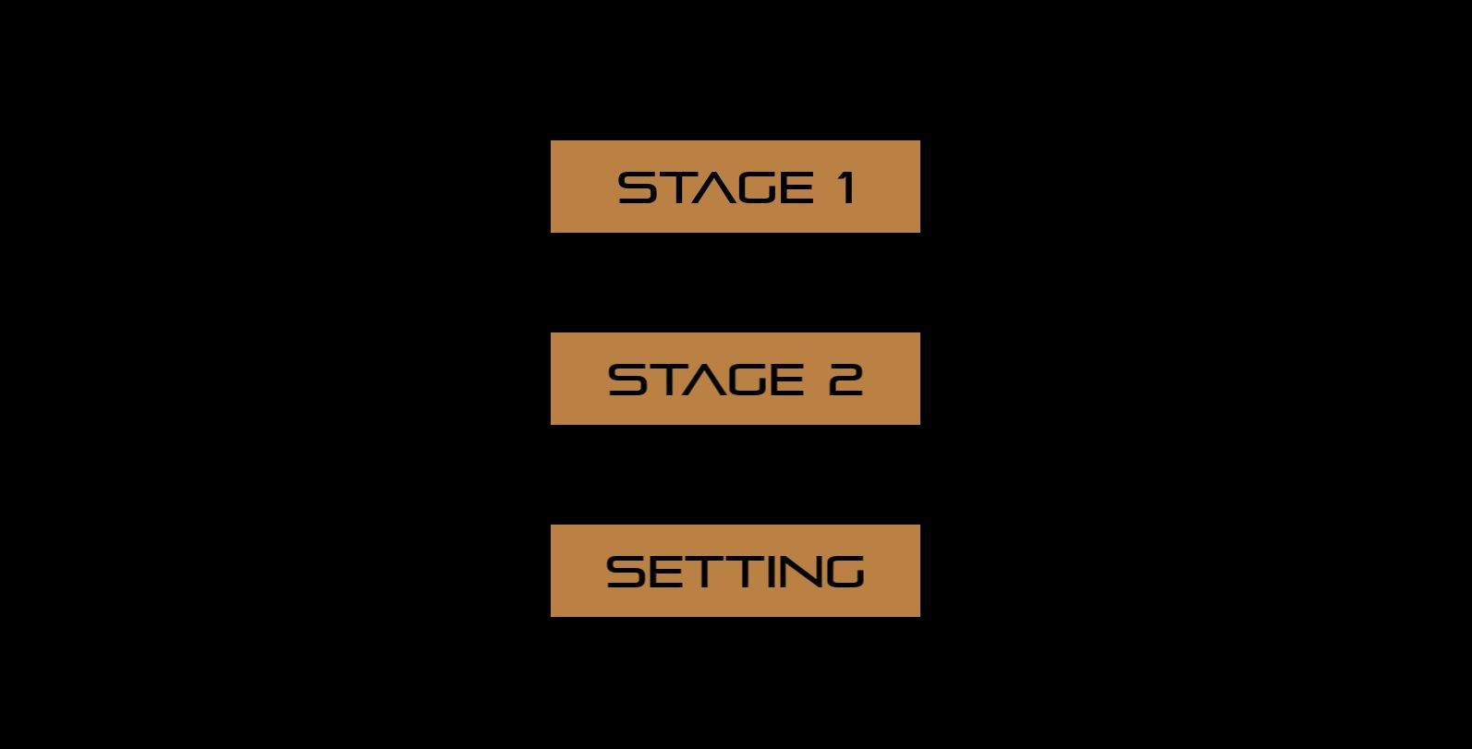
ImageButton (Cont’d)
New scene
Click!
OnMouseMove(): change image
OnMouseDown(): change scene

Slide 31
Template
01
02
03
04
05
GameEngine, Resources, Collider
Label
ImageButton
IScene
Scene Extension

Slide 32
StartScene IScene
Relevant class
IControl
IObject
GameEngine
Group
IControl IObject
Image
IObject
Label
IObject
Resources
Collider
IScene
Group
ImageButton
IControl Image

Slide 33
Group
A class that contains objects / controls.
The derived class of IObject and IControl are stored in an individual list respectively to manage.

Slide 34
IScene
Encapsulates a scene
It must be inherited and customized
IScene
StartScene
SettingScene
PlayScene
WinScene
LoseScene

Slide 35
Template
01
02
03
04
05
GameEngine, Resources, Collider
Label
ImageButton
IScene
Scene Extension

Slide 36
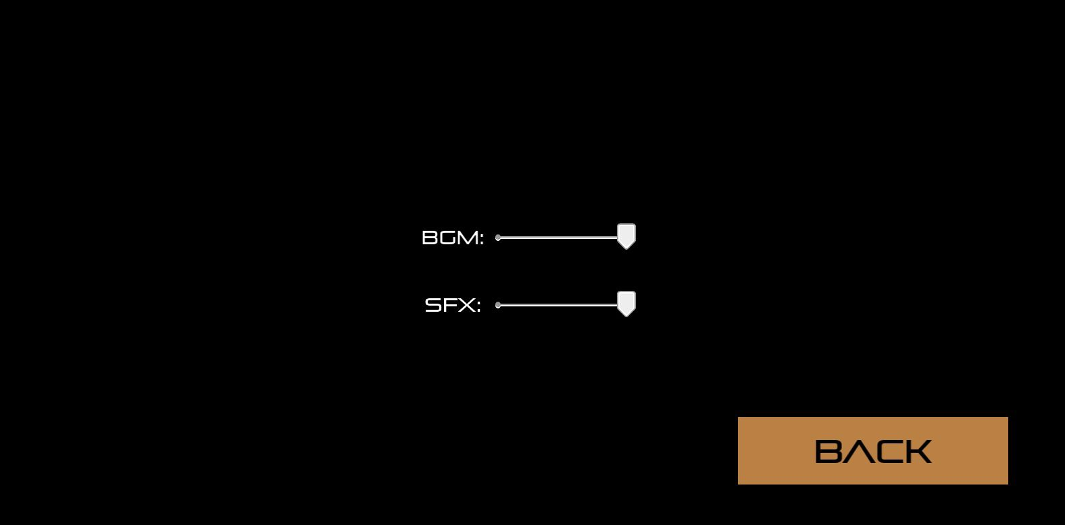
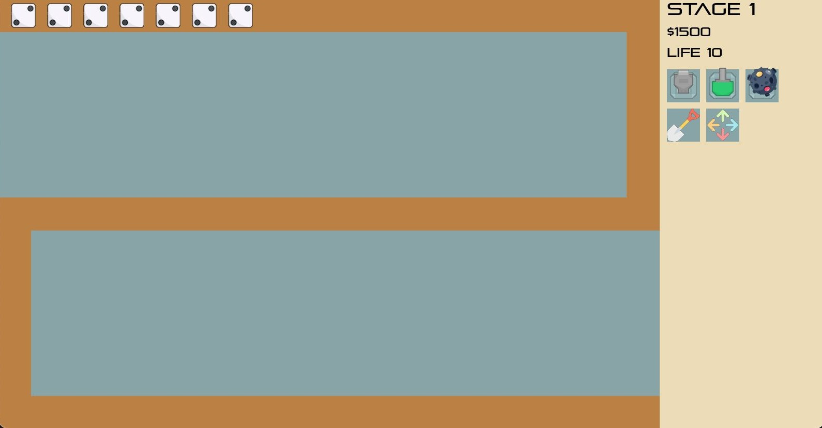
Scene Extension
Slider
Enemy (User deﬁnition)
Label
ImageButton

Slide 37
User Extension
03

Slide 38
User extension
IControl
IObject
GameEngine
Resources
Group
IControl IObject
Image
IObject
Label
IObject
Collider
IScene
Group
ImageButton
Image
Sprite
Image
Add scene
Add button
Add turrets, enemies

Slide 39






Enemy
Turret
Dice
Normal
PlugGun
MachineGun
Bullet
WoodBullet
FireBullet

Slide 40
04
Hackathon schedule

Slide 41
Hackathon schedule (5/13)
9:00 - 10:00
10:00 - 12:00
12:00 - 13:00
13:00 - 17:30
Hackathon & Mini-Project2 tutorial
QA time & Demo
Rest
QA time & Demo

Slide 42
Some details of hackathon
During the QA time, you can directly join the Teams.
Otherwise, please type in chat ﬁrst to make sure TA is online, then join the Teams.
Each student have 6 mins to demo the hackathon, and TAs will only score by your demonstration, so make sure you prepare before the demo.
For more details, please check the spec of the hackathon.

Slide 43
Final Project
2024 I2P(II) Final Project

Slide 44
Final Project Rules
1 to 3 people / per team
Should be based on mini2, using at least Allegro and C++.
Hand in a 2-page proposal describing your idea and list your team members.
Late submission of proposal will receive -5 project score each team member.
Late submission of final project is not accepted
A readme file with your code
In the readme of your source code, you must describe and list the features of your game, and include which teammate is responsible for each part and their contribution percentage
Grade based on novelty, difficulty, and completeness of the project as well as Individual's contribution.

Slide 45
Example Grading
Integrate advanced CS techniques
Ex. Online Multiplayer Ex. AI-driven Enemy
(90%-)
Make major changes to the game
Ex. Switch enemy and turret
(80%-90%)
Add 2-3 features
Ex. Map Editor, Online Scoreboard
(70%-80%)

Slide 46
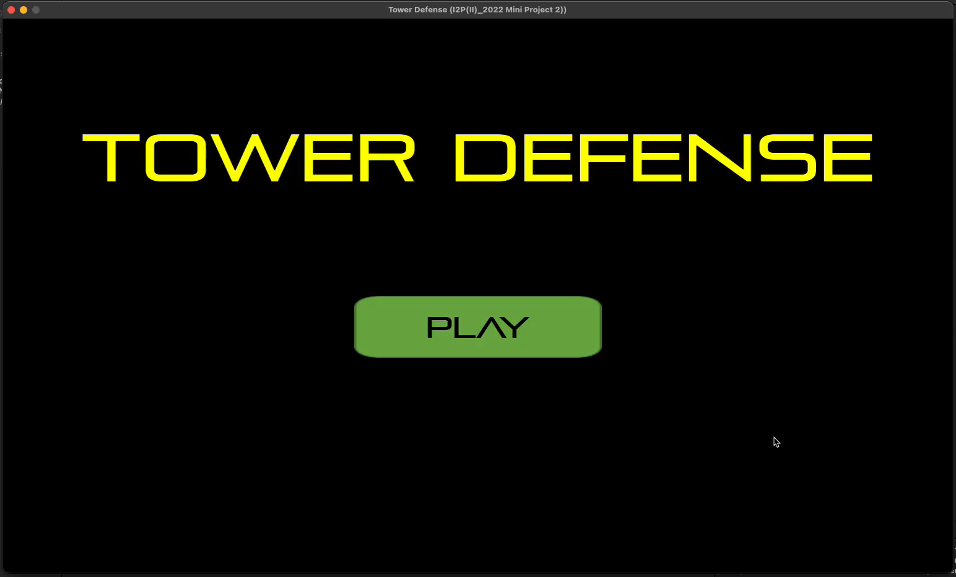
[80%~90%] Change how to play

