Slide 1


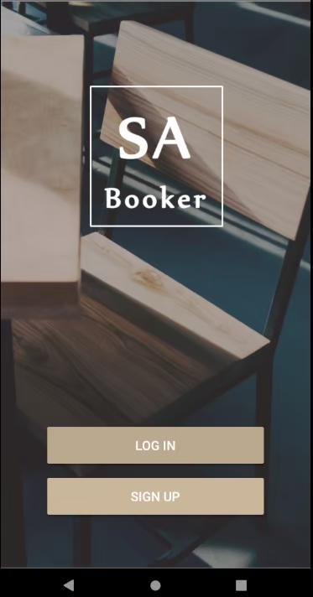
課程專案發表 –
System Analysis and Design
２０２０. 03 － ２０２０.06
Project design description:
Nowadays, virtual currencies play an important role in our daily lives. For example, Google Pay and Apple Pay have become very popular payment methods. Due to its excellent convenience and security, virtual currencies can be applied to almost all trade operations. Therefore, by designing a virtual currency application system, such as: shopping transactions, money transfers, investments, etc., you can learn its operating process to deepen your understanding of personal identity protection and online transactions. Under this topic, this team work assignment allows each group to determine the application topic related to virtual currency transactions.
Advisor ：黃純敏教授
Team member ：卓湘婷、曾育淇、葛繹辰、蔡佩芳、李郁欣、王婕恩
My participation ：UI / UX、use case diagram、class diagram、sequence diagram

Slide 2

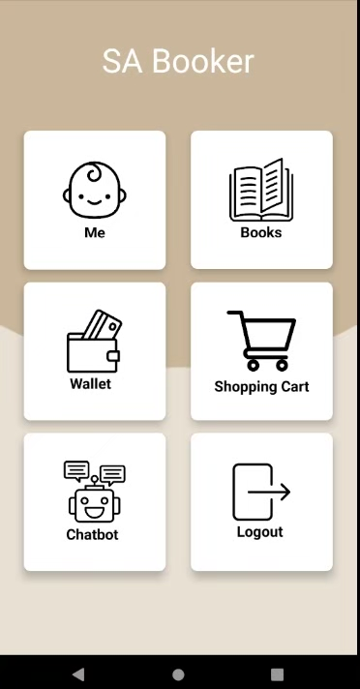
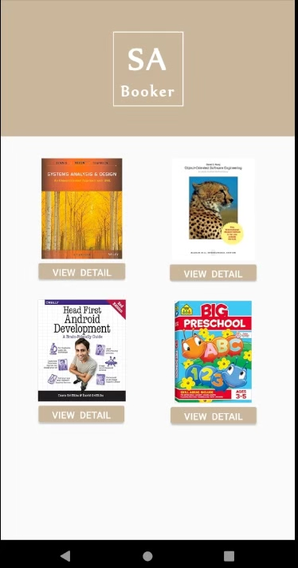
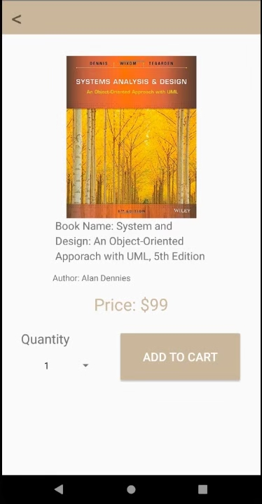
Introduction
Function
Special function explanation
SA Booker
Due to the topic of virtual currency transactions, our team designed an online book shop, and user who has registered can purchase books through virtual payment.
The security protection of the system uses AOTP (Active One-Time-Password) to be verification code. It means the user actively transmits a one-time password to a dedicated telecom short code service provider. In order to complete the certification, it becomes the safest and most convenient payment authentication mechanism for mobile e-cash.
When you bought the book, you can get 1% reward of total price to your wallet.

Slide 3
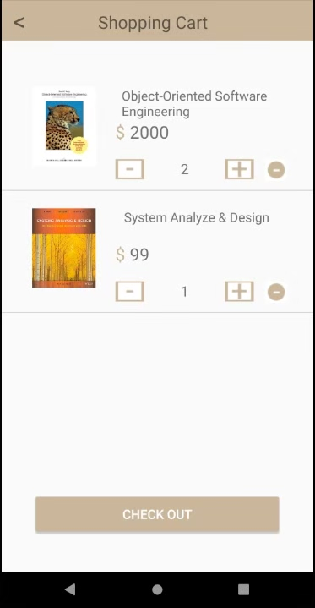
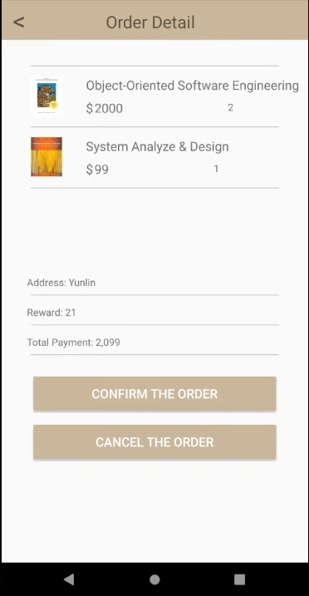
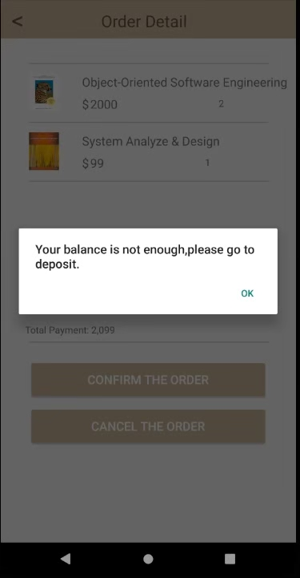
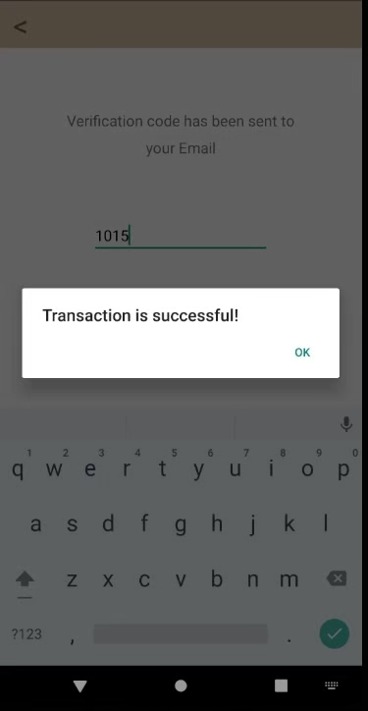
Introduction
Function
Special function explanation
In Shopping Cart page, user can check the price and books of quantity.
SA booker will show the order detail and total price, and user need to make payment.
Case 1 : If the e-wallet doesn’t have enough points, user must deposit enough points in theirs e-wallet.
Case 2 : If the e-wallet has enough points, SA booker will sent an AOTP to user’s email, after entering the correct code then the transaction is completed .

Slide 4
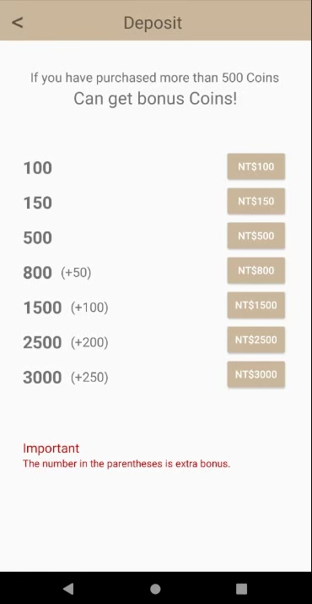
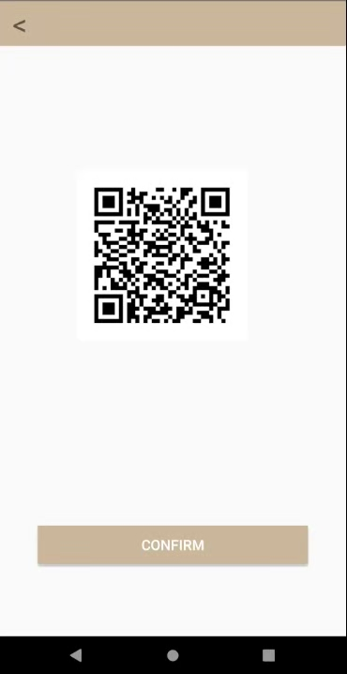
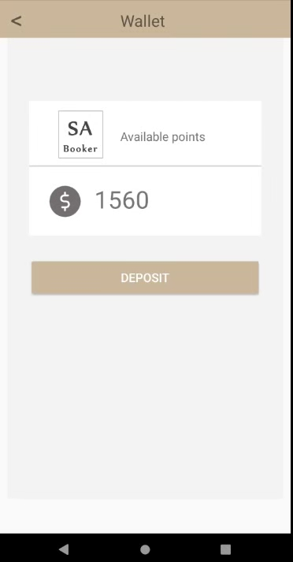
Introduction
Function
Special function explanation
How to deposit the points?
Step 1: User can selects the amount to be deposit (Figure 1), and SA booker will display the QR Code.
Step 2: Let the staff of convenience store scans the QR Code (Figure 2) to make payment.
Step 3: After completing the payment, the user can open the Wallet page to check the balance (Figure 3).
Figure 1
Figure 2
Figure 3

