Slide 1
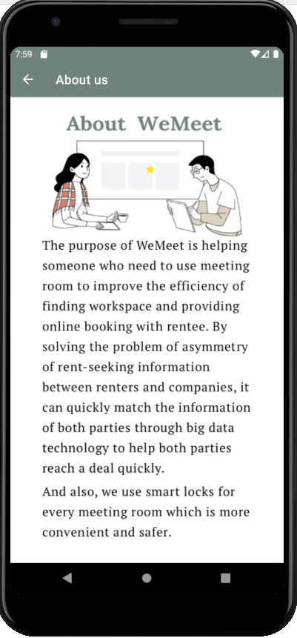
課堂專案發表 –
Object-Oriented Software Engineering
２０２０.９ － ２０２０.１２
WeMeet
Project
在四年級上學期修習一門 Object-Oriented Software Engineering 之課程，此任課老師的作業是以全英文製作一個與IoT應用相關的系統與報告，我們決定以共享經濟為出發點，並觀察如何應用在生活中，最後以共享會議室為主題，藉由WeMeet此APP 作為預約平台，透過 WeMeet 即可連結會議室的門鎖、燈以及電扇或冷氣來達成IoT之應用。
在此專案，我主要負責的項目為前端UI的設計，以及部分後端的開發，如後面圖示中註冊、登入以及管理帳戶的功能。此專案指導老師為黃純敏教授，並由陳昱蓉、董小銘、張葳、邱文彥、鄭宇翔、李郁欣以及我，７位成員共同完成。

Slide 2








Introduction
Function
Special function explanation
Motivation
Purpose
Feature
Problem 1
We usually need to discuss presentations, reports and projects, but meeting room in our college is not enough for students.
Reservation process is miscellaneous.
Problem 2
Public places such as a coffee shop or a fast-food restaurant, the environment is noisy.
The equipment is not completed.
Base on the above problems, our team decided to design an app WeMeet — Shared Meeting Room with Smart Door Lock
Provide the meeting room for someone who need to use.
(2) Use excess resources to promote economic benefit.
According to many rental websites, there are many vacancies commercial offices.
They can convert unleased space into meeting rooms.
The rentee can also increase additional income.
(1) Convenience
The renter don’t need to fill in the reservation form on-site and pay it in cash.
They can search available meeting rooms and book them by using our app.
(2) Reduce the cost of labor
The rentee doesn’t need to arrange a person that needs to be responsible for managing all the bookings, charging and unlocking the meeting room for every renter.
Doesn’t have fixed office.
freelancer
student
Doesn’t have formal meeting room.
startup company

Slide 3

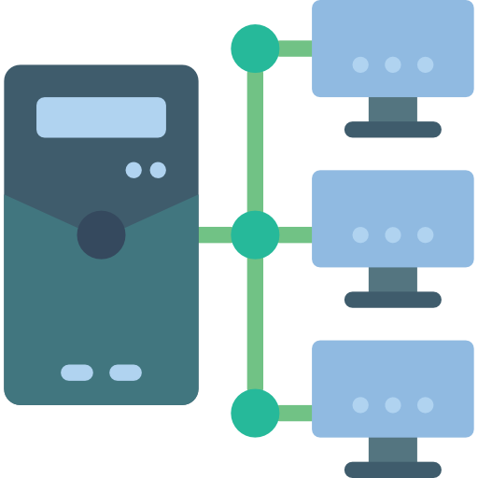



Introduction
Function
Special function explanation
Application of IoT
As we mentioned in the previous page, the rentee does not need to arrange a person that needs to be responsible for “unlocking the meeting room” for every renter. Since our project applies smart door locks for every meeting room we work with. Smart door locks are IoT-enabled keyless entry devices.
How does it work?
When the renter completes the booking process on our app, the information such as renter’s id, meeting room’s id, date and time of the reservation will be matched and sent to the Amazon EC2 server. Then, the server will send the data into Amazon Relational Database Service (RDS).
On the reservation session, when the renter clicks the unlock button on his or her mobile phone, the client will request a server (Amazon EC2) to unlock the corresponding meeting room. If the server has found the match user id and reservation session in RDS, the server will ask AWS IoT to unlock the corresponding door according to the reservation. After, the lock will send an unlock successfully message to renter and save the record of unlock time in RDS .
HTTP
Amazon EC2
AWS IoT
Mobile Phone
Amazon Relational Database Service (RDS)
Door Lock

Slide 4
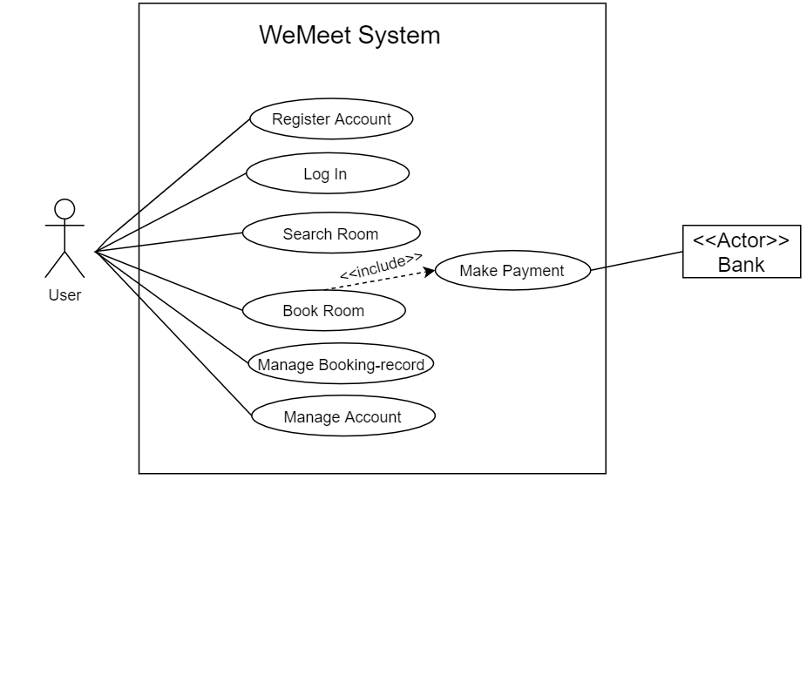
Introduction
Function
Special function explanation
In the Unified Modeling Language (UML), a use case diagram can summarize the details of your system's users and their interactions with the system.
Register Account:
To enhance the safety of the system, the user needs to bind the phone and credit card when registering the account. Also, an extra setting for payment security code is required.
Login:
The user logs in the app via email and password.
Manage Account:
In this use case, the user can rebind the phone number, reset password, reset security code (text message authorization required) and modify or add a new credit card.
Search Room:
The user can select the conditions that fit his or her requirement, such as location, date, time and amount of people, to search for the available meeting rooms.
use case diagram

Slide 5
Introduction
Function
Special function explanation
In the Unified Modeling Language (UML), a use case diagram can summarize the details of your system's users and their interactions with the system.
Booking Room：
The user books the suitable meeting room and pays for it by credit card. (The reservation will not be completed if the renter does not make the payment during the booking process.)
Manage Booking-record:
The use case provides the functions that manage renting history (finished, unfinished, canceled) and the user can unlock the meeting room by his or her mobile phone in the unfinished record page. Also, cancelling the reservation is available.
Make Payment:
Before making payment, the user should enter the security code. After entering, our platform will connect to the bank system for the user to make the payment. If the user enters the incorrect security code for three times, his or her security code will be locked. It should be reset in the manage account use case.
use case diagram

Slide 6
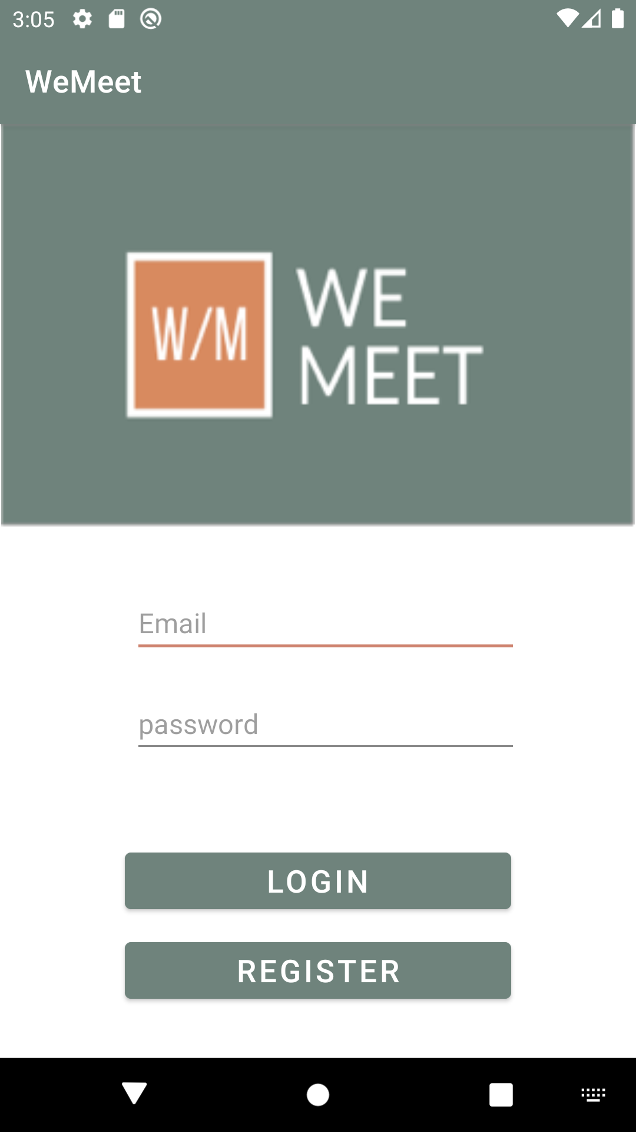
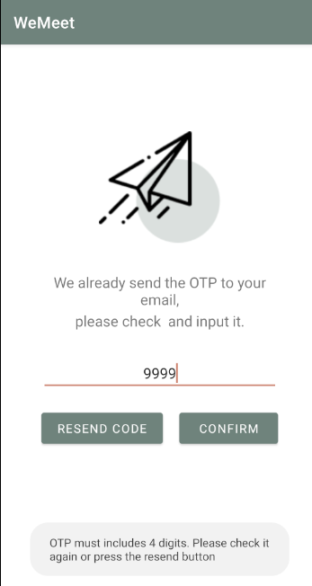
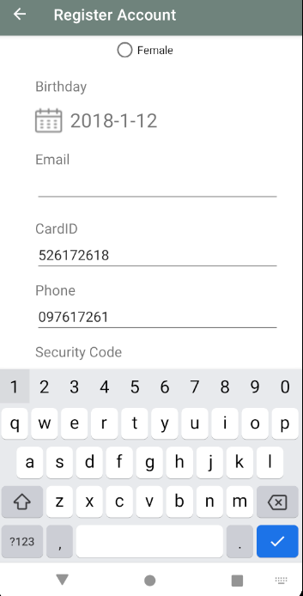
Introduction
Function
Special function explanation
Figure 1
Figure 2
Figure 3
In the process of registration, if the user type wrong OTP code 3 times (Figure 2), APP will go back to previous register page automatically (Figure 3), and require user to re-enter the E-Mail address. In case of unnecessary steps, APP will fill some blanks automatically, like user name, phone number, and so on.

Slide 7
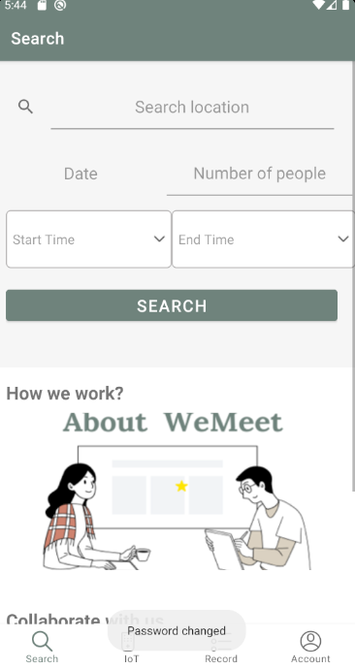
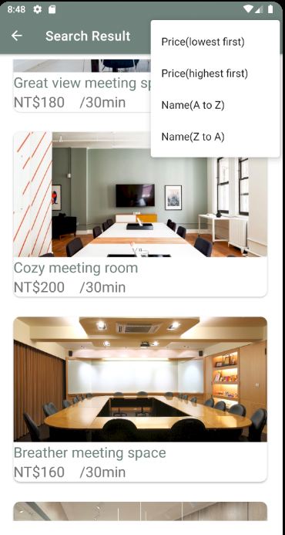
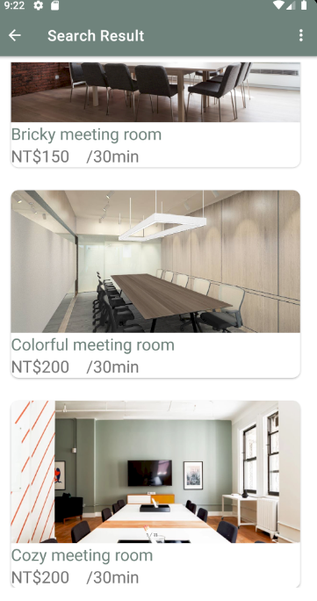
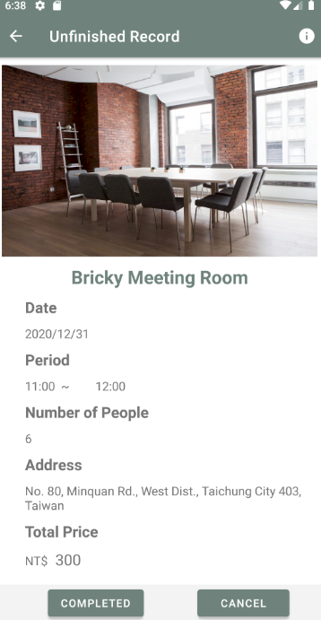
Introduction
Function
Special function explanation
This is home page, user can search the suitable meeting room by selecting the condition.
After pressing search button, user can arrange the order of results according to their preferences.
The result of pressing ‘Name (A to Z)’ button.
The user can view the detail information of each meeting room. The reservation must be completed after the payment.

Slide 8
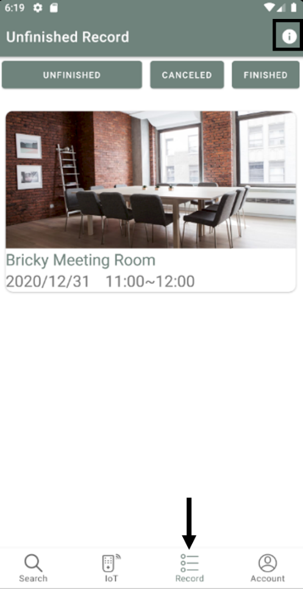
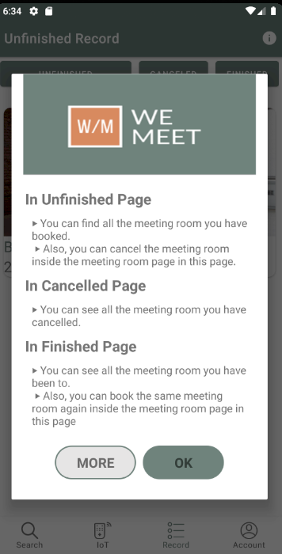
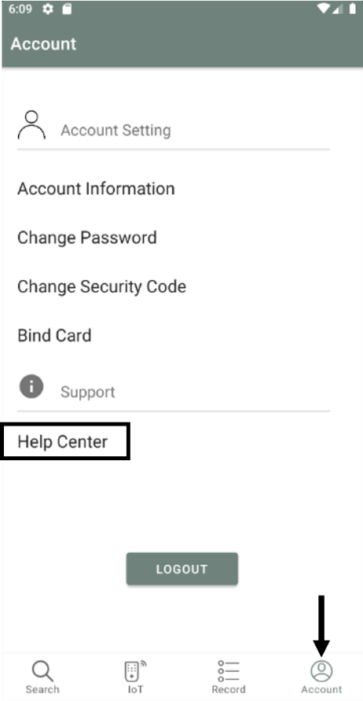
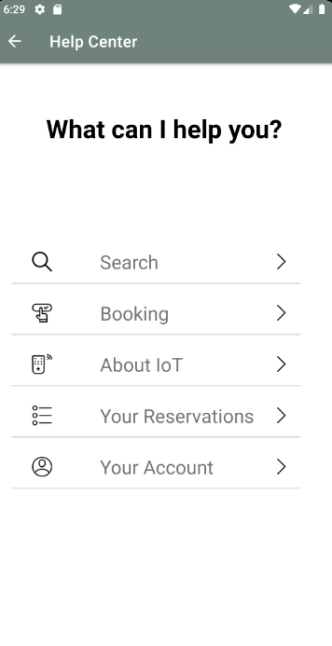
Introduction
Function
Special function explanation
In our Record fragment page, users can check the status of the reservation, it contains three sub-fragments (Unfinished record, Cancelled record and Finished record).
When pressing the information button in the top-right corner, users will see the information of three sub-fragment.
The most general help information in our system is the “Help Center” page that contains in the Account fragment page. It contains all of the possible question the users could be curious for.

Slide 9
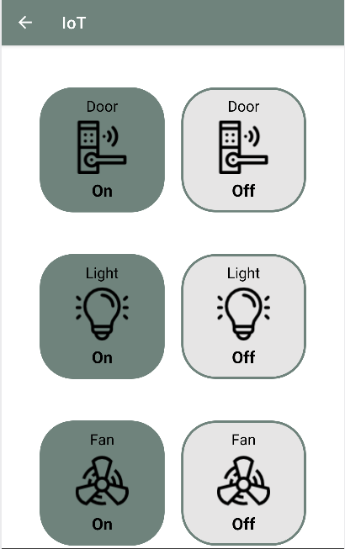
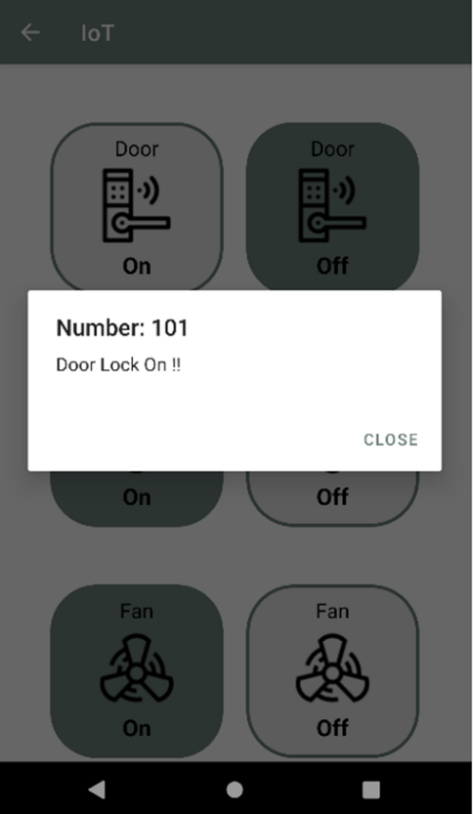
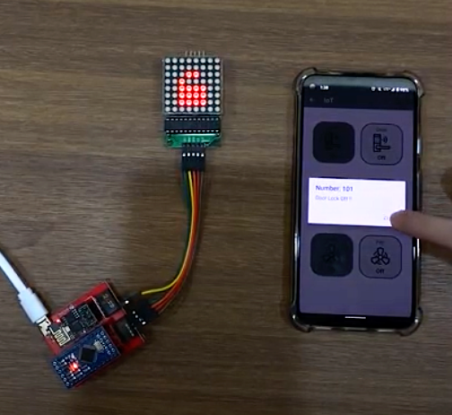
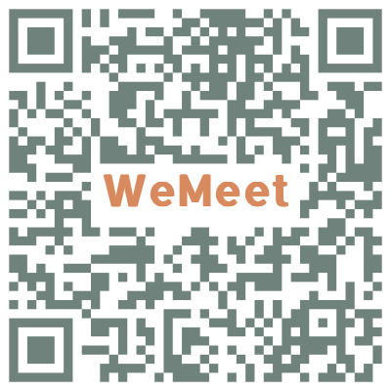
Introduction
Function
Special function explanation
This is our IoT control GUI. You can choose which electronic amenity you want to turn on then click the corresponding button.
When clicking the corresponding button, the alert dialog will be displayed in order to notify the user. This is the content of “Door Lock On” alert dialog .
We use a simple electronic device to demonstrate the result of turn on or turn off. If you want to watch the full video, please scan the QR Code !

