Slide 1
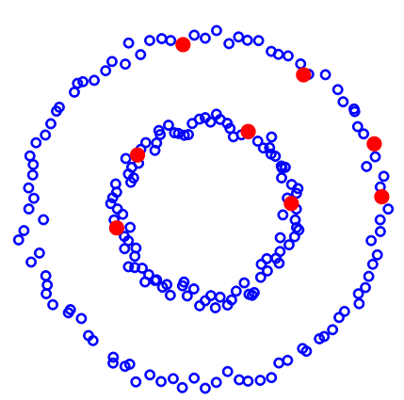
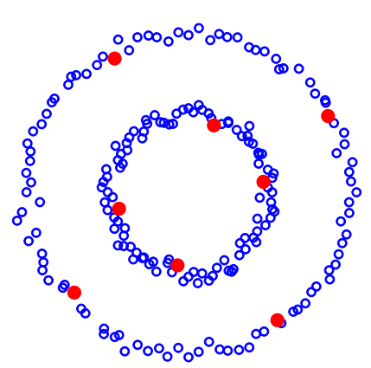
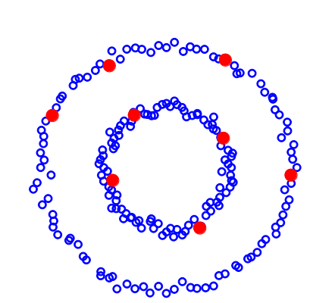
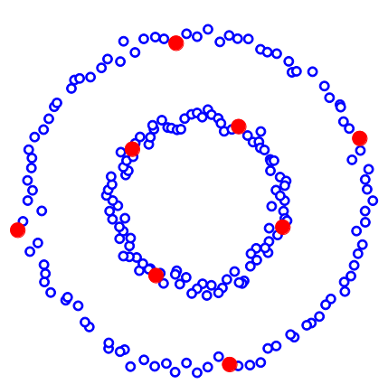
Active Semi-supervised Learning Using Sampling Theory for Graph Signals
Problem
Data points in feature space
Construct similarity graph
Choose points to label
Predict labels for the rest
Methodology
Extending Nyquist Shannon sampling theory to signals on graphs
Sampling rate of B allows perfect reconstruction of signals with bandwidth B/2
1/B
B/2
For graph signals, different sampling patterns uniquely represent signals of different bandwidths.
For given budget, choose a sampling pattern that can represent signals of maximum bandwidth.
Ψ-max
LLR
LLGC bound
Proposed
Akshay Gadde, Aamir Anis and Antonio Ortega
University of Southern California

