Slide 1
ClearStep
AI INNOVATION CHALLENGE MARCH 2026
AI that turns confusing information into calm, actionable steps
Leishka Pagán
Joanne Obodoagwu
Fatima Ahmed
Notes:
Hi, my name is Leishka, and alongside my new friends; Joanne and Fatima, we’re the team behind ClearStep.
We built ClearStep because of the rising need to close a major gap. People don’t fail from lack of information, they fail when they don’t know what to do next.
Every single day, people are faced with messages, instructions, or situations that feel urgent, confusing, or overwhelming, and in those moments, making the wrong decision can have real consequences.
ClearStep was designed to help in exactly that moment.
It doesn’t just explain information, it helps you decide what to do next. Clearly and safely.
We’ll walk you through how it works, how we built it, and how we made sure it stays reliable and safe in real-world use.

Slide 2
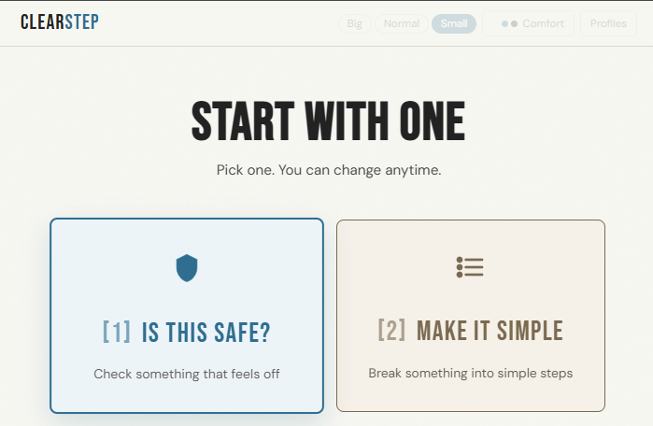
Notes:
This is how ClearStep starts.
We don’t overwhelm the user with options, we ask them to start with one simple choice and this leads us to the first mode. ‘Is this safe?’ This is for the moment when something feels a bit off — a message, a link, an email — and you need to know if you should trust it.
The second mode, ‘Let's Make it simple’ That’s for when something is already confusing — instructions, documents, or tasks — and you just need it broken down into clear steps.
These two modes represent the two moments where people get stuck: Is this safe? What do I do next?
And ClearStep is built specifically for those moments.

Slide 3
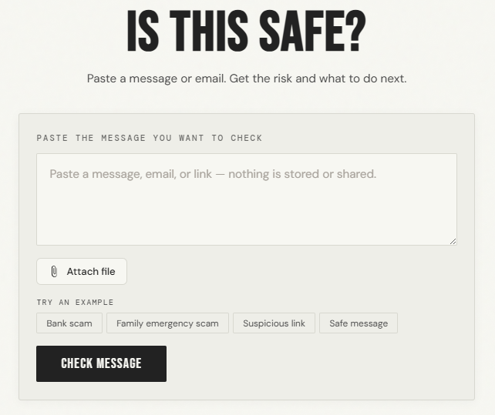
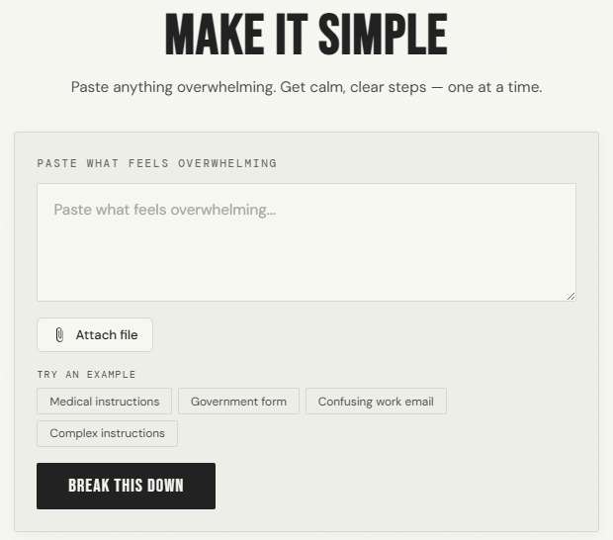
THE PROBLEM
1
Confusing, high-pressure information
2
Detection without guidance
3
Decision burden falls on the user
Users receive messages that feel urgent and unclear.
Existing tools label risk but do not tell users what to do next.
People must interpret, decide, and act, often under stress.
Suspicious messages
Complex instructions
Notes:
Expanded Voiceover (same tone, stronger + fuller)
“In our world today, 1 in 7 people are neurodivergent. People with ADHD, autism, and dyslexia often face cognitive overload when using digital tools.
They’re constantly exposed to messages that feel urgent, unclear, and sometimes intentionally misleading.
And honestly, this isn’t just about scams — it’s everyday communication. Emails, forms, instructions — things that are already hard to process become overwhelming very quickly.
While many tools can detect risk, they stop there. They label something as suspicious — but they don’t tell the user what to actually do next.
So the responsibility shifts entirely to the user.
They have to interpret the situation, make a decision, and act — often under pressure, often without clarity, and without confidence.
That decision burden, especially under stress, is where mistakes happen.
It's not because people don’t understand, it's because they’re forced to decide in moments of overload.”

Slide 4
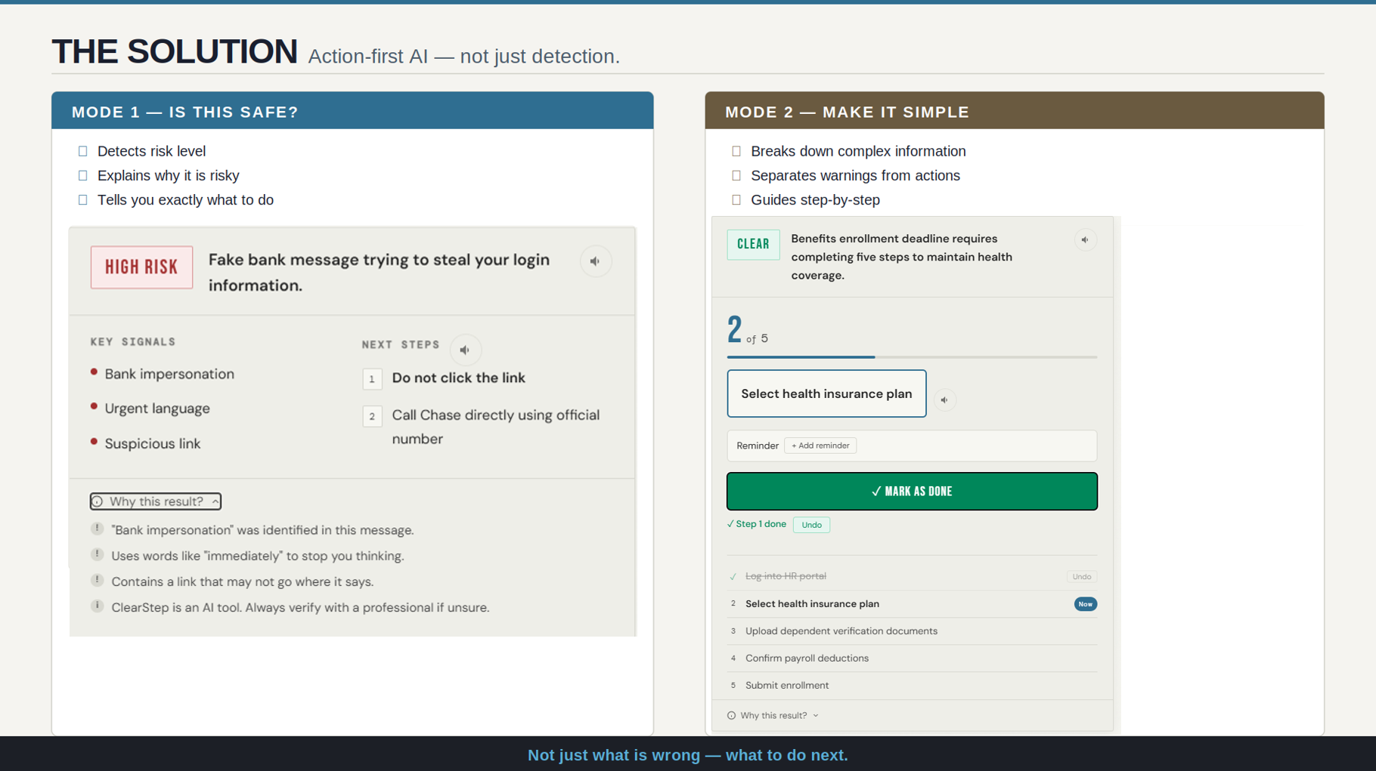
Action First AI
Notes:
ClearStep is built around one core idea — action, not just detection.
On the image to the left, we see that the system doesn’t just flag risk, It shows you exactly what was detected and tells you exactly what to do next. A key offering of our "Is this safe" mode.
In ‘Make It Simple,’ it takes complex, overwhelming information and breaks it down into clear, step-by-step actions. It separates what you need to do from warnings, so the user can move forward without second guessing.
The goal is to remove the burden of interpretation completely.
That's because in real situations, people don’t just need to know what’s wrong — they need to know what to do next.
And that’s the shift ClearStep makes.
Not just detection, decision, and action.”

Slide 5
3-LAYER AI PIPELINE
Every request passes through a strict 3-layer sequence. Robust error handling ensures no system crash
USER
TELEMETRY
Paste message or
upload document
Azure Application Insights
LAYER 1A
LAYER 2A
LAYER 3
VALIDATION
Content Safety
Screens for crisis and Self Harm severity ≥ 4
AI Language
Language Detection and Multilingual
Anthropic Claude
Risk assessment +
Step generation
Python enforcement
layer
STORAGE
Azure Blob Storage
Enforcement
LAYER 1B
LAYER 2B
AI reasoning
Prompt Shields
Detects jailbreak and prompt injection attempts
Azure OpenAI
5 boolean flags +
Is it Safe only
Safety Screen
Context
Notes:
“Every request in ClearStep goes through a controlled pipeline.
Before anything touches a model, we run a safety screen. Azure Content Safety checks for crisis-level harm, and Prompt Shield blocks prompt injection or jailbreak attempts. If something is unsafe, we stop it right there, the model is never even called.
Next thing we do is to build context. We detect the user’s language automatically, and in Safe mode we extract specific risk signals — things like urgency, impersonation, or financial pressure. That gives the system real evidence before it makes a decision.
Afterwards, the reasoning layer runs. The model generates a structured response that's focused on risk and next steps.
But we don’t trust model output on its own. Everything goes through a validation layer in Python, where rules are enforced — structure, safety, and consistency are all checked before anything reaches the user.
And finally, we log system behavior through telemetry and storage so we can monitor how it performs in real use.
So this isn’t just an AI pipeline — it’s a controlled system where safety is enforced before and after the model.” My team mate Joan will now take us to the Azure services.

Slide 6










POWERED BY AZURE AI & CLOUD SERVICES
Built using 10 Azure services across safety, intelligence, and infrastructure
Azure OpenAI
Signal classification, 5 Boolean flags
Content Safety
Crisis screening + jailbreak detection
before LLM
Blob Storage
Audit log and no raw content
Azure AI Language
Multilingual detection
App Service
Managed hosting + CI/CD
Azure Key Vault Secret Management, no keys in code
Azure AI Speech
Text-to-speech
Azure Application Insights
28 custom telemetry events
Azure Cosmos DB
Accessibility preferences
Foundry
Model deployment platform
Notes:
ClearStep is built entirely on Azure — and each service has a specific role in the system.
We’re not just calling APIs — we’re assigning responsibility across the pipeline.
Azure AI Content Safety and Prompt Shields handle safety before anything reaches the model. Azure OpenAI, through Microsoft Foundry, is used for fast signal detection, separating classification from reasoning. Azure AI Language enables automatic multilingual support without adding complexity for the user.
On the infrastructure side, App Service handles deployment and scaling, and Key Vault ensures no secrets are ever exposed in code.
Blob Storage is used for audit logging — but without storing any raw user content — and Cosmos DB stores accessibility preferences so the experience adapts to each user.
Application Insights gives us visibility into how the system behaves in real time, with custom telemetry across the full request lifecycle.
So every Azure service here is doing a job — safety, intelligence, storage, or observability — all working together to make the system reliable.”

Slide 7
ALL AI PRINCIPLES ARE INTEGRATED
Fairness
5 accessibility palettes for specific neurological needs. Varying Reading level. Multi Language detection.
Reliability & Safety
Crisis and medical responses are enforced in Python. Strict schema validation and XSS output sanitization. Automated fallback and rate-limiting to prevent abuse
Privacy & Security
No message content stored. Anonymous session ID. No accounts, no tracking. No PII.
Inclusiveness
Plain language. Built for various users (elderly, neurodivergent, non-English speakers).
Transparency
'Why this result?' panel for every output. Persistent AI disclaimer and fallback indicator unavailable Ai services. Automated deference to the original document for medical content.
Accountability
All actions are auditable. Every analysis, flag, and AI decision is logged to Azure Blob Storage for traceability and responsible review.
Human Oversight
Medical and legal content defers to real professional. Features hardcoded crisis routing (988). User controls every transition, step engine never auto- advance.
Notes:
“One thing we definitely did not do was to treat Responsible AI as a guideline. Instead we built it into the system itself.
For fairness and inclusiveness, ClearStep adapts to the user. We support multiple accessibility profiles for different cognitive needs, adjust reading levels, and automatically detect language — so the system meets the user where they are.
For reliability and safety, we don’t rely on model behavior. Crisis responses, medical safeguards, and output structure are enforced in Python. We validate every response, sanitize output, and apply rate limiting to prevent abuse.
On privacy, we made a clear decision — we don’t store user messages. There are no accounts, no tracking, and no personally identifiable data. Everything runs on anonymous sessions.
For transparency, every result includes a clear explanation of why it was flagged, along with consistent system behavior — even when services are unavailable.
Accountability is handled through logging and telemetry. We track how the system behaves without storing sensitive content.
And finally, human oversight is built in. We defer medical and legal decisions to real professionals, include crisis routing like 988, and keep the user in control — the system never acts on their behalf.
So Responsible AI isn’t something we added at the end — it’s enforced at every layer of the system.

Slide 8
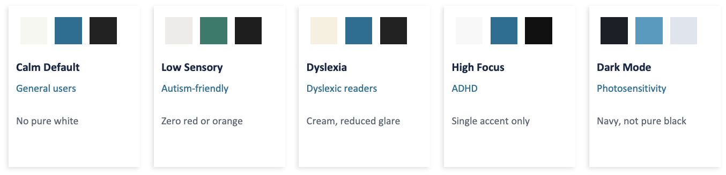
ACCESSIBLE DESIGN IS THE PRODUCT
Five neuro-inclusive palettes engineered for cognitive ease and covering safe, caution, danger and medical states
Adaptive Reading Level
A tri-level toggle (Small/Normal/Large) that dynamically adjusts font size, line height, and AI output density. Preferences persist across sessions via Cosmos DB
Notes:
“I think this is my favorite feature of ClearStep. For us, accessibility isn’t a feature — it’s literally the product.
We designed ClearStep around the idea that people process information differently, especially under stress.
Instead of a single interface, we built five cognitive accessibility profiles — each one tailored to a specific need.
Calm Default reduces glare and keeps things neutral. Low Sensory removes visual noise for users with sensory sensitivity. Dyslexia mode uses a cream background to reduce visual crowding. High Focus strips everything down to support attention. And Dark Mode reduces light exposure for users with photosensitivity.
These are designed environments that change how information is experienced.
On top of that, we added adaptive reading levels so users can adjust how dense or simplified the output is, and those preferences are saved — so the system remembers and adapts every time they come back.
Because reducing cognitive overload isn’t just about simplifying content — it’s about presenting it in a way the user can actually process.”

Slide 9
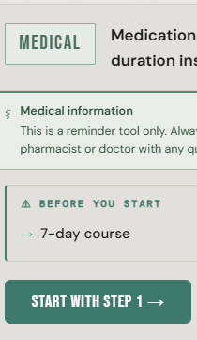
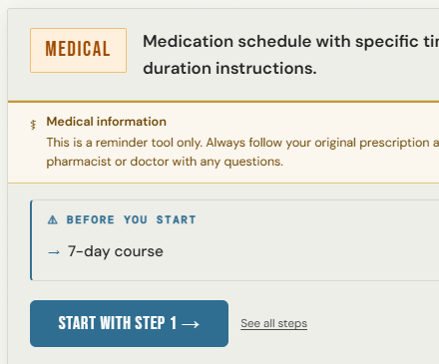
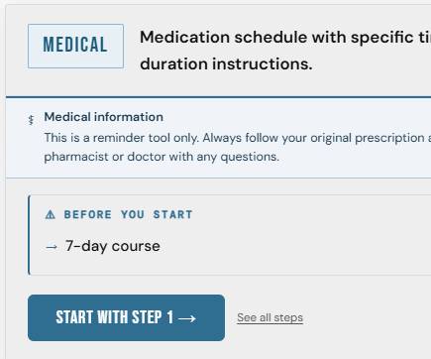
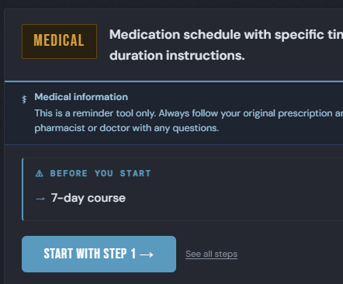
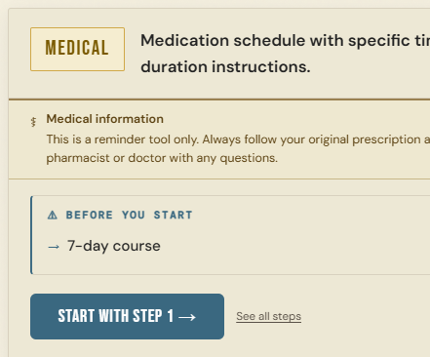
Notes:
“For us, accessibility isn’t a feature — it’s the product.
We designed ClearStep around the idea that people process information differently, especially under stress.
Instead of a single interface, we built five cognitive accessibility profiles — each one tailored to a specific need.
Calm Default reduces glare and keeps things neutral. Low Sensory removes visual noise for users with sensory sensitivity. Dyslexia mode uses a cream background to reduce visual crowding. High Focus strips everything down to support attention. And Dark Mode reduces light exposure for users with photosensitivity.
These aren’t just themes — they’re designed environments that change how information is experienced.
On top of that, we added adaptive reading levels. Users can adjust how dense or simplified the output is, and those preferences are saved — so the system remembers and adapts every time they come back.
Because reducing cognitive overload isn’t just about simplifying content — it’s about presenting it in a way the user can actually process.”

Slide 10

OUR APPROACH TO THE PROBLEM
1
Start with the person not the problem
3
Calm language is a technical requirement
5
Design for Failure and Safety
What does it feel like to receive a frightening message when your brain processes anxiety differently?
Tone of AI output is treated as a critical component of the design
Graceful error states, fallback flows, and transparent limitations, so users stay informed, not abandoned.
2
Ask about experience, not diagnosis
4
Explainability reduces anxiety and create trust.
UI adapts to how you process information, not how you are diagnosed
Showing the “why” behind every model output to empower the user
Notes:
“This is our approach. We started with the person first and not the problem. We asked what it actually feels like to receive a confusing or urgent message, especially for someone who processes information differently.
Second, we focused on experience, not diagnosis. The system adapts to how someone processes information — not labels them.
Third, we made calm language a requirement, not a preference. The tone is treated like an API contract — because how something is said directly affects how it’s understood.
Fourth, we built in explainability. Every result shows the “why,” so users don’t just get an answer — they understand it and can trust it.
And finally, we designed for failure and safety. If something goes wrong, the system doesn’t break — it guides the user clearly and keeps them informed.
These decisions shaped everything, from how the interface looks like, to how the system behaves under pressure.”

Slide 11
KEY LEARNINGS
Labeling without action is Incomplete
A "High Risk" label without a next step increases anxiety. ClearStep provides "Action-First" steps to eliminate decision paralysis
Accessibility First is Universal Design
Solving for cognitive overload by designing a simple, intuitive experience that empowers neurodivergent users and reduces complexity.
Fail-Safe Architecture
We prioritize uptime, security and system integrity by combining 'Zero-Secrets' architecture via Azure Key Vault, protecting user data with a layered Fallback (Azure → Anthropic → Local Scorer).
Ethics as a Pipeline
Integrated all six Responsible AI Principles (Fairness, Reliability, Privacy, Inclusiveness, Transparency, Accountability) directly into the engineering workflow.
Notes:
These are the key things we learned building ClearStep.
First — labeling risk without action isn’t enough. If you tell someone something is high risk but don’t tell them what to do next, you’re increasing anxiety, not reducing it. That’s why we focused on action-first responses.
Second — accessibility-first design isn’t niche, it’s universal. When you design for cognitive overload, you end up creating something that works better for everyone.
Third — the system has to be fail-safe. We designed it so it continues to function even when parts of the pipeline fail, without exposing data or breaking the user experience.
And finally, responsible AI was also very important to us. It has to be built into the system itself. Fairness, safety, privacy, and transparency are enforced in how the system behaves, not just how it’s described.
These weren’t just design choices — they shaped how the system works end-to-end.”

Slide 12



ROADMAP
PHASE 1: HIGH PRIORITY
PHASE 2: PLANNED
PHASE 3: FUTURE
Azure Computer Vision
Session History
Browser Extension
Finalizing OCR endpoint configuration and schema validation for vision Integration.
Optional anonymous history log for users to revisit past analyses without account creation or tracking.
Integrate "Is This Safe?" tool to any email client, allowing users to verify suspicious messages without leaving their inbox.
Notes:
ClearStep was built as a focused MVP for this hackathon. The core system — the pipeline, the safety layer, and the user experience — is already fully working and deployed.
We were intentional about scope, and we’re clear on what comes next.
First, we’re adding Azure Computer Vision. That allows users to upload photos of documents — not just text — and still get the same guidance. The infrastructure is already there, we’re just finalizing the last piece of validation.
Next is session history. No accounts, no tracking — but users can still come back and see what they analyzed before.
And then, a browser extension. So “Is This Safe?” works directly inside email — no copying, no switching tabs.
The key point is — these aren’t new systems. They’re direct extensions of what’s already built and running.

Slide 13
ClearStep
Reducing cognitive load for neurodivergent users
Leishka
Pagán
Product Owner, Security Lead, Azure Engineer, Frontend Engineer, UX Director
Joanne Obodoagwu
Cloud/DevOps Engineer
Fatima
Ahmed
Research Support, Feature ideation, UX concept exploration
Live Demo
Github Repository
Notes:
ClearStep is live. You can try it right now — the link is on screen. Everything we walked through — the pipeline, the safety layer, the accessibility system — it's all deployed and working. Thank you.

