Slide 1

Data Analyst Presentation
JoAnne Hatcher
© IBM Corporation. All rights reserved.

Slide 2






OUTLINE
Executive Summary
Introduction
Methodology
Results
  Visualization – Charts
  Dashboard
Discussion
  Findings & Implications
Conclusion
Appendix

Slide 3

EXECUTIVE SUMMARY
Current Technology Usage: Developers primarily rely on a small set of well-established programming languages, databases, platforms, and web frameworks. Usage is concentrated around proven, scalable technologies with strong community support, highlighting a clear preference for stable and industry- standard tools in modern software development.
Future Technology Trends: Developers show strong interest in learning modern, in-demand technologies for the coming year. Preferences highlight a shift toward scalable programming languages, cloud-ready databases, and flexible platforms and frameworks. Overall, the trend reflects a forward-looking focus on tools that support modern, efficient, and data-driven application development.
  Respondents show strong interest in learning and using modern, in-demand programming languages next year, indicating a focus on skills that support scalability, performance, and long-term career growth.
  Developers express growing interest in learning modern and scalable database technologies, reflecting increased demand for cloud-based, data-intensive, and high-performance data management solutions.
  Respondents are keen to work with flexible, cloud-ready platforms that support modern development practices and improve efficiency in building scalable applications.
Demographics Overview: The survey respondents represent a diverse, global community spanning multiple countries and age groups. Most participants have formal education in technical fields, highlighting the importance of structured learning in the technology sector.
The survey highlights a balance between stability and innovation: developers continue to rely on proven technologies while actively seeking to learn modern tools for future projects. These insights can guide technology strategy, workforce development, and training initiatives to align with evolving industry demands.
The survey underscores a developer community that values both proven technologies and continuous learning. Current usage emphasizes stability and efficiency, while future trends highlight adaptability and skill growth, providing a clear roadmap for technology adoption and workforce development.

Slide 4

INTRODUCTION
This report presents an analysis of a developer survey, focusing on current technology usage, future technology trends, and respondent demographics. Its purpose is to provide actionable insights into the tools, platforms, and skills developers currently use and those they aim to adopt in the near future.
The target audience includes technology managers, team leads, HR and training professionals, and organizations planning technology adoption or workforce development strategies.
The report’s value lies in highlighting patterns in technology preferences, emerging trends, and skill gaps, enabling informed decision-making for training programs, technology investments, and strategic planning in the software development ecosystem.
  This report analyzes survey data to highlight current and future technology preferences of developers, including languages, databases, platforms, and frameworks.
  Targeted at technology leaders and HR teams, the report provides insights to guide technology adoption, workforce planning, and skill development in line with industry trends.

Slide 5

METHODOLOGY
Data Sources: The analysis uses survey data collected from developers, covering technology usage, future technology interests, and demographic information.
Collection Methods: Data was gathered via an online survey, where respondents selected multiple options for programming languages, databases, platforms, and frameworks they have worked with or wish to learn.
Data Wrangling: Key steps included:
  Removing missing values for relevant columns.
  Splitting multi-select responses into separate rows for analysis.
  Cleaning extra whitespace and standardizing text entries.
  Counting frequencies to identify top technologies.
  Preparing data for visualizations such as bar charts and pie charts.
This methodology ensures accurate insights into both current and desired technology trends among developers.

Slide 6
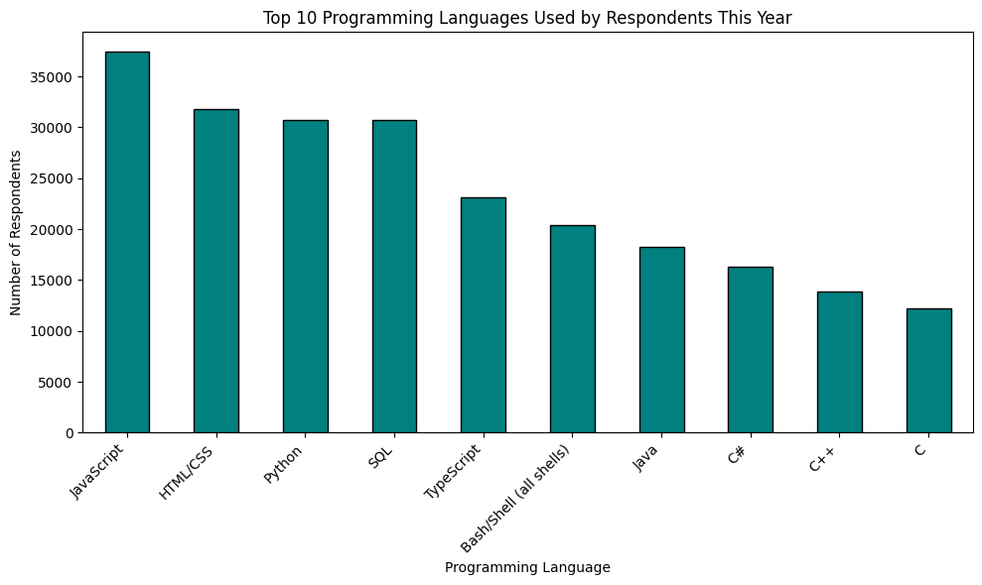
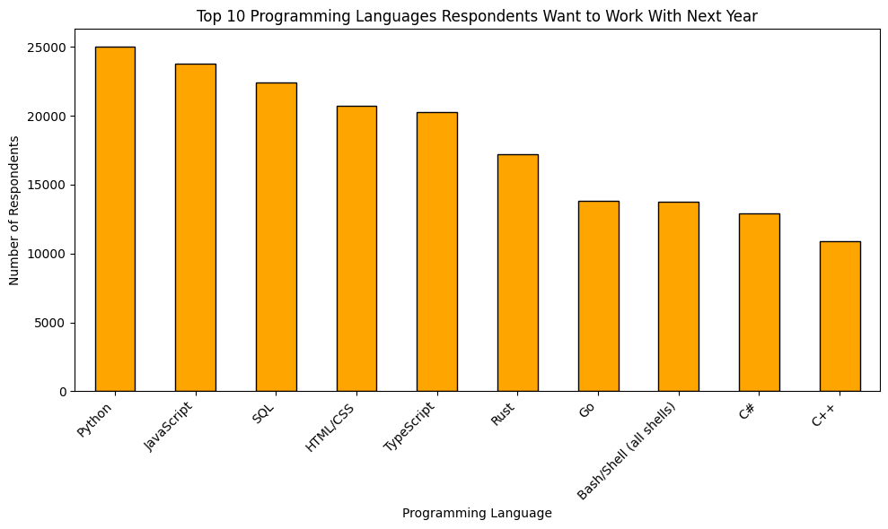
PROGRAMMING LANGUAGE TRENDS
Current Year Next Year

Slide 7
PROGRAMMING LANGUAGE TRENDS - FINDINGS & IMPLICATIONS
Findings Implications
Current Year: Top 10 languages dominate usage, showing reliance on stable, well-supported, and versatile tools.
Next Year: Developers are interested in modern, in-demand languages that support emerging technologies, while still valuing some current favorites.
Insight: There is a balance between using proven languages
today and learning new ones for future projects.
Workforce Planning: Organizations should ensure developers are skilled in both widely used current languages and emerging languages that will be important next year.
Training & Development: There is a clear need for continuous learning programs to help developers adopt modern languages and stay competitive.
Technology Strategy: Companies can align project planning and technology adoption with languages that are both popular today and expected to grow in demand, ensuring long-term relevance.
Recruitment: Hiring strategies can focus on candidates with expertise in both established and emerging languages to future-proof teams.

Slide 8
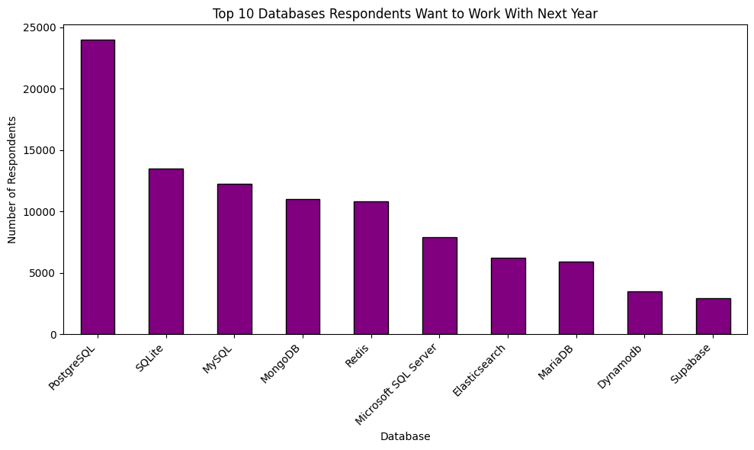
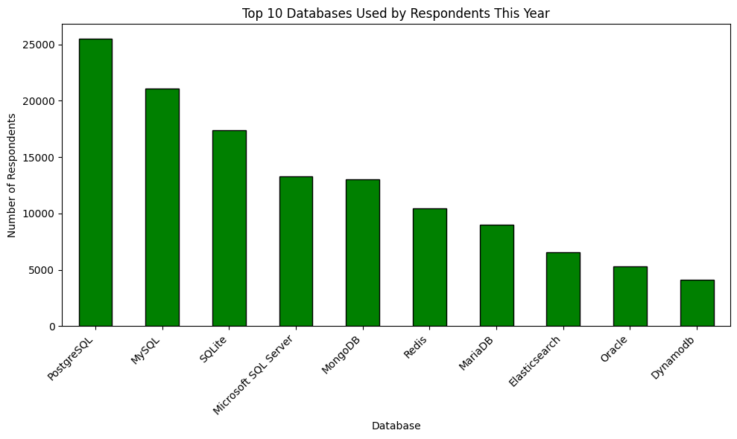
DATABASE TRENDS
Current Year
Next Year

Slide 9
DATABASE TRENDS - FINDINGS & IMPLICATIONS
Findings
Current Year:
  A small set of databases dominates usage, with the top 10
accounting for the majority of respondents’ experience.
  Popular databases are mature, widely adopted, and reliable, reflecting industry-standard choices for data storage and management.
Next Year:
  Developers show interest in learning modern, scalable, and cloud-ready databases.
  Some currently popular databases remain in demand, but emerging technologies are gaining attention for future projects.
There is a balance between reliance on proven databases today and interest in adopting newer technologies for the future.
Implications
Workforce Development: Training programs should cover both widely used current databases and emerging ones to prepare developers for future projects.
Technology Planning: Organizations can prioritize database adoption and integration strategies aligned with both current usage and future trends.
Recruitment: Hiring strategies can target candidates with expertise in both established and modern databases to ensure long-term flexibility and competitiveness.
Project Strategy: Selecting databases for new projects should
consider both current stability and future scalability needs.

Slide 10

DASHBOARD

Slide 11
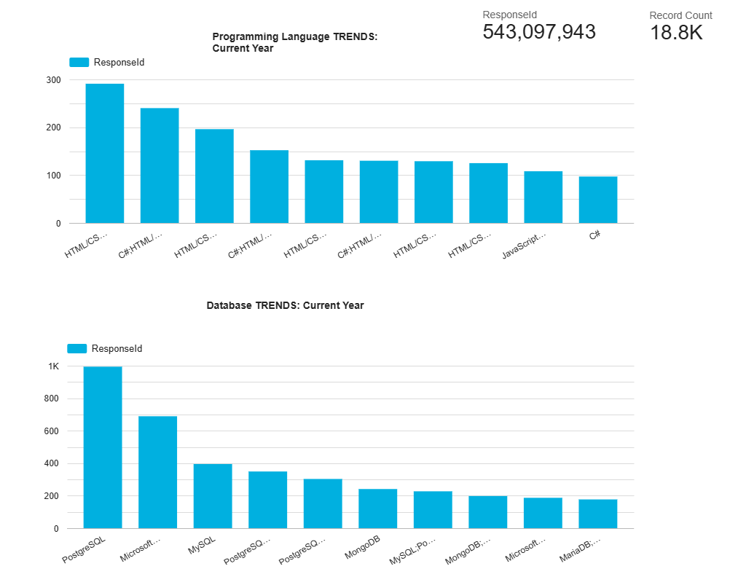
DASHBOARD TAB 1

Slide 12
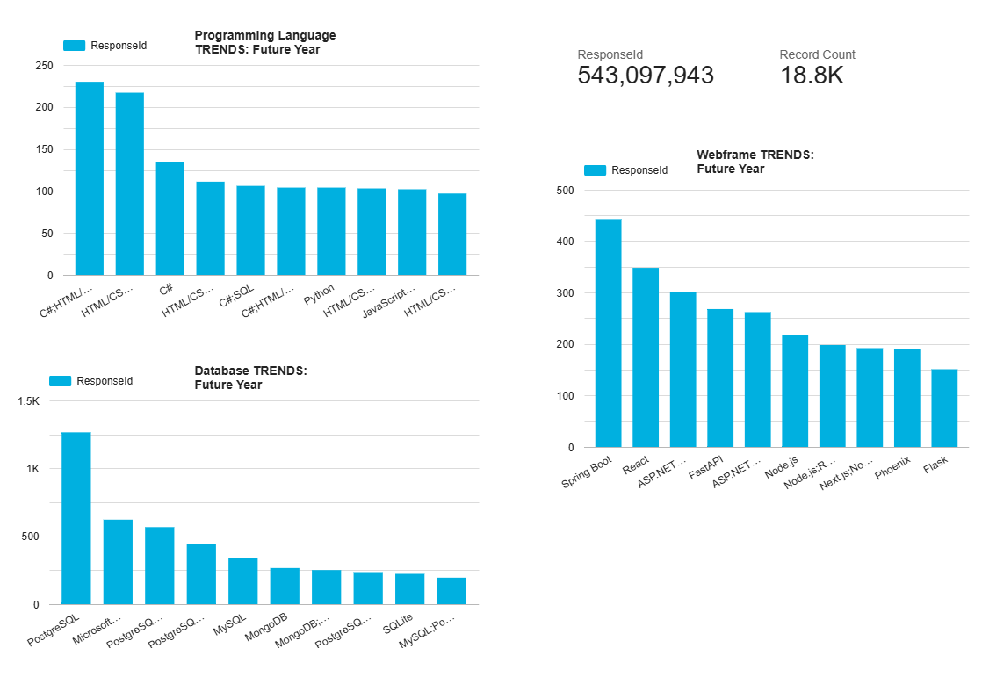
DASHBOARD TAB 2

Slide 13
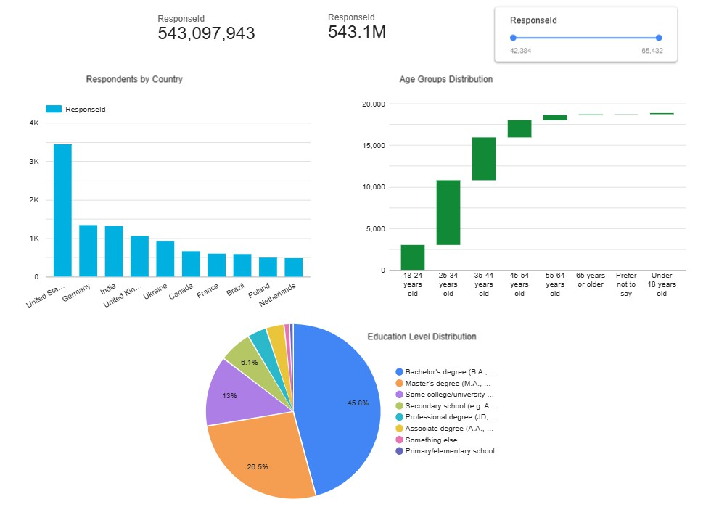
DASHBOARD TAB 3

Slide 14
DISCUSSION
Current Technology Usage
Developers rely on core, well-established languages
(Python, JavaScript, Java), databases, platforms, and
web frameworks, favoring stability and efficiency.
Future Technology Trends
There is strong interest in learning new languages,
databases, and frameworks, indicating evolving skill
demands and opportunities for training and adoption.
Demographics Insights
Respondents are diverse in country, age, and education.
Technology preferences vary by demographic, helping
guide recruitment and learning initiatives.
Cross-Insights
Current usage aligns with future learning interests,
suggesting organizations can balance stable
technologies with emerging tools for strategic growth.
Limitations
Multi-select data processing may introduce minor
aggregation bias, and the survey sample may not
represent all developers globally.

Slide 15
OVERALL FINDINGS & IMPLICATIONS
Findings
Current Technology Usage
Implications
Workforce Planning
Developers mostly use a few core programming languages
Organizations can align training and hiring with both current
(Python, JavaScript, Java) and widely adopted databases,
usage and future learning trends to maintain a competitive
platforms, and web frameworks.
Web frameworks like React and Django are highly popular.
workforce.
Technology Adoption
Technology usage is concentrated on stable, industry-proven
tools.
Future Technology Trends
Emphasizing stable, proven tools ensures reliability, while
monitoring emerging technologies supports innovation.
Targeted Initiatives
Developers show strong interest in learning new programming
Demographic insights enable tailored learning programs and
languages, databases, platforms, and frameworks next year.
recruitment strategies.
Strategic Decision-Making
Emerging technologies are gaining traction alongside
established tools.
Demographics Insights
  Respondents are diverse in country, age, and education level.
Balancing current usage with future trends helps in resource allocation, project planning, and staying ahead in technology
adoption.
Technology preferences vary by demographics, with younger
developers often favoring modern frameworks and new databases.

Slide 16

CONCLUSION
Developers rely on a core set of well-established programming languages, databases, platforms, and web frameworks, emphasizing stability and efficiency in current work.
There is strong interest in learning new technologies next year, reflecting a
willingness to adapt and expand skills alongside industry trends.
Demographic factors such as age, country, and education influence technology preferences, highlighting the importance of tailored training and recruitment strategies.
Organizations can leverage these insights to balance adoption of proven technologies with emerging tools, optimize workforce development, and make informed strategic decisions.

Slide 17

APPENDIX
Data Source Dataset: survey-data.csv
Respondents: Global developers from diverse countries, ages, and education levels
Columns Used:
Current Usage: LanguageHaveWorkedWith, DatabaseHaveWorkedWith, PlatformHaveWorkedWith, WebframeHaveWorkedWith
Future Trends: LanguageWantToWorkWith, DatabaseWantToWorkWith, PlatformWantToWorkWith, WebframeWantToWorkWith
Demographics: Country, Age, EdLevel
Data Processing
Split multi-select columns into separate rows; cleaned whitespace. Dropped or marked missing values as “Unknown.”
Metrics use COUNT_DISTINCT(RespondentID) for unique counts.
Dashboard Notes Tools: Looker Studio
Charts: Bar (top languages, databases, frameworks), Pie/Donut (platforms), Waterfall (age), Bar (countries)
Slider/Dropdown: Country, Age, Education Level for interactive analysis
Limitations
Multi-select splitting may slightly inflate counts.
Survey may not fully represent all developers globally.
Insights reflect trends within the respondent group only.

Slide 18
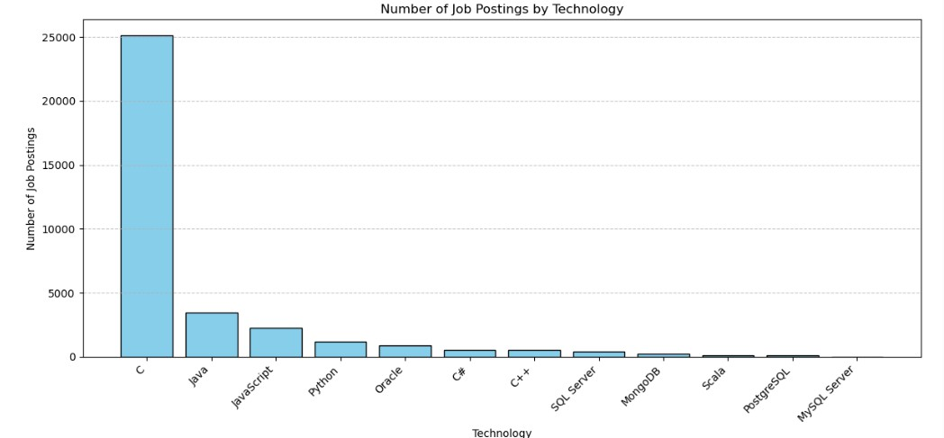
JOB POSTINGS
The resulting bar chart will clearly show which technologies have the highest demand according to the API data.

