Slide 1
Tutorial 8 Group C10
22nd October 2018
Joanne Ong

Slide 2
Plans for today
Lecture recap
Problem 20.1
Problem 20.2
Problem 21.1
Problem 21.2
Problem 22.1
Problem 22.2

Slide 3
Lecture recap
Preprocessing
Preprocessing: text processing and substitution process
e.g. #include
#define

Slide 4
Lecture recap Macro
Macro: block of code that is given an identifying name and is substituted and expanded during pre-processing
e.g. #define SQUARE(x) x*x
Notes:
Macro is named square,

Slide 5
Lecture recap Macro
Macro
Not called, just substituted during pre-processing phase
No information about types (no return types/ parameter types)
Notes:
Macro is named square,

Slide 6
Lecture recap Macro
#define SQUARE(x) x*x
#define PI 3.1415926
int main() {
double radius = 4.0;
cs1010_print_double(PI*SQUARE(radius));
}

Slide 7
Lecture recap Macro
int main() {
double radius = 4.0;
cs1010_print_double(3.1415926*radius*radius);
}
Notes:
You can see that only text substitution is done here.

Slide 8
Problem 20.1 (a)
What are the values for i and j?
#define MIN(a, b) a < b ? a : b
long i = MIN(10, 20);
long j = MIN(10, 20) + 1;

Slide 9
Problem 20.1 (a)
What are the values for i and j?
#define MIN(a, b) a < b ? a : b
long i = 10 < 20 ? 10 : 20;
long j = 10 < 20 ? 10 : 20 + 1;

Slide 10
Problem 20.1 (a)
What are the values for i and j?
#define MIN(a, b) a < b ? a : b
long i = 10 < 20 ? 10 : 20;
i = 10

Slide 11
Problem 20.1 (a)
What are the values for i and j?
#define MIN(a, b) a < b ? a : b
long j = 10 < 20 ? 10 : 20 + 1;
long j = 10 < 20 ? 10 : 21;
j = 10

Slide 12
Problem 20.1 (b)
What are the values for i and k?
#define MIN(a,b) a < b ? a : b
long i = 10;
long j = 20;
long k = MIN(j, i++);

Slide 13
Problem 20.1 (b)
What are the values for i and k?
#define MIN(a,b) a < b ? a : b
long i = 10;
long j = 20;
long k = j < i++ ? j : i++;
Notes:
i = 12, k = 11

Slide 14
Problem 20.1 (b)
i++: increment the value of i but return the original value i held before being incremented

Slide 15
Problem 20.1 (b)
#define MIN(a,b) a < b ? a : b
long i = 10;
long j = 20;
long k = 20 < i++ ? 20 : i++;
k = 20 < 10++ ? 20 : i++;
k – 20 < 10 ? 20 : 11++;
k = 11, i = 12
Notes:
i = 12, k = 11

Slide 16
Problem 20.2
Suppose we write our SWAP macro without opening and closing brackets. What could go wrong?
#define SWAP(T, x, y) T temp = x;\
x = y;\
y = temp;
Notes:
Error: redefinition of `temp`!

Slide 17
Problem 20.2
#define SWAP(T, x, y) T temp = x;\
x = y;\
y = temp;
int main() {
long x = 3.0;
long y = -1.0;
SWAP(long, x, y);
}
Notes:
Error: redefinition of `temp`!

Slide 18
Problem 20.2
#define SWAP(T, x, y) T temp = x;\
x = y;\
y = temp;
int main() {
long x = 3.0;
long y = -1.0;
long temp = x; x = y; y = temp;
}
Notes:
Error: redefinition of `temp`!

Slide 19
Problem 20.2
#define SWAP(T, x, y) {\
T temp;\
temp = x;\
x = y;\
y = temp;\
}
int main() {
long x = 3.0;
long y = -1.0;
SWAP(long, x, y);
}
#define SWAP(T, x, y) T temp = x;\
x = y;\
y = temp;
int main() {
long x = 3.0;
long y = -1.0;
long temp = x; x = y; y = temp;
}
Problem 1: Error: redefinition of `temp`!
(if `SWAP` is called in a scope that contains the variable `temp`)

Slide 20
Problem 20.2
if (x < y)
long temp = x;
x = y;
y = temp;
if (x < y)
SWAP(long, x, y);
Problem 2: If statement
If SWAP is used in an if statement without curly braces there can be unexpected behaviour!

Slide 21
Lecture recap Assert macro
C provides a macro called assert in the header file assert.h
Example of error message:
assert: assert.c:12: int main(): Assertion `i >= 0 && i < nrows && j >= 0 && j < ncols' failed. Aborted

Slide 22
Problem 21.1
Would the assert in line 5 ever fail?
void foo(long x) {
if (x % 2 == 0) {
// do something
} else {
assert(x % 2 == 1);
}
}

Slide 23
Problem 21.1
Yes!
x % 2 can be 0, 1 or -1. When x % 2 == -1 the assertion fails!
Note: According to the C11 standard:
(a / b) * b + a % b == a
so x % 2 can be negative
e.g. (-3 / 2) * 2 + -3 % 2 = -3
and (-3 / 2) * 2 = -2
so (-3 % 2) must be -1

Slide 24
Problem 21.2
Will not be going through in class.
You can try if you want to ☺

Slide 25
Lecture recap Efficiency
Efficiency
Worst performance
No repetition

Slide 26
Lecture recap Big O notation
Big-O notation: the “rate of growth” of a function
- Low-level counting (e.g. how many additions in the function etc) is not meaningful

Slide 27
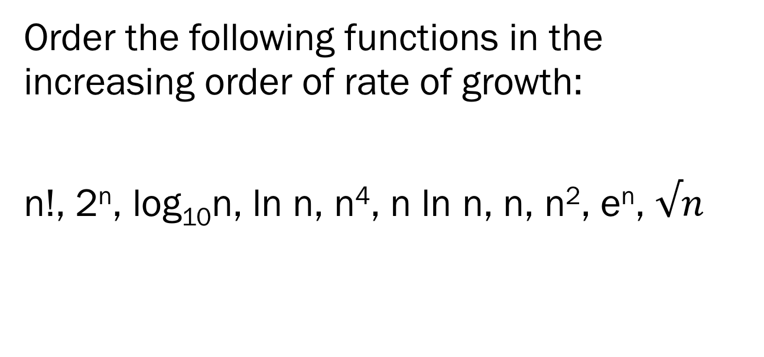
Problem 22.1
Order the following functions in the increasing order of rate of growth:
n!, 2^{n}, log₁₀n, ln n, n⁴, n ln n, n, n², e^{n}, $√n$

Slide 28
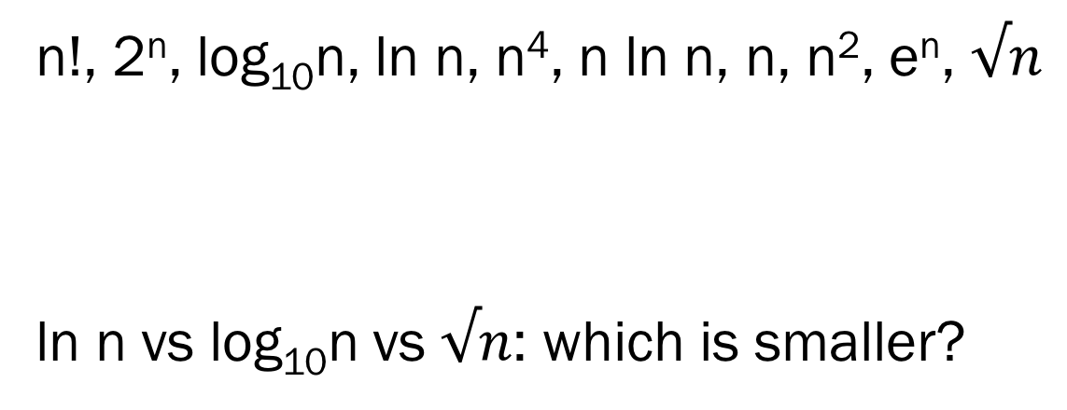
Problem 22.1
n!, 2^{n}, log₁₀n, ln n, n⁴, n ln n, n, n², e^{n}, $√n$
ln n vs log₁₀n vs $√n$: which is smaller?

Slide 29
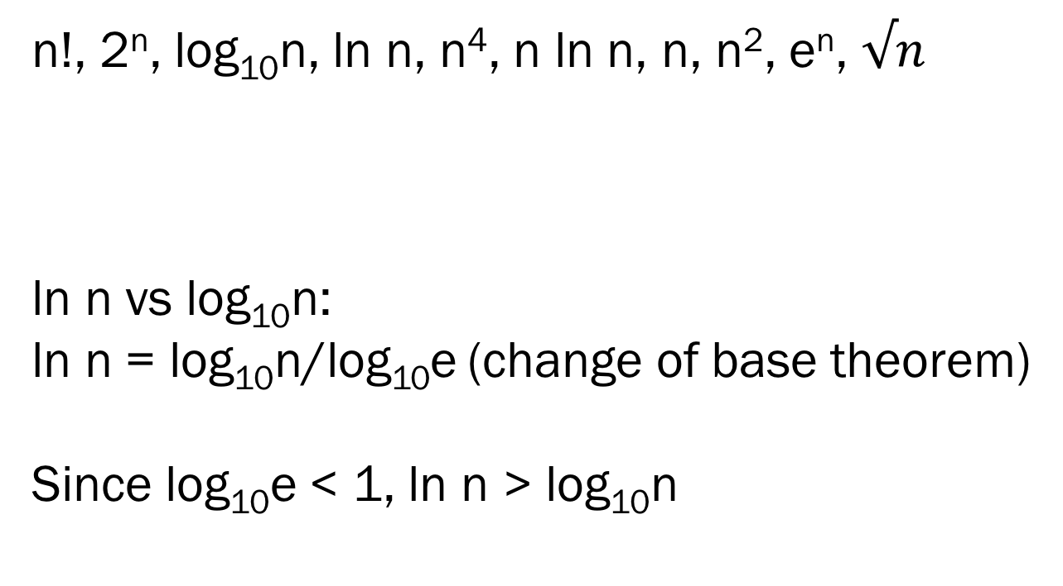
Problem 22.1
n!, 2^{n}, log₁₀n, ln n, n⁴, n ln n, n, n², e^{n}, $√n$
ln n vs log₁₀n:
ln n = log₁₀n/log₁₀e (change of base theorem)
Since log₁₀e < 1, ln n > log₁₀n

Slide 30
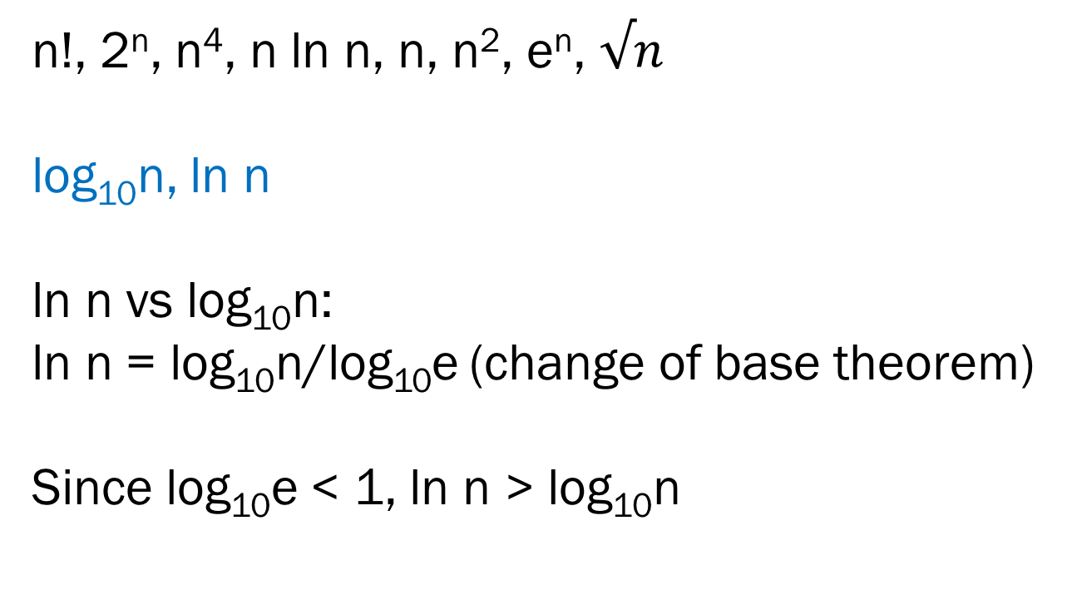
Problem 22.1
n!, 2^{n}, n⁴, n ln n, n, n², e^{n}, $√n$
log₁₀n, ln n
ln n vs log₁₀n:
ln n = log₁₀n/log₁₀e (change of base theorem)
Since log₁₀e < 1, ln n > log₁₀n

Slide 31
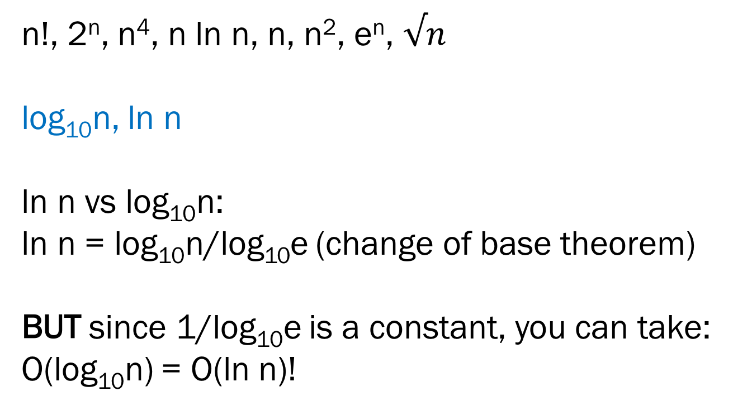
Problem 22.1
n!, 2^{n}, n⁴, n ln n, n, n², e^{n}, $√n$
log₁₀n, ln n
ln n vs log₁₀n:
ln n = log₁₀n/log₁₀e (change of base theorem)
BUT since 1/log₁₀e is a constant, you can take:
O(log₁₀n) = O(ln n)!

Slide 32
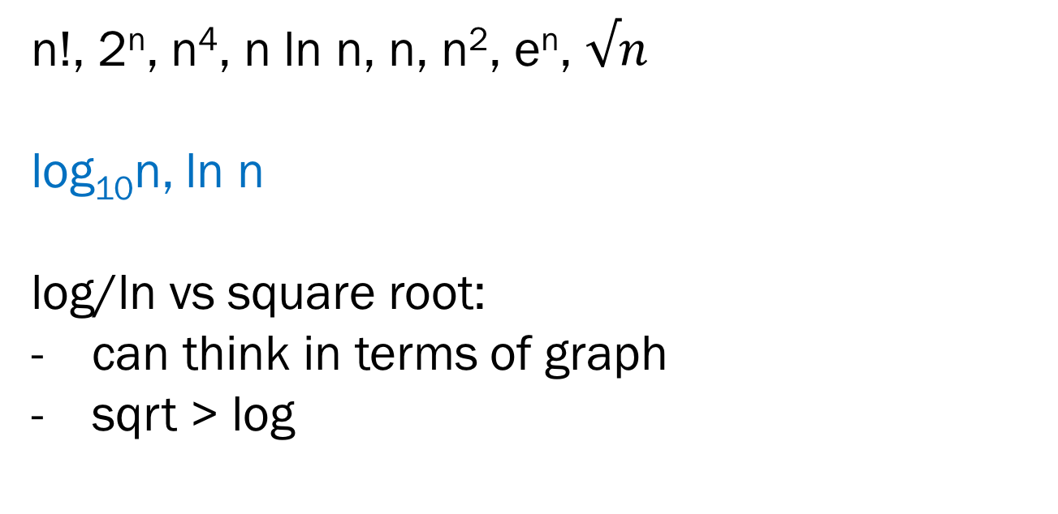
Problem 22.1
n!, 2^{n}, n⁴, n ln n, n, n², e^{n}, $√n$
log₁₀n, ln n
log/ln vs square root:
can think in terms of graph
sqrt > log

Slide 33
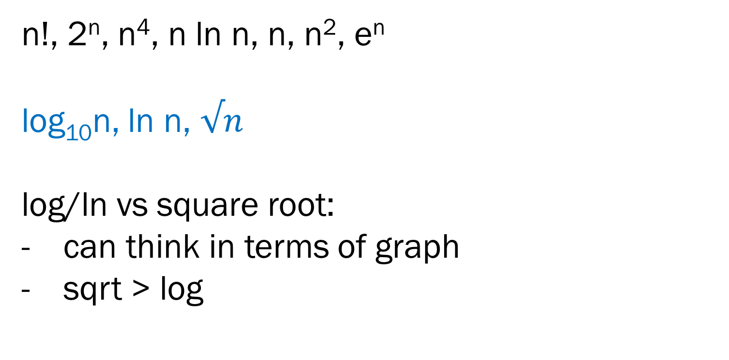
Problem 22.1
n!, 2^{n}, n⁴, n ln n, n, n², e^{n}
log₁₀n, ln n, $√n$
log/ln vs square root:
can think in terms of graph
sqrt > log

Slide 34
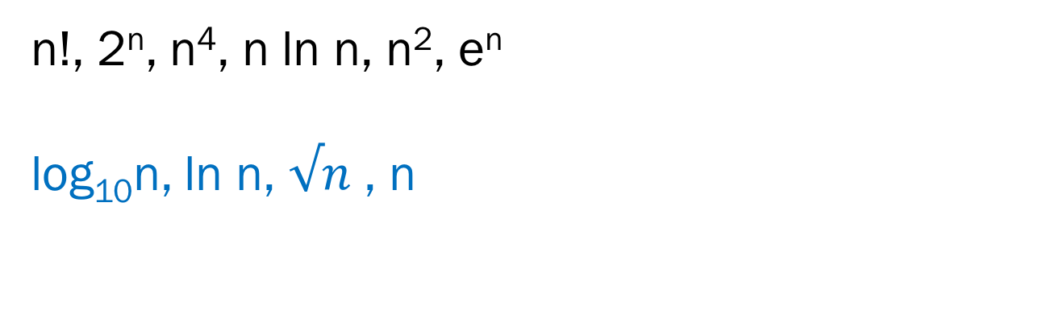
Problem 22.1
n!, 2^{n}, n⁴, n ln n, n², e^{n}
log₁₀n, ln n, $√n$ , n

Slide 35
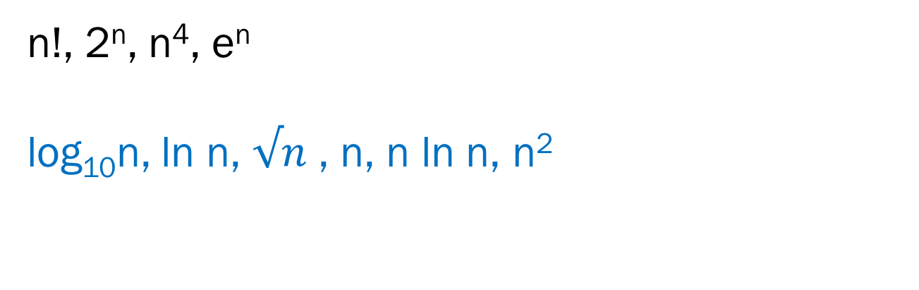
Problem 22.1
n!, 2^{n}, n⁴, e^{n}
log₁₀n, ln n, $√n$ , n, n ln n, n²

Slide 36
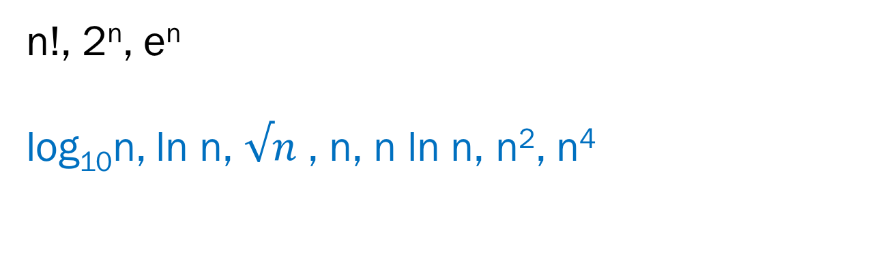
Problem 22.1
n!, 2^{n}, e^{n}
log₁₀n, ln n, $√n$ , n, n ln n, n², n⁴

Slide 37
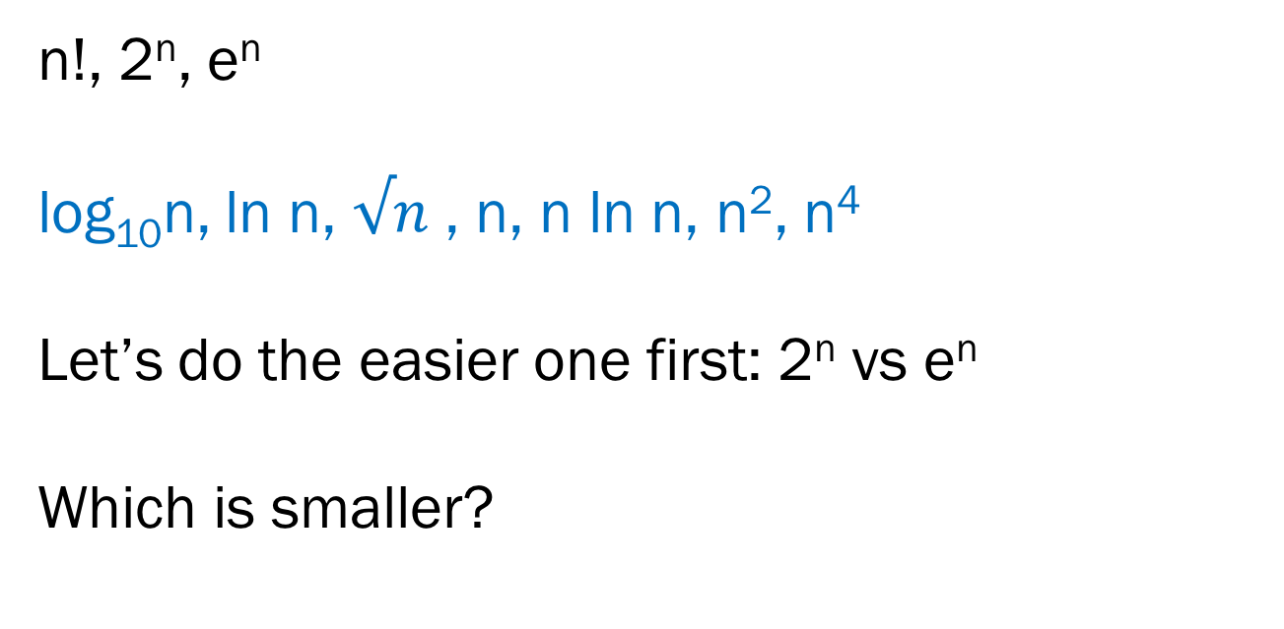
Problem 22.1
n!, 2^{n}, e^{n}
log₁₀n, ln n, $√n$ , n, n ln n, n², n⁴
Let’s do the easier one first: 2^{n} vs e^{n}
Which is smaller?

Slide 38
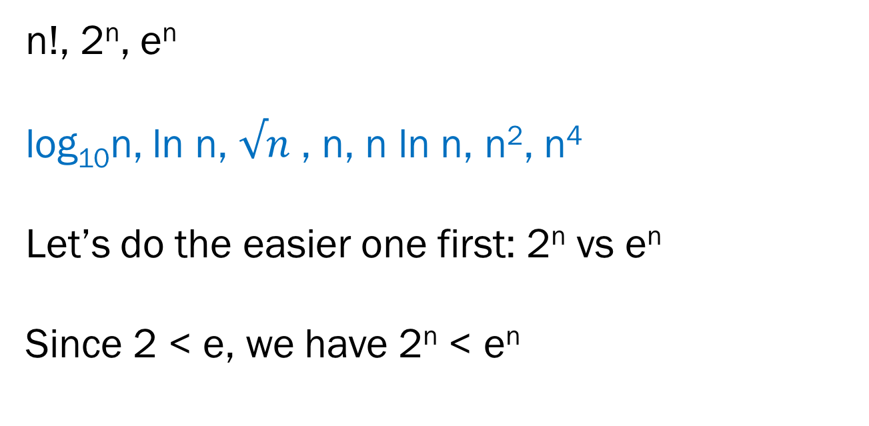
Problem 22.1
n!, 2^{n}, e^{n}
log₁₀n, ln n, $√n$ , n, n ln n, n², n⁴
Let’s do the easier one first: 2^{n} vs e^{n}
Since 2 < e, we have 2^{n} < e^{n}

Slide 39

Problem 22.1
n!, 2^{n}, e^{n}
log₁₀n, ln n, $√n$ , n, n ln n, n², n⁴
What about n! vs e^{n} ?
Which is smaller?

Slide 40
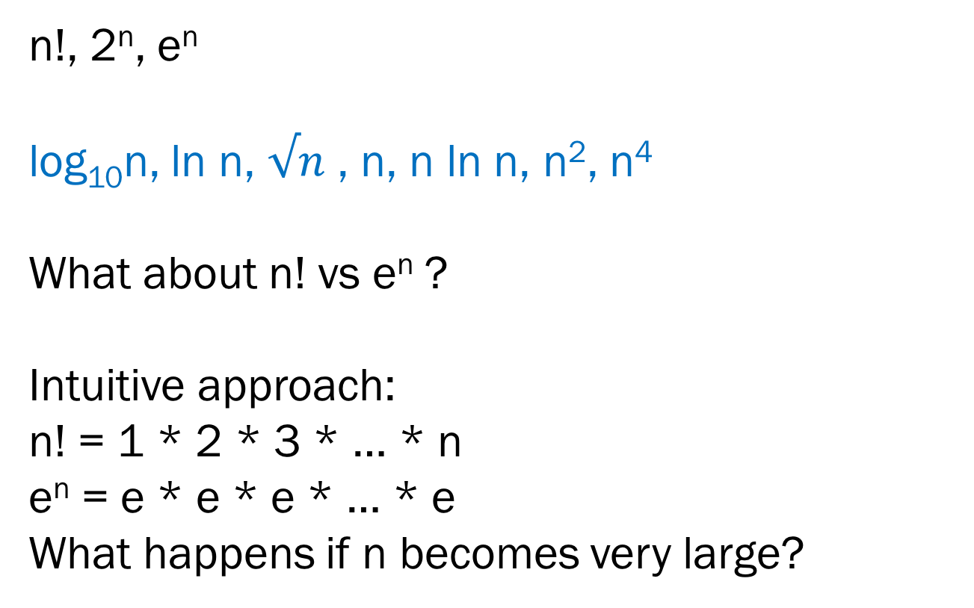
Problem 22.1
n!, 2^{n}, e^{n}
log₁₀n, ln n, $√n$ , n, n ln n, n², n⁴
What about n! vs e^{n} ?
Intuitive approach:
n! = 1 * 2 * 3 * … * n
e^{n} = e * e * e * … * e
What happens if n becomes very large?

Slide 41
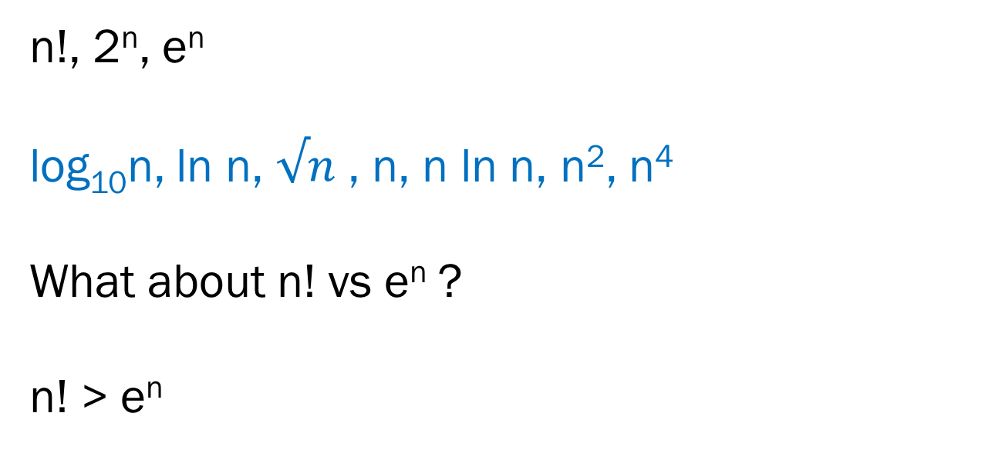
Problem 22.1
n!, 2^{n}, e^{n}
log₁₀n, ln n, $√n$ , n, n ln n, n², n⁴
What about n! vs e^{n} ?
n! > e^{n}

Slide 42
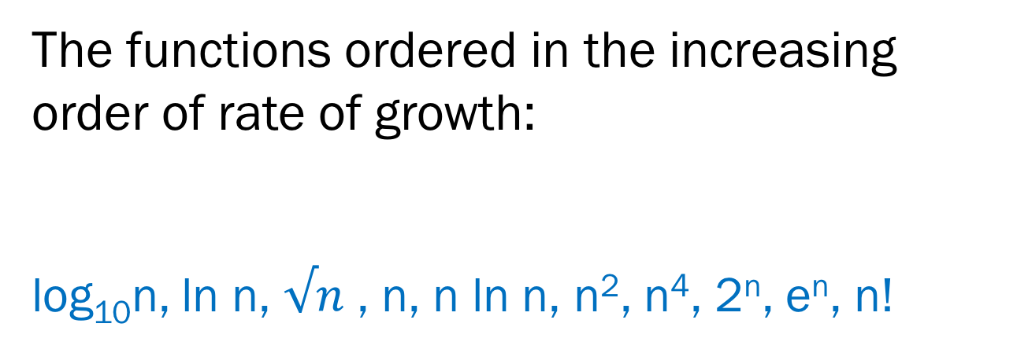
Problem 22.1
The functions ordered in the increasing order of rate of growth:
log₁₀n, ln n, $√n$ , n, n ln n, n², n⁴, 2^{n}, e^{n}, n!

Slide 43
Problem 22.2 (a)
What is its big O run time?
for (long i = 0; i < n; i += 1) {
for (long j = 0; j < n; j += 2) {
cs1010_println_long(i + j);
}
}
Notes:
O(n^2)

Slide 44
Problem 22.2 (a)
How many times does the outer loop run?
for (long i = 0; i < n; i += 1) {
for (long j = 0; j < n; j += 2) {
cs1010_println_long(i + j);
}
}
Notes:
O(n^2)

Slide 45
Problem 22.2 (a)
How many times does the inner loop run?
for (long i = 0; i < n; i += 1) {
for (long j = 0; j < n; j += 2) {
cs1010_println_long(i + j);
}
}
Notes:
O(n^2)

Slide 46
Problem 22.2 (a)
Total: n * (n/2) = n²/2 = O(n²)
for (long i = 0; i < n; i += 1) {
for (long j = 0; j < n; j += 2) {
cs1010_println_long(i + j);
}
}
Notes:
O(n^2)

Slide 47
Problem 22.2 (b)
What is its big O run time?
for (long i = 1; i < n; i *= 2) {
for (long j = 1; j < n; j *= 2) {
cs1010_println_long(i + j);
}
}

Slide 48
Problem 22.2 (b)
How many times does the outer loop run?
for (long i = 1; i < n; i *= 2) {
for (long j = 1; j < n; j *= 2) {
cs1010_println_long(i + j);
}
}

Slide 49
Problem 22.2 (b)
How many times does the inner loop run?
for (long i = 1; i < n; i *= 2) {
for (long j = 1; j < n; j *= 2) {
cs1010_println_long(i + j);
}
}

Slide 50
Problem 22.2 (b)
Total: log(n) * log(n) = (log(n))²
for (long i = 1; i < n; i *= 2) {
for (long j = 1; j < n; j *= 2) {
cs1010_println_long(i + j);
}
}

Slide 51
Problem 22.2 (c)
What is its big O run time?
long k = 1;
for (long j = 0; j < n; j += 1) {
k *= 2;
for (long i = 0; i < k; i += 1) {
cs1010_println_long(i + j);
}
}

Slide 52
Problem 22.2 (c)
How many times does the outer loop run?
long k = 1;
for (long j = 0; j < n; j += 1) {
k *= 2;
for (long i = 0; i < k; i += 1) {
cs1010_println_long(i + j);
}
}

Slide 53
Problem 22.2 (c)
What happens in each loop?
long k = 1;
for (long j = 0; j < n; j += 1) {
k *= 2;
for (long i = 0; i < k; i += 1) {
cs1010_println_long(i + j);
}
}

Slide 54
Problem 22.2 (c)
Total: 2 + 2² + 2³ + … + 2^{n-1} = 2(2^{n} – 1)/(2 – 1)
= O(2^{n})
long k = 1;
for (long j = 0; j < n; j += 1) {
k *= 2;
for (long i = 0; i < k; i += 1) {
cs1010_println_long(i + j);
}
}
Notes:
Summation of a geometric series!!!

