Slide 1
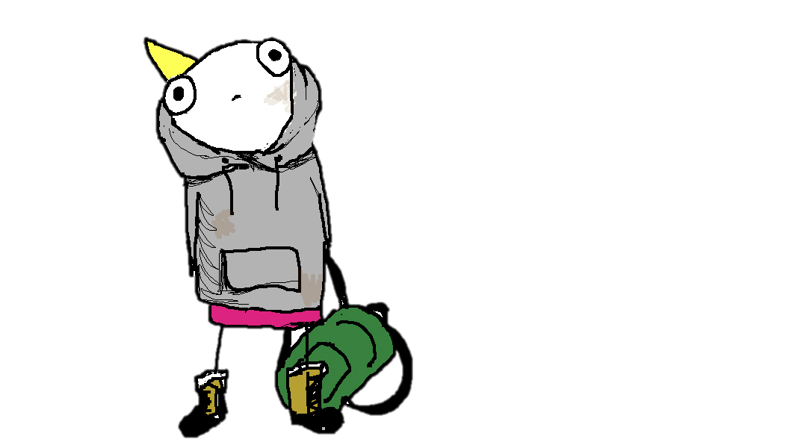
LAST TUTORIAL!

Slide 2
Tutorial 11 Group C10
12th November 2018
Joanne Ong

Slide 3
Plans for today
Problem 27.1
Problem 27.2
Random recursion
Kahoot review

Slide 4
Problem 27.1 nqueens
Given an n by n chessboard, find a possible placement of n queens so that the queens do not threaten each other.
Notes:
(5 mins)

Slide 5

Problem 27.1 nqueens
Is this a valid placement?
a
b
c
d
Notes:
Yes

Slide 6
Problem 27.1 nqueens
Is this a valid placement?
a
b
c
d
Notes:
Yes

Slide 7
Problem 27.1 nqueens
Is this a valid placement?
a
b
c
d
Notes:
No

Slide 8
Problem 27.1 nqueens
a
b
c
d
There must be exactly one queen in each row and each column.
Notes:
Then, if you label each column with a letter, you get a string!

Slide 9
Problem 27.1 nqueens
a
b
c
d
See the problem as a string permutation problem.
Here, the string is “cadb”

Slide 10
Problem 27.1 nqueens
What is the string for this placement?
a
b
c
d
Notes:
bdac

Slide 11
Problem 27.1 nqueens
What is the string for this placement?
a
b
c
d
Notes:
dbac

Slide 12
Problem 27.1 nqueens
a
b
c
d
Basic idea: generate all permutations of the string
e.g. “abcd”

Slide 13
Problem 27.1 nqueens
a
b
c
d
”abcd”
Check whether the solution is valid – what do you have to check?
Notes:
You need to check if any queen threatens other queens diagonally.

Slide 14
Problem 27.1 nqueens
a
b
c
d
”abcd”
Check whether the solution is valid – check if any queen threatens other queens diagonally!
Notes:
This is because right the string representation already make it such that there is only one queen per row and one queen per column

Slide 15
Problem 27.1 nqueens
a
b
c
d
Recall how we permute strings (from last week) – swapping mechanism.
abc | bac | cab
acb | bca | cba

Slide 16
Problem 27.1 nqueens
a
b
c
d
To speed up nqueens solution, we can prune impossible solutions
i.e. check while generating permutations and don’t permute the rest of the string if it’s impossible

Slide 17
Problem 27.1 nqueens
a
b
c
d
e.g. string now: “abcd”
Since first and second rows already threaten each other, don’t bother generating other permutations that start with “ab” (e.g. “abcd”)

Slide 18
Problem 27.1 nqueens
void nqueens(char queens[], long n, long row) {
if (row == n-1) {
if (!threaten_each_other_diagonally(queens, n)) {
cs1010_println_string(queens);
}
return;
}
if (!threaten_each_other_diagonally(queens, row)) {
nqueens(queens, n, row + 1);
}
for (long i = row + 1; i < n; i++) {
swap(queens, row, i);
if (!threaten_each_other_diagonally(queens, row)) {
nqueens(queens, n, row + 1);
}
swap(queens, row, i);
}
}

Slide 19
Problem 27.1 nqueens
bool threaten_each_other_diagonally(char queens[], long len) {
for (long i = 0; i < len; i += 1) {
if (has_a_queen_in_diagonal(queens, len, i)) {
return true;
}
}
return false;
}
Notes:
Has a queen in diagonal will check all the rows after the current row

Slide 20
Problem 27.1 nqueens
Identify the repetitive work being done in the calls threaten_each_other_diagonally.
Notes:
(5 mins)

Slide 21
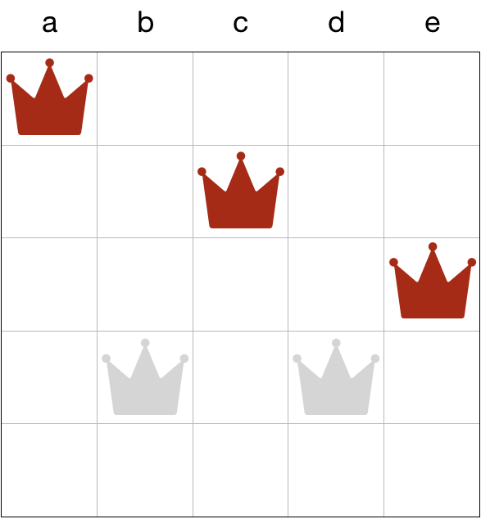


Problem 27.1 nqueens
Current solution:

Slide 22
Problem 27.1 nqueens
Current solution:

Slide 23
Problem 27.1 nqueens
Here, we repeatedly check if the queens on row 0 to row (len – 1) threaten each other.
But when we recurse with nqueens(queens, n, row + 1), we already know that queens on previous rows do not threaten each other

Slide 24
Problem 27.1 nqueens
Better solution:
Already “safe.”
No need to check
again.
Only check the new
row against the queens
above.

Slide 25
Problem 27.1 nqueens
It is enough to check if the newly added queen threatens any of the queens in the previous rows!

Slide 26
Problem 27.2
void permute(char a[], long len, long curr) {
if (curr == len-1) {
cs1010_println_string(a);
return;
}
permute(a, len, curr + 1);
for (long i = curr + 1; i < len; i += 1) {
if (!appear_before(a, curr, i) { // Line A
swap(a, curr, i);
permute(a, len, curr + 1);
swap(a, i, curr);
}
}
}
Notes:
Previous solution to find permutations of a string

Slide 27
Problem 27.2
Restrict permutations to where the same character does not appear next to each other.

Slide 28
Problem 27.2
Idea: check if every ”first” character of a permutation is the same with the previous character.
If it is the same, just prune the process.

Slide 29
Problem 27.2
bool consecutive(const char a[], long curr, long i) {
return a[i] == a[curr-1];
}

Slide 30
Problem 27.2
void permute(char a[], long len, long curr) {
if (curr == len-1) {
if (!consecutive(a, curr, curr)) {
cs1010_println_string(a);
}
return;
}
if (!consecutive(a, curr, curr)) {
permute(a, len, curr+1);
}
for (int i = curr+1; i < len; i++) {
if (!appear_before(a, curr, i) && !consecutive(a, curr, i)) {
swap(a, curr, i);
permute(a, len, curr+1);
swap(a, curr, i);
}
}
}

Slide 31
Random recursion Coin change problem
Find the number of ways we can form N cents from a given list of coins.
First integer: N, the total cents to form
Second integer: M, the number of coin denominations
Next M integers: M different coin denominations

Slide 32
Random recursion Coin change problem
For example:
Input:
3
4
1 2 5 10
Output:
2 (1, 1, 1 or 1, 2)

Slide 33
Random recursion Coin change problem
For example:
Input:
3
4
1 2 5 10
Output:
2 (1, 1, 1 or 1, 2)

Slide 34
Random recursion Coin change problem
What is the strategy?

Slide 35
Random recursion Coin change problem
If N is 0, how many ways are there to return?

Slide 36
Random recursion Coin change problem
If N is 0, how many ways are there to return?
1
If N is < 0, how many ways are there to return?

Slide 37
Random recursion Coin change problem
If N is 0, how many ways are there to return?
1
If N is < 0, how many ways are there to return?
0

Slide 38
Random recursion Coin change problem
If N is 0, how many ways are there to return?
1
If N is < 0, how many ways are there to return?
0
If M is < 0, how many ways are there to return?
0

Slide 39
Random recursion Coin change problem
Otherwise, what should you do?

Slide 40
Random recursion Coin change problem
Otherwise, what should you do?
Either you choose that coin, or you don’t choose that coin.

Slide 41
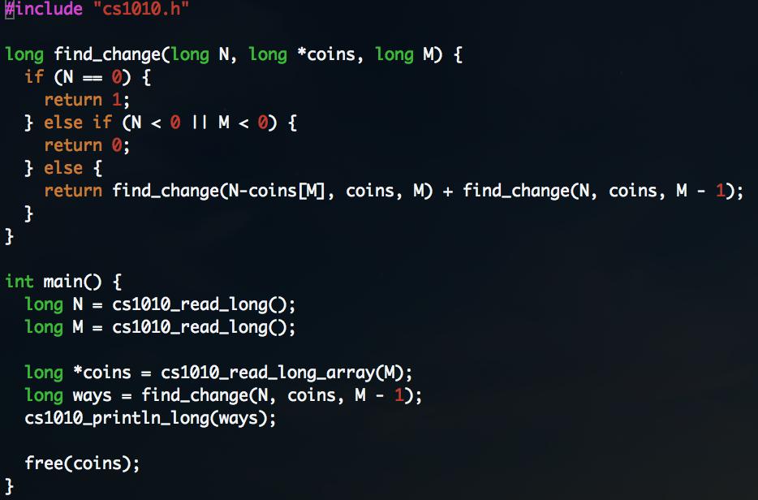
Random recursion Coin change problem

Slide 42
Kahoot review
https://play.kahoot.it/#/k/8867d688-a87d-4d40-95e9-1c8a8a733e85

Slide 43

LAST TUTORIAL!

