Slide 1
Presentation:
SportsStats
By Joan Ovalles

Slide 2
Contents
Review of Questions to Answer/ Hypotheses/ Approach
Initial Findings
Deeper Analysis
Recommendations and Actions

Slide 3
Project Proposal
In this project, we are collaborating with SportsStats, a prominent sports analysis firm, to uncover compelling insights related to the Olympics spanning the past 120 years. Our primary objective is to explore a diverse array of data sources, from athlete performance metrics to global sports events data, in order to identify intriguing patterns, trends, and correlations. These findings will cater to a wide range of stakeholders, including local news outlets seeking fresh and captivating sports-related stories. Furthermore, the general public will find these insights valuable for gaining a deeper understanding of the Olympics' evolution and the key health and performance trends that have emerged over the decades. By utilizing data analytics, we aim to provide actionable insights that captivate audiences, inform decision-makers, and contribute to the well-being and performance optimization of athletes and sports enthusiasts in the context of the Olympic Games' extensive history.

Slide 4
Questions and Hypotheses
What is the extent of the correlation between age, height, and weight and their impact on athletic success across a diverse range of sports?
Hypothesis: Age, height, and weight constitute significant determinants of an athlete's overall success. While the influence of these factors may vary across sports, with certain disciplines placing less emphasis on athleticism and others valuing the advantages of experience in older competitors, it is evident that, on a holistic scale, youth and physical fitness confer a substantial competitive advantage.
How have women's sports undergone evolution and transformation over the course of recent history and what key trends and shifts can be identified?
Hypothesis: Women's sports have witnessed substantial growth and evolution over the years. Notably, in recent times, we have observed a flourishing interest among women in domains previously considered inaccessible to them, with sports proving to be no exception to this transformative trend.

Slide 5
Approach
We will explore the relationship between an athlete's age, height, and weight with their success, as indicated by medals won. To do this, we'll use statistical techniques like correlation analysis and visualization tools to assess the strength and direction of these relationships. For instance, we will investigate whether there's a correlation between height and success in sports that favor taller athletes, like basketball or volleyball. Additionally, we'll analyze whether age is a critical factor in sports where experience matters.
To evaluate the hypothesis about the growth of women's sports, we will initially analyze the 'Sex' and 'Year' columns to understand how female participation in sports has evolved over time. We can visualize this with time series plots or bar charts. Additionally, we will explore the 'Sport' and 'Event' columns to identify trends in the types of sports and events that have seen increased female participation. If we observe growth, we may use percentage changes and trend analysis as evaluation measures. Further, we can examine the 'Medal' column to understand if the success of female athletes has increased over the years.

Slide 6
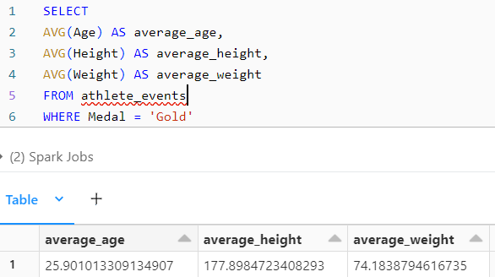
Initial Findings
The average age for gold medalists is 25.9 while the age range for all athletes is 10 between and 97. 23-year-old athletes won the most gold medals with 1136.
The average height for gold medalists is 177.9 centimeters while the age range for all athletes is between 127 and 226 centimeters. Athletes whose height is 180 centimeters won the most gold medals with 604.
The average weight for gold medalists is 74.9 kilograms while the weight range for all athletes is between 25 and 214 kilograms. Athletes who weigh 70 kilograms have the most gold medals with 473.

Slide 7
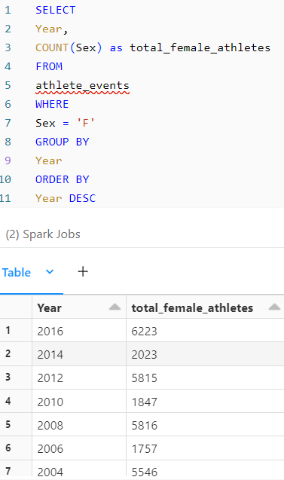
In 1900 only 33 female athletes participated, while in the most recent, 2016, 6223 participated.
With the exception of 2008 to 2012, when the number of female athletes decreased by 1 (5816 to 5815), the number of female athletes has increased over the years for both summer and winter Olympics.

Slide 8
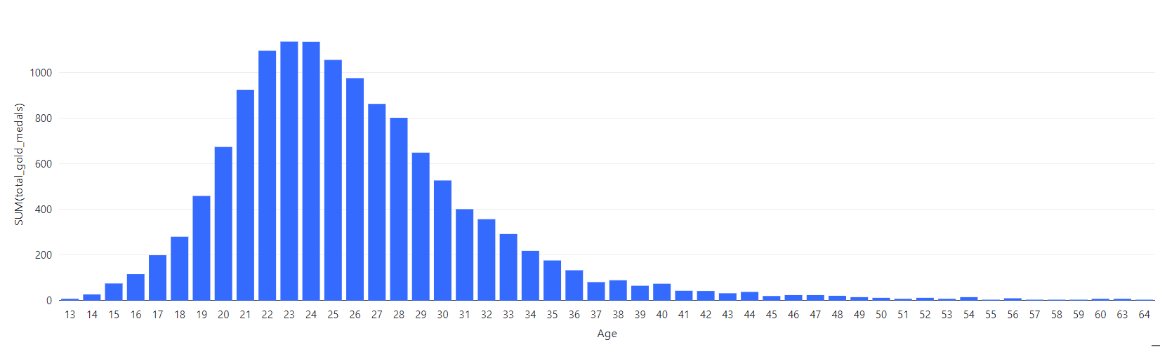
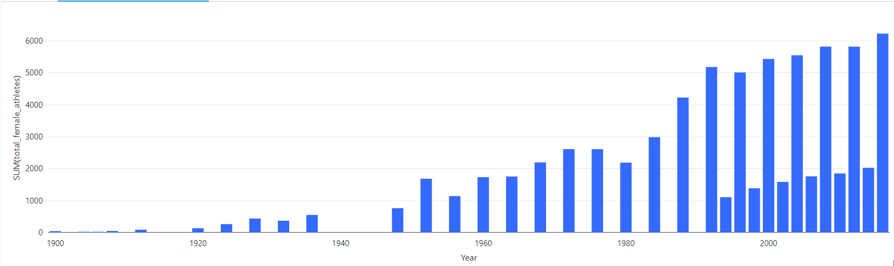
This approves my hypotheses that youth and physical fitness confer a substantial competitive advantage and that women's sports have experienced tremendous growth over the years.

Slide 9
Deeper Analysis
Subsequently, we will ascertain the nations in which athletes exhibit optimal physical fitness and explore whether this condition confers a competitive advantage in comparison to other countries.

Slide 10

Top Countries
The USA has the most medals out of all countries, followed by URS, Germany, and Great Britain as the only countries with more than 2,000 medals.

Slide 11
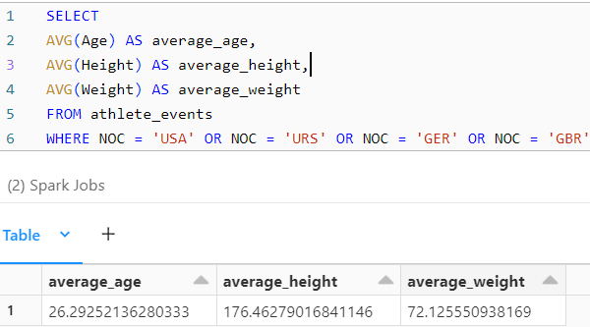
The average age of athletes from these countries is 26.3, which is very close to the average age of gold medalists (25.9). The average height of athletes from these countries is 176.5 centimeters, which is very close to the average height of gold medalists (177.9). Lastly, the average weight of athletes from these countries is 72.1 kilograms, which is close to the average weight of gold medalists (74.9).

Slide 12
Recommendations and Actions
My strategic initiative involves fostering a culture of adherence to established guidelines among athletes and coaches, aimed at enhancing their physical preparedness for various competitive events. By advocating for the systematic incorporation of recommended protocols, I aim to empower athletes and coaches with the necessary tools to optimize their performance in competitive arenas.
Through targeted communication and educational programs, my objective is to instill a heightened awareness of the significance of adhering to established guidelines. By facilitating a comprehensive understanding of these protocols, athletes and coaches can actively contribute to their own physical preparedness, ultimately elevating the standard of performance in competitive settings. This approach aligns with the overarching goal of promoting a disciplined and informed approach to training and competition within the sporting community.

