Slide 1



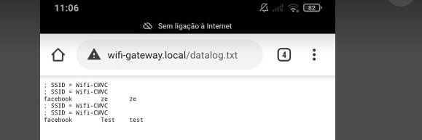

Subject
Cybersecurity
Students
João Dantas
José Antunes
Year
2020/2021
HoneyESP portal/honeypot Project
https://youtu.be/HP3GXLs-rus
INTRODUCTION
RESULTS
On this Mini-Project we consolidate some subjects along the course of ERSC, like “Sistemas Embebidos/Ciberfísicos, Progamação Web e Criptografica/CiberSegurança”
The Honey Project is a fake captive or portal/honeypot for microcontroller boards in this case ESP-32.
We can call this system as Honeypot, not just like the ones mounted on the networks to simulate a real target, but a honeypot as phishing on a public Wi-Fi.
After powering up, the device will create Wi-Fi access point with configured network name (see Configuration). It will assign IPs to clients with DHCP and also serves as DNS. All DNS requests are resolved to 10.0.0.1, IP address of device itself.
HoneyESP also runs HTTP server on default port 80. All requests are redirected to http://wifi-gateway.local/ and on this address it runs the captive portal stored in embedded SPIFFS.
As we can see on the next figure, the results obtained
Are going to a specific path that we choose.
WORK
The first and main difference is that only SPIFFS variant is supposed. There is no support for SD card variant yet.
Second difference is that the website contents and data files need to be uploaded using slightly different process:
Hardware Setup
SPPIFS Configuration
Building firmware to ESP-32
Using the honeypot
Save the data acquired
CONCLUSIONS
The main goal of this project was obtained, and for our experience we think this type of systems is very dangerous and can cause a lot of serious problems only because you(target) just want to have an Internet Connection.
REFERENCES & LINKS
https://resources.infosecinstitute.com/topic/ghost-usb-honeypot-part-2/
https://github.com/ridercz/HoneyESP/wiki/Usage/

