Slide 1
E-commerce: Sportswear Demand Forecast
Joao Luiz Rossi
Lighthouse Labs Final Project
January 2022

Slide 2
Background information
Background
Education:
    Bachelor in Mathematics
    Master’s in Statistics
Diverse Work Experience:
    Data analysis in academia
    Business Dev. Specialist
Lighthouse Labs Bootcamp!
    Filling the ML gap

Slide 3
Project Motivation
GOAL:
Use machine learning models to predict demand for different products in different markets
Poor demand predictions can affect:
Supply chain
Inventory
Customer Service
Profitability
Why forecast demand?
Notes:
Really hard to conduct a business if you do not know how many units you will sell.
With good predictions:
Preparing budget
More effective marketing campaigns

Slide 4
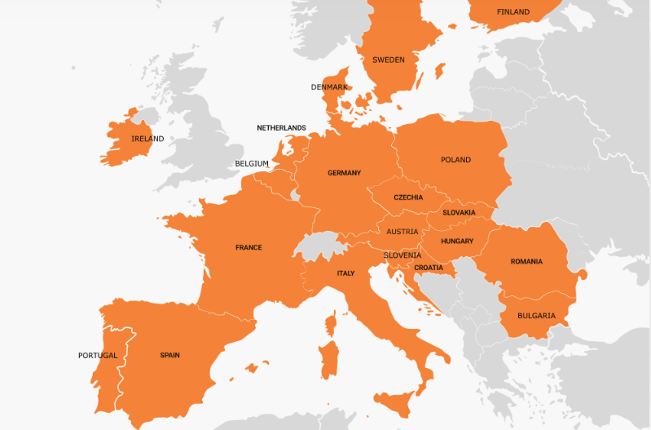
The dataset
One of the biggest E-commerce companies in Europe.
Orders (925,050)
Roughly 30 months of data (June 2019 – January 2022)

Slide 5
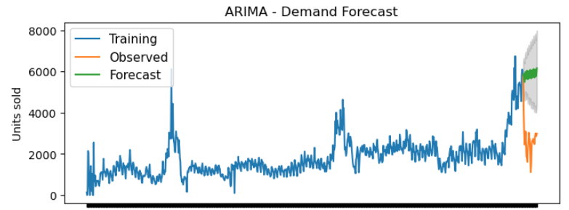
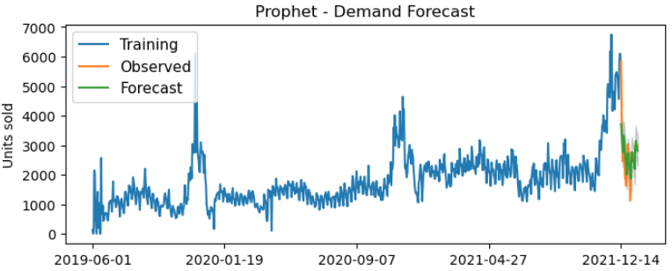
Model Selection – Time Series
ARIMA
Prophet

Slide 6
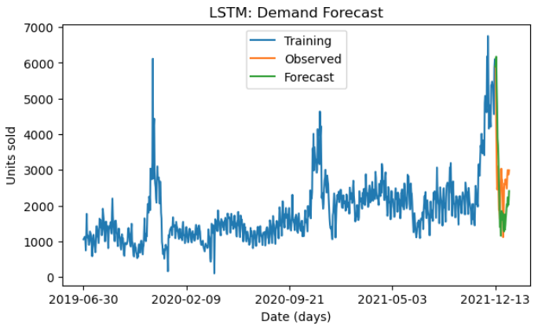
Model Selection -
Supervised Learning
Notes:
Long Short Term Memory
hyperbolic tangent (`tanh`) activation function
4 LSTM
2 Densely connected
1 Densely connected for output

Slide 7
Model Selection - Comparison
Model | MAE | MAPE | MSE
ARIMA | 3202 | 1.40 | 10m
Prophet | 459 | 0.21 | 450k
LSTM | 778 | 0.30 | 971k
Both Prophet and LSTM seem to be reasonable candidates for forecasting demand of the products.
LSTM could get better if other data sources were included
Proceeded with Prophet
Notes:
mean absolute percentage error
Scaled MAE

Slide 8
Fitting Prophet to all series
Items types:
Running Shoes
Pants
T-Shirts
Sweatshirts
...
Countries:
Czech Republic
Slovakia
Romania
Hungary
...
Fitting individual series : baseline VS parameter tuning
 | Elapsed Time | Average MAPE
Baseline | 2 minutes | 0.87
Tuning | 45 minutes | 0.65
* 121 Combination Series
About 0.2 decrease in MAPE
Evidence of decrease in MAPE with tuning (p-value < 0.001)
*Some combinations did not have enough data for fitting the model

Slide 9
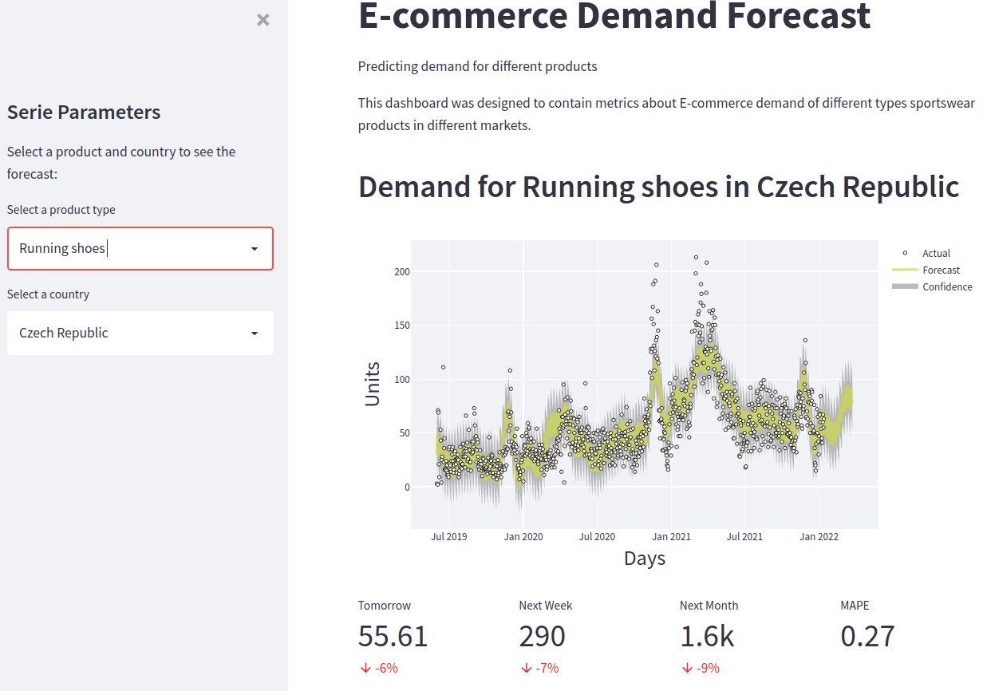
Final product - Streamlit
http://localhost:8501/
Notes:
http://localhost:8501/

Slide 10


Future Work
Add holidays and major sales events to prophet modelling
Explore features with LSTM:
  Weather
  Social media
  Sport events data
Deploy model / dashboard and schedule frequent updates

Slide 11
THANK YOU
Questions?

Slide 12
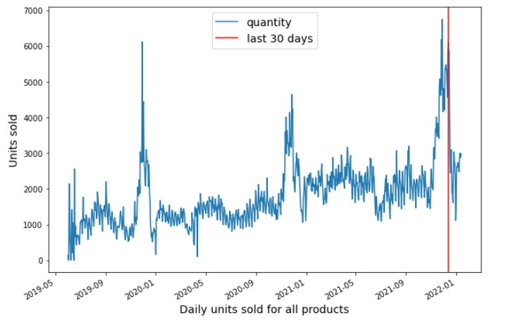
Model Selection
Units sold: All products and all countries
Test
ARIMA
Prophet
LSTM

