Slide 1
Mid Term Project
flight delay prediction

Slide 2
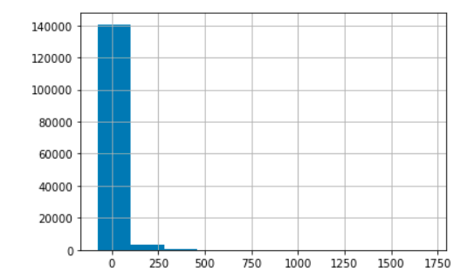
Task 1: Test the hypothesis that the delay is from Normal distribution. and that mean of the delay is 0.
p_value=0, deny the Normal distribution hypothesis

Slide 3
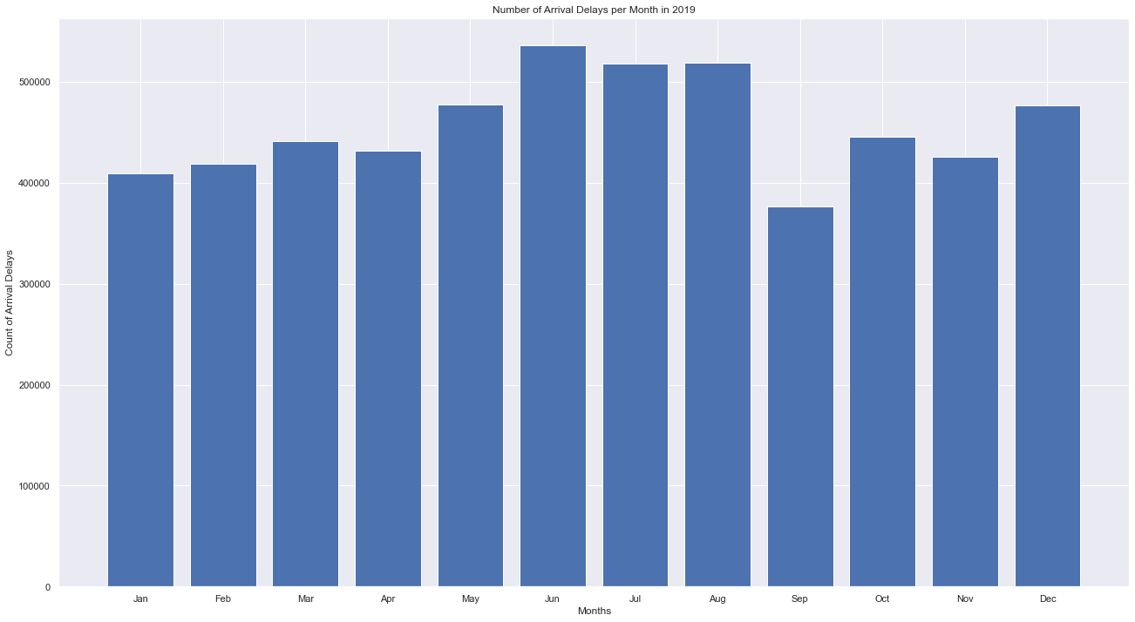
Task 2: Is average/median monthly delay different during the year? If yes, which are months with the biggest delays and what could be the reason?

Slide 4
Task 3: Does the weather affect the delay?
Snow, Rain, Fog P-value<0.05, deny the No affect hypothesis

Slide 5
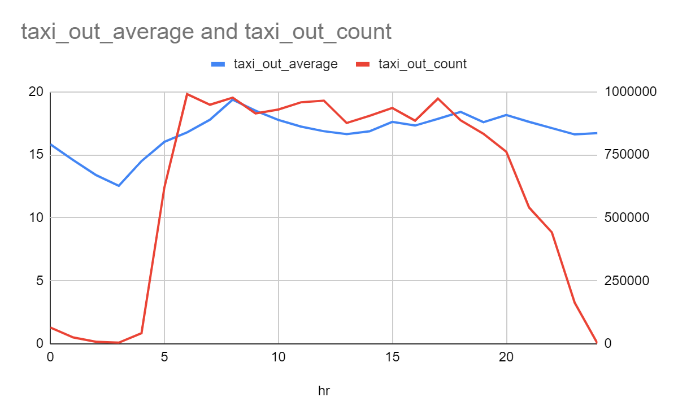
Task 4: How taxi times changing during the day? Does higher traffic lead to bigger taxi times?

Slide 6
Task 5: What is the average percentage of delays that is already created before departure?
71.24%
of delays are created before departure

Slide 7
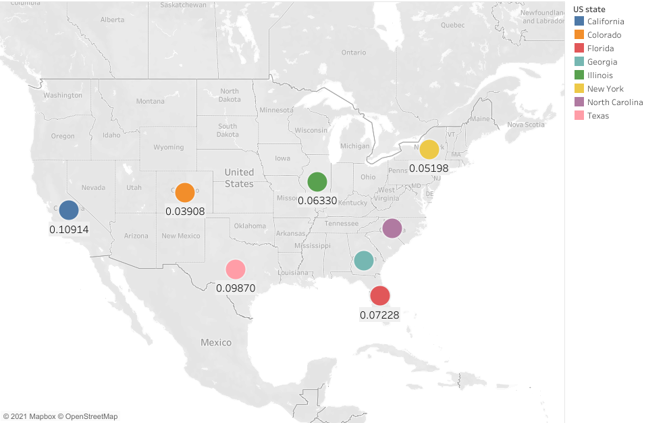
Task 6: How many states cover 50% of US air traffic?
8 States. California,Texas,Florida,Illinois,
Georgia,New York,North Carolina,Colorado

Slide 8
Task 7: Test the hypothesis whether planes fly faster when there is the departure delay?
When the plane is late on departure, pilots tend to fly faster 70.25% of the time.

Slide 9
Task 8: When (which hour) do most 'LONG', 'SHORT', 'MEDIUM' haul flights take off?
6-6:30 | do most short haul filgth
7-7:30 | do most medium haul filgth
17-17:59 | do most medium long filgth

Slide 10
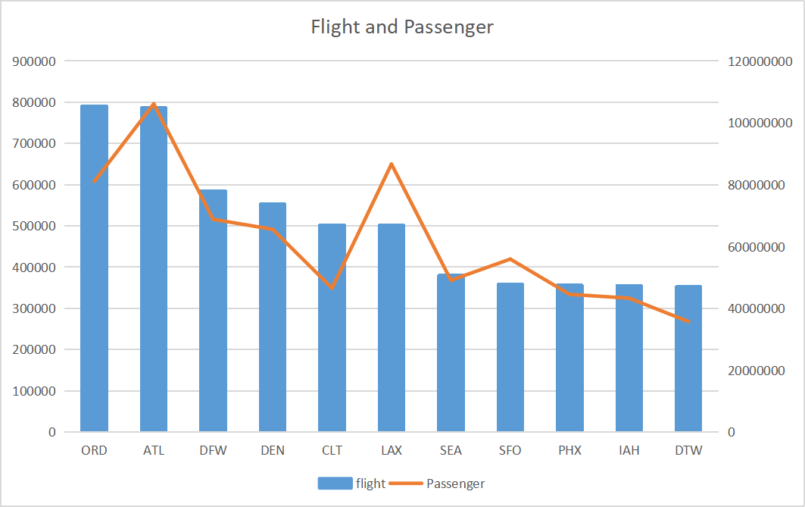
Task 9: Find the top 10 the bussiest airports.

Slide 11
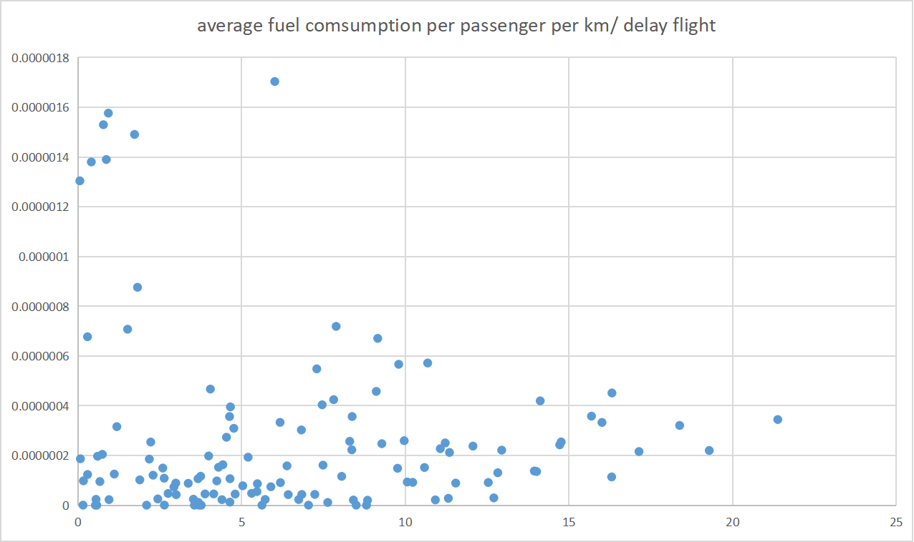
Task 10: Do bigger delays lead to bigger fuel comsumption per passenger?

