Slide 1
Bidimensional Lattice Boltzmann Implementation using CUDA
Antonio Lucas N. de O. Barros
Cátia Souza do Nascimento
João Vicente Lima
CMP 557
Programming Massively Parallel Processors using CUDA
Instituto de Informática
PPGC - UFRGS

Slide 2
Outline
Lattice Boltzmann
Implementation
Experimental Results
Conclusion
Future Work

Slide 3
Lattice Boltzmann
Iterative Numeric Method
Mesoscopic
Relation with LGA method
  Particle Representation:
    MLB Uses real distribuitions
    LGA uses boolean distributions

Slide 4
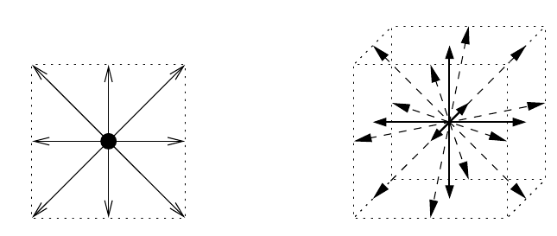
Lattice Boltzmann
Models:
D2Q9 – 2 Dimensions, 9 possible directions
D3Q19- 3 Dimensions,19 possible directions
D2Q9
D3Q19

Slide 5
Implementation - Kernels
redistribute
propagate
bounceback
relaxation

Slide 6
Kernels - redistribute

Slide 7
Kernels - propagate

Slide 8
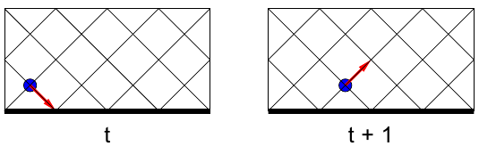
Kernels - bounceback
Used to grant Contour Conditions
Invert vector direction of the particles in case of colision with a border

Slide 9
Kernels - relaxation

Slide 10
Experimental Results
Hardware Used:
  Core i7 @ 2.80 Ghz / GTX480
  Athlon QL @1.9 Ghz / 9100M ???

Slide 11
Future Work
Reduce Number of Parameters in Kernels
Merge Kernels?
Test Shared Memory on Fermi
Make a D3 version (D3Q15/D3Q19)

Slide 12


