Slide 1


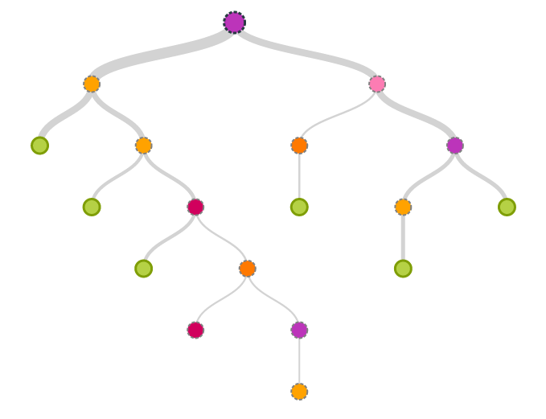
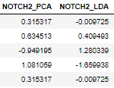


1.
2.
3.
SNP’s
database
Correlated Genes
Decision Trees
Genes
Extract Features
Top Features and Genes
Correlated Genes
LDA
PCA
Mean
Variance
Known Risk Genes
Average $χ^{2}$ test

