Slide 1

Genetic Markers for Type 2 Diabetes

Slide 2
T2D Disease
1

Slide 3

Type 2 Diabetes
Risk Factors for T2D
Insulin resistance
Build up of sugar in the blood
The incidence of diabetes is increasing
Age > 45 years
First-degree relative with type 2 diabetes
African-American, Hispanic, Asian, Pacific Islander or Native-American ethnicity
Overweight, especially abdominal obesity
Cardiovascular disease, hypertension, dyslipidemia, or other features of the metabolic syndrome

Slide 4
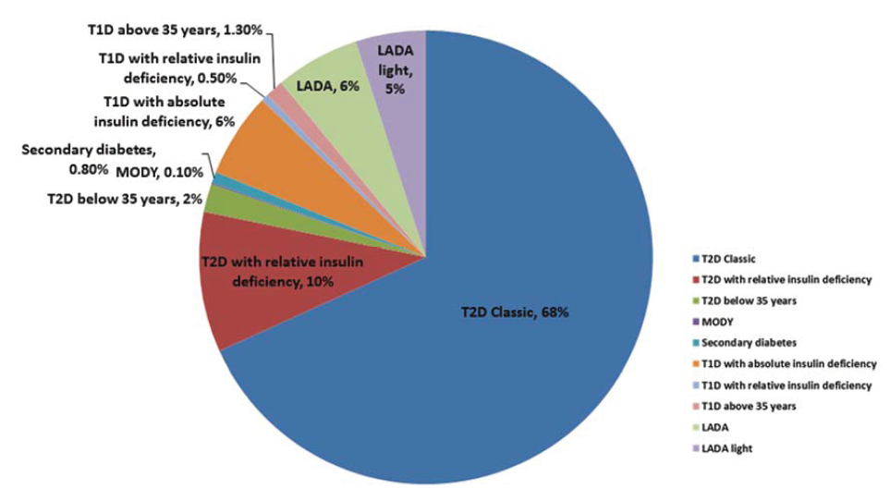
Types
T1D
T2D
LADA (Latent
Autoimmune Disease
in Adults)

Slide 5
T2D & Genetics
2

Slide 6
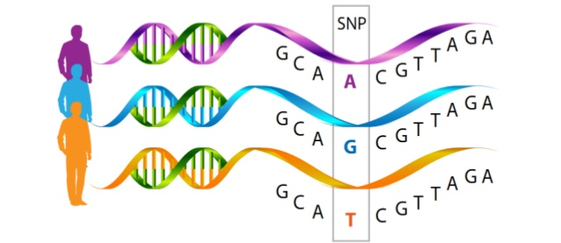
Genetic Context
Single Nucleotide Polymorphisms – SNP’s
T2D is strongly influenced by genetic and environmental factors
Rare and common variants

Slide 7
Factors
Epigenetics (DNA Methylation)
Epistasis
Protective Variants
Copy Number Variants – CNV’s

Slide 8
Genome Wide Association Studies
3
And some methods

Slide 9
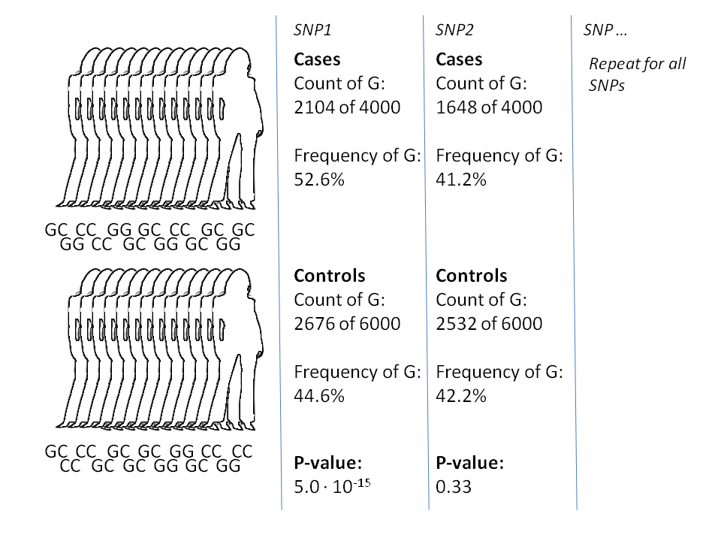
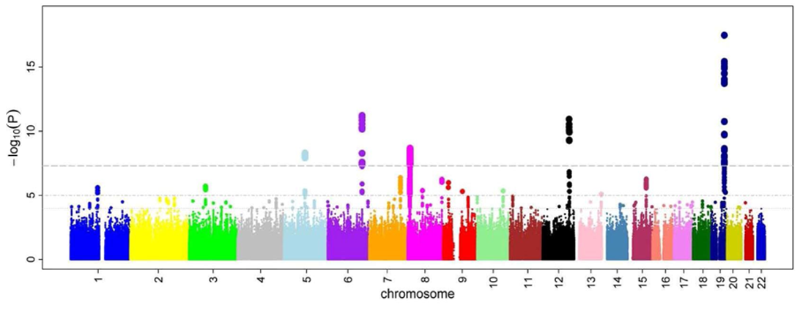

Slide 10
Methods
Non-linear methods
Random Forests
Deep Learning
Above all, previous factors mentioned must be included as features

Slide 11
Challenges
4

Slide 12
To consider
Computing Time
Gene-environment interaction
Phantom Heritability

Slide 13
References
[1] Sandeep Vijan. Type 2 diabetes. Annals of internal medicine, 152(5):ITC3–1, 2010.
[2] Rashmi B Prasad and Leif Groop. Genetics of type 2 diabetes—pitfalls and possibilities. Genes, 6(1):87–123, 2015.
[3] Mark I McCarthy and Eleftheria Zeggini. Genome-wide association studies in type 2 diabetes. Current diabetes reports, 9(2):164–171, 2009.
[4] Christian Fuchsberger, Jason Flannick, Tanya M Teslovich, Anubha Mahajan, Vineeta Agarwala, Kyle J Gaulton, Clement Ma, Pierre Fontanillas, Loukas Moutsianas, Davis J McCarthy, et al. The genetic architecture of type 2 diabetes. Nature, 536(7614):41–47, 2016.
[5] Jason H Moore, Folkert W Asselbergs, and Scott M Williams. Bioinformatics challenges for genome-wide association studies. Bioinformatics, 26(4):445–455, 2010.
[6] Suneetha Uppu, Aneesh Krishna, and Raj P Gopalan. Towards deep learning in genomewide association interaction studies. In PACIS, page 20, 2016.
[7] Or Zuk, Eliana Hechter, Shamil R Sunyaev, and Eric S Lander. The mystery of missing heritability: Genetic interactions create phantom heritability. Proceedings of the National

