Slide 1

e-Course
GRUPO 45

Slide 2
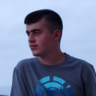
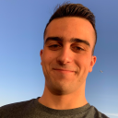
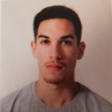
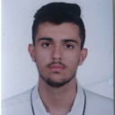
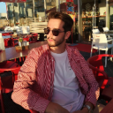
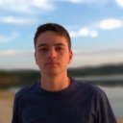
TEAM
João Rodrigues
Jorge Lima
Mateus Fernandes
João Veríssimo
José Teixeira
João Morais

Slide 3
RESULTS ACHIEVED
Our project has achieved outstanding results, showcasing its remarkable effectiveness. Through our unwavering commitment to success, we have reached significant milestones across multiple aspects. The dedication and hard work of our exceptional team have played a pivotal role in elevating the project’s outcomes to new heights.

Slide 4



ANALYSIS OF RESULTS AND TEAMWORK
STRENGTHS +
WEAKNESSES –
OPPORTUNITIES +
THREATS –
Adaptability
Problem-solving
Communication
Collaboration
Time Management
Insufficient Training and Development
Market Demand
Technological Advancements
User Feedback
Competition
Economic Conditions

Slide 5
Completed Activities
ID | Description | Assigned | Baseline | Real | Status
US3004 | As User, I want to share a board | João Rodrigues | Start: 22-05-23 End: 18-06-23 | Start: 31-05-23 End: 18-06-23 | Done
US3005 | As User, I want to view, in real-time, the updates in the shared boards | José Nuno | Start: 22-05-23 End: 18-06-23 | Start: 24-05-23 End: 18-06-23 | Done
US3006 | As User, I want to create a post-it on a board | Mateus Fernandes | Start: 22-05-23 End: 18-06-23 | Start: 31-05-23 End: 18-06-23 | Done
US3007 | As User, I want to change a post-it | João Morais | Start: 22-05-23 End: 18-06-23 | Start: 25-05-23 End: 18-06-23 | Done
US3008 | As User, I want to undo the last change in a post-it | Jorge Lima | Start: 22-05-23 End: 18-06-23 | Start: 05-05-23 End: 18-06-23 | Done

Slide 6
Completed Activities
ID | Description | Assigned | Baseline | Real | Status
US3009 | As User, I want to view the history of updates on a board | João Veríssimo | Start: 22-05-23 End: 18-06-23 | Start: 07-06-23 End: 15-06-23 | Done
US3010 | As User, I want to archive a board I own | Mateus Fernandes | Start: 22-05-23 End: 18-06-23 | Start: 31-05-23 End: 18-06-23 | Done
US2004 | As Student, I want to take an exam | José Nuno | Start: 22-05-23 End: 18-06-23 | Start: 26-05-23 End: 18-06-23 | Done
US2005 | As Student, I want to view a list of my grades | João Rodrigues | Start: 22-05-23 End: 18-06-23 | Start: 09-06-23 End: 18-06-23 | Done
US2006 | As Teacher, I want to view a list of the grades of exams of my courses | João Veríssimo | Start: 22-05-23 End: 18-06-23 | Start: 05-05-23 End: 18-06-23 | Done

Slide 7
Completed Activities
ID | Description | Assigned | Baseline | Real | Status
US2009 | As Student, I want to take an automatic formative exam | José Nuno | Start: 22-05-23 End: 18-06-23 | Start: 26-05-23 End: 18-06-23 | Done
US4002 | As User, I want to cancel a meeting | Jorge Lima | Start: 22-05-23 End: 18-06-23 | Start: 05-06-23 End: 18-06-23 | Done
US4003 | As User, I want to accept or reject a meeting request | João Morais | Start: 22-05-23 End: 18-06-23 | Start: 25-05-23 End: 18-06-23 | Done
US4004 | As User, I want to view a list of participants in my meeting and their status (accept or reject) | Jorge Lima | Start: 22-05-23 End: 18-06-23 | Start: 09-06-23 End: 18-06-23 | Done
US5002 | As Software Product Client, I want the team (software supplier) to prepare a presentation | Everyone | Start: 22-05-23 End: 18-06-23 | Start: 05-05-23 End: 18-06-23 | Done

Slide 8
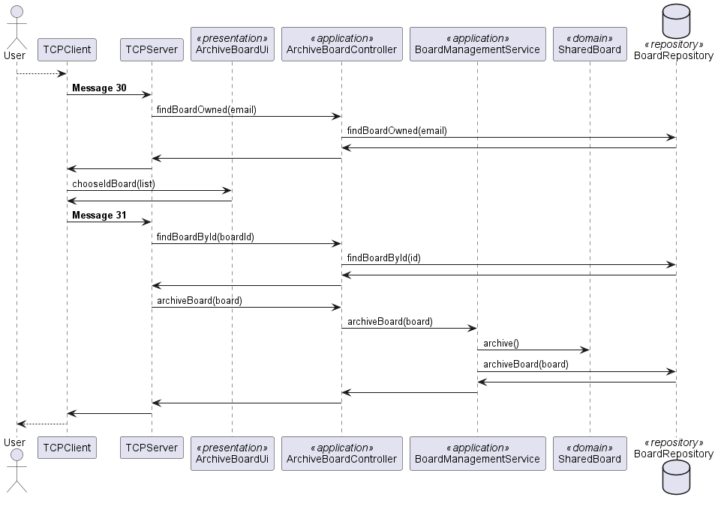
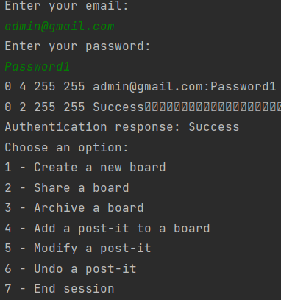
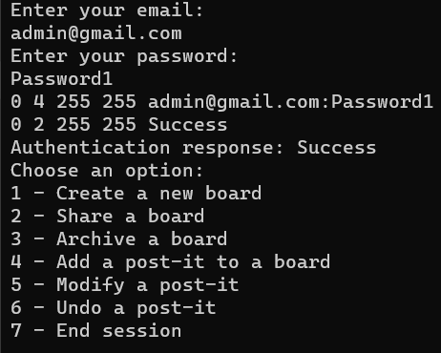
EVIDENCE OF APPLYING THE SOFTWARE ENGINEERING

Slide 9
DEPLOYMENT SCENARIO
Product quality is assured
Results satisfy the client needs with proper documentation
DISCOVERY
Collect ideas from team members
Early risks understood
PLANNING
Defining size, priority, and difficulty
Assigning tasks to team members
DESIGN
Development Planned
Product Design with respective documentation
Building our features based on the previous phase
Product quality needs to meet design requirement
LAUNCH
DEVELOPMENT

Slide 10
QUALITY OF THE FINAL PRODUCT
91 %

Slide 11
SUGGESTIONS OF IMPROVMENT
Despite our exceptional achievements, it is important to acknowledge areas where we faced challenges:
LPROG could not be fully accomplished
Graphic Interface was not made
Make the software more efficient

Slide 12
SELF_ASSESSMENT

Slide 13
SELF_ASSESSMENT

Slide 14
SELF_ASSESSMENT
João Rodrigues_ Making a hindsight of all the sprints, and being this one, another successfull one, I could develop both technical and soft skills and I am sure that will be very importante to my future, both at professional and social levels.
Mateus Fernandes_ Based on the work done over another successful integrative project, I was able to continue to develop my skills on a personal, social and professional level.
João Veríssimo_ As I assess my technical and interpersonal skills, my aim is to maximize my strengths while proactively addressing my weaknesses, fostering continuous personal and professional growth.

Slide 15
SELF_ASSESSMENT
Jorge Lima_ In reflecting on my technical and interpersonal skills, I am determined to harness my strengths while actively seeking avenues to improve areas of weakness, driving my personal and professional growth forward.
João Morais_ Assessing my technical and interpersonal skills, I aim to leverage strengths while proactively improving areas of weakness for personal and professional growth.
José Teixeira_ I am pleased to acknowledge the successful execution of the project, where I dedicated significant effort and demonstrated a high level of commitment. This project has been a catalyst for personal development, allowing me to cultivate various competencies.

Slide 16
THE END

