Slide 1
Analysis of Social and Information Networks
Chapter 18 - Power Laws And Rich-Get-Richer Phenomena

Slide 2
Popularity on Reddit
Number of upvotes determines popularity of content
Rich-get-richer phenomena:
  Upvoted content is shown first to any user, causing it to become more upvoted and popular
Popularity and power laws:
  Several distributions will present a power law model for popularity:
    Comments and upvotes
    Links and upvotes
    Links and number of comments

Slide 3
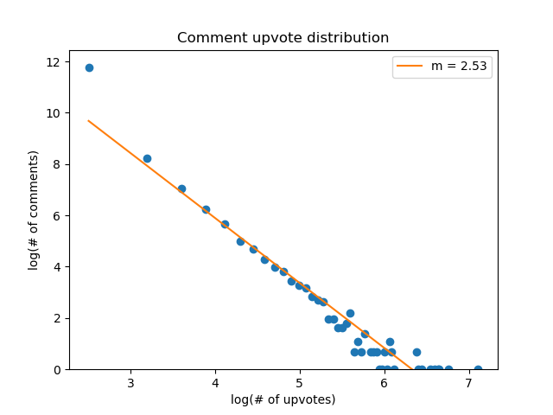
Comments and number of upvotes
Distribution of comments and respective upvotes,
calculated using a 100-bin histogram

