Slide 1
Analysis of Social and Information Networks
Chapter 19 – Cascading Behavior in Networks

Slide 2
Diffusion of Opinion on Reddit
Reddit has very homophilic communities
  Subreddits are created for one topic/purpose = Isolated Clusters
  Controversial/unpopular opinions are usually downvoted: less impact on the community
Adoption/Change of opinion is very unlikely on a large subreddit
  Subreddits tend to share the same general opinion: Reddit Hive Mind, Circlejerking
  If a group of users does not feel represented in a subreddit, they create their own for that topic

Slide 3

Collective Action on Reddit
The power of anonymity decreases the risk of repercussions from collective actions
  Some events unite all the subreddits with a common goal

Slide 4
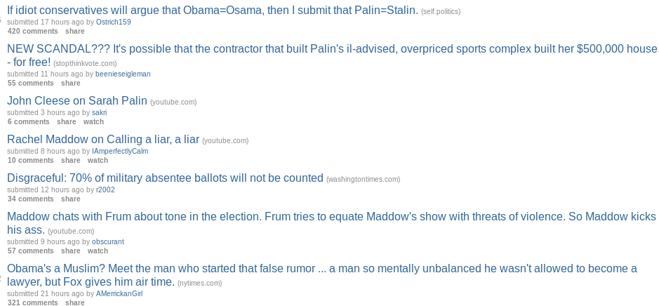
r/politics and Political Support
r/politics is a subreddit for political discussion
  Usually U.S.A. politics
On 2008, prior to the Obama vs. McCain Election:
  Most of the links and comments supported Obama
  Only a few unpopular submissions were supporting McCain

