Slide 1
Analysis of Social and Information Networks
Chapter 1 and 2

Slide 2

Reddit.com: the frontpage of the Internet

Slide 3
Reddit.com: the frontpage of the Internet
Reddit is a website where users can share links to images, blogs, videos, GIFs, etc. and comment on these links
Every signed user can vote on content:
  The more upvotes a link/comment has, the higher up it is displayed
  Downvoted content is pushed further down on the webpage
A user-moderated hub for news, hobbies, communities, questions,…
https://www.youtube.com/watch?v=tlI022aUWQQ

Slide 4

Subreddits
Subreddits are a smaller community contained in the reddit website
Usually oriented towards one specific topic of interest
  r/asoiaf
  r/TodayILearned
  r/gaming
  r/DungeonsAndDragons
  r/DataIsBeautiful
  r/Gephi

Slide 5
The Reddit Comment Database
Complete dataset of reddit comments, divided by month, since October 2007
  Author name
  Body of comment
  Score
  Thread
  Subreddit
  Timestamp
  ...

Slide 6
The Subreddit Graph
Nodes represent a subreddit, with attributes:
  Number of comments
  Number of unique comment authors
Edges connect subreddits:
  Undirected connection
  Edge weight corresponds to the number of shared authors between the communities
Comment processing was done with Python
Graph analysis was done with Gephy

Slide 7
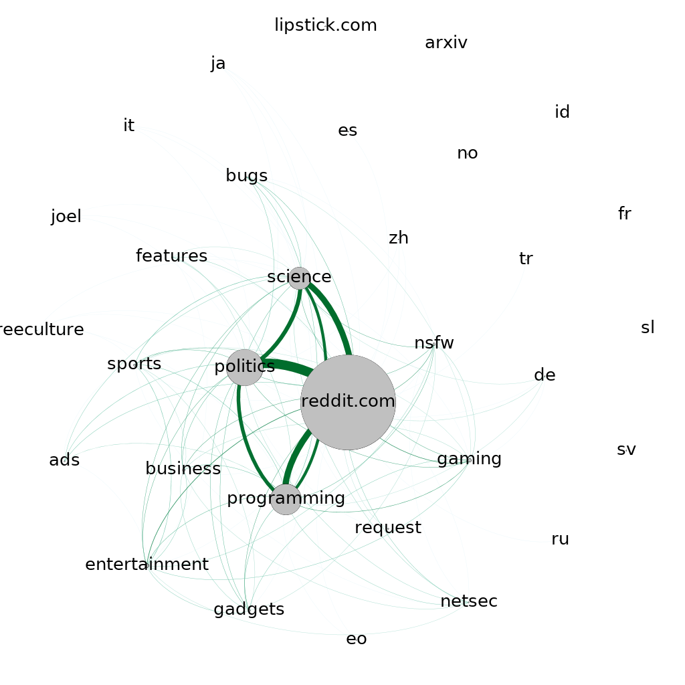
Subreddit Graph for October 2007
32 subreddits
104 connections
The main page of reddit was a separate subreddit back then. Today it’s a collection of links from all subreddits.

Slide 8
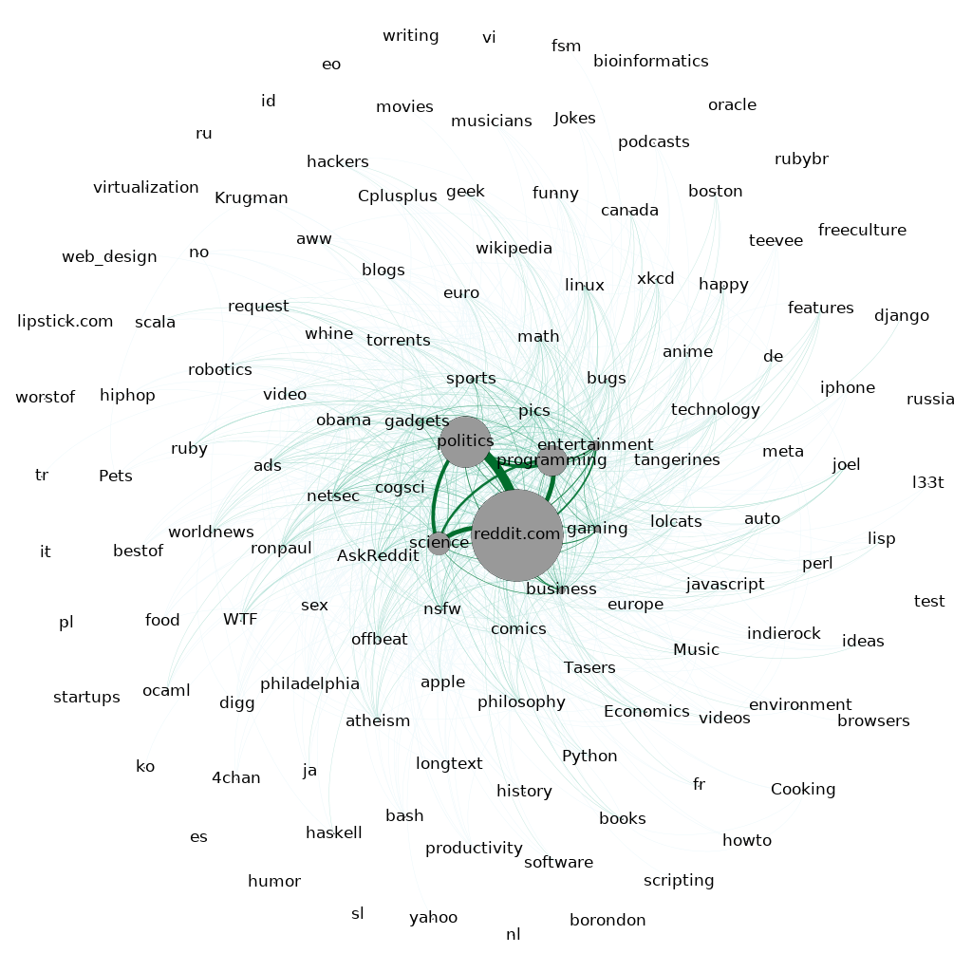
Subreddit Graph for January 2008
126 subreddits
856 connections
Boom of subreddits, but still 4 central:
  Reddit.com
  Politics
  Science
  Programming

Slide 9
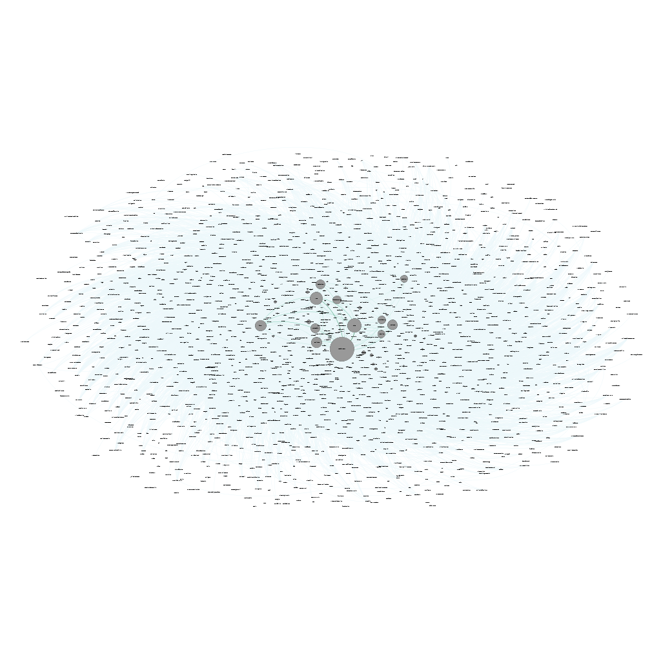
Subreddit Graph for July 2009
1686 subreddits
60733 connections
A dozen subreddits start to gain more popularity

