Slide 1
Analysis of Social and Information Networks
Chapter 3

Slide 2
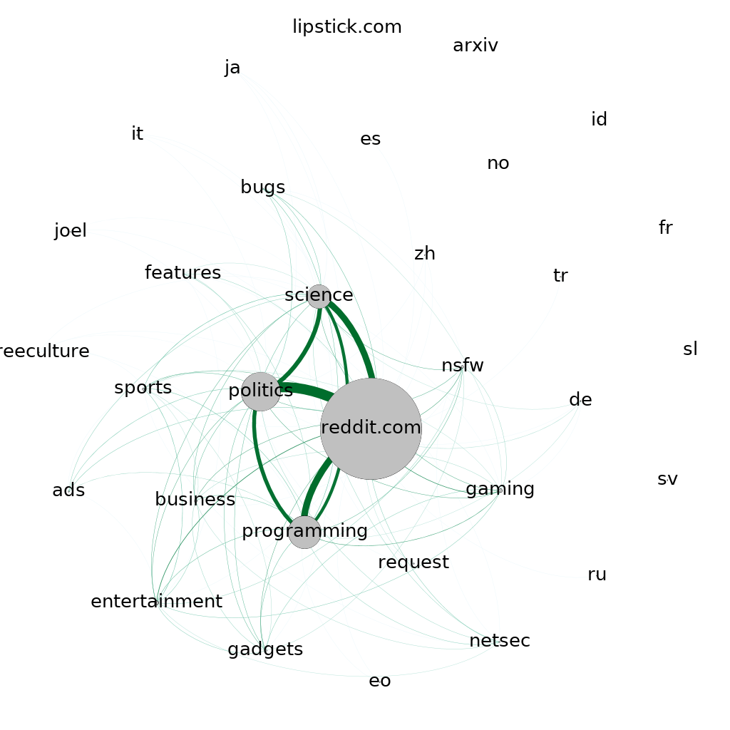
Clustering Coefficient Over Time
Users tend to gravitate towards the bigger subs
  Lots of shared users between all subreddits
  Isolated subreddits are usually very small
  High number of connections between nodes
  High Clustering Coefficient
  ≈ 85%

Slide 3
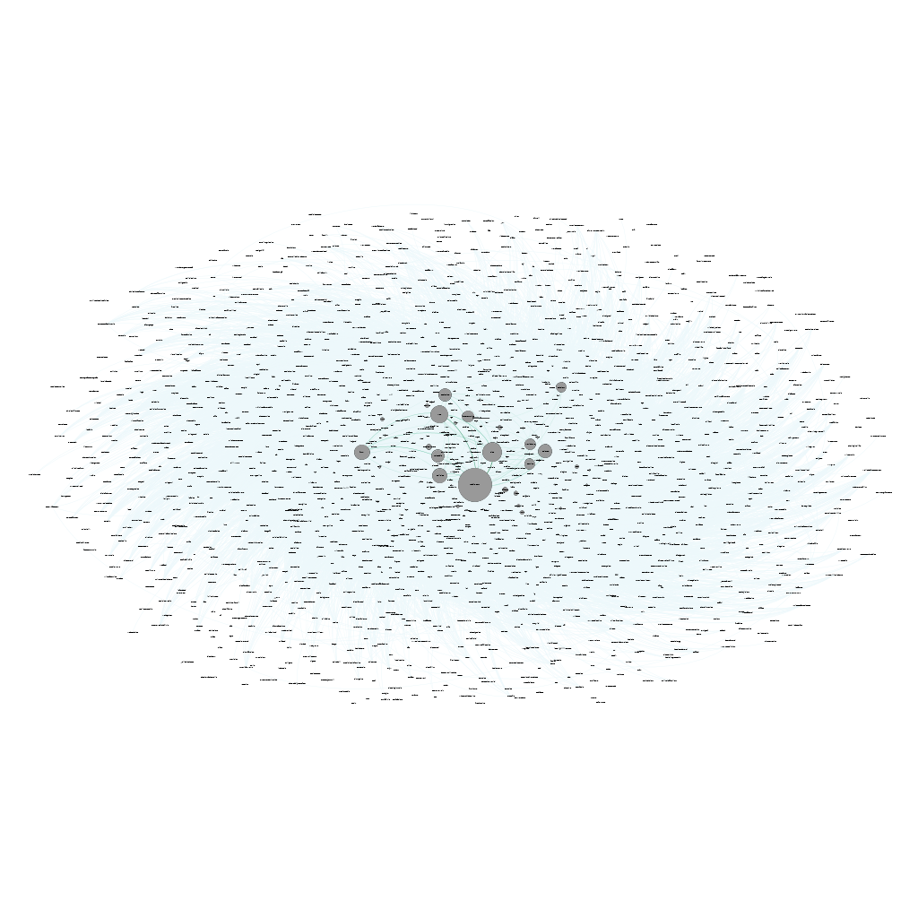
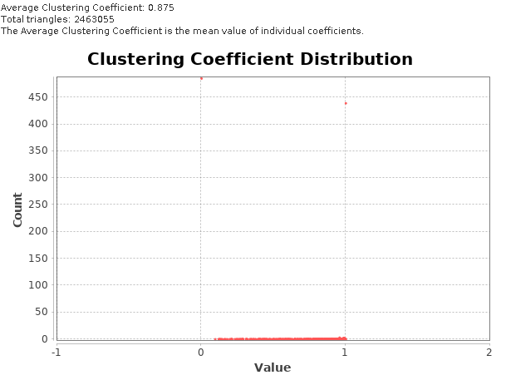
Clustering Coefficient Over Time

Slide 4
Clustering Coefficient Over Time
Small increase overall of the Clustering Coeff.
  All subs tend to be connected, considering it just takes one shared author to establish a connection
  Low number of local and global bridges
  Increase in coeff. can be due to growing subs with more diverse commentators: higher participation in a large number of subs will increase the number of connections between all
Triadic closure usually exists:
  If 3 subs share one author, all of them will be connected
More interesting to analyze the evolution of shared authors between specific subs
  “Triadic Reinforcement”: subs that are connected will tend to increase the weights between them

Slide 5
Triadic Reinforcement Between Subs
Connected subs become increasingly more connected

Slide 6
Triadic Reinforcement Between Subs
It’s hard to say if there is a real effect of Triadic Closure happening
  A connection to another sub probably doesn’t affect its users to actively engage in the other, unlike with friend networks
  Since these are the 4 most popular subs at the time, it’s more likely that more users visit and interact with them, since they are growing in popularity
The increasing popularity of the site brings new users to all the subs, increasing their connections

